Slide 1
Generic algorithms
Like brute-force, but better

Slide 2
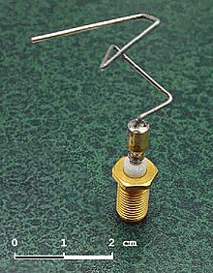
Application
Fancy pet-projects
Evolved antenna from NASA (see picture)
Game bots

Slide 3
Structure
Generate the initial population of individuals randomly. (First generation)
Evaluate the fitness of each individual in that population (time limit, sufficient fitness achieved, etc.)
Repeat the following regenerational steps until termination:
Select the best-fit individuals for reproduction. (Parents)
Breed new individuals through crossover and mutation operations to give birth to offspring.
Evaluate the individual fitness of new individuals.
Replace least-fit population with new individuals.

Slide 4
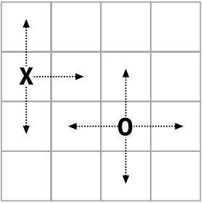
Tasks
1. Create a Service which will:
Take a target phrase, mutation rate, population size
Return number of generations
2. Bot for Chase game:
Capture your opponent by moving in his cell.
Player can’t move in one direction twice.
If Player tries to go out of board area he misses his turn.

