Slide 1





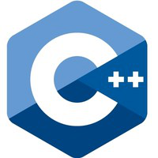



Programming Languages Compared

Slide 2
Chapter 1 – Installation/Setup
Installation of
Compilers
C, C++, Go, Groovy, Java, Scala, and Python
Editor/IDE
Visual Studio Code
Version Control – git

Slide 3
Section 1.1 – Course Overview
Go Language : https://golang.org/dl/
Scala : https://www.scala-lang.org/download/
Python : https://www.python.org/downloads/
Groovy : http://groovy-lang.org/download.html
Java : https://www.java.com/en/download/
C/C++ (windows): https://www.microsoft.com/en-us/download/developer-tools.aspx

Slide 4
Compilers & Interpreters
Go Language : https://golang.org/dl/
Scala : https://www.scala-lang.org/download/
Python : https://www.python.org/downloads/
Groovy : http://groovy-lang.org/download.html
Java : https://www.java.com/en/download/
C/C++ (windows): https://www.microsoft.com/en-us/download/developer-tools.aspx

Slide 5
Other Tools
Git SCM : https://git-scm.com/
VSCode Editor : https://code.visualstudio.com/download

Slide 6
VSCode Plugins
Auto-Open Markdown Preview (hnw)
C/C++ (Microsoft)
C/C++ snippets (Harsh)
Code Runner (Jun Han)
Diff Tool (jinshihou)
Go (lukehoban)
Language Support for Java(TM) by Red Hat (Red Hat)
Python (Don Jayamanne)
Scala (Lilya Tryapitsin)
TODO Parser (minhthai)

Slide 7
Course Material
Github Repo: https://github.com/xiliax/programming-languages-compared
$ mkdir lcp
$ cd lcp
$ git clone git@github.com:xiliax/programming-languages-compared.git

Slide 8
Section 1.2 – Mac OS X Setup
Pre-installed
Git*
Python*
Java*
Not Installed
Go
Groovy
Scala
Xcode & Clang (C/C++) - Available In AppStore
* Should install updated version

Slide 9
Section 1.3 – Linux Setup
Pre-installed
Python*
Not Installed - Available In Package Repository
Clang or GCC/G++ (C/C++)
Go
Groovy
Java+
Scala
*Should install updated version ---- ⁺Not in all distro repo.

Slide 10
Section 1.4 – Windows Setup
Pre-installed
Not Installed
Clang or Visual Studio* (C/C++)
Go
Groovy
Java
Python
Scala

Slide 11
Section 1.5 - VSCode Plugins Installation
Auto-Open Markdown Preview (hnw)
C/C++ (Microsoft)
C/C++ snippets (Harsh)
Code Runner (Jun Han)
Diff Tool (jinshihou)
Go (lukehoban)
Language Support for Java(TM) by Red Hat (Red Hat)
Python (Don Jayamanne)
Scala (Lilya Tryapitsin)
TODO Parser (minhthai)

Slide 12
Chapter 2 – Hello World
Print the string ‘Hello, World!’ on Standard out

Slide 13
Section 2.1 – Go, C, and C++
Print ‘Hello, World’ followed by a new line in Go, C, and C++.
Do not use a class for C++.

Slide 14
Section 2.2 – Java and C++
Print ‘Hello, World’ followed by a new line in Java and C++.
Must use a class for C++.

Slide 15
Section 2.3 – Groovy, Scala, and Python
Print ‘Hello, World’ followed by a new line in Groovy, Scala, and Python.

Slide 16
JVM (Java Virtual Machine) Illustrated
Java App
Groovy App
JVM
Scala App
OS (Linux, Mac, Windows, etc.)
non-JVM
Hardware

Slide 17
Chapter x – Map & Dictionary
Print the string ‘Hello, World!’ on Standard out

Slide 18
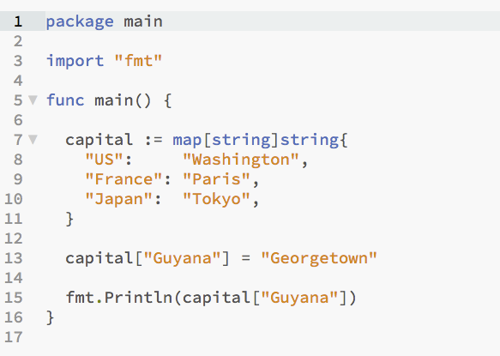
Go

Slide 19
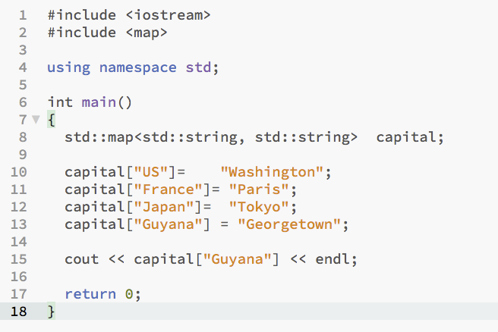
C++

Slide 20
Reference

