Slide 1





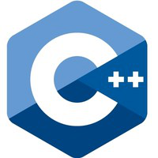



Programming Languages Compared

Slide 2
Chapter 1 – Installation/Setup
Installation of
Compilers
C, C++, Go, Groovy, Java, Scala, and Python
Editor/IDE
Visual Studio Code
Version Control – git

Slide 3
Compilers & Interpreters
Go Language : https://golang.org/dl/
Scala : https://www.scala-lang.org/download/
Python : https://www.python.org/downloads/
Groovy : http://groovy-lang.org/download.html
Java : https://www.java.com/en/download/
C/C++ (windows): https://www.microsoft.com/en-us/download/developer-tools.aspx

Slide 4
Other Tools
Git SCM : https://git-scm.com/
VSCode Editor : https://code.visualstudio.com/download

Slide 5
VSCode Plugins
Auto-Open Markdown Preview (hnw)
C/C++ (Microsoft)
C/C++ snippets (Harsh)
Code Runner (Jun Han)
Diff Tool (jinshihou)
Go (lukehoban)
Language Support for Java(TM) by Red Hat (Red Hat)
Python (Don Jayamanne)
Scala (Lilya Tryapitsin)
TODO Parser (minhthai)

Slide 6
Course Material
Github Repo: https://github.com/xiliax/programming-languages-compared
$ mkdir lcp
$ cd lcp
$ git clone git@github.com:xiliax/programming-languages-compared.git

Slide 7
Section 1 – Mac OS X Setup
Pre-installed
Git*
Python*
Java*
Not Installed
Go
Groovy
Scala
Xcode & Clang (C/C++) - Available In AppStore
* Should install updated version

Slide 8
Section 2 – Linux Setup
Pre-installed
Python*
Not Installed - Available In Package Repository
Clang or GCC/G++ (C/C++)
Go
Groovy
Java+
Scala
*Should install updated version ---- ⁺Not in all distro repo.

Slide 9
Section 3 – Windows Setup
Pre-installed
Not Installed
Clang or Visual Studio* (C/C++)
Go
Groovy
Java
Python
Scala

Slide 10
Chapter 2 – Hello World
Print the string ‘Hello, World!’ on Standard out

Slide 11
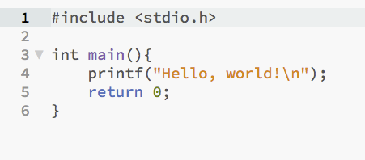
C

Slide 12
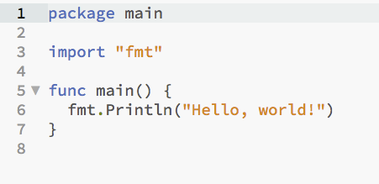
Go

Slide 13


Python & Scala

Slide 14
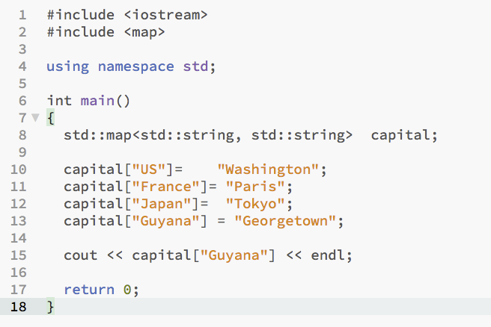
C++

Slide 15
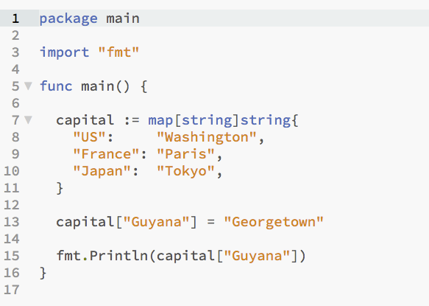
Go

Slide 16
Reference

