Slide 1
Searchlight RSA: terms
Representational geometry: which items (actions) are treated as similar or different from one another. Generally this is thought to indicate something about the underlying properties that are important (e.g., if a representational geometry reveals that all animals are similar to each other, and all objects are similar to each other, but all animals are different from objects, the underlying property that’s important is animacy)
RDM: Representational Dissimilarity Matrix. Square matrix with dimensions = items x items. Each cell i, j contains the dissimilarity between item i and item j. Common dissimilarity metrics are 1-correlation and squared Euclidean distance
Searchlight RDM: an RDM calculated based on neural responses to the items, within some small region of cortex
Target RDM: the RDM that you’re comparing to the searchlight RDMs. Could be based on behavior or a feature model.
Voxel: 3-dimensional pixel, the basic unit we can measure using fMRI. Ours are 3mm cubes
Brain patterns: matrix of neural responses for a given region or searchlight (generally dimensions = items/videos x voxels in the region)

Slide 2
Analysis overview
Question: how similar is the representational geometry in the brain to the representational geometry measured using some other method?
Method:
Decide on a set of voxels to analyze (e.g., the gray-matter voxels in the whole brain)
Decide how large your searchlight spheres should be (this really varies by paper, but I’ve used spheres with radius = 3 voxels ~10.5 mm)
For each voxel:
Gather the responses from the nearby voxels that fall within a searchlight sphere centered at this voxel
Make an RDM based on those responses
Correlate the neural RDM with the target RDM
~120 voxels
videos
videos
r
videos
videos
videos

Slide 3
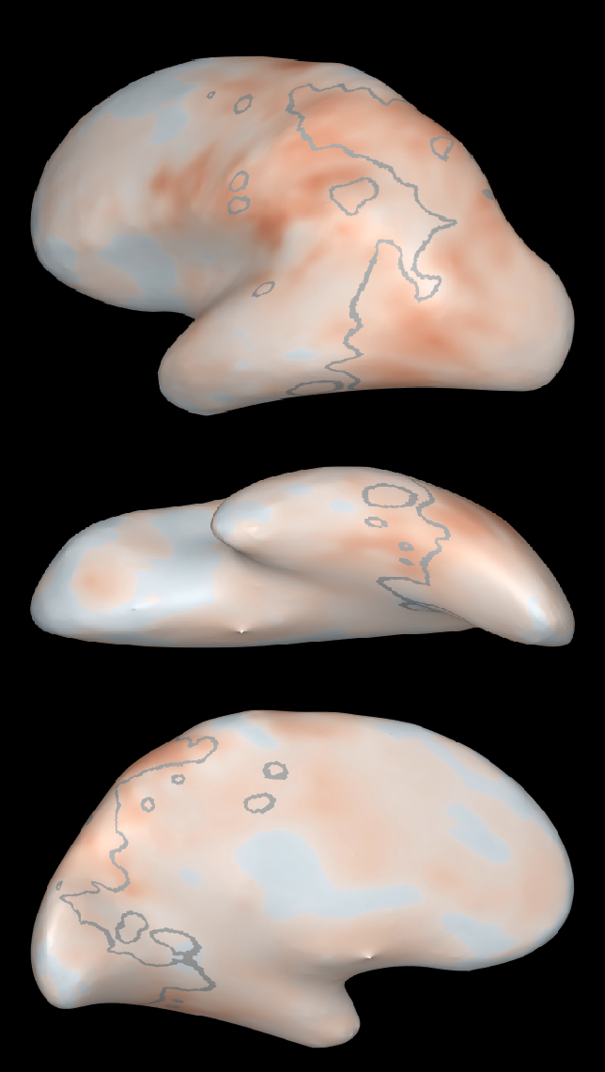
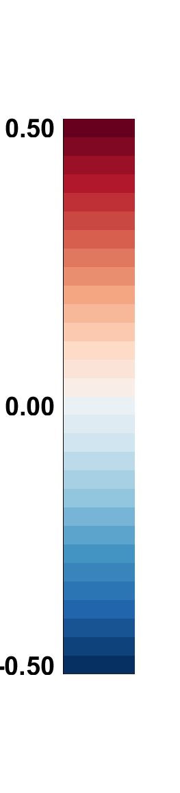
Result: a map of correlation values for every voxel you analyzed
Next Step: which of these voxels is significantly correlated with the target RDM?
Brain-behavior correlation
(grey lines mark the voxels that respond reliably – not important right now)

Slide 4
What does a searchlight sphere look like?
What’s its shape?
How many voxels does it contain?
Note: our spheres have a radius = 3 voxels (voxels are 3mm in each dimension, so this means their radius = 10.5 mm)

Slide 5
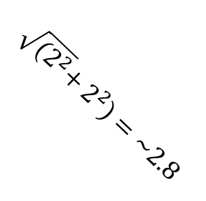
Same plane as the central voxel:
3 voxels
3 voxels
$$\sqrt{{(2}^{2}}+2^{2})=\sim 2.8$$

Slide 6




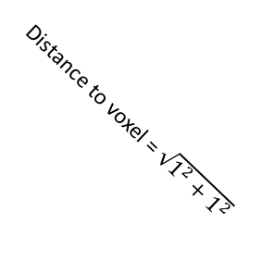
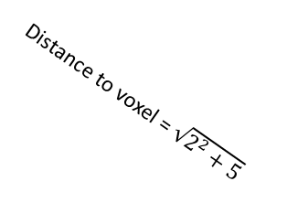
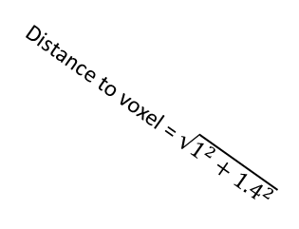

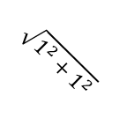
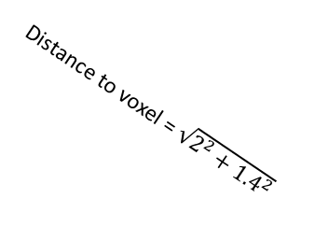
One plane out from the central voxel:
Diagonal of a voxel (in 2d) ~ 1.4
3 voxels away
$$\sqrt{1^{2}+1^{2}}$$
2.5 voxels away
$2.2$ voxels away
2.5 voxels away
3 voxels away
1 voxel-length
1 voxel-length
1.7 voxels away
$1.4$ voxels away
1.7 voxels away
Distance to voxel = $\sqrt{1^{2}+1^{2}}$
1 vox-length up
Distance to voxel = $\sqrt{1^{2}+{1.4}^{2}}$
$2.2$ voxels away
$1.4$ voxels away
1 voxel away
$1.4$ voxels away
$2.2$ voxels away
1 voxel-length up
1 vox-length forward
1 voxel-diagonal forward
= 1.4
1.7 voxels away
$1.4$ voxels away
1.7 voxels away
Distance to this voxel ~ 1.7
3 voxels away
2.5 voxels away
$2.2$ voxels away
2.5 voxels away
3 voxels away
Distance to voxel = $\sqrt{2^{2}+{1.4}^{2}}$
Distance to voxel = $\sqrt{2^{2}+5}$
2 vox down
2 vox down
1 vox-diag forward
$$\sqrt{5 }vox−lengths diagonally$$

Slide 7
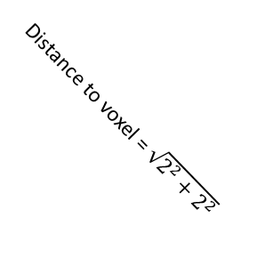
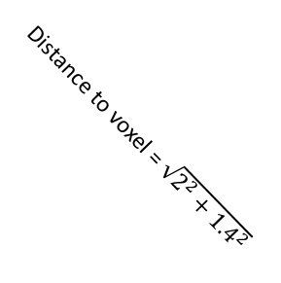
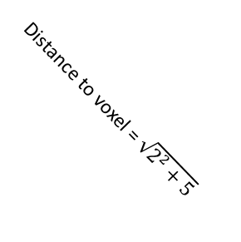

2 planes out from the central voxel:
2 vox up
3 vox away
2.8 vox away
Distance to voxel = $\sqrt{2^{2}+2^{2}}$
2 vox forward
$\sqrt{5 }$ vox up
Distance to voxel = $\sqrt{2^{2}+5}$
2 vox forward
2.4 vox away
Distance to voxel = $\sqrt{2^{2}+{1.4}^{2}}$
1 vox diag
2 vox away
2 vox forward

Slide 8
3 planes out from the central voxel:
3 vox away

Slide 9


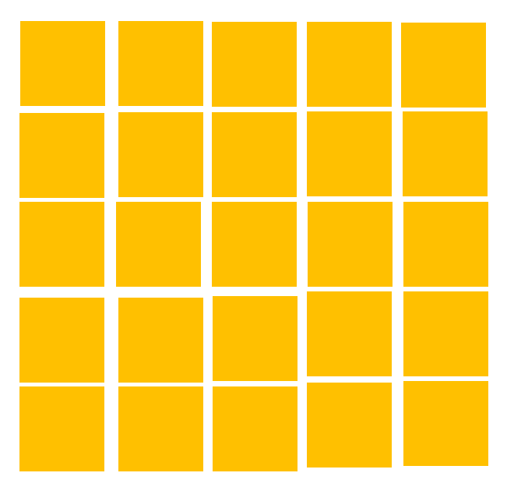

Total volume of the “sphere”:
+
+
+
+
+
+
1
1
21
25
21
29
25
= 123 voxels*
*max amount – spheres might be smaller if they’re on the edge of the brain cube, don’t include all gray matter, etc.

Slide 10
Doing stats on Searchlight RSA
The common practice is to take 2 steps:
Voxel-level statistics (keep only the voxels with a significant correlation)
Cluster-level statistics (get rid of any tiny clusters, which are likely to be spurious)

Slide 11
Voxel-Level statistics: permutation tests
Goal: generate a distribution of the correlations you’d expect in the absence of a real effect
Outcome: compare the correlation you’ve measured to that distribution, and decide whether it’s “real” or noise.
In each grey matter voxel…
Get the brain patterns matrix (videos x voxels) for the surrounding searchlight
Shuffle the brain patterns matrix (re-order the videos) and make an RDM based on the shuffled matrix
Correlate the shuffled brain RDM with the behavioral/target RDM
Repeat 100-1000x → distribution of noise correlations
Compare the real brain-behavior correlation with the noise distribution
For p < 0.01:
…If it’s >= 99% of the noise distribution → it’s real
…If it’s < 99% of the noise distribution → it’s noise, so mask it out
r for shuffled data

Slide 12
Cluster-Level statistics: more permutation tests
Goal: generate a distribution of the cluster sizes you’d expect in the absence of a real effect
Outcome: compare the cluster sizes after thresholding at the voxel level, and decide whether each one is big enough.
Step 1: Identify the clusters in the voxel-corrected results
Step 2: Get a noise distribution of cluster sizes
Apply the voxel-level corrections to the shuffled data results (from the previous set of permutation tests)
Identify the clusters in the corrected shuffled data, and measure their size
Step 3: Keep the big clusters
For each cluster in the intact data:
compare the cluster’s size to the noise distribution
…If it’s larger than the mass of the distribution (using FDR test q < 0.05) → keep it
…If not, mask it out
Cluster size for shuffled data

Slide 13
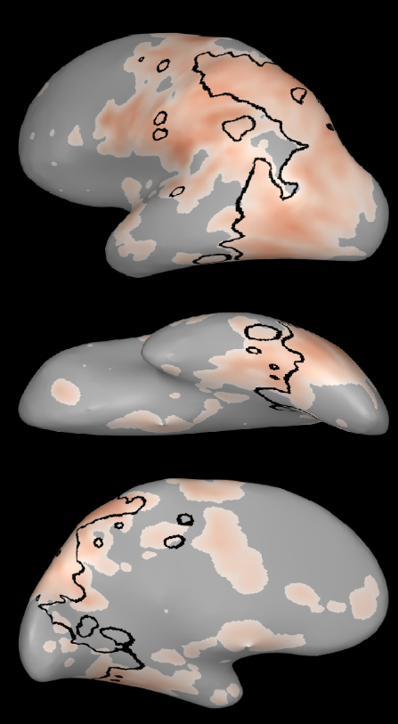
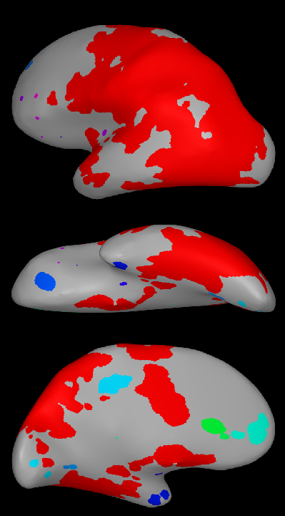
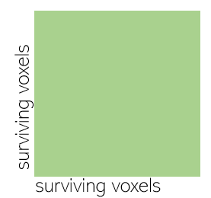
Identifying the clusters
Cluster the voxels using Density-Based Spatial Clustering of Applications with Noise (DBSCAN)
Inputs:
Distance matrix* or matrix of 3d coordinates
*I found the distance matrix worked better
Epsilon: neighborhood that dbscan looks in around a voxel → if there are enough other voxels in that neighborhood, it counts it as a “core” point and will try to build a cluster around it → I ended up setting to 3
Minpts: min # of voxels in a voxel’s epsilon neighborhood for it to count as a core point → I used 1
Example RSA map after voxel-level corrections (black lines = reliable voxels)
Surviving voxels grouped into clusters using dbscan

Slide 14
Parameters I’ve used
voxel-level stats:
100 permutations (more is better – some people do 1000 – but it’s computationally expensive and I honestly think that 100 is fine)
Keep voxels if p < 0.01
Cluster-level stats:
Identifying clusters with dbscan:
Epsilon = 3
Minpts = 1
Input format = matrix of straight-line distances between voxels
Keep voxels if they belong to a cluster where FDR-corrected q < 0.05

