Slide 1
Calculating Pose Feature Similarity
Summer 2020

Slide 2
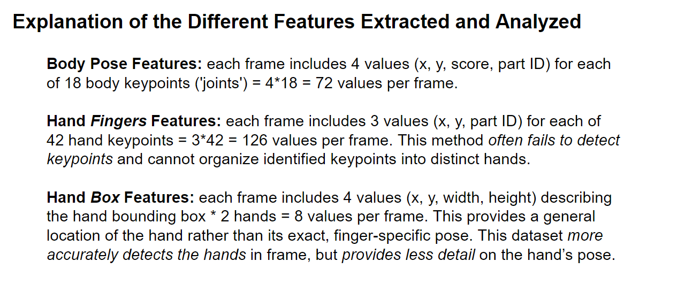
Background
Pose features extracted for each frame of each action video
How should you calculate the similarity between action videos based on their pose features?

Slide 3
Method 1: collapsing over time
For each video, you have a matrix of pose features:
To compare videos, calculate the distance between the average location for each joint
elbow
shoulder
Average over frames
…
joints
joints
Time (75 frames)
(x, y) for joint i in frame j
60 vids
average (x, y) for joint i
60 vids
RDMs for each joint
Distance between average elbow location for video i and video j

Slide 4
Method 2: keeping time in
It’s pretty straightforward to look at joint similarity without paying attention to time, but it also leaves a lot of information out:
Are the joints in the same locations at the same times?
What are the joints’ actual movements like, and do they move around the video frame in a similar way?
There are a few ways to calculate joint similarity while taking this temporal dimension into account (but it’s not clear yet what’s best / easiest):
Calculate the distance between joint locations at each frame → average
Compare the shape of the temporal trajectories (something like Procrustes’ distance)

Slide 5
Option 1: average frame-wise distances
For each video and joint, get that joint’s trajectory through time:
For each frame, calculate the distance between the joint’s location in video 1 vs. video 2
video 1
video 2
frame 75
average
512 px
frame 1
Average frame-by-frame distance between elbow locations, comparing videos 1 & 2
75 frames
512 px

Slide 6
Option 2: Procrustes distance
Aim: capture similarity in the shape of two videos’ joint location trajectories:
Similar movement pattern regardless of vertical or horizontal translations (which are more about the video’s framing than the movement)
Similar movement pattern regardless of differences in scaling (which are more about level of zoom than the movement)

Slide 7
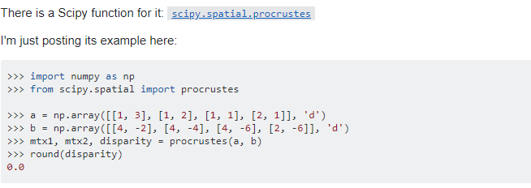
How can we measure this?
Basic intuition: first step is to normalize / translate the trajectories so they’re as close as possible. Second step is to calculate the distance between each point in the trajectories.
I think Procrustes distance essentially does this:
general description: https://en.wikipedia.org/wiki/Procrustes_analysis
In-depth guide: https://graphics.stanford.edu/courses/cs164-09-spring/Handouts/paper_shape_spaces_imm403.pdf
Procrustes in Python:
https://docs.scipy.org/doc/scipy/reference/generated/scipy.spatial.procrustes.html

Slide 8
Other metrics that could be cool / useful
Amplitude of the movement for each joint (to capture large vs. small movements)
Largest translation for each joint
Speed of each joint (average translation per frame)
How far are the joints from the body’s center of mass?

