Slide 1
Calendar Helper
——Topic1(Next Generation of Personal Assistants)
Zhu YuXuan （朱宇轩）
Zhao LuYuan（赵璐媛）

Slide 2




Why we need this
Function Introduction
How we designed this
Applications in daily life

Slide 3

Why we need this
Forget what next day is
Difficulties when talking about lunar date
The fortune of some exact days

Slide 4








Function Introduction
Lunar & solar calendar
conversion
Fortune Telling
Speech Recognition

Slide 5
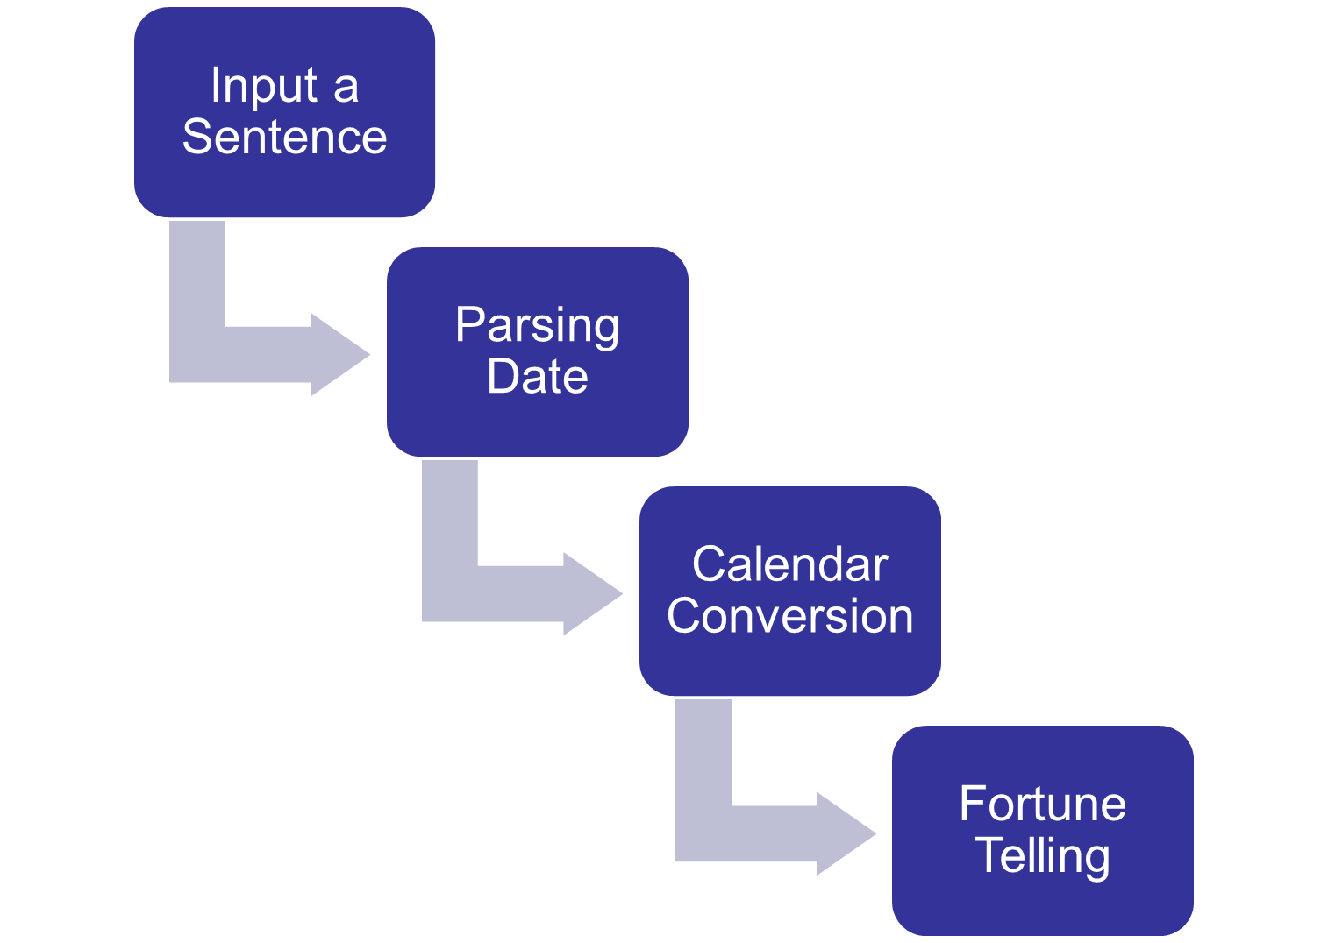

Slide 6
How we designed this
Phrase Understanding
  Chinese Word Segmentatio from HIT’s LTP-Cloud
The Fortune of some exact day
  laohuangli.net
Speech Recognization
  Bing Speech API

Slide 7
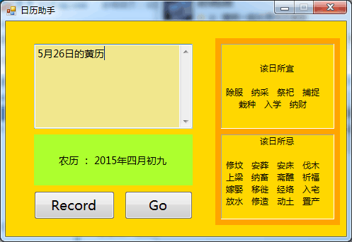
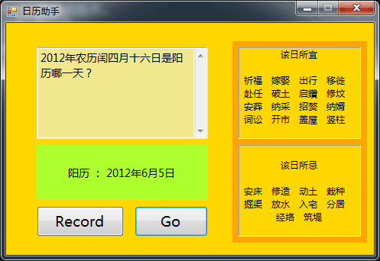
Applications in daily life
今天是农历大年初三。
明天是农历几号？
把农历五月廿一转换成阳历。
今天是2013年1月31日。
5月1日的农历是几号？
2012年农历闰四月十六日是阳历哪一天？
…………

Slide 8

Thank You!

