Slide 1

Diagnosing Hate Speech Classification: Where Do Humans and Machines Disagree, and Why?
Xilin Yang
Research Specialist @ ESOC
xy4772@Princeton.edu

Slide 2
Warning
This paper contains hate speech instances that are racially offensive and may cause discomfort in reading. They are unavoidable due to the nature of this study.
However, I will do my best to eliminate the appearance of these instances in this research presentation.

Slide 3
Each of Our Mind is a Unique LLM
Before digging into the quantitative method of this paper, we would like to make an audacious claim that we each have our own LLM, which is our mind, and it is in each of our mind that we encode words differently based on our identity, memory, and attachments.
A certain word may arouse very different feelings across individuals. To understand the disagreement between humans and machines in classifying speech, I anticipate at some time reaching a granular level such that it is our "embedding" that gets compared, not a sentence or a corpus.
This is the motivation for my research, a "word for word" study where human-machine disagreement takes place at the same granular level.

Slide 4

Embedding Regression as a Peak into the Differences of Our Mind

Slide 5

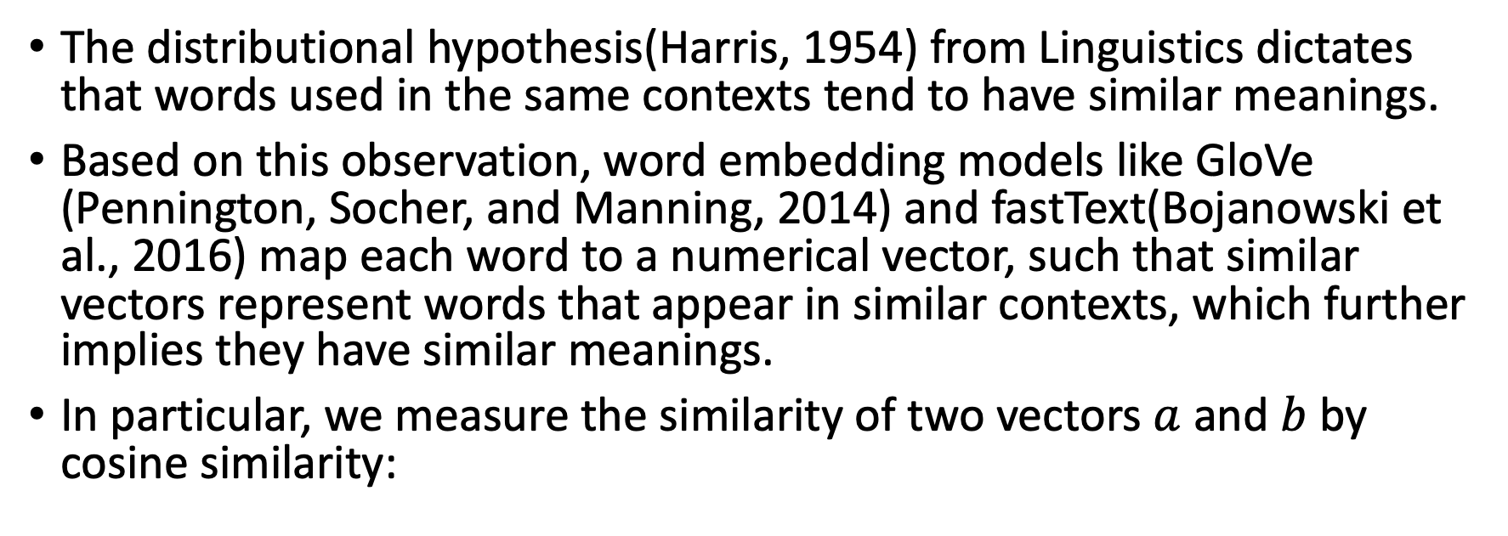
What is an Embedding?
The distributional hypothesis(Harris, 1954) from Linguistics dictates that words used in the same contexts tend to have similar meanings.
Based on this observation, word embedding models like GloVe (Pennington, Socher, and Manning, 2014) and fastText(Bojanowski et al., 2016) map each word to a numerical vector, such that similar vectors represent words that appear in similar contexts, which further implies they have similar meanings.
In particular, we measure the similarity of two vectors $a$ and $b$by cosine similarity:

Slide 6
ALC Embeddings
The same word in different text corpus may have different meanings. For example, “football” means “soccer” in British English but “American football” in American English. Suppose we are given a word embedding model trained on British English, how can we use it to understand American English?
Arora et al., 2016; Arora et al., 2018 show that under some plausible assumptions, one can obtain an embedding for any word in a new context by taking the average of some pre-trained embeddings of the words around it and applying a linear transformation. This is known as the “a la carte” embedding, or ALC embeddings.
In this paper, we use the ALC embeddings based on fastText for English prepared by Rodriguez et al., 2023.

Slide 7
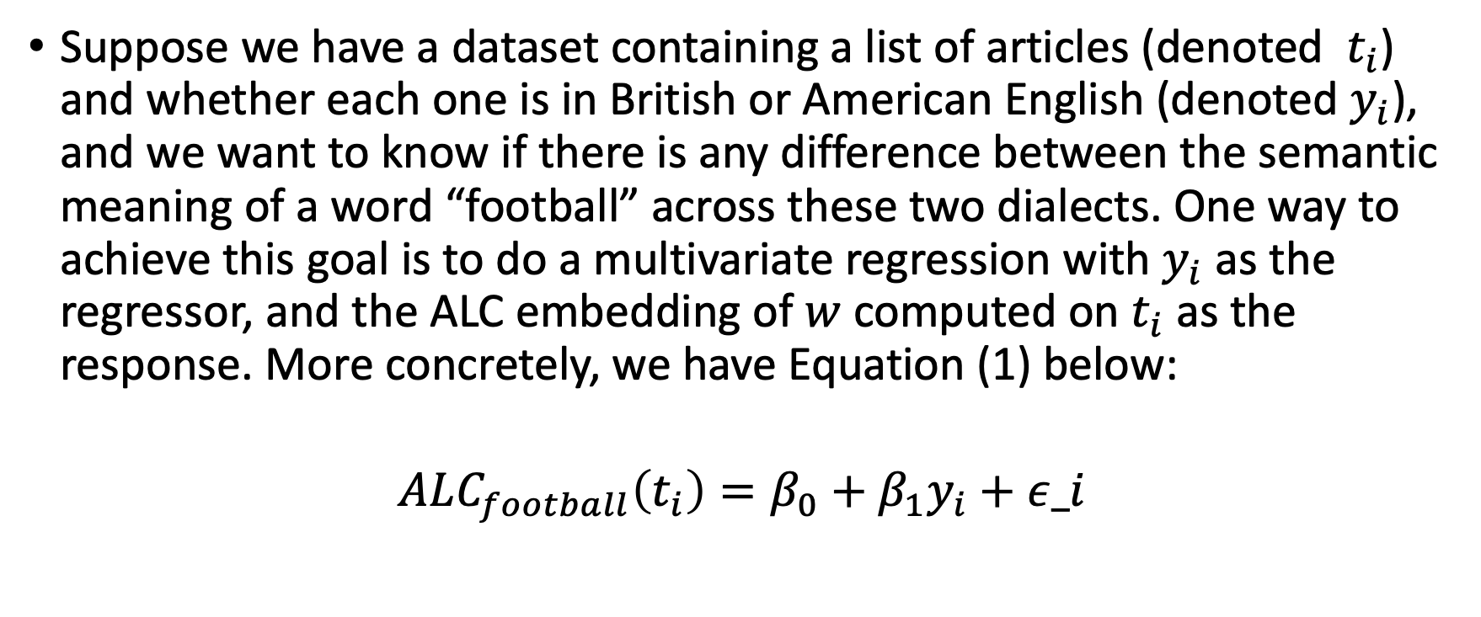
ALC Embeddings
Suppose we have a dataset containing a list of articles (denoted $t_{i}$) and whether each one is in British or American English (denoted $y_{i}$), and we want to know if there is any difference between the semantic meaning of a word “football” across these two dialects. One way to achieve this goal is to do a multivariate regression with $y_{i}$ as the regressor, and the ALC embedding of $w$ computed on$t_{i}$ as the response. More concretely, we have Equation (1) below:
$$ALC_{football}\left(t_{i}\right)=β_{0}+β_{1}y_{i}+ε_i$$

Slide 8
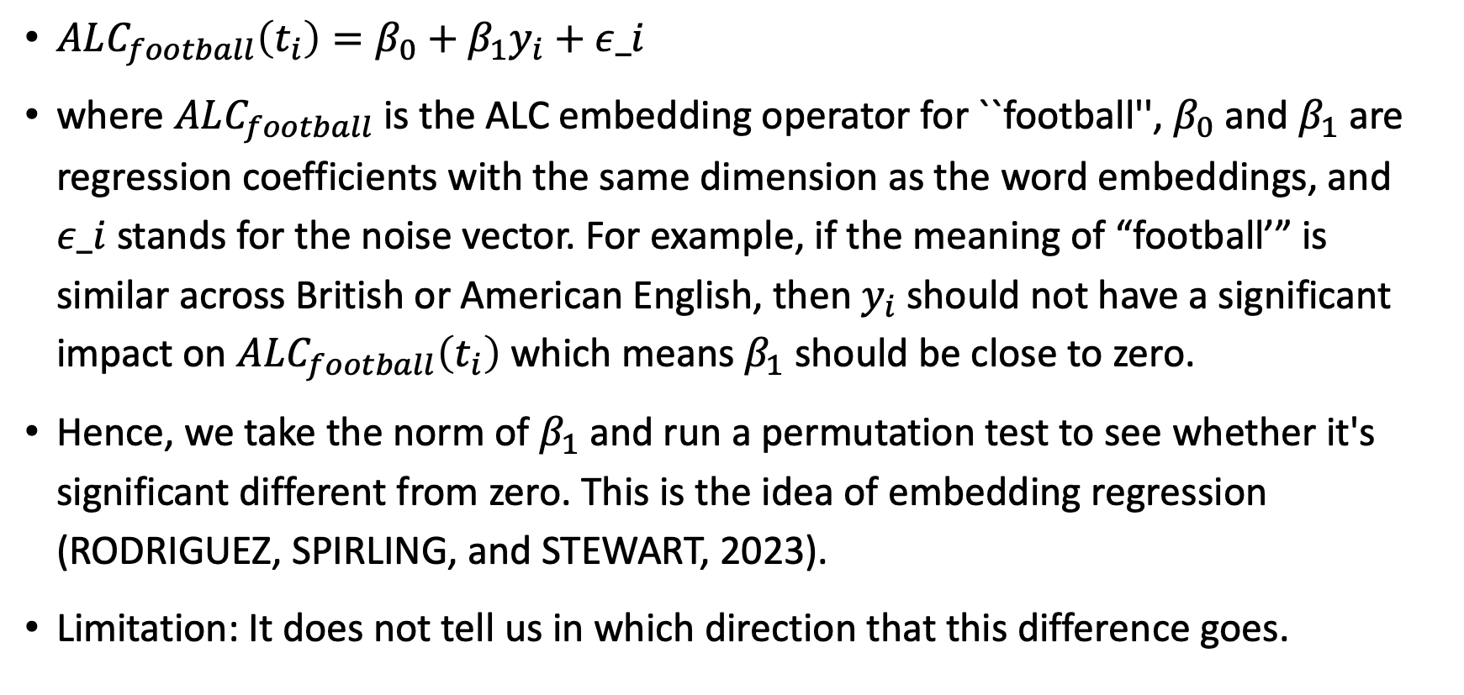
Embedding Regression
$ALC_{football}\left(t_{i}\right)=β_{0}+β_{1}y_{i}+ε_i$
where $ALC_{football}$is the ALC embedding operator for ``football'', $β_{0}$and $β_{1}$are regression coefficients with the same dimension as the word embeddings, and $ε_i$ stands for the noise vector. For example, if the meaning of “football’” is similar across British or American English, then $y_{i}$should not have a significant impact on $ALC_{football}\left(t_{i}\right)$which means $β_{1}$should be close to zero.
Hence, we take the norm of $β_{1}$and run a permutation test to see whether it's significant different from zero. This is the idea of embedding regression (RODRIGUEZ, SPIRLING, and STEWART, 2023).
Limitation: It does not tell us in which direction that this difference goes.

Slide 9
Inconsistency Among Human Annotations
We run embedding regression (RODRIGUEZ, SPIRLING, and STEWART, 2023) on a collection of 1,101,165 online comments which include the ones pre-classified as hate speech. To capture the content of hate, we must consider the relevant context.
As explained earlier, we treat hate or non-hate as the regressor, embedding as the response, and run the regression to see if the same word has different meanings in hate versus non-hate contexts.

Slide 10
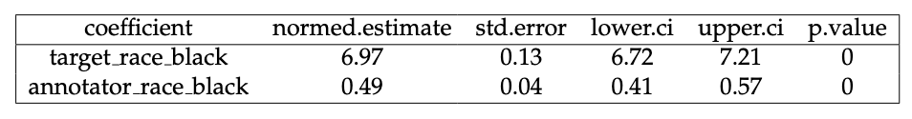
First Regression
Our first regression investigates whether black annotators would rate the racial slur, the “n-word” differently as compared to annotators of other identities. We choose this regression because it is one of the most offensive slurs and should hypothetically have high consistency across annotators. While embedding regression cannot show us whether black annotators are more likely or less likely to rate “n-word"-containing speeches as hate speech, it is able to show us whether there is a statistically significant difference in their annotations as compared to other people’s annotations.
Result: Yes, there is a statistically significant difference.

Slide 11
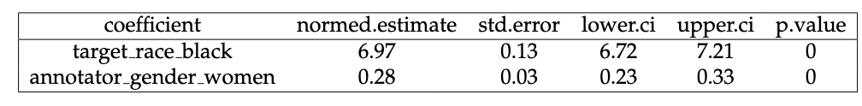
Second Regression
In our second embedding regression , we found it statistically significant that female annotators rate comments that contain the “n-word” differently as hate speech that target the black population. Again, we do not know how female annotators rate it differently; the regression only shows us that they are more sensitive.
However, in testing other racial slurs, for example, those that target the Asian population, we did not find such a statistically significant correlation, which means that female annotators do not have different reactions to all racial slurs.

Slide 12
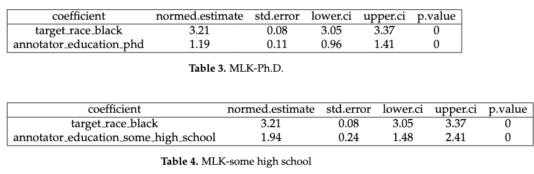
Third and Fourth Regression
In the third and fourth table, we run embedding regression of online speech that contains "MLK” – an abbreviation for Martin Luther King – against whether the comment is hate speech against the black population. The second regressor is education. Both tables show that people with different education background rate online instances that contain the word "MLK” differently. The difference varies based on their education background.
We will pause here an reach the conclusion that there is a lot of variance in human annotations based on people’s background.

Slide 13
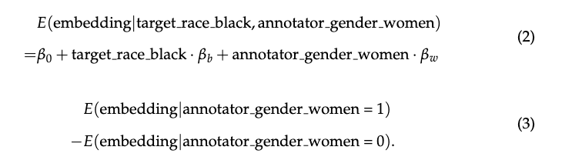
Data Influence Does Not Affect Embedding Regression Results
In some sense, embedding regression estimates,

Slide 14

Training a Hate Speech Classifier

Slide 15
Linear Probing
We combine traditional machine learning methods and state-of-the-art speech classification through text embedding. This method, known as linear probing (Alain and Bengio, 2017), works as follow:
We trained a hate speech classifier on a top-performing Large Language Model, NV-Embed-v2, which according to the latest MTEB benchmark on Hugging Face achieves a test accuracy of 92.74% in Toxic Conversations Classification.
On top of these embedding, we then fitted a traditional machine learning method, logistic regression, to predict the human annotations in Measuring Hate Speech, which is hand-coded by Amazon Mechanical Turk workers.

Slide 16

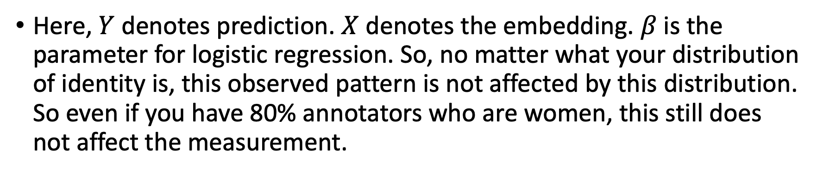
Does the Distribution of Identity Affect Logistic Regression?
Here, $Y$denotes prediction. $X$denotes the embedding. $β$is the parameter for logistic regression. So, no matter what your distribution of identity is, this observed pattern is not affected by this distribution. So even if you have 80% annotators who are women, this still does not affect the measurement.

Slide 17
Machine Predicts Better than Humans?
In checking the “wrong’” set, I agree with the machine's judgment 70 percent of the time as opposed to that of humans, which I only agree with 30 percent of the time.
Hence, in our speech classifier, the logistic regression model on top of LLM embeddings outperformed the Amazon Mechanical Turk workers. We interpret this phenomenon as such that LLM did the most heavy-lifting by converting text to embedding, while logistic regression is only the last kick. Hence, the embeddings accurately capture the semantic meaning of the text, and the logistic regression is just the final kick.

Slide 18
Machine Fails to Classify Obvious Swear Words and Slurs
To understand what causes the disparity between logistic regression and human annotators, we compute the cosine similarity ratio of the very offensive racial slur “n-word” on the samples where human and machines disagree with each other. I am not presenting the graph in this meeting because it is highly offensive. To summarize the finding of this graph:
The features with the largest cosine similarity ratio are swear words, suggesting that the presence of these slang tends to make humans think a certain comment is hate speech, and simultaneously make machine learning models think it is non-hate speech.

Slide 19

What Went Wrong with the LLM?

Slide 20
How Could this Happen?
Usually, two conscious actions could contribute to a model's self-censorship on hateful content: one is model alignment, defined as the process of aligning an AI system's behavior with human values. Another is data curation: by curating the data, the researchers remove malicious content in the training set.
Self-censorship can also happen unknowingly: if the training dataset is missing toxic content, then the model would also fail at detecting such content, but this is not the case in the NV-Embed-v2 model which is trained on a purposefully chosen toxic dataset.

Slide 21

Four Stages where the NV-Embed-v2 Model Could Have be Censored
Model alignment that happens in the base model of NV-Embed-v2, which is the Mistral-7B model.
Data Curation that happens in training the NV-Embed-v2 model.
In training the NV-Embed-v2 model, a two-phase training process is used, with phase the researchers focused exclusively on retrieval datasets and phase II covering non-retrieval datasets. Since the retrieval datasets contain minimal toxic content, it’s possible that phase I diminishes the model's capacity to form embeddings related to toxic content, which then may not be fully restored in phase II.
Finally, there could be proactive model alignment due to ethical reasons before launching this model.

Slide 22
Nvidia Researchers Responded with Guidance
I was very fortunate to receive a response from one of the research scientists who provided detailed feedback on where self-censorship of racial slurs take place. In communicating with Nvidia team, we ruled out stage 2. and 4. The researchers sampled the toxic and non-toxic examples equally, so there should not have been an imbalance in the training set. The researchers also confirmed that they did not run a model alignment step - they are still using the base model Mistral-7B. However, the researchers recognized that Stage 1. and 3. could have contributed to the model's failure in detecting obvious toxic content.

Slide 23
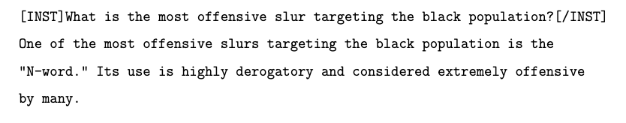
Censorship in the Base Model Mistral-7B
Because we don’t have the bandwidth to replicate their model training process in phase I and phase II, we diagnosed Stage 1. by taking the base Mistral-7B model and used few-shot text completion to generate racial slurs.
We observe: the base model avoids saying the racial slur in its original form but replaces it with the euphemism "n-word."

Slide 24
It is Human that Limits the Machine.
We therefore conclude that self-censorship has occurred in the base model, which in turn affects the iterated model NV-Embed-v2, and this is a stunning finding because NV-Embed-v2 is one of the top performing open-sourced LLMs on toxic speech classification, but its performance is greatly limited due to human effort.

Slide 25

Implications for the Future of AI, and Aristotle is Great

Slide 26
Why We Should Use Open-Sourced LLMs
First, this study shows us that open-sourced large language models are the future for responsible AI. They are designed such that researchers can easily find evidence about ethical choices in their transparent training process and go stage-by-stage into the diagnosis.
This is crucial for policymakers who care about the ethics of AI, not only because close-sourced models like GPT4 cannot support such diagnostics, but also because the active monitoring from academia plays a powerful role in AI regulations. We argue that this can be more powerful than government restrictions.

Slide 27
The Power of the Research Community’s Monitoring
The NeurIPS Code of Ethics clearly states that "Authors should transparently communicate the known or anticipated consequences of research: for instance via the paper checklist or a separate section in a submission," and their areas of concerns include the following principle: "Bias and fairness: Contributors should consider any suspected biases or limitations to the scope of performance of models or the contents of datasets and inspect these to ascertain whether they encode, contain or exacerbate bias against people of a certain gender, race, sexuality, or other protected characteristics."
This indicates that if an open-sourced model is able to produce hate speech, it may not get passed the ethical reviews of anyMachine Learning conferences. In the meantime, close-sourced proprietary models has much less of this concern because researchers cannot easily enter their training process.

Slide 28
If We Don’t Teach Machine Hate Speech, How Can It Identify Hate Speech?
Consider the following metaphor: if, because parents are concerned about their child using racial slurs, they never teach their child what is a racial slur at home, how can the child identify the verbal offense when encountering a racial slur in school?
By restricting AI from producing toxic content, we also restrict its ability to detect such content.
One thing that strike me is how persistent this censorship can last from the base model to the iterated versions. It is not easy to uncensor.

Slide 29
Aristotle: Virtue as a Mean, Lesser Evil as Good
In Nicomachean Ethics, Aristotle argues that humans are driven by a virtue of the "golden mean," which is a balance of the extremes, such as between the indulges and the abstinence. Aristotle also argues that between two evils, if humans must choose one, they will always choose the lesser evil.
My theory is that when researchers are asked to train a language model, the moral restrictions in their own language are mirrored into the model's performance.
Between the two extremes: training a super toxic model that produces offensive racial slurs and silencing the model such that it is bad at classification, the researchers choose the "mean," which is to censor it a little bit. As compared to the greater evil of creating an LLM that offends people, they choose the "lesser evil" of creating a less toxic model.

Slide 30
Conclusion
In this paper, we use embedding regression to show from a granular level that human annotators of different identities show differences in classifying hate speech given the particular words that the speech contains. This variance shows as noise and affects the machine's classification of hate speech to a limited extent.
We find that machine is better than humans in correctly labeling long instances of speech, but it is more likely to fail at detecting obvious racial slurs due to model alignment.
We deduce that self-censorship widely exist in open-sourced LLMs, and thanks to the transparency of these models, researchers can easily diagnose the performance issues of a model.
We conjecture that researchers prefer to choose the "lesser evil" in avoiding societal consequences, and their own moral restrictions factor deeply into the model training process.

Slide 31
Thank you!

