Slide 1
CSC 536 Lecture 1

Slide 2
Outline
Synchronization
Clock synchronization
Logical clocks
Lamport timestamps
Vector timestamps
Global states and distributed snapshot
Leader election
Mutual exclusion

Slide 3
What time is it?
In distributed system we need practical ways to deal with time
E.g. we may need to agree that update A occurred before update B
Or offer a “lease” on a resource that expires at time 15:10:07.0150
Or guarantee that the notification about a time critical event will reach all interested parties within 100ms

Slide 4
Physical clock synchronization
Centralized System: unambiguous time
Distributed System: time can be ambiguous
Example: make utility in UNIX
file time modified
input.c 144
input.o 143
output.c 2143
output.o 2144

Slide 5
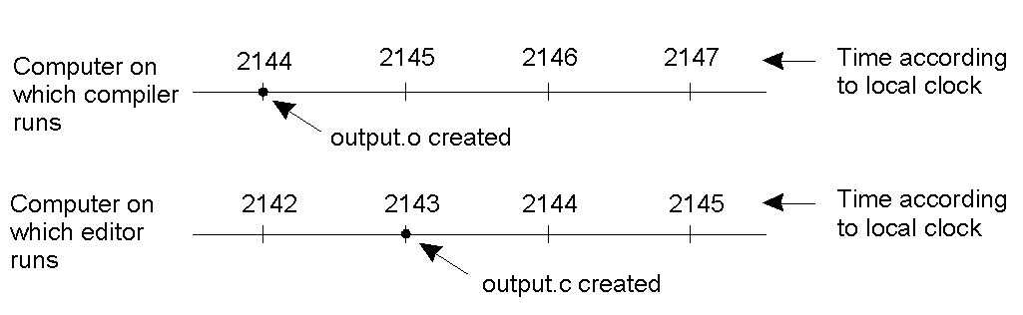
Clock Synchronization
When each machine has its own clock, an event that occurred after another event may nevertheless be assigned an earlier time.

Slide 6
Physical clocks
Timer: quartz crystal + counter + holding register
Interupt creates a clock tick
Physical clocks may be off
Clock skew
Clock drift
Questions:
How do we synchronize clocks with each other?
How do we keep them synchronized?
How do we synchronize clocks with “real” time?

Slide 7
3. What is time?
Solar day: 1 sec = 1/86400 solar day
Problem: it varies.
Atomic clocks: TAI (International Atomic Time)
Problem: it does not vary!
UTC (Universal Coordinated Time)
Leap seconds
Sources of UTC:
WWV shortwave radio
GPS

Slide 8
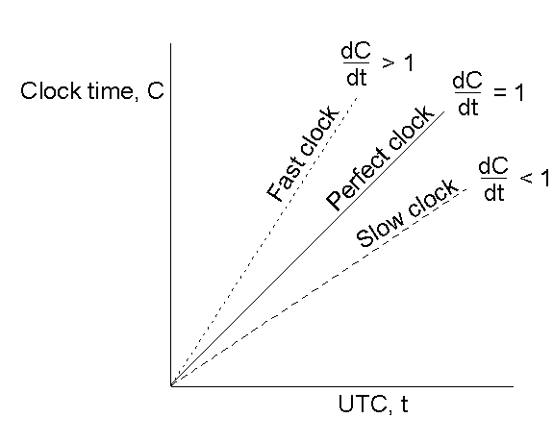
2. Drift rate
The relation between clock time C and UTC t when clocks tick at different rates.

Slide 9
2. The synchronization problem
t = UTC time
C(t) = time at node
Ideally, C(t) = t, for every time t.
Equivalent to dC/dt = 1
Realistically, we should be happy to know the maximum drift rate r:
1 - r < dC/dt < 1 + r
Problem: keep clocks synchronized within ε.

Slide 10
2. The synchronization problem
t = UTC time
C(t) = time at node
Ideally, C(t) = t, for every time t.
Realistically, we should be happy to know the maximum drift rate r:
1 - r < dC/dt < 1 + r
Problem: keep clocks synchronized within ε.
Solution: resynchronize every ε/r steps

Slide 11
2. The synchronization problem
t = UTC time
C(t) = time at node
Ideally, C(t) = t, for every time t.
Realistically, we should be happy to know the maximum drift rate r:
1 - r < dC/dt < 1 + r
Problem: keep two clocks synchronized within ε.

Slide 12
2. The synchronization problem
t = UTC time
C(t) = time at node
Ideally, C(t) = t, for every time t.
Realistically, we should be happy to know the maximum drift rate r:
1 - r < dC/dt < 1 + r
Problem: keep two clocks synchronized within ε.
Solution: resynchronize every ε/2r steps

Slide 13
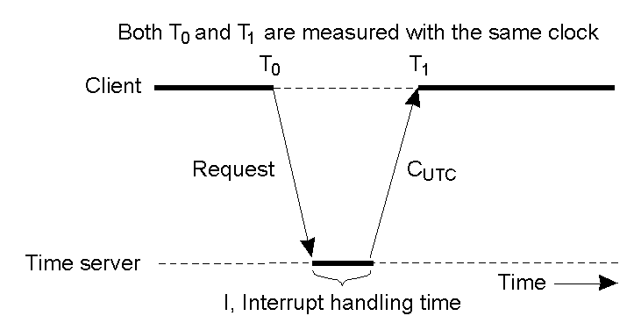
1. Cristian's Algorithm
Getting the current time from a time server.

Slide 14
1. Cristian's Algorithm
If nothing is known about the request, reply, and interrupt handling time, Client sets clock to C_{UTC} + (T1-T2)/2.

Slide 15
Synchronization issues
What if clock is fast and new time < old time?
What about message delay?
NTP (Network Time Protocol)
For more info: http://www.faqs.org/rfcs/rfc1305.html

Slide 16
Logical clocks
Often, what really matters is not agreement on time, but agreement on the order in which events occur.
Example:
Alice sends message to Bob
Bob opens attachment
Bob's disk reformatted
Synchronized physical clocks cannot always decide on the order of events

Slide 17
Lamport’s approach
Leslie Lamport suggests that we should reduce time to its basics
Time that lets a system ask
“Which came first: event A or event B?”
In effect: time is a means of labeling events so that…
... if A happened before B, TIME(A) < TIME(B)
... if TIME(A) < TIME(B), A happened before B

Slide 18
Defining “happens-before” relation
snd_{p}(m)
p
m
q
rcv_{q}(m) deliv_{q}(m)

Slide 19
Defining “happens-before” relation
snd_{p}(m)
p
A
B
m
q
C
D
rcv_{q}(m) deliv_{q}(m)
A, B, C and D are “events”.
A, B, C, and D could be anything meaningful to the application
So are snd(m) and rcv(m) and deliv(m)
What ordering claims are meaningful?

Slide 20
Defining “happens-before” relation
snd_{p}(m)
p
A
B
m
q
C
D
rcv_{q}(m) deliv_{q}(m)
A happens before B, and C before D
“Local ordering” at a single process
Write and

Slide 21
Defining “happens-before” relation
snd_{p}(m)
p
A
B
m
q
C
D
rcv_{q}(m) deliv_{q}(m)
send_{p}(m) also happens before rcv_{q}(m)
“Distributed ordering” introduced by a message
Write

Slide 22
Defining “happens-before” relation
snd_{p}(m)
p
A
B
m
q
C
D
rcv_{q}(m) deliv_{q}(m)
A happens before D
Transitivity: A happens before snd_{p}(m), which happens before rcv_{q}(m), which happens before D

Slide 23
Defining “happens-before” relation
snd_{p}(m)
p
A
B
m
q
C
D
rcv_{q}(m) deliv_{q}(m)
B and D are concurrent
Looks like B happens first, but D has no way to know. No information flowed…

Slide 24
Defining “happens-before” relation
snd_{p}(m)
p
A
B
m
q
C
D
rcv_{q}(m) deliv_{q}(m)
B and C are concurrent
Looks like C happens first, but C has no way to know. No information flowed…

Slide 25
“happens before” relation
DEFINITION:
We’ll say that “A happens before B”, written A→B, if
A→^{P}B according to the local ordering, or
A is a send event and B is a receive event and A→^{M}B, or
A and B are related under the transitive closure of rules (1) and (2)
So far, this is just a mathematical relation, not a “systems tool”

Slide 26
Logical clocks
A simple tool that can capture parts of the happens before relation
First version: uses just a single integer
Designed for big (64-bit or more) counters
Each process p maintains LT_{p}, a local counter
A message m will carry LT_{m}

Slide 27
Rules for managing logical clocks
When an event happens at a process p it increments LT_{p}
Any event that matters to process p
Normally, also snd and rcv events (since we want receive to occur “after” the matching send)
When p sends m, set LT_{m} = LT_{p}
When q receives m, set LT_{q} = max(LT_{q}, LT_{m})+1

Slide 28
Time-line with LT annotations
snd_{p}(m)
p
A
B
LT_{p} | 0 | 1 | 1 | 2 | 2 | 2 | 2 | 2 | 2 | 3 | 3 | 3 | 3
m
q
C
D
rcv_{q}(m) deliv_{q}(m)
LT_{q} | 0 | 0 | 0 | 1 | 1 | 1 | 1 | 3 | 3 | 3 | 4 | 5 | 5
LT(A) = 1, LT(snd_{p}(m)) = 2, LT(B) = 3, ...
LT(m) = 2,
LT(C) = 1, LT(rcv_{q}(m))=max(1,2)+1=3, etc…

Slide 29
Issue with Lamport timestamps
Problem: typically we also want LT(a) not equal to LT(b) for two different events a and b.

Slide 30
Issue with Lamport timestamps
Problem: typically we also want LT(a) not equal to LT(b) for two different events a and b.
Solution: Attach the unique process IDs to each timestamp and use process IDs to break ties (second version)

Slide 31
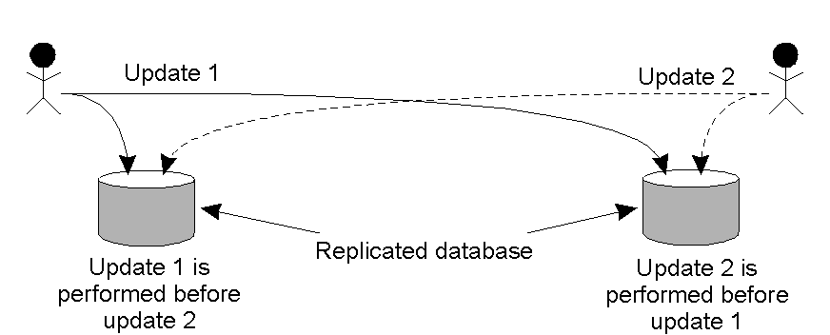
Example: Totally-Ordered Multicasting
Updating a replicated database and leaving it in an inconsistent state.

Slide 32
Example: Totally-Ordered Multicasting
Want replica consistency, i.e. updates must be performed in the same order at each replica.
This can be achieved by totally ordered multicasting
Totally-ordered: all replicas see the same sequence of updates
Assumptions:
All messages are multicast to all replicas (including sender).
Each multicast message carries a Lamport timestamp.
Two messages from the same sender are delivered in FIFO order.

Slide 33
Totally-Ordered Multicasting Algorithm
An update request is multicast to all replicas.
When a replica receives an update request:
It puts the request into a priority queue, ordered according to its timestamp.
It multicasts an acknowledgement to all replicas.
NOTE:
All processes will have same copy of the queue... eventually.
No two update requests have the same timestamp.
An update request is performed at a replica only when:
The update request has top priority in the priority queue
the replica receives acknowledgments from all other replicas.

Slide 34
Totally-Ordered Multicasting Algorithm
What this algorithm (again due to Lamport) achieves is something fundamental:
A distributed system in which every node sees the same
ordering of “updates” (or “writes”)

Slide 35
Logical clocks
If A happens before B, A→B, then LT(A)<LT(B)
But converse might not be true:
If LT(A)<LT(B), we can’t be sure that A→B
The “happens before” relation is not captured by Lamport timestamps
This is because processes that don’t communicate still assign timestamps and hence events will “seem” to have an order

Slide 36
Can we do better?
The “happens before” relation is not captured by Lamport timestamps; can we do better?
One option is to use vector clocks
We treat timestamps as a list
One counter for each process
Rules for managing vector times differ from what we did with Lamport timestamps

Slide 37
Vector clocks
Clock is a vector: e.g. VT(A)=[1, 0]
We’ll just assign process p index 0 and process q index 1
Rules for managing vector clock
When event happens at p, increment VT_{p}[index_{p}]
Normally, also increment for snd and rcv events
When sending a message, set VT(m)=VT_{p}
When receiving, set VT_{q}=max(VT_{q}, VT(m))
Vector timestamps have the following properties:
VT_{i}[i] = number of events that occurred so far at process i.
If V_{i}[j] = k, process i “knows of” the first k events that have occurred at process j

Slide 38
Time-line with VT annotations
snd_{p}(m)
p
A
B
VT_{p} | 0 0 | 1 0 | 1 0 | 2 0 | 2 0 | 2 0 | 2 0 | 2 0 | 2 0 | 3 0 | 3 0 | 3 0 | 3 0
m
VT(m)=[2,0]
q
C
D
rcv_{q}(m) deliv_{q}(m)
VT_{q} | 0 0 | 0 0 | 0 0 | 0 1 | 0 1 | 0 1 | 0 1 | 2 2 | 2 2 | 2 2 | 2 3 | 2 3 | 2 4
Could also be [1,0] if we decide not to increment the clock on a snd event. Decision depends on how the timestamps will be used.

Slide 39
Rules for comparison of VTs
We’ll say that VT_{A} ≤ VT_{B} if for all i VT_{A}[i] ≤ VT_{B}[i]
And we’ll say that VT_{A} < VT_{B} if
VT_{A} ≤ VT_{B} but VT_{A} ≠ VT_{B}
That is, for some i, VT_{A}[i] < VT_{B}[i]
Examples:
[2,4] ≤ [2,4]
[1,3] < [7,3]
[1,3] is “incomparable” to [3,1]

Slide 40
Time-line with VT annotations
snd_{p}(m)
p
A
B
VT_{p} | 0 0 | 1 0 | 1 0 | 2 0 | 2 0 | 2 0 | 2 0 | 2 0 | 2 0 | 3 0 | 30 | 3 0 | 3 0
m
VT(m)=[2,0]
q
C
D
rcv_{q}(m) deliv_{q}(m)
VT_{q} | 0 0 | 0 0 | 0 0 | 0 1 | 0 1 | 0 1 | 0 1 | 2 2 | 2 2 | 2 2 | 23 | 2 3 | 2 4
VT(A)=[1,0]. VT(D)=[2,4]. So VT(A)<VT(D)
VT(B)=[3,0]. So VT(B) and VT(D) are incomparable
VT(C)=[0,1]. So VT(B) and VT(C) are incomparable

Slide 41
Vector time and happens before
If A→B, then VT(A)<VT(B)
Write a chain of events from A to B
Step by step the vector clocks get larger
If VT(A)<VT(B) then A→B
Two cases: if A and B both happen at same process p, trivial
If A happens at p and B at q, can trace the path back by which q “learned” VT_{A}[p]
Otherwise A and B happened concurrently

Slide 42
Example: causally-ordered multicasting
Totally-ordered multicasting is expensive
It insures that all replicas see the same sequence of updates, even if the updates are not causally related
In some applications, updates that are concurrent do not need to be performed in the same order at all replicas
Goal: ensure that a message is delivered to the application only if messages that causally precede it have also been delivered (causally-ordered multicasting)

Slide 43
Causally-ordered multicasting (setup)
Assume that all updates are multicast to all replicas and that vector clocks only count send events:
When sending a message, process P_{i} increments VC_{i}[i]
Every message m is assigned a timestamp ts(m) that is the vector time at the sender process
When Pj delivers a message with timestamp ts(m), it sets VC_{j}[k] to max{VC_{j}[k], ts(m)[k]} for every k

Slide 44
Causally-ordered multicasting (algorithm)
Suppose P_{j} receives message m from P_{i} with vector timestamp ts(m)
The delivery of the message to the application will be delayed until these conditions are met:

Slide 45
Causally-ordered multicasting (algorithm)
Suppose P_{j} receives message m from P_{i} with vector timestamp ts(m)
The delivery of the message to the application will be delayed until these conditions are met:
ts(m)[i] = VC_{j}[i]+1
ts(m)[k] ≤ VC_{j}[k] for all k ≠ i

Slide 46
Global state
There are many situations in which we want to talk about some form of simultaneous event, or global state
Global state:
local state of each process
messages in transit at a certain time.
Useful for:
Termination detection
Deadlock detection
Crash recovery
Garbage collection
Debugging distributed programs

Slide 47
Global state
There are many situations in which we want to talk about some form of simultaneous event, or global state
Global state:
local state of each process
messages in transit at a certain time.
Problem: Impossible to do.

Slide 48
Temporal distortions
Things can be complicated because we can’t predict
Message delays (they vary constantly)
Execution speeds (often a process shares a machine with many other tasks)
Timing of external events
Lamport looked at this question too

Slide 49
Temporal distortions
p
0
a
d
p
b
c
e
1
p
f
2
p
3
What does “now” mean?

Slide 50
Temporal distortions
Timelines can “stretch”…
… caused by scheduling effects, message delays, message loss…
p
0
a
d
p
b
c
e
1
p
f
2
p
3

Slide 51
Temporal distortions
Timelines can “shrink” ...
... because of a machine speed up
p
0
a
d
p
b
c
e
1
p
f
2
p
3

Slide 52
Temporal distortions
Cuts represent instants of time.
But not every “cut” makes sense
p
0
a
d
p
b
c
e
1
p
f
2
p
3

Slide 53
Temporal distortions
Cuts represent instants of time.
But not every “cut” makes sense
Black cuts could occur but not gray ones.
p
0
a
d
p
b
c
e
1
p
f
2
p
3

Slide 54
Consistent cuts and snapshots
Idea is to identify system states that “might” have occurred in real-life
Need to avoid capturing states in which a message is received but nobody is shown as having sent it
This the problem with the gray cuts

Slide 55
Temporal distortions
Red messages cross gray cuts “backwards”
p
0
a
d
p
b
c
e
1
p
f
2
p
3

Slide 56
Temporal distortions
Red messages cross gray cuts “backwards”
In a nutshell: the cut includes a message that was never sent
p
0
a
p
b
c
e
1
p
2
p
3

Slide 57
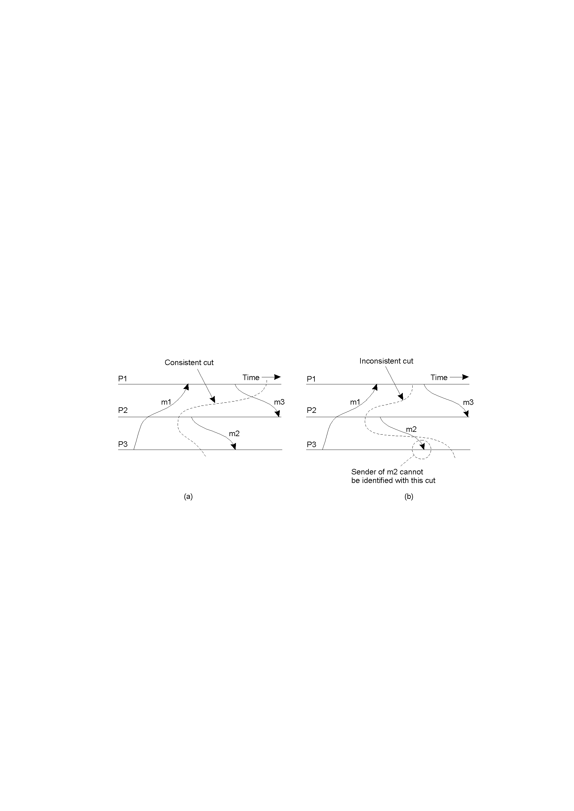
Cut examples
Consistent cut
Inconsistent cut

Slide 58
Distributed Snapshot
A possible local state of each process + messages in transit, i.e. a global state that might have been.
A cut is consistent if the following is true for very pair of processes P and Q:
If the local state of processor P indicates the receipt of a message m from Q, then the local state of processor Q should indicate that message m has been sent.

Slide 59
Deadlock detection example
Suppose, for example, that we want to do distributed deadlock detection
System lets processes “wait” for actions by other processes
A process can only do one thing at a time
A deadlock occurs if there is a circular wait

Slide 60
Deadlock detection “algorithm”
p worries: perhaps we have a deadlock...
p is waiting for q, so it sends q: “what’s your state?”
q, on receipt, is waiting for r, so it sends the same question… and r for s…. And s is waiting on p.

Slide 61
Suppose we detect this state
We see a cycle…
… but is it a deadlock?
p
Waiting for
q
Waiting for
Waiting for
s
Waiting for
r

Slide 62
Phantom deadlocks!
Suppose system has a very high rate of locking.
Then perhaps a lock release message “passed” a query message
i.e. we see “q waiting for r” and “r waiting for s” but in fact, by the time we checked r, q was no longer waiting!

Slide 63
Consistent cuts and snapshots
How do we compute a consistent cut?
Goal is to draw a line across the system state such that
Every message “received” by a process is shown as having been sent by some other process
Some pending messages might still be in communication channels
A “cut” is the frontier of a “snapshot”

Slide 64
Chandy/Lamport snapshot Algorithm
Assume that if p_{i} can talk to p_{j} they do so using a lossless, FIFO connection
To start the snapshot algorithm, process p_{i}:
records its current process state
turns on recording of messages arriving from all incoming channels
then, after it has recorded its state, for each outgoing channel c, P_{i} sends one marker message over c (before it sends any other message over c).
The distributed application program then continues at p_{i} as usual, computing, sending and receiving messages

Slide 65
Chandy/Lamport snapshot algorithm
On process p_{i}’s receipt of a marker msg over channel c:
If p_{i} has not yet recorded its state yet, it
records its process state now;
records the state of c as the empty set;
turns on recording of messages arriving over other incoming channels;
after p_{i} has recorded its state, for each outgoing channel c:
p_{i}sends one marker message over c (before it sends any other message over c).
Else p_{i} records the state of channel c as the set of messages it has received over c since it saved its state.

Slide 66
Chandy/Lamport Algorithm Variant
This algorithm, but implemented with an outgoing flood followed by an incoming wave of snapshot contributions
Snapshot ends up accumulating at the initiator, p_{i}
Note: neither algorithm tolerates process failures or message failures.

Slide 67
Chandy/Lamport
w
t
q
r
p
s
u
y
v
x
z
A network

Slide 68
Chandy/Lamport
w
I want to start a snapshot
t
q
r
p
s
u
y
v
x
z
A network

Slide 69
Chandy/Lamport
w
t
p records local state
q
r
p
s
u
y
v
x
z
A network

Slide 70
Chandy/Lamport
w
p starts monitoring incoming channels
t
q
r
p
s
u
y
v
x
z
A network

Slide 71
Chandy/Lamport
w
t
“contents of channel p-y”
q
r
p
s
u
y
v
x
z
A network

Slide 72
Chandy/Lamport
w
p floods message on outgoing channels…
t
q
r
p
s
u
y
v
x
z
A network

Slide 73
Chandy/Lamport
w
t
q
r
p
s
u
y
v
x
z
A network

Slide 74
Chandy/Lamport
q is done
w
t
q
r
p
s
u
y
v
x
z
A network

Slide 75
Chandy/Lamport
w
t
q
q
r
p
s
u
y
v
x
z
A network

Slide 76
Chandy/Lamport
w
t
q
q
r
p
s
u
y
v
x
z
A network

Slide 77
Chandy/Lamport
w
t
q
q
r
p
s
u
y
v
x
s
z
z
A network

Slide 78
Chandy/Lamport
w
x
t
q
q
r
p
u
s
u
y
v
x
s
z
z
v
A network

Slide 79
Chandy/Lamport
w
w
x
t
q
q
r
s
z
p
s
y
v
r
u
u
y
v
x
z
A network

Slide 80
Chandy/Lamport
w
t
p
q
q
Done!
r
p
r
s
s
t
u
w
u
v
y
x
y
v
x
z
z
A snapshot of a network

Slide 81
What’s in the “state”?
In practice we only record things important to the application running the algorithm, not the “whole” state
E.g. “locks currently held”, “lock release messages”
Idea is that the snapshot will be
Easy to analyze, letting us build a picture of the system state
Will have everything that matters for our real purpose, like deadlock detection

Slide 82
Leader election algorithms
Many distributed algorithms require a coordinator.
Typically, it does not matter which process takes this responsibility, only that some process has to do it.
Algorithm requirements:
Must assume that each process has a unique ID.

Slide 83
Safety and liveness properties
A distributed algorithm must satisfy the following properties:
Safety (nothing bad happens)
Liveness (eventually something good happens)
For leader election:
Safety property:
Liveness:

Slide 84
Safety and liveness properties
A distributed algorithm must satisfy the following properties:
Safety (nothing bad happens)
Liveness (eventually something good happens)
For leader election:
Safety property: no 2 processes are elected leaders
Liveness:

Slide 85
Safety and liveness properties
A distributed algorithm must satisfy the following properties:
Safety (nothing bad happens)
Liveness (eventually something good happens)
For leader election:
Safety property: no 2 processes are elected leaders
Liveness: eventually every process learns whether it is elected or non-elected

Slide 86
The bully algorithm (1)
Assume that each process knows the processes with higher IDs
When a process P notices that current coordinator failed:
P sends ELECTION message to all processes with higher IDs.
If no one responds, P wins election, and informs all processes it is the new coordinator.
If a higher up responds, it takes over (i.e. It calls an election). P's job is done.
If a process comes back up, it holds an election.
Note: we assume that message delivery is reliable and that the system is synchronous.

Slide 87
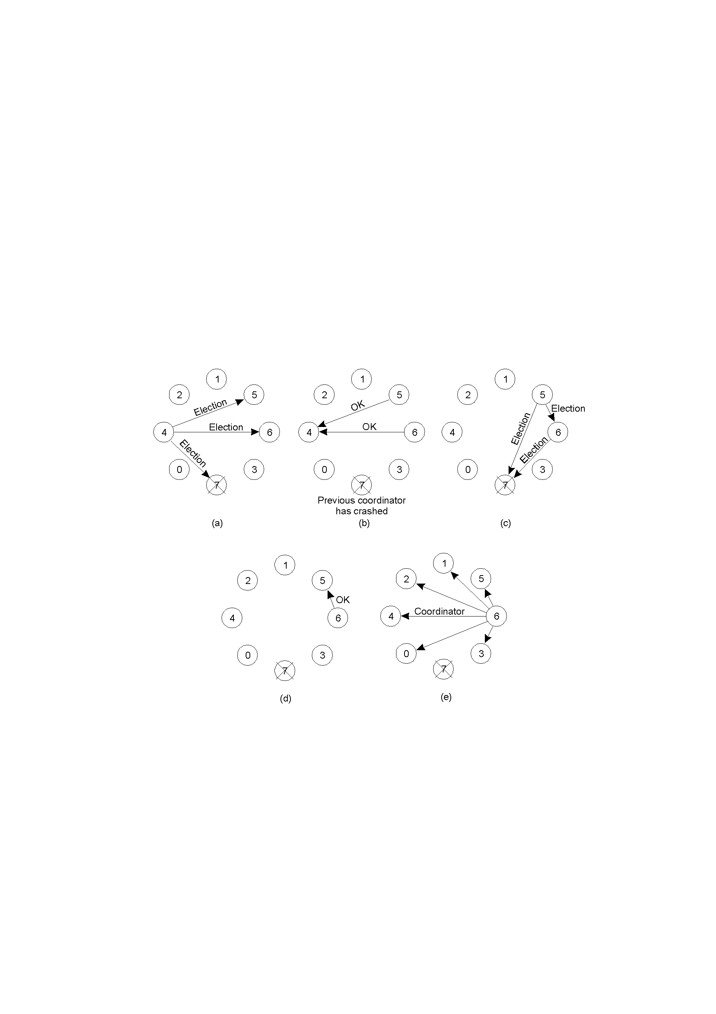
The bully algorithm (2)
The bully election algorithm
Process 4 holds an election
Process 5 and 6 respond, telling 4 to stop
Now 5 and 6 each hold an election

Slide 88
The bully algorithm (3)
Process 6 tells 5 to stop
Process 6 wins and tells everyone

Slide 89
The bully algorithm (4)
Safety property is satisfied as long as the system is synchronous and the communication is reliable
Liveness is similarly satisfied
O(n²) messages in the worst case
Delay: O(1)
How is the addition of a process handled?

Slide 90
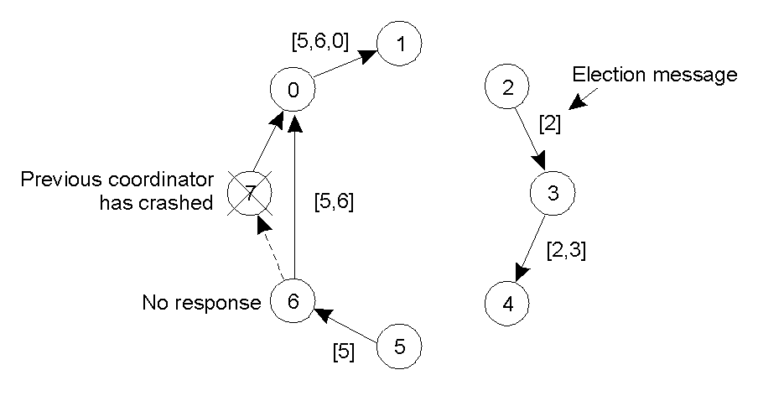
A ring algorithm (1)
Election algorithm using a ring.

Slide 91
A ring algorithm (2)
Processes arranged in a physical or logical ring.
Each process knows the ordering of the processes.

Slide 92
A ring algorithm (3)
When process P notices that coordinator is down:
P sends ELECTION message to first up successor. Attached to the message is a list containing, initially, P's ID.
When a process receives an ELECTION message:
it adds its own ID to the list and forwards the message to the next up successor.
When P receives the message back:
it circulates a COORDINATOR message along with the final list which determines the new ring ordering and the new coordinator (the highest ID process in list).

Slide 93
Mutual exclusion
Multiple processes, shared data.
Critical regions used to achieve mutual exclusion.
In single-processor systems, critical regions are protected using semaphores, monitors etc.
In distributed systems, several approaches exist.

Slide 94
Safety and liveness properties
A distributed algorithm must satisfy the following properties:
Safety (nothing bad happens)
Liveness (eventually something good happens)
For mutual exclusion:
Safety:
Liveness:

Slide 95
Safety and liveness properties
A distributed algorithm must satisfy the following properties:
Safety (nothing bad happens)
Liveness (eventually something good happens)
For mutual exclusion:
Safety: at most one process may execute in the critical section at a time
Liveness:

Slide 96
Safety and liveness properties
A distributed algorithm must satisfy the following properties:
Safety (nothing bad happens)
Liveness (eventually something good happens)
For mutual exclusion:
Safety: at most one process may execute in the critical section at a time
Liveness1: no deadlock

Slide 97
Safety and liveness properties
A distributed algorithm must satisfy the following properties:
Safety (nothing bad happens)
Liveness (eventually something good happens)
For mutual exlusion:
Safety: at most one process may execute in the critical section at a time
Liveness1: no deadlock
Liveness2: no starvation (stronger liveness condition)

Slide 98
Safety and liveness properties
A distributed algorithm must satisfy the following properties:
Safety (nothing bad happens)
Liveness (eventually something good happens)
For mutual exlusion:
Safety: at most one process may execute in the critical section at a time
Liveness1: no deadlock
Liveness2: no starvation (stronger liveness condition)
Liveness3: requests are handled in the order defined by the “happens before” relation (strongest liveness condition)

Slide 99
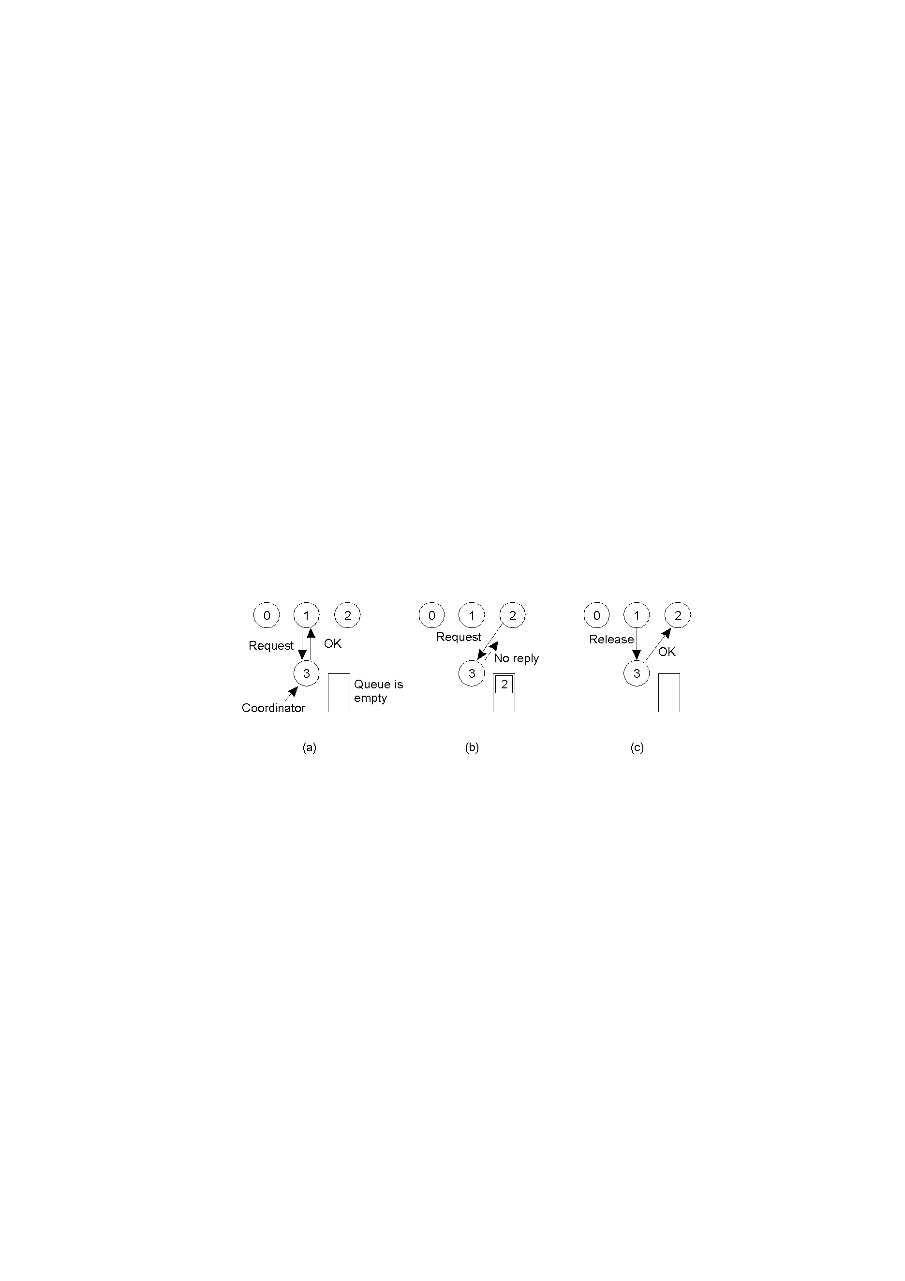
A centralized token-based algorithm
Process 1 asks the coordinator for permission to enter a critical region. Permission is granted
Process 2 then asks permission to enter the same critical region. The coordinator does not reply.
When process 1 exits the critical region, it tells the coordinator, when then replies to 2

Slide 100
A centralized algorithm (2)
Safety: √
No starvation: √ (and therefore no deadlock)
Liveness 3: not satisfied!

Slide 101
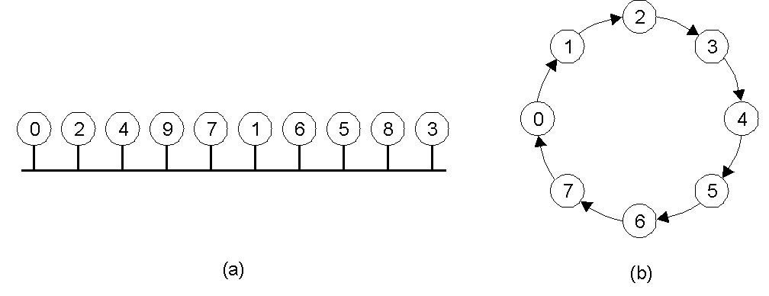
A token-based ring algorithm
An unordered group of processes on a network.
A logical ring constructed in software.

Slide 102
A token ring algorithm (2)
Safety: √
No starvation: √ (and therefore no deadlock)
Liveness 3: not satisfied!

Slide 103
A distributed algorithm
When a process P wants to enter critical region (CR):
P sends a timestamped request message (using Lamport timestamps!) to all processes. P enters CR only when all processes reply OK.
When a process Q receives a request message it does one of the following:
If Q is not in CR and does not want it, Q replies OK. (I)
If Q is already in CR, it queues the request. (II)
If Q wants to enter CR, Q compares its request timestamp with P's request timestamp. If Q's is higher, case I, else II.
When a process exits the CR, it replies OK to all processes on its queue.

Slide 104
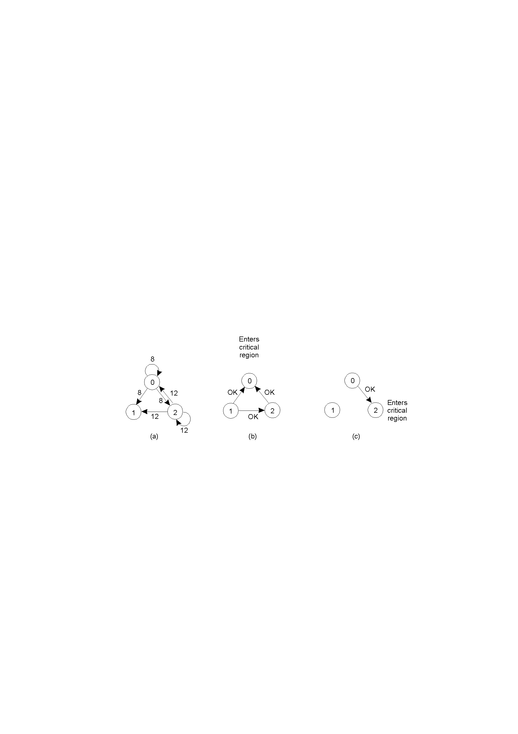
A distributed algorithm (2)
Two processes want to enter the same critical region at the same moment.
Process 0 has the lowest timestamp, so it wins.
When process 0 is done, it sends an OK also, so 2 can now enter the critical region.

Slide 105
A distributed algorithm (3)
Safety: check
No starvation: check (and therefore no deadlock)
Liveness 3: check

Slide 106
Comparison
Algorithm
Messages per entry/exit
Delay before entry (in message times)
Problems
Centralized
3
2
Coordinator crash
Distributed
2 ( n - 1 )
2
Crash of any process
Token ring
1 to ∞
0 to n - 1
Lost token, process crash
A comparison of three mutual exclusion algorithms.

