Slide 1
CSC 536 Lecture 3

Slide 2
Outline
Remote Akka actors
Akka example: mapreduce
Mutual exclusion

Slide 3
Remote Actors
Distributed by default
Actor interactions are asynchronous messages
Local actor interactions are optimization of general case (remote actors)

Slide 4
Remoting configuration (server)
Add dependency to build.sbt
libraryDependencies += "com.typesafe.akka" %% "akka-remote" % "2.6.4”
Add application.conf configuration file
server {
akka {
actor {
provider = remote
}
remote {
use-unsafe-remote-features-outside-cluster = on
artery {
transport = tcp
canonical.hostname = "127.0.0.1"
# canonical.port = 25520
}
}
}
}
server {
akka {
actor {
provider = remote
}
remote {
enabled-transports = ["akka.remote.netty.tcp"]
netty.tcp {
hostname = "127.0.0.1"
port = 2552
}
}
}
}

Slide 5
Remoting Configuration
application.conf configuration:
Change provider from local to remote
Transport mode: specifies transport protocol
Host name
Port number - the port the actor system should listen on, set to 0 to have it chosen automatically (e.g., for clients)

Slide 6
Remoting configuration (client)
Add dependency to build.sbt
libraryDependencies += "com.typesafe.akka" %% "akka-remote" % "2.6.4”
Add application.conf configuration file
remotelookup {
akka {
actor {
provider = remote
}
remote {
use-unsafe-remote-features-outside-cluster = on
artery {
transport = tcp
canonical.hostname = "127.0.0.1"
canonical.port = 0
}
}
}
}

Slide 7
Client-side code
To obtain the handle to a remote actor:
ActorSystem method actorSelection() takes the URL of a remote actor and returns an ActorSelection to it
val joe = system.actorSelection("akka.tcp://GreetingSystem@127.0.0.1:2552/user/joe”)
You can now send messages to the remote actor as usual
To acquire an ActorRef for an ActorSelection
you need to send a message to the selection
the actor should reply
use the reference of the reply from the actor

Slide 8
Remoting example
server.scala + application.conf
client.scala + application.conf
To execute the server and the client at sbt command line:
> server/runMain Server
> client/runMain Client
Project remote

Slide 9
Remoting example 2
Client ActorSystem can create a pool of distributed remote actors:
val addresses = Seq(
AddressFromURIString("akka.tcp://GreetingSystem@140.192.39.187:25520"),
AddressFromURIString("akka.tcp://GreetingSystem@140.192.37.111:25520"))
val routerRemote = system.actorOf(
RemoteRouterConfig(RoundRobinPool(4), addresses).props(Props[Joe]))

Slide 10
Remoting example
server.scala + application.conf
client.scala + application.conf
Project remote2
Project remote3

Slide 11
MapReduce Framework: Motivation
Want to process lots of data ( > 1 TB)
Want to parallelize the job across hundreds/thousands of commodity CPUs connected by a commodity networks
Want to make this easy, re-usable

Slide 12
Example Uses at Google
Pagerank
wordcount
distributed grep
distributed sort
web link-graph reversal
term-vector per host
web access log stats
inverted index construction
document clustering
machine learning
statistical machine translation
…

Slide 13
Programming Model
Users implement interface of two functions:
mapper (in_key, in_value) ->
list((out_key, intermediate_value))
reducer (out_key, intermediate_values list) ->
(out_key, out_value)

Slide 14
Map phase
Records from the data source are fed into the mapper function as (key, value) pairs
(filename, content) (goal: wordcount)
(web page URL, web page content) (goal: web link-graph reversal)
mapper produces one or more intermediate (output key, intermediate value) pairs from the input
(word, 1)
(link URL, web page URL)

Slide 15
Reduce phase
After the Map phase is over, all the intermediate values for a given output key are combined together into a list
(“hello”, 1), (“hello”, 1), (“hello”, 1) -> (“hello”, [1,1,1])
Done by intermediate aggregator step of MapReduce
reducer function combines those intermediate values into one or more final values for that same output key
(“hello”, [1,1,1]) -> (“hello”, 3)

Slide 17
Parallelism
mapper functions run in parallel, creating different intermediate values from different input data sets
reducer functions also run in parallel, each working on a different output key
All values are processed independently

Slide 18
MapReduce example: wordcount
Problem: Count the number of occurrences of words in a set of files
Input to any MapReduce job: A set of (input_key, input_value) pairs
In wordcount: (input_key, input_value) = (filename, content)
filenames = ["a.txt", "b.txt", "c.txt"]
content = {}
for filename in filenames:
f = open(filename)
content[filename] = f.read()
f.close()

Slide 19
MapReduce example: wordcount
The content of the input files
a.txt:
The quick brown fox jumped over the lazy grey dogs.
b.txt:
That's one small step for a man, one giant leap for mankind.
c.txt:
Mary had a little lamb,
Its fleece was white as snow;
And everywhere that Mary went,
The lamb was sure to go.

Slide 20
MapReduce example: wordcount
Map phase:
Function mapper is applied to every (filename, content) pair
mapper moves through the words in the file
for each word it encounters, it returns the intermediate key and value (word, 1)
A call to mapper("a.txt", content["a.txt"]) returns:
[('the', 1), ('quick', 1), ('brown', 1), ('fox', 1), ('jumped', 1), ('over', 1), ('the', 1), ('lazy', 1), ('grey', 1), ('dogs', 1)]
The output of the Map phase is the concatenation of the lists for map("a.txt", content["a.txt"]), map("b.txt", content[“b.txt"]), and map("c.txt", content[“c.txt"])

Slide 21
MapReduce example: wordcount
The output of the Map phase
[('the', 1), ('quick', 1), ('brown', 1), ('fox', 1),
('jumped', 1), ('over', 1), ('the', 1), ('lazy', 1),
('grey', 1), ('dogs', 1), ('mary', 1), ('had', 1),
('a', 1), ('little', 1), ('lamb', 1), ('its', 1),
('fleece', 1), ('was', 1), ('white', 1), ('as', 1),
('snow', 1), ('and', 1), ('everywhere', 1), ('that', 1),
('mary', 1), ('went', 1), ('the', 1), ('lamb', 1),
('was', 1), ('sure', 1), ('to', 1), ('go', 1),
('thats', 1), ('one', 1), ('small', 1), ('step', 1),
('for', 1), ('a', 1), ('man', 1), ('one', 1),
('giant', 1), ('leap', 1), ('for', 1), ('mankind', 1)]

Slide 22
MapReduce example: wordcount
The Map phase of MapReduce is logically trivial
But when the input dictionary has, say, 10 billion keys, and those keys point to files held on thousands of different machines, implementing the map phase is actually quite non-trivial.
The MapReduce library should handle:
knowing which files are stored on what machines,
making sure that machine failures don’t affect the computation,
making efficient use of the network, and
storing the output in a useable form.
The programmer only writes the mapper function
The MapReduce framework takes care of everything else

Slide 23
MapReduce example: wordcount
In preparation for the Reduce phase, the MapReduce library groups together all the intermediate values which have the same key to obtain this intermediate dictionary:
{'and': [1], 'fox': [1], 'over': [1], 'one': [1, 1], 'as': [1], 'go': [1], 'its': [1], 'lamb': [1, 1], 'giant': [1], 'for': [1, 1], 'jumped': [1], 'had': [1], 'snow': [1], 'to': [1], 'leap': [1], 'white': [1], 'was': [1, 1], 'mary': [1, 1], 'brown': [1], 'lazy': [1], 'sure': [1], 'that': [1], 'little': [1], 'small': [1], 'step': [1], 'everywhere': [1], 'mankind': [1], 'went': [1], 'man': [1], 'a': [1, 1], 'fleece': [1], 'grey': [1], 'dogs': [1], 'quick': [1], 'the': [1, 1, 1], 'thats': [1]}

Slide 24
MapReduce example: wordcount
In the Reduce phase, a programmer-defined function
reducer(out_key, intermediate_value_list)
is applied to each entry in the intermediate dictionary.
For wordcount, reducer
sums up the list of intermediate values, and
returns both out_key and the sum as the output.
def reduce(out_key, intermediate_value_list):
return (out_key, sum(intermediate_value_list))

Slide 25
MapReduce example: wordcount
The output from the Reduce phase, and from the complete MapReduce computation, is:
[('and', 1), ('fox', 1), ('over', 1), ('one', 2), ('as', 1),
('go', 1), ('its', 1), ('lamb', 2), ('giant', 1), ('for', 2),
('jumped', 1), ('had', 1), ('snow', 1), ('to', 1), ('leap', 1),
('white', 1), ('was', 2), ('mary', 2), ('brown', 1), ('lazy', 1),
('sure', 1), ('that', 1), ('little', 1), ('small', 1),
('step', 1), ('everywhere', 1), ('mankind', 1), ('went', 1),
('man', 1), ('a', 2), ('fleece', 1), ('grey', 1), ('dogs', 1),
('quick', 1), ('the', 3), ('thats', 1)]

Slide 26
MapReduce example: wordcount
Map and Reduce can be done in parallel... but how is the grouping step that takes place between the Map phase and the Reduce phase done?
For the reducer functions to work in parallel, we need to ensure that all the intermediate values corresponding to the same key get sent to the same machine

Slide 27
MapReduce example: wordcount
Map and Reduce can be done in parallel... but how is the grouping step that takes place between the Map phase and the Reduce phase done?
For the reducer functions to work in parallel, we need to ensure that all the intermediate values corresponding to the same key get sent to the same machine
The general idea:
Imagine you’ve got 1000 machines that you’re going to use to run reduce on.
As the mapper functions compute the output keys and intermediate value lists, they compute hash(out_key) mod 1000 for some hash function.
This number is used to identify the machine in the cluster that the corresponding reducer will be run on, and the resulting output key and value list is then sent to that machine.
Because every machine running mapper uses the same hash function, this ensures that value lists corresponding to the same output key all end up at the same machine.
Furthermore, by using a hash we ensure that the output keys end up pretty evenly spread over machines in the cluster

Slide 28
mapreduce example
project mapreduce in lecture 3 code

Slide 29
MapReduce optimizations
Locality
Fault Tolerance
Time optimization
Bandwidth optimization

Slide 30
Locality
Master program divvies up tasks based on location of data
tries to have mapper tasks on same machine as physical file data, or at least same rack
mapper task inputs are divided into 64 MB blocks
same size as Google File System chunks

Slide 31
Redundancy for Fault Tolerance
Master detects worker failures via periodic heartbeats
Re-executes completed & in-progress mapper tasks
Re-executes in-progress reducer tasks

Slide 32
Redundancy for time optimization
Reduce phase can’t start until Map phase is complete
Slow workers significantly lengthen completion time
A single slow disk controller can rate-limit the whole process
Other jobs consuming resources on machine
Bad disks with soft errors transfer data very slowly
Weird things: processor caches disabled
Solution: Near end of phase, spawn backup copies of tasks
Whichever one finishes first "wins”
Effect: Dramatically shortens job completion time

Slide 33
Bandwidth Optimizations
“Aggregator” function can run on same machine as a mapper function
Causes a mini-reduce phase to occur before the real Reduce phase, to save bandwidth

Slide 34
Mutual Exclusion

Slide 35
Mutual exclusion
Multiple processes, shared data.
Critical regions used to achieve mutual exclusion.
In single-processor systems, critical regions are protected using semaphores, monitors etc.
In distributed systems, several approaches exist.

Slide 36
Safety and liveness properties
A distributed algorithm must satisfy the following properties:
Safety (nothing bad happens)
Liveness (eventually something good happens)
For mutual exclusion:
Safety:
Liveness:

Slide 37
Safety and liveness properties
A distributed algorithm must satisfy the following properties:
Safety (nothing bad happens)
Liveness (eventually something good happens)
For mutual exclusion:
Safety: at most one process may execute in the critical section at a time
Liveness:

Slide 38
Safety and liveness properties
A distributed algorithm must satisfy the following properties:
Safety (nothing bad happens)
Liveness (eventually something good happens)
For mutual exclusion:
Safety: at most one process may execute in the critical section at a time
Liveness1: no deadlock

Slide 39
Safety and liveness properties
A distributed algorithm must satisfy the following properties:
Safety (nothing bad happens)
Liveness (eventually something good happens)
For mutual exlusion:
Safety: at most one process may execute in the critical section at a time
Liveness1: no deadlock
Liveness2: no starvation (stronger liveness condition)

Slide 40
Safety and liveness properties
A distributed algorithm must satisfy the following properties:
Safety (nothing bad happens)
Liveness (eventually something good happens)
For mutual exlusion:
Safety: at most one process may execute in the critical section at a time
Liveness1: no deadlock
Liveness2: no starvation (stronger liveness condition)
Liveness3: requests are handled in the order defined by the “happens before” relation (strongest liveness condition)

Slide 41
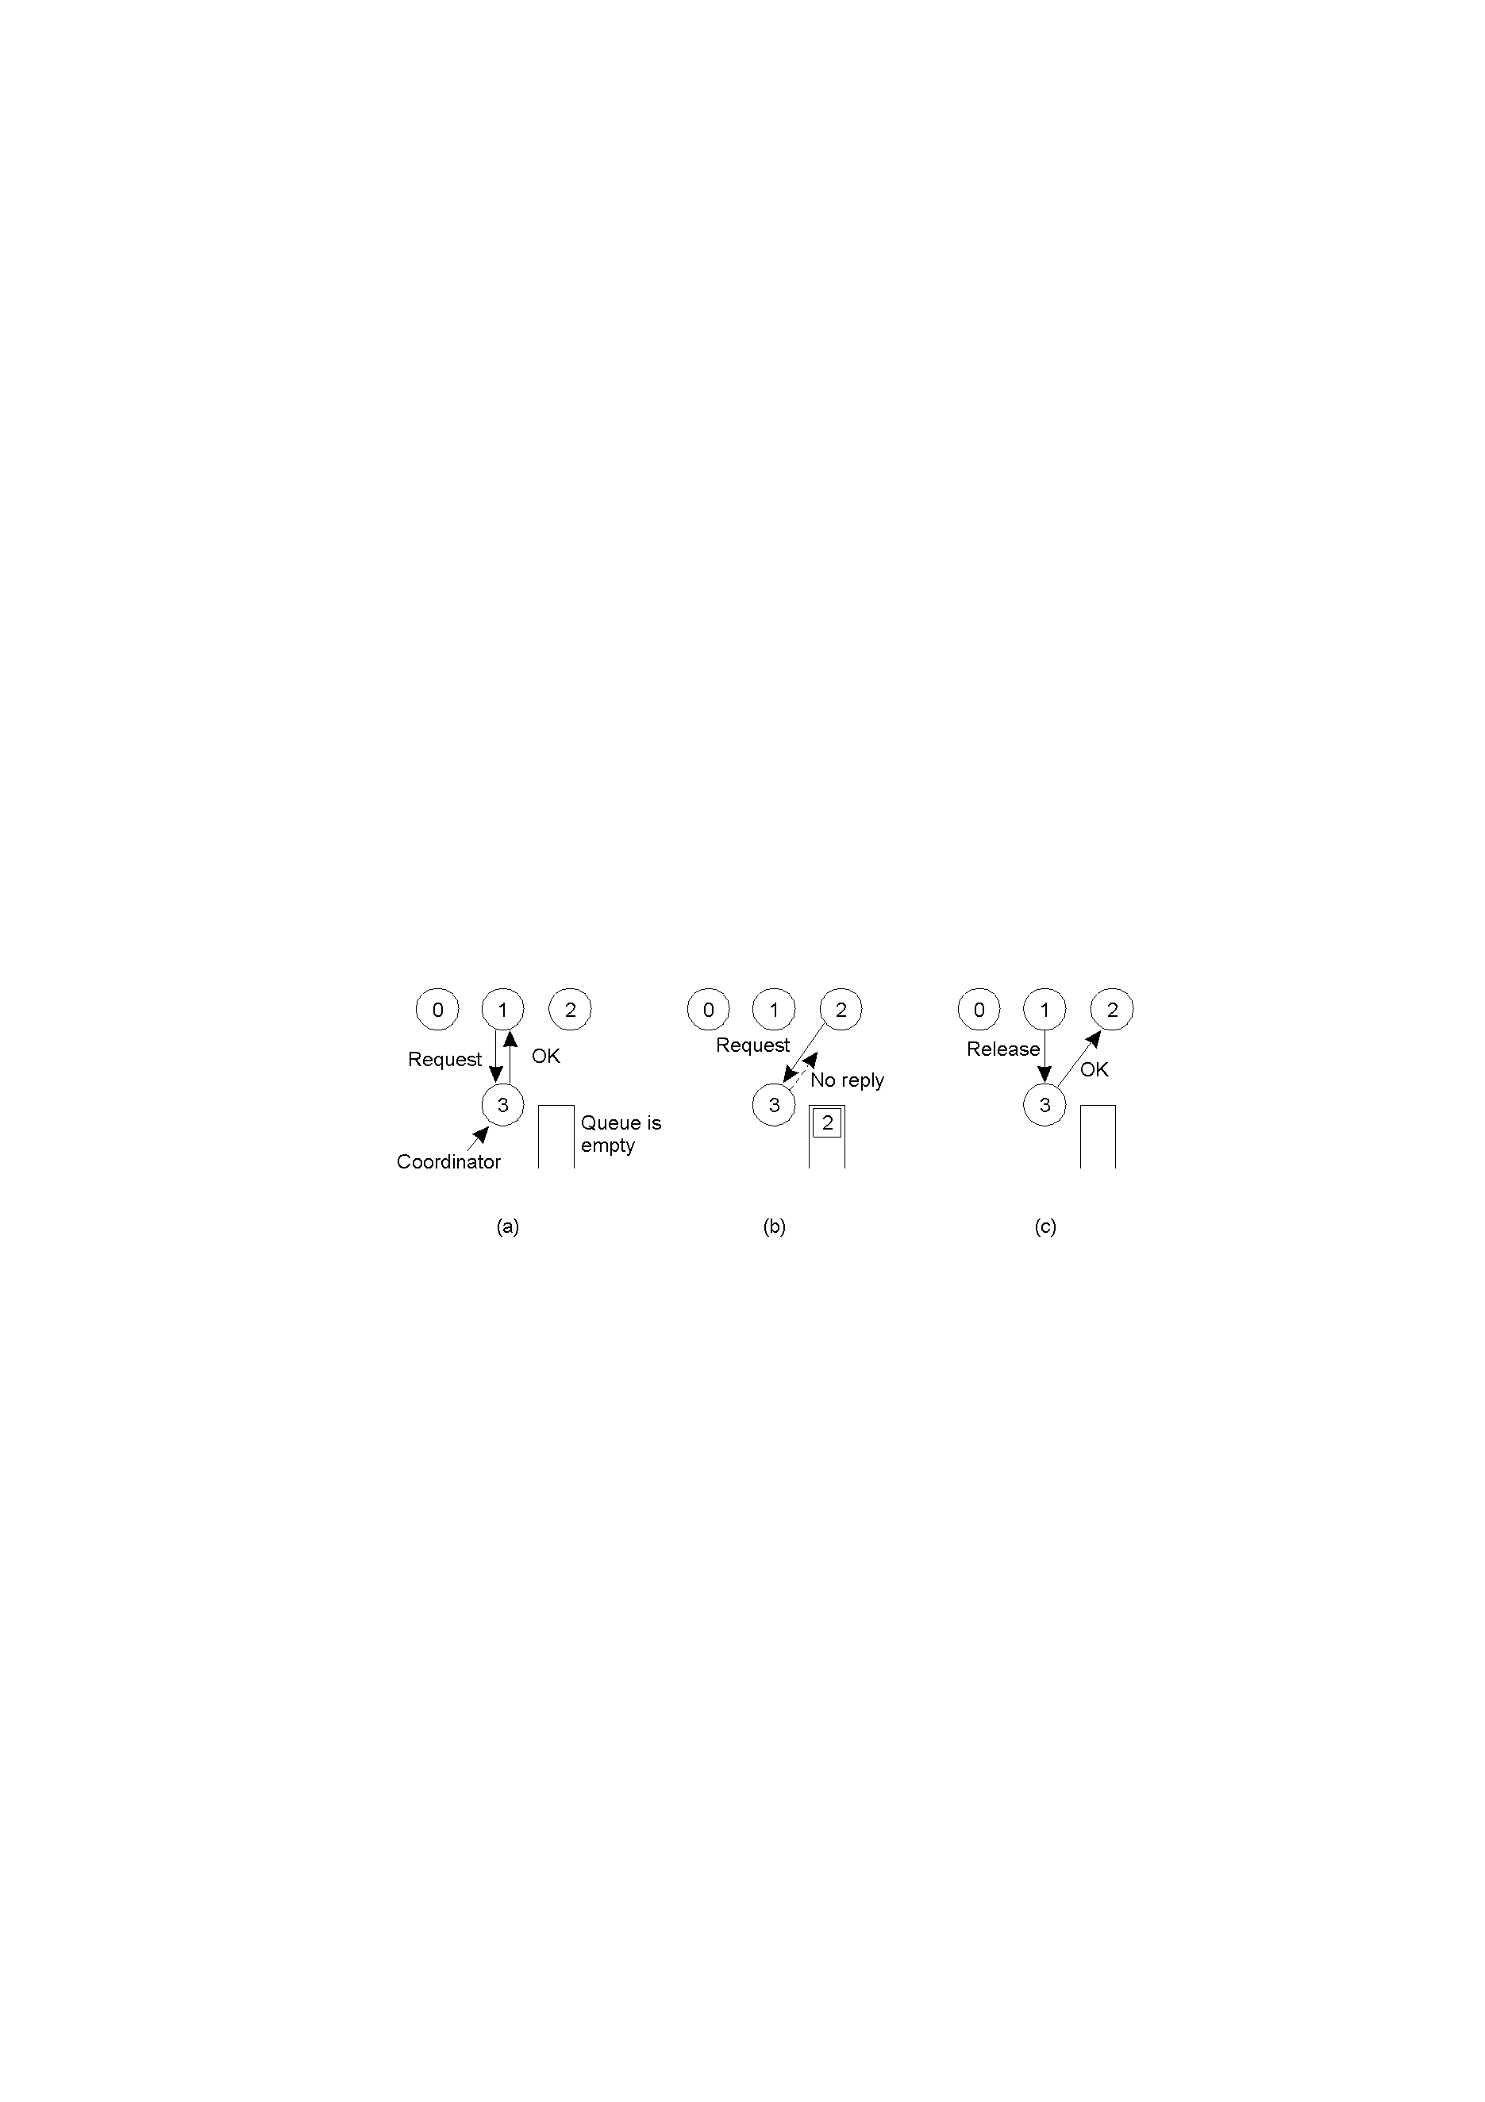
A centralized token-based algorithm
Process 1 asks the coordinator for permission to enter a critical region. Permission is granted
Process 2 then asks permission to enter the same critical region. The coordinator does not reply.
When process 1 exits the critical region, it tells the coordinator, when then replies to 2

Slide 42
A centralized algorithm (2)
Safety: √
No starvation: √ (and therefore no deadlock)
Liveness 3: not satisfied!

Slide 43
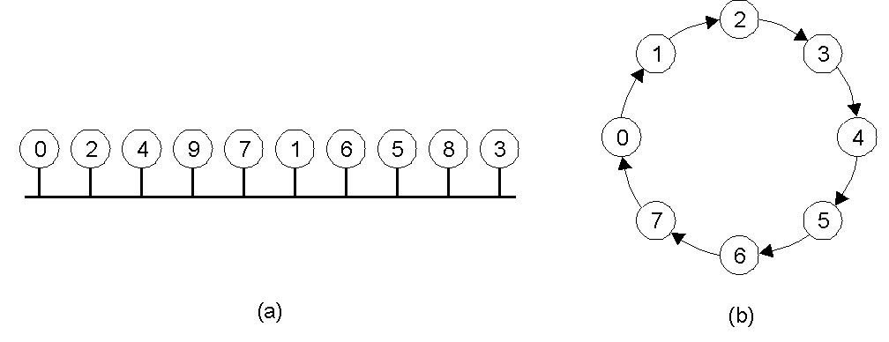
A token-based ring algorithm
An unordered group of processes on a network.
A logical ring constructed in software.

Slide 44
A token ring algorithm (2)
Safety: √
No starvation: √ (and therefore no deadlock)
Liveness 3: not satisfied!

Slide 45
A distributed algorithm
When a process P wants to enter critical region (CR):
P sends a timestamped request message (using Lamport timestamps!) to all processes. P enters CR only when all processes reply OK.
When a process Q receives a request message it does one of the following:
If Q is not in CR and does not want it, Q replies OK. (I)
If Q is already in CR, it queues the request. (II)
If Q wants to enter CR, Q compares its request timestamp with P's request timestamp. If Q's is higher, case I, else II.
When a process exits the CR, it replies OK to all processes on its queue.

Slide 46
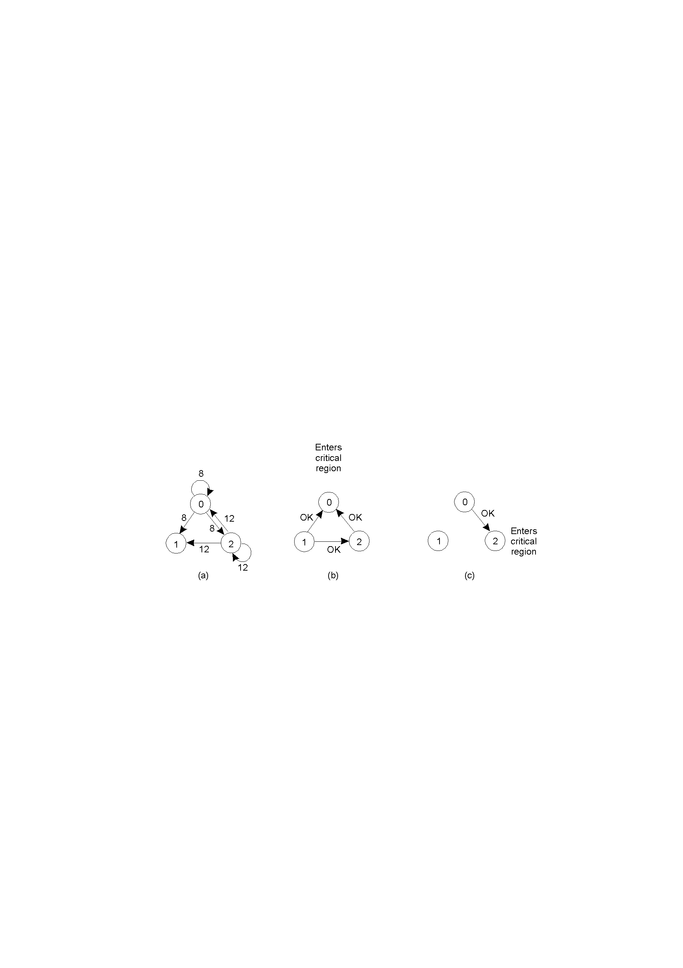
A distributed algorithm (2)
Two processes want to enter the same critical region at the same moment.
Process 0 has the lowest timestamp, so it wins.
When process 0 is done, it sends an OK also, so 2 can now enter the critical region.

Slide 47
A distributed algorithm (3)
Safety: check
No starvation: check (and therefore no deadlock)
Liveness 3: check

Slide 48
Comparison
Algorithm
Messages per entry/exit
Delay before entry (in message times)
Problems
Centralized
3
2
Coordinator crash
Distributed
2 ( n - 1 )
2
Crash of any process
Token ring
1 to ∞
0 to n - 1
Lost token, process crash
A comparison of three mutual exclusion algorithms.

