Slide 1
CSC 536 Lecture 4

Slide 2
Outline
Distributed Transactions
Atomicity
Concurency control
Serializability
2-Phase locking
Timestamp ordering
Replication and Consistency
Defining consistency models
Data centric
Client centric
Implementing replica consistency
Replica management
Consistency Protocols

Slide 3
Distributed Transactions

Slide 4
Distributed transactions
Transactions, like mutual exclusion, protect shared data against simultaneous access by several concurrent processes.
Transactions allow a process to access and modify multiple data items as a single atomic transaction.
If the process backs out halfway during the transaction, everything is restored to the point just before the transaction started.

Slide 5
Distributed transactions: example 1
A customer dials into her bank web account and does the following:
Withdraws amount x from account 1.
Deposits amount x to account 2.
If telephone connection is broken after the first step but before the second, what happens?
Either both or neither should be completed.
Requires special primitives provided by the DS.

Slide 6
The Transaction Model
Primitive
Description
BEGIN_TRANSACTION
Make the start of a transaction
END_TRANSACTION
Terminate the transaction and try to commit
ABORT_TRANSACTION
Kill the transaction and restore the old values
READ
Read data from a file, a table, or otherwise
WRITE
Write data to a file, a table, or otherwise
Examples of primitives for transactions

Slide 7
Distributed transactions: example 2
BEGIN_TRANSACTION reserve WP -> JFK; reserve JFK -> Nairobi; reserve Nairobi -> Malindi; END_TRANSACTION
(a)
BEGIN_TRANSACTION reserve WP -> JFK; reserve JFK -> Nairobi; reserve Nairobi -> Malindi full => ABORT_TRANSACTION
(b)
Transaction to reserve three flights commits
Transaction aborts when third flight is unavailable

Slide 8
ACID
Transactions are
Atomic: to the outside world, the transaction happens indivisibly.
Consistent: the transaction does not violate system invariants.
Isolated (or serializable): concurrent transactions do not interfere with each other.
Durable: once a transaction commits, the changes are permanent.

Slide 9
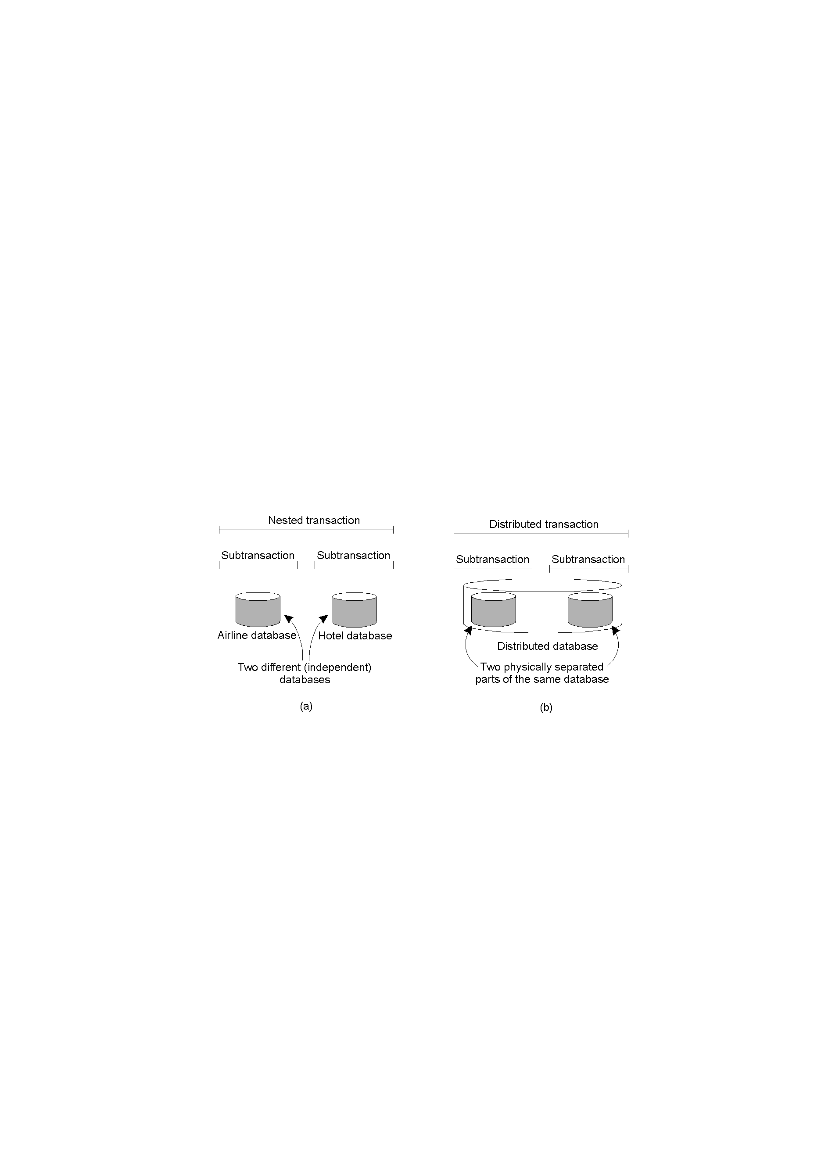
Nested and distributed transactions
A nested transaction
A distributed transaction

Slide 10
Implementation of distributed transactions
For simplicity, we consider transactions on a file system.
Note that if each process executing a transaction just updates the file in place, transactions will not be atomic, and changes will not vanish if the transaction aborts.
Other methods required.

Slide 11
Atomicity
If each process executing a transaction just updates the file in place, transactions will not be atomic, and changes will vanish if the transaction aborts.

Slide 12
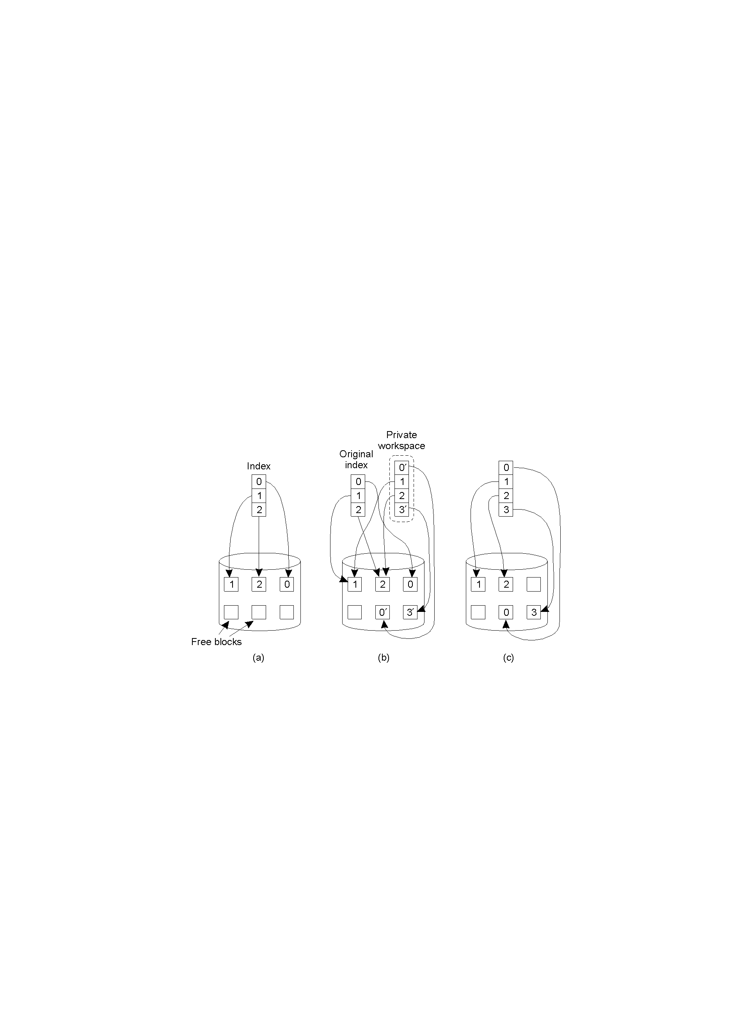
Solution 1: Private Workspace
The file index and disk blocks for a three-block file
The situation after a transaction has modified block 0 and appended block 3
After committing

Slide 13
Solution 2: Writeahead Log
x = 0;
y = 0;
BEGIN_TRANSACTION;
x = x + 1;
y = y + 2
x = y * y;
END_TRANSACTION;
(a)
Log
[x = 0 / 1]
(b)
Log
[x = 0 / 1]
[y = 0/2]
(c)
Log
[x = 0 / 1]
[y = 0/2]
[x = 0/4]
(d)
(a) A transaction
(b) – (d) The log before each statement is executed

Slide 14
Concurrency control (1)
We just learned how to achieve atomicity; we will learn about durability when discussing fault tolerance
Need to handle consistency and isolation
Concurrency control allows several transactions to be executed simultaneously, while making sure that the data is left in a consistent state
This is done by scheduling operations on data in an order whereby the final result is the same as if all transactions had run sequentially

Slide 15
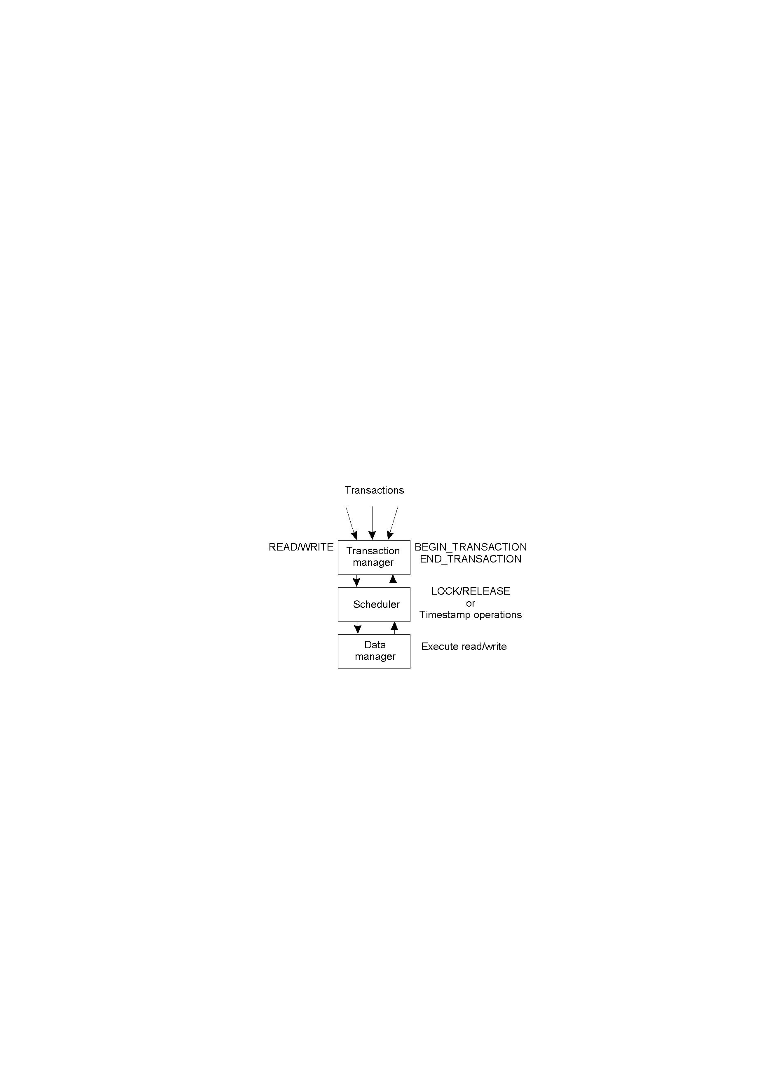
Concurrency control (2)
General organization of managers for handling transactions

Slide 16
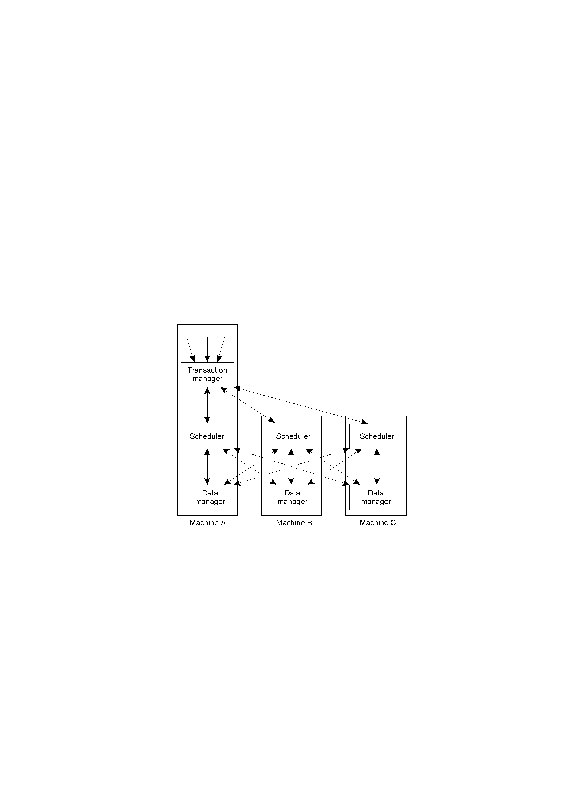
Concurrency control (3)
General organization of managers for handling distributed transactions.

Slide 17
Serializability
The main issue in concurrency control is the scheduling of conflicting operations (operating on same data item and one of which is a write operation)
Read/Write operations can be synchronized using:
Mutual exclusion mechanisms, or
Scheduling using timestamps
Pessimistic/optimistic concurrency control

Slide 18
The lost update problem
Accounts a, b, and c start with $100, $200, and $300, respectively
Transaction
T
:
Transaction
U
:
balance = b.getBalance();
balance = b.getBalance();
b.setBalance(balance*1.1);
b.setBalance(balance*1.1);
a.withdraw(balance/10)
c.withdraw(balance/10)
balance = b.getBalance();
$200
balance = b.getBalance();
$200
b.setBalance(balance*1.1);
$220
b.setBalance(balance*1.1);
$220
a.withdraw(balance/10)
$80
c.withdraw(balance/10)
$280

Slide 19
The inconsistent retrievals problem
Accounts a and b start with $200 each.
Transaction
:
V
:
Transaction
W
a.withdraw(100)
aBranch.branchTotal()
b.deposit(100)
a.withdraw(100);
$100
total = a.getBalance()
$100
total = total+b.getBalance()
$300
total = total+c.getBalance()
b.deposit(100)
$300

Slide 20
A serialized interleaving of T and U
Transaction
T
:
Transaction
U
:
balance = b.getBalance()
balance = b.getBalance()
b.setBalance(balance*1.1)
b.setBalance(balance*1.1)
a.withdraw(balance/10)
c.withdraw(balance/10)
balance = b.getBalance()
$200
b.setBalance(balance*1.1)
$220
balance = b.getBalance()
$220
b.setBalance(balance*1.1)
$242
a.withdraw(balance/10)
$80
c.withdraw(balance/10)
$278

Slide 21
A serialized interleaving of V and W
Transaction
V
:
Transaction
W
:
a.withdraw(100);
aBranch.branchTotal()
b.deposit(100)
a.withdraw(100);
$100
b.deposit(100)
$300
total = a.getBalance()
$100
total = total+b.getBalance()
$400
total = total+c.getBalance()
...

Slide 22
Read and write operation conflict rules
Operations of different
Conflict
Reason
transactions
read
read
No
Because the effect of a pair of
read
operations
does not depend on the order in which they are
executed
read
write
Yes
Because the effect of a
read
and a
write
operation
depends on the order of their execution
write
write
Yes
Because the effect of a pair of
write
operations
depends on the order of their execution

Slide 23
Serializability
Two transactions are serialized
if and only if
All pairs of conflicting operations of the two transactions are executed in the same order at all objects they both access.

Slide 24
A non-serialized interleaving of operations of transactions T and U
Transaction
T
:
Transaction
U
:
x = read(i)
write(i, 10)
y = read(j)
write(j, 30)
write(j, 20)
z = read (i)

Slide 25
Recoverability of aborts
Aborted transactions must be prevented from affecting other concurrent transactions
Dirty reads
Cascading aborts

Slide 26
A dirty read when transaction T aborts
Transaction
T
:
Transaction
U
:
a.getBalance()
a.getBalance()
a.setBalance(balance + 10)
a.setBalance(balance + 20)
balance = a.getBalance()
$100
a.setBalance(balance + 10)
$110
balance = a.getBalance()
$110
a.setBalance(balance + 20)
$130
commit transaction
abort transaction

Slide 27
Cascading aborts
Suppose:
Transaction U has seen the effects of transaction T
Transaction V has seen the effects of transaction U
T decides to abort

Slide 28
Cascading aborts
Suppose:
Transaction U has seen the effects of transaction T
Transaction V has seen the effects of transaction U
T decides to abort
V and U must abort

Slide 29
Transactions T and U with locks
Transaction
T
:
Transaction
U
:
balance = b.getBalance()
balance = b.getBalance()
b.setBalance(bal*1.1)
b.setBalance(bal*1.1)
a.withdraw(bal/10)
c.withdraw(bal/10)
Operations
Locks
Operations
Locks
openTransaction
bal = b.getBalance()
lock
B
b.setBalance(bal*1.1)
openTransaction
a.withdraw(bal/10)
lock
A
bal = b.getBalance()
waits for
T
’s
lock on
B
closeTransaction
unlock
A
,
B
lock
B
b.setBalance(bal*1.1)
c.withdraw(bal/10)
lock
C
closeTransaction
unlock
B
,
C

Slide 30
Two-phase locking (2)
Idea: the scheduler grants locks in a way that creates only serializable schedules.
In 2-phase-locking, the transaction acquires all the locks it needs in the first phase, and then releases them in the second. This will insure a serializable schedule.
Dirty reads and cascading aborts are still possible

Slide 31
Two-phase locking (2)
Idea: the scheduler grants locks in a way that creates only serializable schedules.
In 2-phase-locking, the transaction acquires all the locks it needs in the first phase, and then releases them in the second. This will insure a serializable schedule.
Dirty reads and cascading aborts are still possible
Under strict 2-phase locking, a transaction that needs to read or write an object must be delayed until other transactions that wrote the same object have committed or aborted
Locks are held until transaction commits or aborts
Example: CORBA Concurrency Control Service

Slide 32
Two-phase locking in a distributed system
The data is assumed to be distributed across multiple machines
Centralized 2PL: central scheduler grants locks
Primary 2PL: local scheduler is coordinator for local data
Distributed 2PL: (data may be replicated)
the local schedulers use a distributed mutual exclusion algorithm to obtain a lock
The local scheduler forwards Read/Write operations to data managers holding the replicas

Slide 33
Two-phase locking issues
Exclusive locks reduce concurrency more than necessary. It is sometimes preferable to allow concurrent transactions to read an object; two types of locks may be needed (read locks and write locks)
Deadlocks are possible.
Solution 1: acquire all locks in the same order.
Solution 2: use a graph to detect potential deadlocks.

Slide 34
Deadlock with write locks
Transaction
T
Transaction
U
Operations
Locks
Operations
Locks
a.deposit(100);
write lock
A
b.deposit(200)
write lock
B
b.withdraw(100)
waits for
U
’s
a.withdraw(200);
waits for
T
’s
lock on
B
lock on
A

Slide 35
The wait-for graph
Held by
Waits for
A
T
U
T
U
Waits for
B
Held by

Slide 36
A cycle in a wait-for graph
U
T
V

Slide 37
Deadlock prevention with timeouts
Transaction T
Transaction U
Operations
Locks
Operations
Locks
a.deposit(100);
write lock
A
b.deposit(200)
write lock
B
b.withdraw(100)
waits for
U
’s
a.withdraw(200);
waits for T’s
lock on
B
lock on
A
(timeout elapses)
T’s lock on
A
becomes vulnerable,
unlock
A
, abort T
a.withdraw(200);
write locks
A
unlock
A
,
B

Slide 38
Disadvantages of locking
High overhead
Deadlocks
Locks cannot be released until the end of the transaction, which reduces concurrency
In most applications, the likelihood of two clients accessing the same object is low

Slide 39
Pessimistic timestamp concurrency control
A transaction’s request to write an object is valid only if that object was last read and written by an earlier transaction
A transaction’s request to read an object is valid only if that object was last written by an earlier transaction
Advantage: Non-blocking and deadlock-free
Disadvantage: Transactions may need to abort and restart

Slide 40
Operation conflicts for timestamp ordering
Rule
T_{c}
T_{i}
1.
write
read
T_{c}
must not
write
an object that has been
read
by any
T_{i}
where
T_{i}
>
T_{c}
this requires that
T_{c}
≥ the maximum read timestamp of the object.
2.
write
write
T_{c}
must not
write
an object that has been
written
by any
T_{i}
where
T_{i}
>
T_{c}
this requires that
T_{c}
> write timestamp of the committed
object.
3.
read
write
T_{c}
must not
read
an object that has been
written
by any
T_{i}
where
T_{i}
>
T_{c}
this requires that
T_{c}
> write timestamp of the committed object.

Slide 41
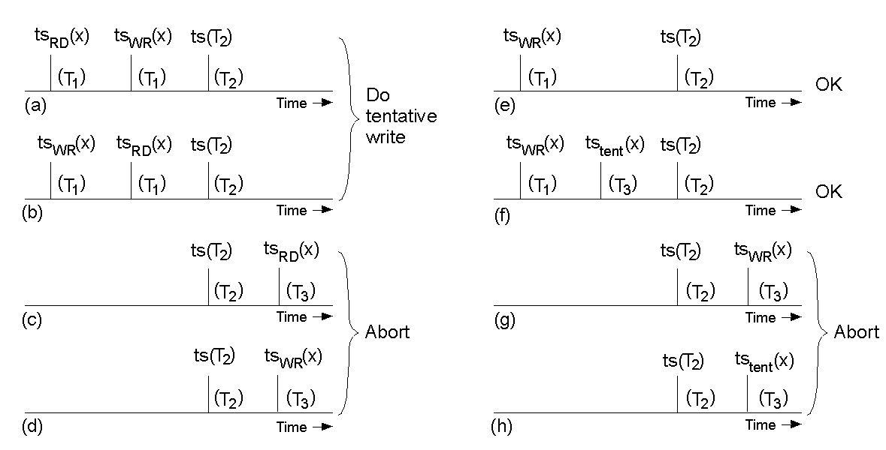
Pessimistic Timestamp Ordering
Concurrency control using timestamps.

Slide 42
Optimistic timestamp ordering
Idea: just go ahead and do the operations without paying attention to what concurrent transactions are doing:
Keep track of when each data item has been read and written.
Before committing, check whether any item has been changed since the transaction started. If so, abort. If not, commit.
Advantage: deadlock free and fast.
Disadvatange: it can fail and transactions must be run again.
Example: Scala Software Transactional Memory (next week)

Slide 43
Replication and consistency (Chapter 7)

Slide 44
Replication and consistency
Defining consistency models
Data centric
Client centric

Slide 45
Replication and consistency
Replication
Reliability
Performance
Multiple replicas leads to consistency problems.
Keeping the copies the same can be expensive.

Slide 46
Replication and scaling
We focus for now on replication as a scaling technique
Placing copies close to processes using them reduces the load on the network
But, replication can be expensive
Keeping copies up to date puts more load on the network
Example: distributed totally-ordered multicasting
Example: central coordinator
The only real solution is to loosen the consistency requirements
The price is that replicas may not be the same
We will develop several consistency models
Data-centric
Client-centric

Slide 47
Data-centric consistency models

Slide 48
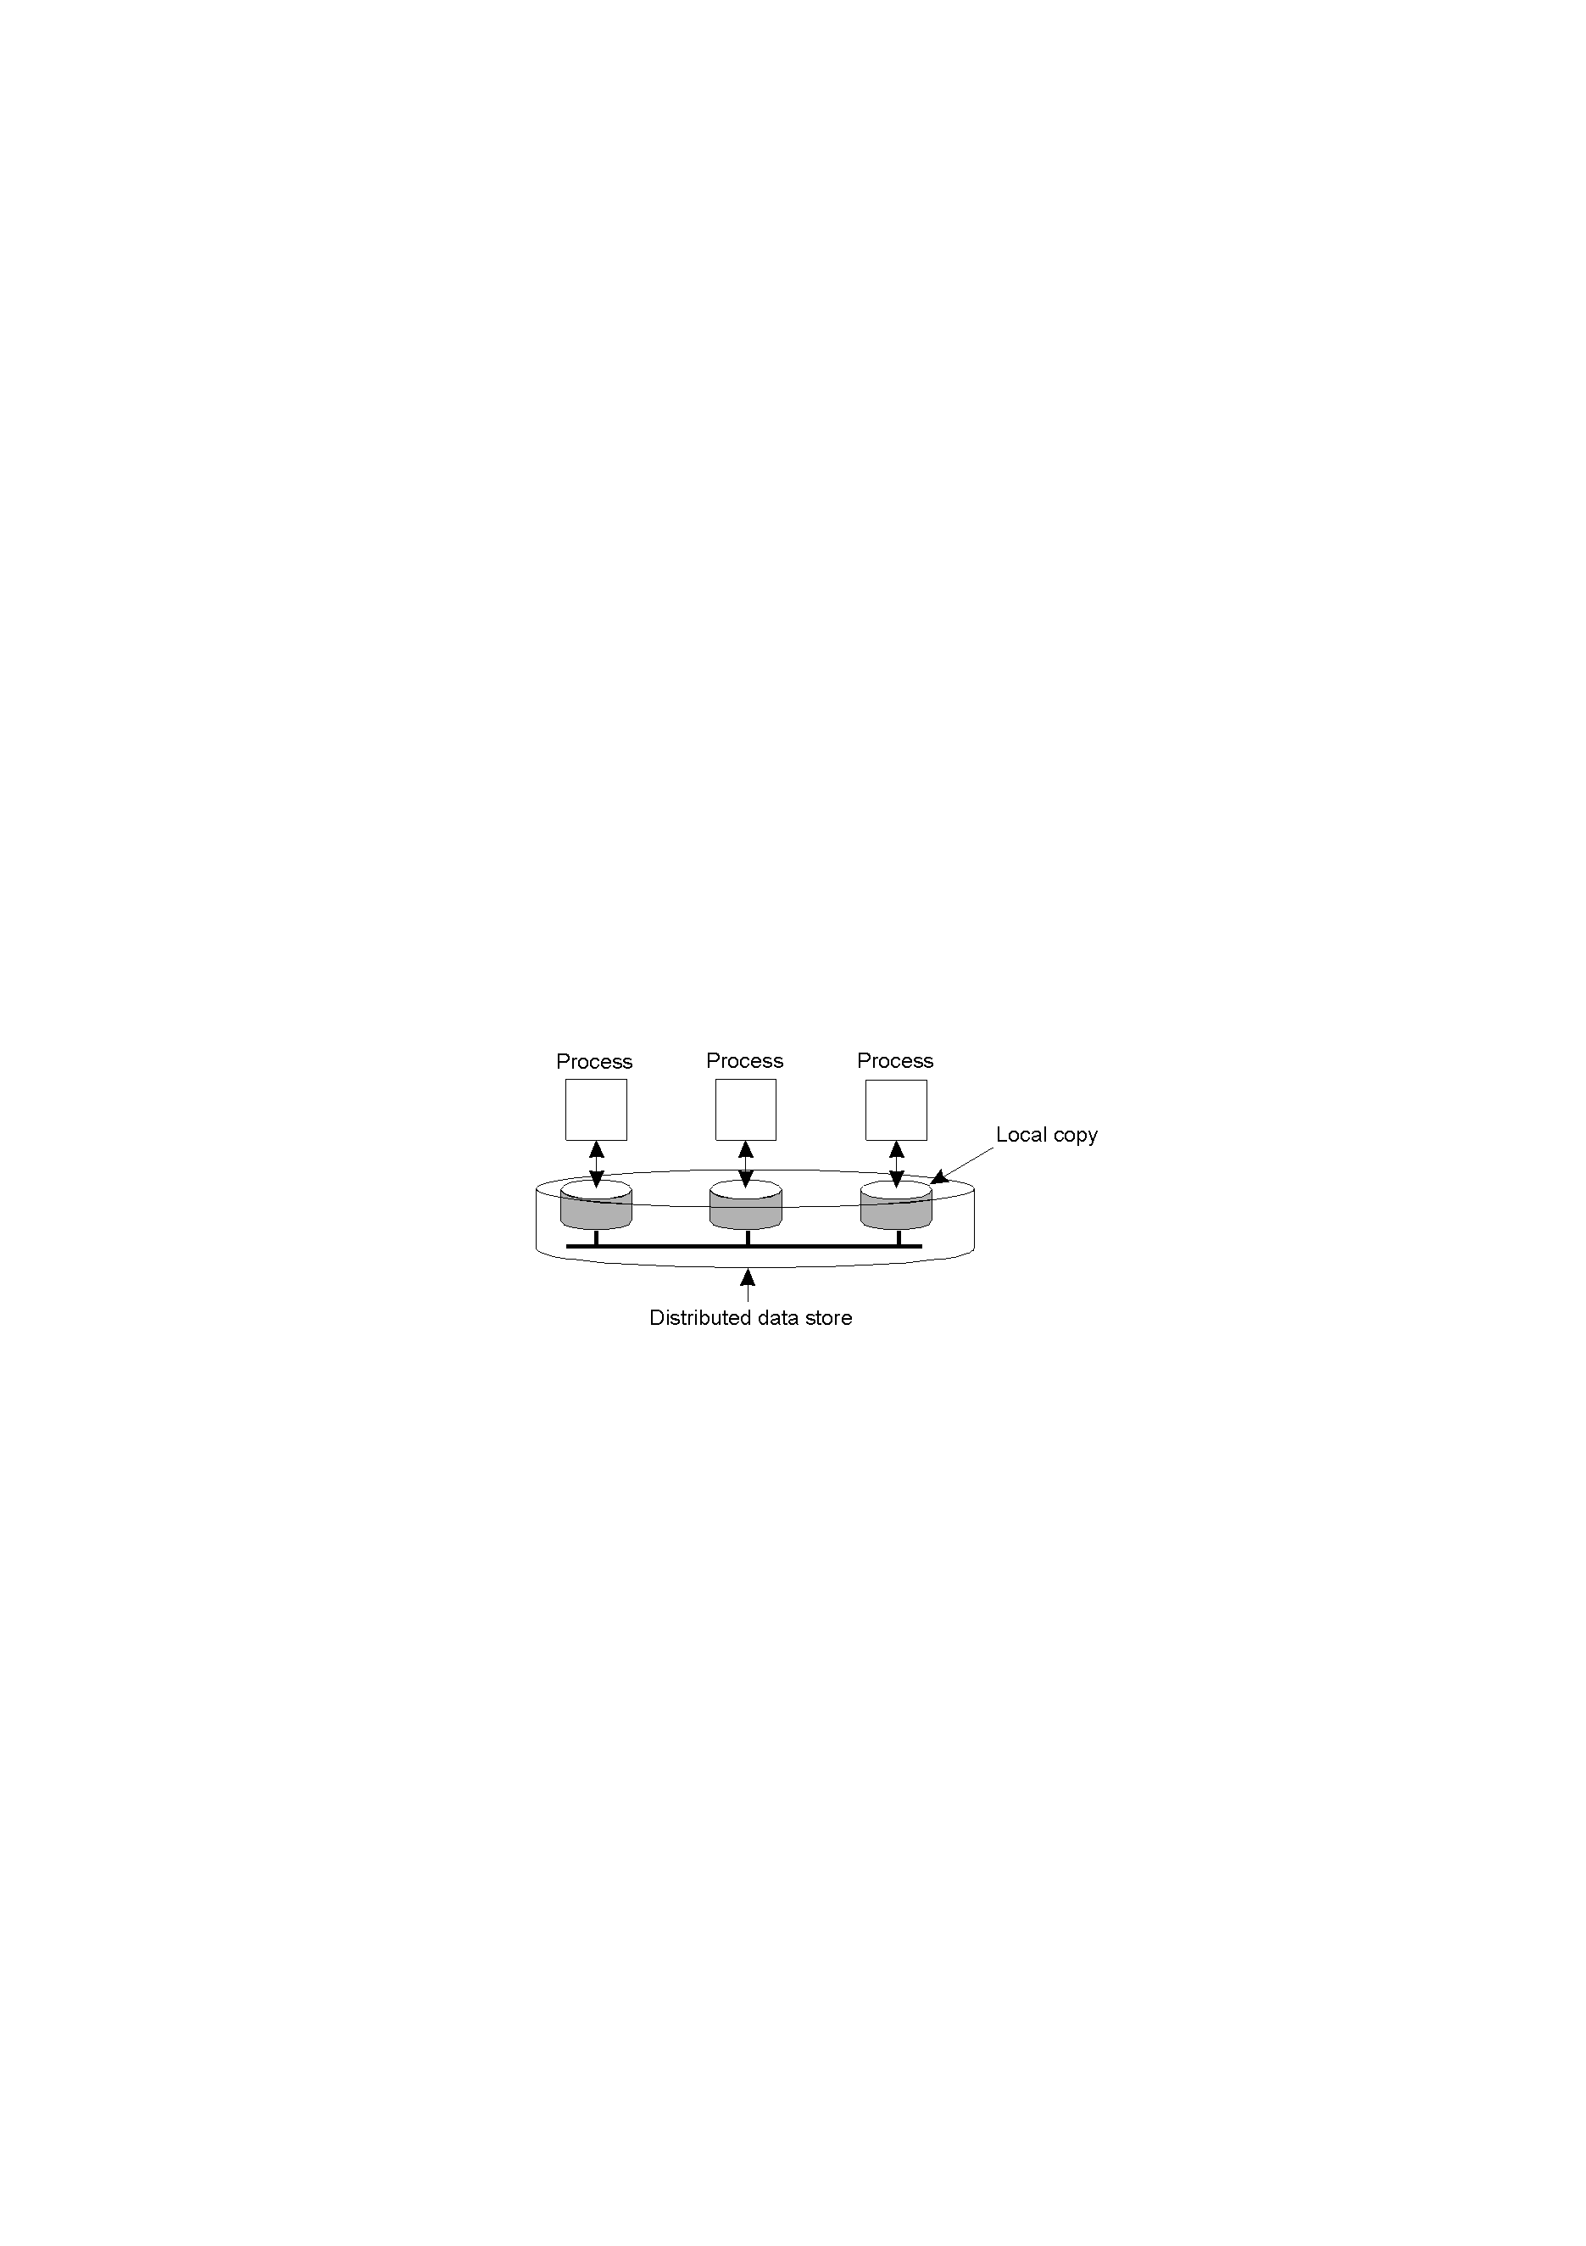
Data-Centric Consistency Models
The general organization of a logical data store, physically distributed and replicated across multiple processes.

Slide 49
Consistency models
A consistency model is a contract between processes and the data store.
If processes obey certain rules, i.e. behave according to the contract, then ...
The data store will work “correctly”, i.e. according to the contract.

Slide 50
Strict consistency
Any read on a data item x returns a value corresponding to the most recent write on x
Definition implicitly assumes existence of absolute global time
Definition makes sense in uniprocessor systems:
a=1;a=2;print(a);
Definition makes little sense in distributed system
Machine B writes x
A moment later, machine A reads x
Does A read old or new value?

Slide 51

Strict Consistency
Behavior of two processes, operating on the same data item.
A strictly consistent store.
A store that is not strictly consistent.

Slide 52
Weakening of the model
Strict consistency is ideal, but un-achievable
Must use weaker models, and that's OK!
Writing programs that assume/require the strict consistency model is unwise
If order of events is essential, use critical sections or transactions

Slide 53
Sequential consistency
The result of any execution is the same as if
the (read and write) operations by all processes on the data store were executed in some sequential order, and
the operations of each individual process appear in this sequence in the order specified by its program
No reference to time
All processes see the same interleaving of operations.

Slide 54

Sequential Consistency
A sequentially consistent data store.
A data store that is not sequentially consistent.

Slide 55
Sequential Consistency
Process P1
Process P2
Process P3
x = 1;
print ( y, z);
y = 1;
print (x, z);
z = 1;
print (x, y);
Three concurrently executing processes.

Slide 56
Sequential Consistency
x = 1;
print ((y, z);
y = 1;
print (x, z);
z = 1;
print (x, y);
Prints: 001011
(a)
x = 1;
y = 1;
print (x,z);
print(y, z);
z = 1;
print (x, y);
Prints: 101011
(b)
y = 1;
z = 1;
print (x, y);
print (x, z);
x = 1;
print (y, z);
Prints: 010111
(c)
y = 1;
x = 1;
z = 1;
print (x, z);
print (y, z);
print (x, y);
Prints: 111111
(d)
Four valid execution sequences for the processes of the previous slide. The vertical axis is time.

Slide 57
Sequential consistency more precisely
An execution E of processor P is a sequence of R/W operations by P on a data store.
This sequence must agree with the P's program order .
A history H is an ordering of all R/W operations that is consistent with the execution of each processor.
In a sequentially consistent model, the history H must obey the following rules:
Program order (of each process) must be maintained.
Data coherence must be maintained.

Slide 58
Sequential consistency is expensive
Suppose A is any algorithm that implements a sequentially consistent data store
Let r be the time it takes A to read a data item x
Let w be the time it takes A to write to a data item x
Let t be the message time delay between any two nodes
Then r + w > ??

Slide 59
Sequential consistency is expensive
Suppose A is any algorithm that implements a sequentially consistent data store
Let r be the time it takes A to read a data item x
Let w be the time it takes A to write to a data item x
Let t be the message time delay between any two nodes
Then r + w > t
If lots of reads and lots of writes, we need weaker consistency models.

Slide 60
Causal consistency
Sequential consistency may be too strict: it enforces that every pair of events is seen by everyone in the same order, even if the two events are not causally related
Causally related: P1 writes to x; then P2 reads x and writes to y
Not causally related: P1 writes to x and, concurrently, P2 writes to x
Reminder: operations that are not causally related are said to be concurrent.

Slide 61
Causal consistency
Writes that are potentially causally related must be seen by all processes in the same order.
Concurrent writes may be seen in a different order on different machines.

Slide 62

Causal consistency
This sequence is allowed with a causally-consistent store, but not with sequentially or strictly consistent store.

Slide 63
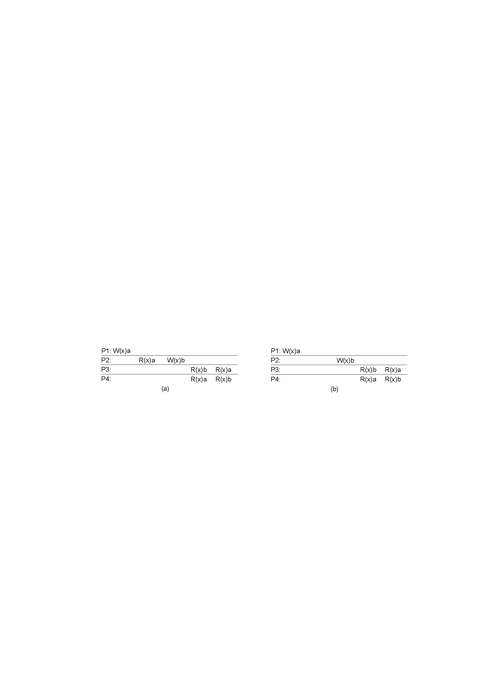
Causal consistency
A violation of a causally-consistent store.
A correct sequence of events in a causally-consistent store.

Slide 64
FIFO consistency
Writes done by a single process are seen by all other processes in the order in which they were issued, but writes from different processes may be seen in a different order by different processes.

Slide 65

FIFO consistency
A valid sequence of events of FIFO consistency

Slide 66
Weak consistency
Sequential and causal consistency defined at the level of read and write operations
The granularity is fine
Concurrency is typically controlled through synchronization mechanisms such as mutual exclusion or transactions
A sequence of reads/writes is done in an atomic block and their order is not important to other processes
The consistency contract should be at the level of atomic blocks
granularity should be coarser
Associate synchronization of data store with a synchronization variable
when the data store is synchronized, all local writes by process P are propagated to all other copies, whereas writes by other processes are brought in to P's copy

Slide 67
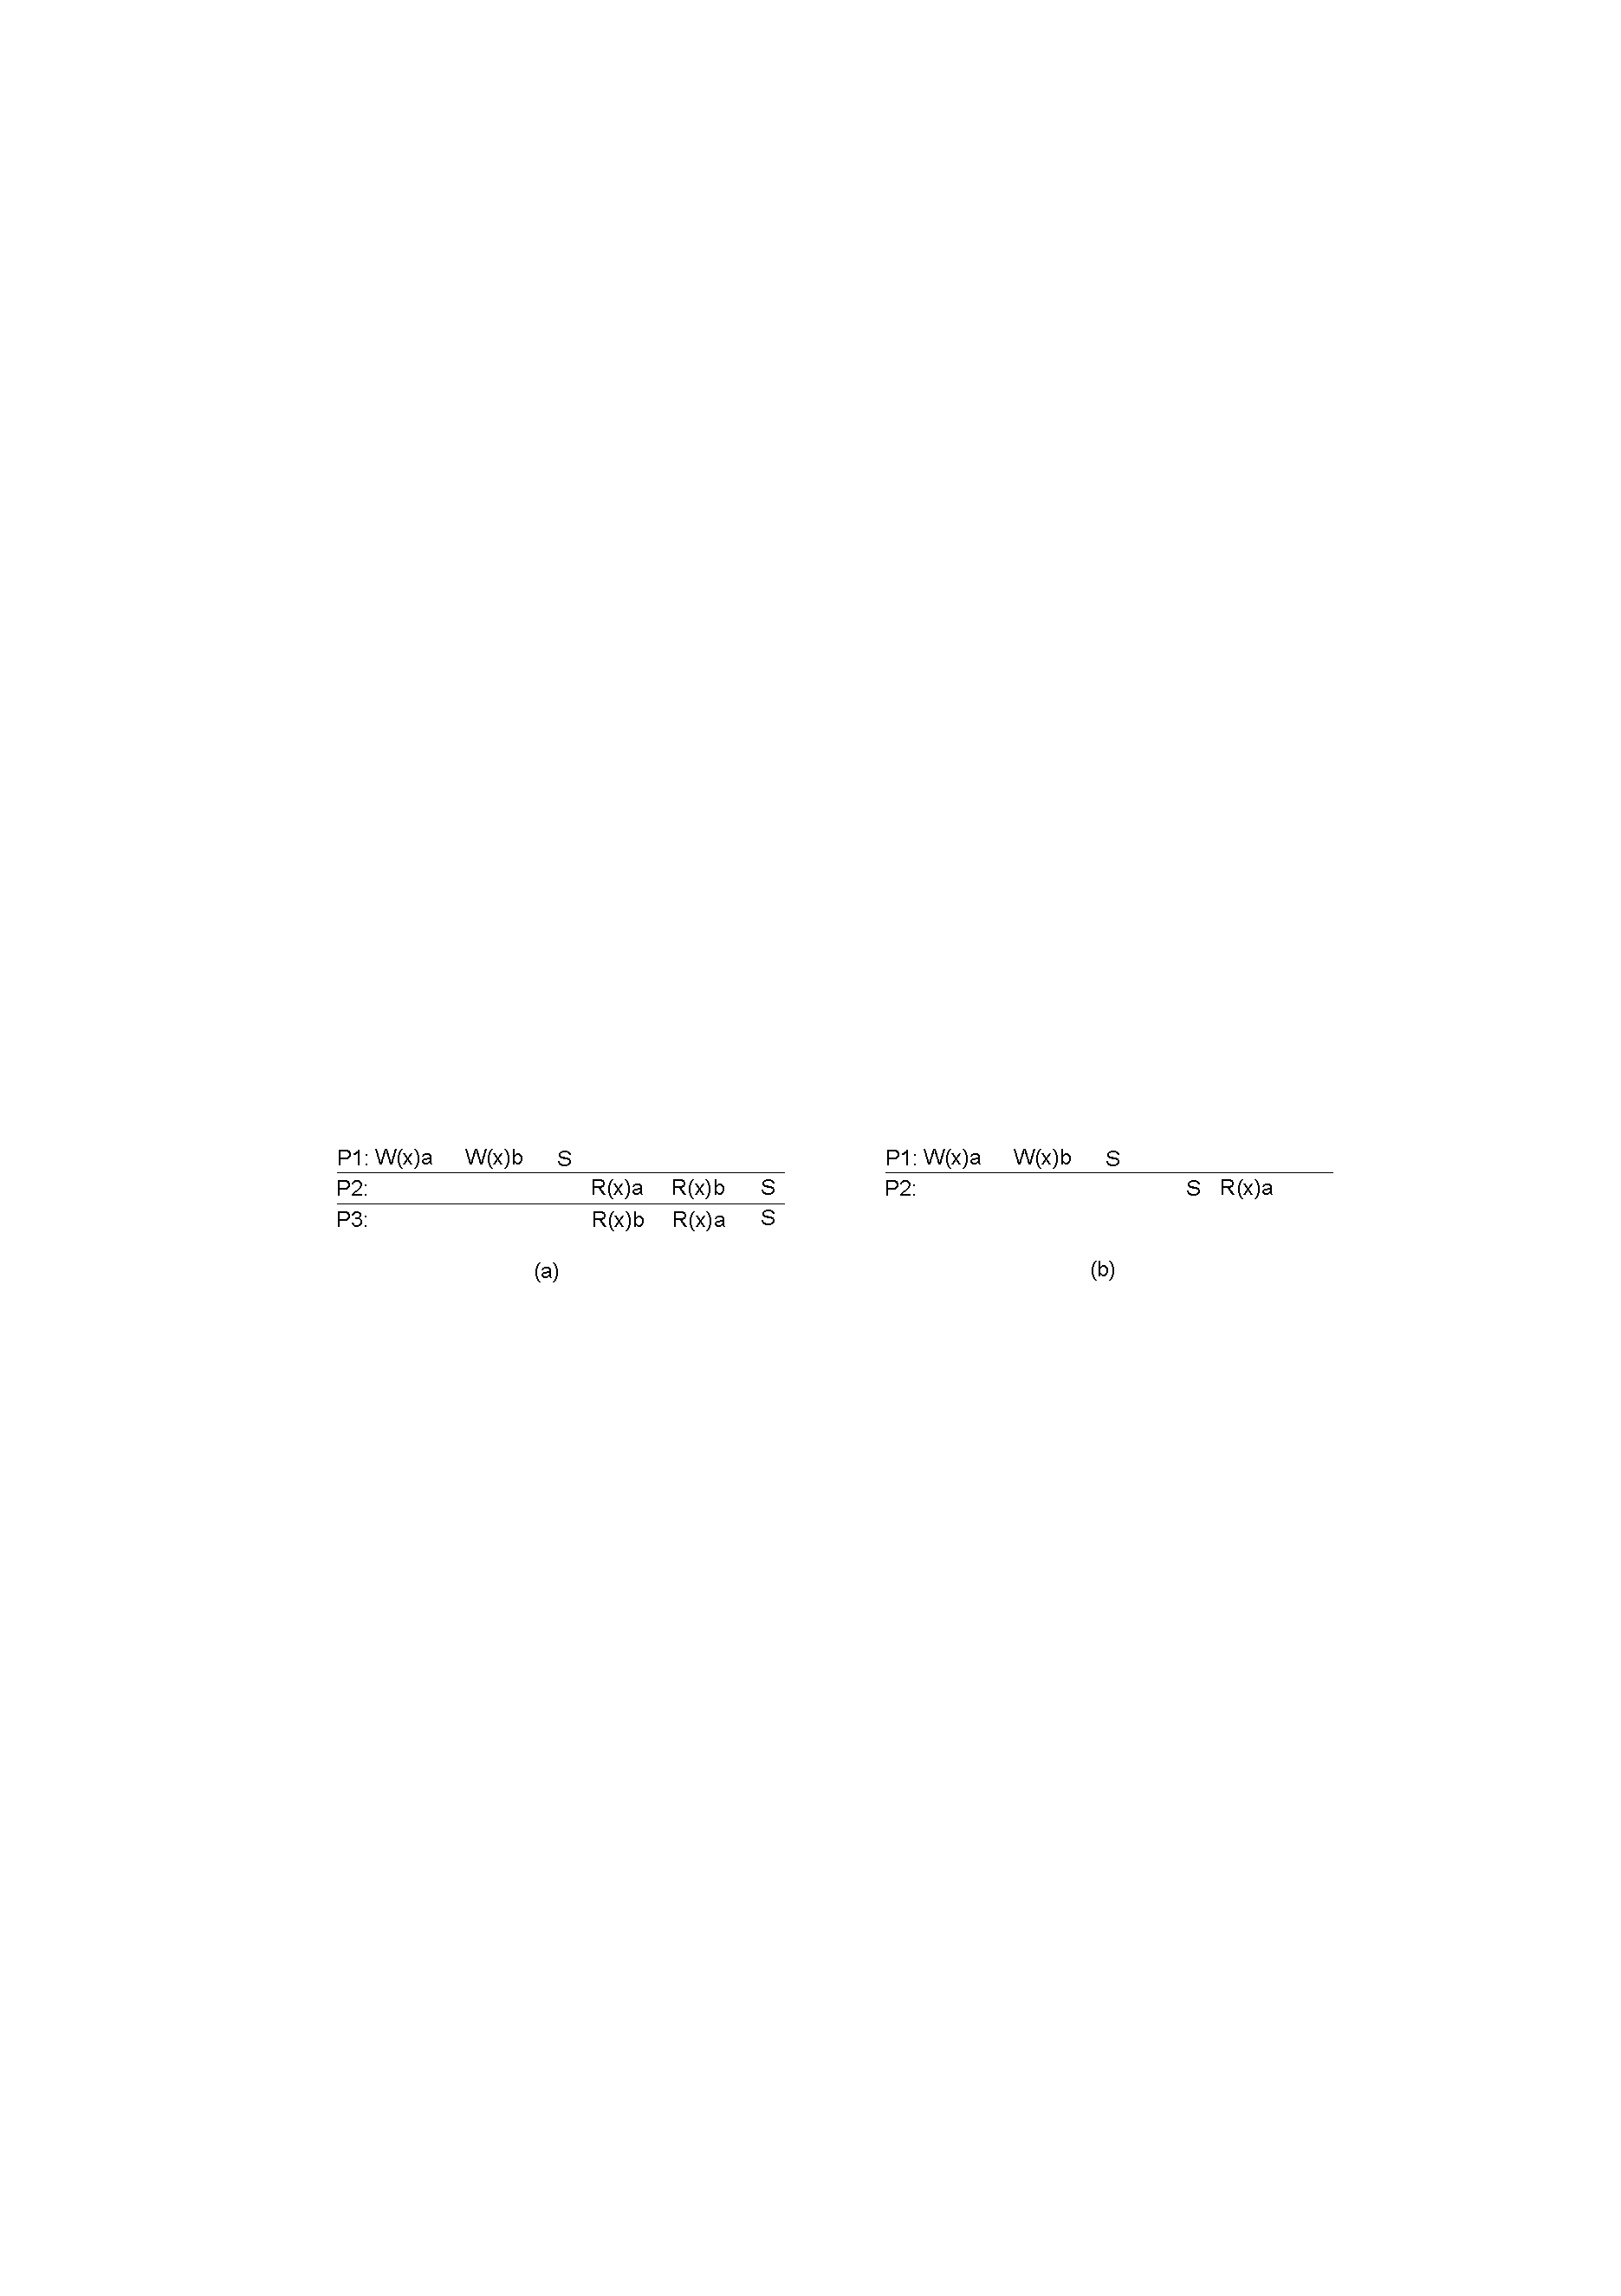
Weak consistency
A valid sequence of events for weak consistency.
An invalid sequence for weak consistency.

Slide 68
Weak consistency
Examples of weak consistency:
Entry consistency
Release consistency

Slide 69
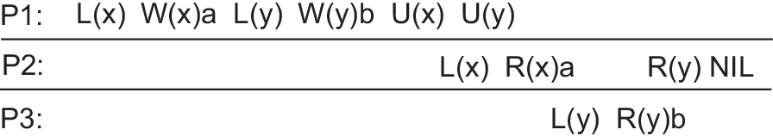
Entry consistency
A lock is associated with each data item
L(x): acquire the lock for x, that is, lock x
U(x): release the lock on x, or unlock it.
When locking or unlocking a variable, a process is explicitly telling the underlying distributed system that the copies of that variable need to be synchronized.
A simple read operation without locking may thus result in reading a local value that is effectively stale.

Slide 70

Release consistency
Divide access to a synchronization variable into two parts
Acquire phase: forces a requester to wait until the lock on a synchronization variable is obtained and the shared data can be accessed
Release phase: sends requestor’s local value to other servers in the data store

Slide 71
Release consistency
When a lock on a shared variable is being released, the updated variable value is sent to shared memory
To view the value of a shared variable as guaranteed by the contract, an acquire (i.e. a lock) is required
Accesses to synchronization variables are FIFO consistent (sequential consistency is not required).

Slide 72
Release consistency example: JVM
The Java Virtual Machine uses the SMP model of parallel computation.
Each thread will create local copies of shared variables
Calling a synchronized method is equivalent to an acquire
exiting a synchronized method is equivalent to a release
A release has the effect of flushing the cache to main memory
writes made by this thread can be visible to other threads
An acquire has the effect of invalidating the local cache so that variables will be reloaded from main memory
Writes made by the previous release are made visible

Slide 73
Client-centric consistency models

Slide 74
Data-centric consistency is too much
Data-centric consistency models aim at providing a system-wide consistent view of a data store.
The goal is to provide consistency in the face of concurrent updates
In some data stores, there may not be concurrent updates, or if there are, they may be easy to handle:
DNS: each domain has unique naming authority
WWW: each web page has an owner
Some database systems often have just a few processes that do updates

Slide 75
Eventual consistency
The previous examples have in common:
They tolerate some inconsistency.
If no updates take place for a long time, then all replicas will eventually be consistent.
Eventual consistency is a consistency models that guarantees the propagation of updates to all replicas
Nothing else
Cheap to implement
Works fine if a client always accesses the same replica
But what if different replicas are accessed?

Slide 76
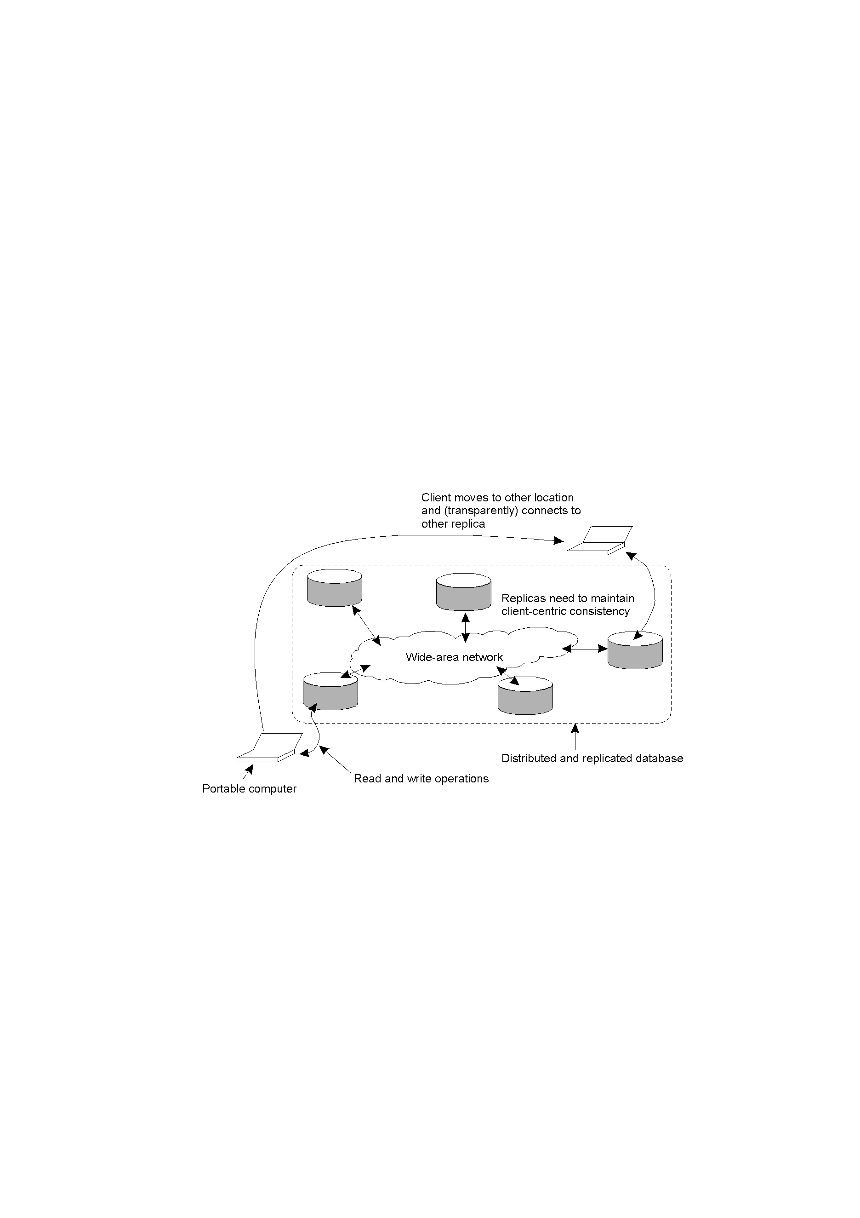
Eventual Consistency
A mobile user accessing different replicas of a distributed database.

Slide 77
Client-centric consistency
It provides consistency guarantees for a single client.
We will define several versions of client-centric consistency
Assumptions:
Data store is distributed across multiple machines.
A process connects to the nearest copy and all R/W operations are performed on that copy.
Updates are eventually propagated to other copies.
Each data item has an owner process, which is the only one that can update that item.

Slide 78
Monotonic-read consistency
If a process reads the value of a data item x, any successive read operations on x by that process will always return that same value or a more recent value.
Example: replicated mail server

Slide 79
Monotonic-write consistency
A write operation by a process on a data item x is completed before any successive write operation on x by the same process.
Example: a software library

Slide 80
Read-your writes consistency
The effect of a write operation by a process on data item x will always be seen by a successive read operation on x by the same process.
Example: updating passwords for a web resource

Slide 81
Write-follow-reads consistency
A write operation by a process on a data item x following a previous read operation by the same process, is guaranteed to take place on the same or a more recent value of x that was read.
Example: newsgroups.

Slide 82
Implementing replica consistency

Slide 83
Distribution protocols
There are different ways of propagating (distributing) updates to replicas
independent of the consistency model that is supported
Before we discuss them, we need to discuss the following:
When, where, and by whom copies of the data store are to be placed?

Slide 84
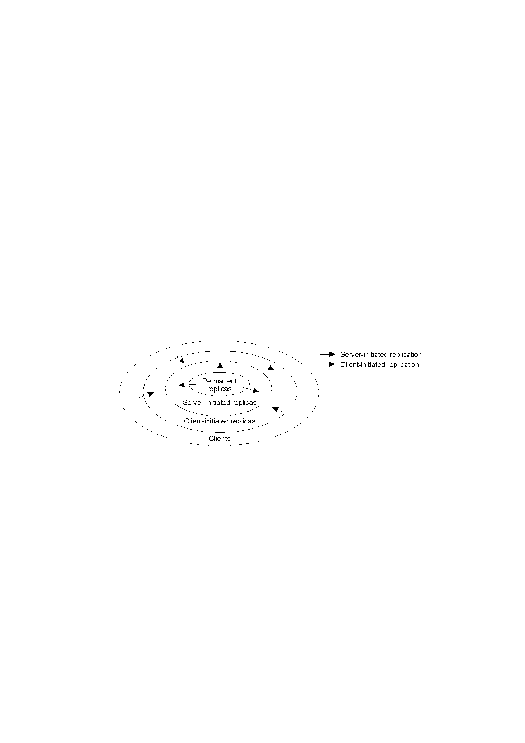
Replica placement
The logical organization of different kinds of copies of a data store into three concentric rings.

Slide 85
Permanent replicas
Initial set of replicas
Example: mirroring web sites to a few servers
Example: web site whose files are replicated across a few servers on a LAN; requests are forwarded to copies in a round-robin fashion

Slide 86
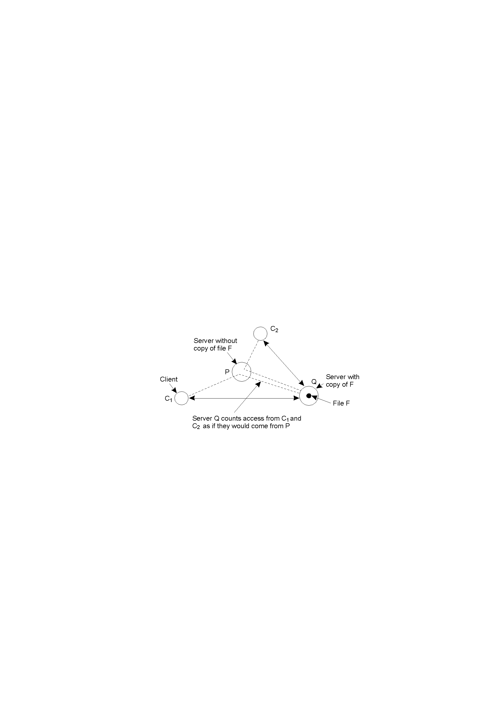
Server-Initiated Replicas
Counting access requests from different clients.

Slide 87
Client-initiated replicas
Caches
Goal is only to improve performance, not enhance reliability

Slide 88
Update propagation
Updates are initiated by a client and subsequently forwarded to one of the copies.
From the copies, updates should be propagated to other copies.
What to propagate?
Propagate only notifications of an update
Transfer updated data from one copy to another
Propagate the update operation to other copies

Slide 89
Push or pull?
In a push-based approach, updates are propagated to replicas without those replicas even asking for the updates
Useful when ???
Used between permanent and server-initiated replicas, and even client caches
In a pull-based approach, a server or client requests another server to send it any updates it has at that moment
Useful when ???
Example: web caches

Slide 90
Push or pull?
In a push-based approach, updates are propagated to replicas without those replicas even asking for the updates
Useful when ratio of reads vs. writes is high
Used between permanent and server-initiated replicas, and even client caches
In a pull-based approach, a server or client requests another server to send it any updates it has at that moment
Useful when ratio of reads vs. writes is low
Example: web caches

Slide 91
Pull versus Push Protocols
Issue | Push-based | Pull-based
State of server | List of client replicas and caches | None
Messages sent | Update | Poll and update
Response time at client | Immediate | Fetch-update time
A comparison between push-based and pull-based protocols in the case of multiple client, single server systems.

Slide 92
Consistency protocols
A consistency protocol describes an implementation of a specific consistency model
Protocols for client-centric consistency models
Protocols for data-centric consistency models
Focus on consistency models in which operations are globally serialized (Sequential consistency, Atomic transactions, Weak consistency with synchronization variables)

Slide 93
Implementing monotonic-read consistency
Each write operation is assigned a unique global ID.
Every client keeps track of a:
Write set of IDs of writes performed by that client.
Read set of IDs of writes the client knows about (i.e. it has read them).
When a client performs a read operation at a server, it hands its read set to the server.
The server checks that all writes in the read set have taken place
If not, server must contact other servers for updates

Slide 94
Implementing other client-centric consistency models
Monotonic-writes
Read-your-writes
Writes-follow-reads

Slide 95
Implementing data-centric consistency models
Consistency protocols can be classified as:
Primary based protocols
Replicated-write protocols

Slide 96
Primary based protocols
Each data item x in the data store has an associated primary, which is responsible for coordinating all updates of x
Two approaches:
primary fixed at a remote server (remote write)
Write operations are carried out locally after moving the primary to the process where the write is initiated (local write)

Slide 97
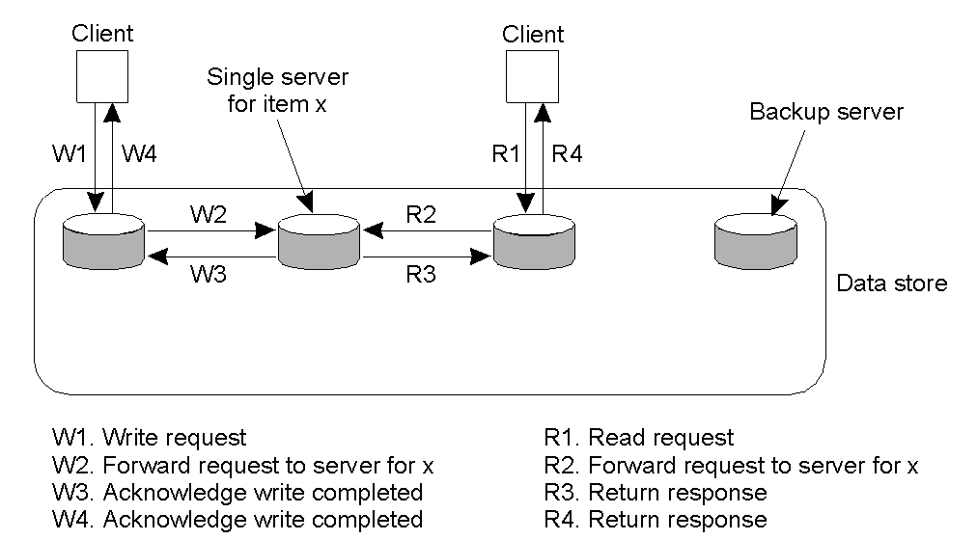
Remote-Write Protocols (1)
Primary-based remote-write protocol with a fixed server to which all read and write operations are forwarded.

Slide 98
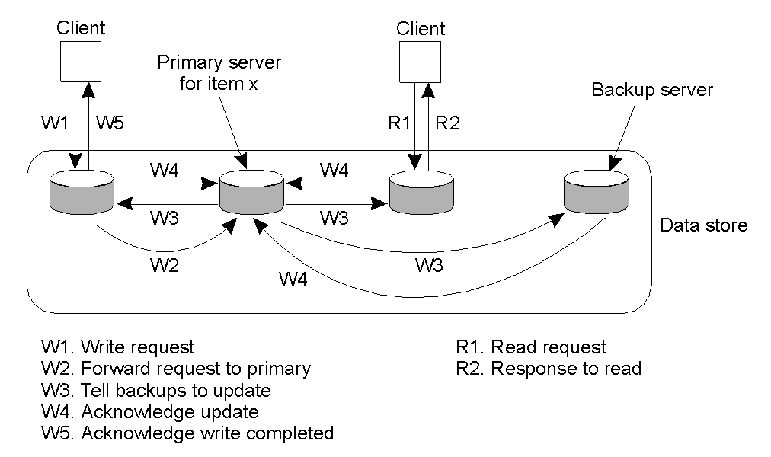
Remote-Write Protocols (2)
The principle of primary-backup protocol.

Slide 99
Issues with remote-write protocols
Original approach
Problem: update blocks process that initiated the update
Advantage: fault tolerant
Alternative approach: use non-blocking approach in which the primary updates x and immediately returns an acknowledgement, before sending the update to other replicas
Advantage: better performance
Problem: not fault tolerant
Either way, remote write protocols can be used to implement sequential consistency

Slide 100
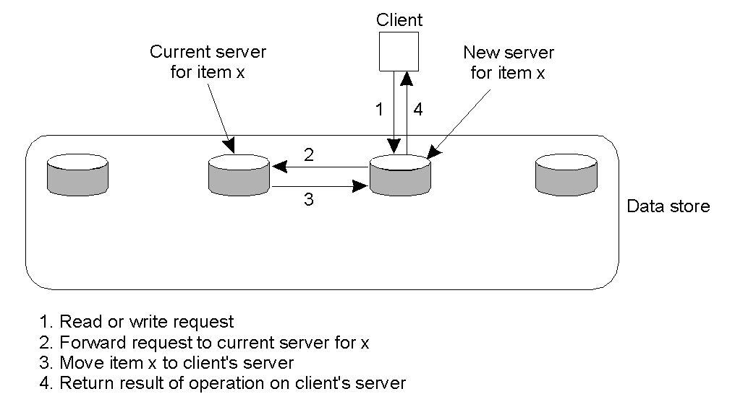
Local-Write Protocols (1)
Primary-based local-write protocol in which a single copy is migrated between processes.

Slide 101
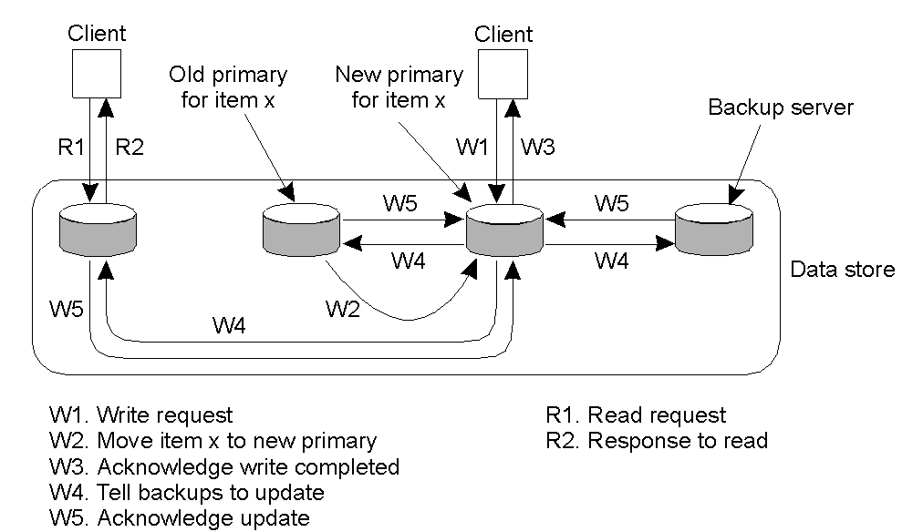
Local-Write Protocols (2)
Primary-backup protocol in which the primary migrates to the process wanting to perform an update.

Slide 102
Issues with local-write protocols
How to keep track of where each data item is located?
LAN: broadcasting
Large-scale, widely distributed systems: harder
Sequential consistency is easy to implement since the primary can coordinate updates of other copies

Slide 103
Replicated-write protocols
A write operation can be carried out at any replica
Two approaches:
Active replication
Majority voting

Slide 104
Active replication
A client sends update request to a replica
Replica should forward the update to other replicas
How to make sure all updates are done in the same order at each replica?
Using Lamport timestamps
Seen that, done that
Using a central coordinator (sequencer)
Just like primary based consistency protocols!

Slide 105
Quorum-based protocols
Idea: require clients to request and acquire the permission of multiple servers before either reading or writing a replicated data item.

Slide 106
Example
Distributed file system with N replicated servers
To update a file, a client must send a request and wait for at least N_{w} servers to agree. Once N_{w} servers agree, the file is updated and receives a new version number
To read a file, a client must send a request and wait for at least N_{r} replies. It picks the file whose version is most recent
How do we make sure no read/write conflict occurs? (i.e. we read the most recent file)
How do we make sure no write/write conflict occurs? (i.e. two writes get same version number)

Slide 107
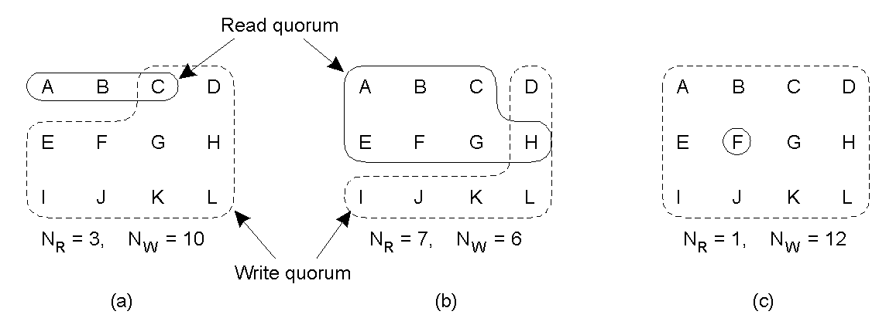
Quorum-Based Protocols
Three examples of the voting algorithm:
A correct choice of read and write set
A choice that may lead to write-write conflicts
A correct choice, known as ROWA (read one, write all)

Slide 108
Solution
Distributed file system with N replicated servers
How do we make sure no read/write conflict occurs? (i.e. we read the most recent file)
We need ???
How do we make sure no write/write conflict occurs? (i.e. two writes get same version number)
We need ???

Slide 109
Solution
Distributed file system with N replicated servers
How do we make sure no read/write conflict occurs? (i.e. we read the most recent file)
We need N_{w} + N_{r} > N
How do we make sure no write/write conflict occurs? (i.e. two writes get same version number)
We need N_{w} > N/₂

