Slide 1

Akamai Content Delivery Network
Slides from Bruce Maggs

Slide 2
HTML Title Page for www.xyz.com with Embedded Objects
<html>
<head>
<title>Welcome to xyz.com!</title>
</head>
<body>
<img src=“
<img src=“
<h1>Welcome to our Web site!</h1>
<a href=“page2.html”>Click here to enter</a>
</body>
</html>
http://www.xyz.com/logos/logo.gif”>
http://www.xyz.com/jpgs/navbar1.jpg”>

Slide 3



Downloading www.xyz.com
- before Akamai
DNS
Content Provider’s Web Server
1
WWW.XYZ.COM
2
5
10.10.123.8
3
4
6
7
10.10.123.8
User enters www.xyz.com
Browser obtains IP addresses for hostnames listed in URLs of objects embedded on page
Browser requests IP
address for www.xyz.com
DNS returns IP address
Browser requests
embedded objects
Browser requests HTML
Content provider’s web server returns embedded objects
Content provider’s web server returns HTML
Notes:
We’ll talk about how DNS cloud works in a bit—like 411 service.
Prepared usual type of slides and passed them on to marketing and they came back like this!
Thank Bruce and Danny for help with slides.
Show a mini html page both the one that contains the link that the user clicked on, and the page that we returned, along with embedded URLs.

Slide 4



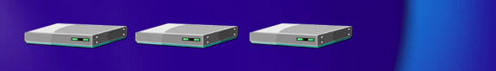


DNS Resolution
.com .net
Root
4
5
Local Name
Server
TTL:
1 Day
6
7
xyz.com
DNS Servers
TTL:
30 Minutes
10
1
3
8
2
Browser’s Cache
9
OS
Notes:
Trying to get IP address for www.xyz.com. First go to internic to get xyz.com address.
Explain caching with TTLs. Many people share local nameserver.

Slide 5


Problems with the Centralized Approach
Slow
  content must traverse multiple backbones and long distances
Unreliable
  delivery may be prevented by
  congestion or backbone
  peering problems
Not scalable
  usage limited by bandwidth
  available at master site
Inferior streaming quality
  packet loss, congestion, and narrow pipes degrade stream quality
Notes:
Flash crowds

Slide 6


The Akamai Solution
Monitors the Internet and routes around trouble spots
Distributes all forms of content and supports applications
Provides feedback
on hit counts to content providers

Slide 7




Downloading www.xyz.com
- The Akamai way
DNS
Content Provider’s Web Server
1
WWW.XYZ.COM
5
2
3
4
6
Content provider’s web server
returns page with Akamaized URLs
User enters www.xyz.com
Browser requests IP
address for www.xyz.com
Browser obtains IP address of optimal Akamai server for embedded objects
DNS returns IP address
Browser obtains objects from optimal Akamai server
Browser requests HTML
Notes:
Same as before but most content is local! Transparent to end-user.

Slide 8
Content Delivery Using Akamai
Embedded URLs are Converted to ARLs
<html>
<head>
<title>Welcome to xyz.com!</title>
</head>
<body>
<img src=“
<img src=“
<h1>Welcome to our Web site!</h1>
<a href=“page2.html”>Click here to enter</a>
</body>
</html>
ak
http://www.xyz.com/logos/logo.gif”>
http://www.xyz.com/jpgs/navbar1.jpg”>
Notes:
Very simple process.

Slide 9
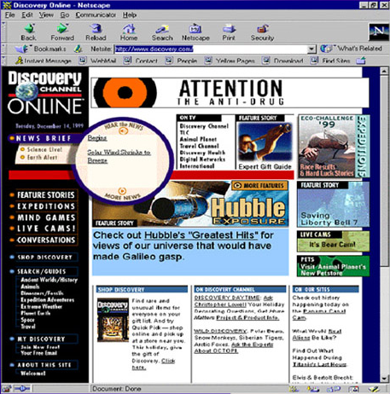
Typical Page Content
Total page 87,550 bytes
Total Akamai Served 68,756 bytes
Banner Ads 16,174 bytes
Logos
3,395 bytes
Gif links
22,395 bytes
Navigation Bar
9,674 bytes
Fresh Content
17,118 bytes
78%
Page Served by Akamai
Notes:
Walk though each arrow/component of the web site...
Look at how much can be off-loaded by the Akamai network. We’ll take all of your rich content - make it faster and more efficient

Slide 10
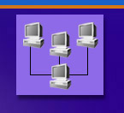






Akamai DNS Resolution
4
xyz.com
.com .net
Root
5
10.10.123.5
xyz.com’s nameserver
akamai.net
a212.g.akamai.net
8
7
9
6
15.15.125.6
ak.xyz.com
10
g.akamai.net
20.20.123.55
11
Akamai High-Level DNS Servers
12
a212.g.akamai.net
30.30.123.5
13
Akamai Low-Level DNS Servers
End User
Local Name Server
16
1
3
14
2
Browser’s Cache
15
OS
Notes:
One of many ways—don’t have to do cname but it is easy. Note that usually address is already in local name server and you don’t do all these steps.

Slide 11
Advantages of the Akamai Solution
Fast
  Content is served from locations near to end users
Reliable
  No single point
  of failure
  Automatic fail-over
Scalable
  Master site no longer requires massive available bandwidth

Slide 12
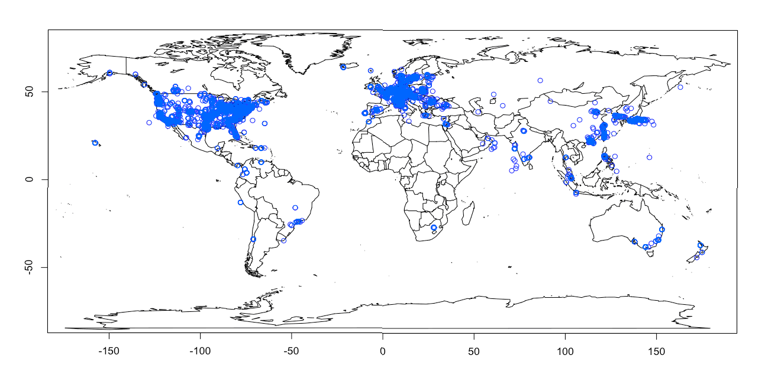

Network Deployment
40000+
Servers
1450+
POPs
950+
Networks
67+
Countries

Slide 13



























































































































































Over 1300 Web
Sites are Now Akamaized
Notes:
Most of the major web sites are now akamaized. We’re one of the largest users of BW on internet today, if not the largest—and growing rapidly. And we’re making these sites faster for everyone. Really does handle flash crowds and really does make order of magnitude faster. What makes us most happy after all the hard work—goal was to have a positive impact with algorithms and we are doing that.

Slide 14
Assigning Clients to Servers
“High level”: Map client to a cluster based on client’s nameserver’s IP address. Algorithm: stable marriage with multi-dimensional hierarchical capacity constraints.
“Low level”: Assign client to specific server or servers within cluster based on content requested. Algorithm: consistent hashing.

Slide 15
Embedded Image Delivery
(e.g., Amazon)
Embedded URLs are Converted to ARLs
<html>
<head>
<title>Welcome to xyz.com!</title>
</head>
<body>
<img src=“
<img src=“
<h1>Welcome to our Web site!</h1>
<a href=“page2.html”>Click here to enter</a>
</body>
</html>
ak
http://www.xyz.com/logos/logo.gif”>
http://www.xyz.com/jpgs/navbar1.jpg”>
Notes:
Very simple process.

Slide 16
Akamai DNS Resolution
select cluster
4
ak.xyz.com
20.20.123.55
5
Akamai High-Level DNS Servers
6
ak.xyz.com
30.30.123.5
7
Akamai Low-Level DNS Servers
End User
Local Name Server
select servers within cluster
10
1
3
8
2
Browser’s Cache
9
OS
Notes:
One of many ways—don’t have to do cname but it is easy. Note that usually address is already in local name server and you don’t do all these steps.

Slide 17
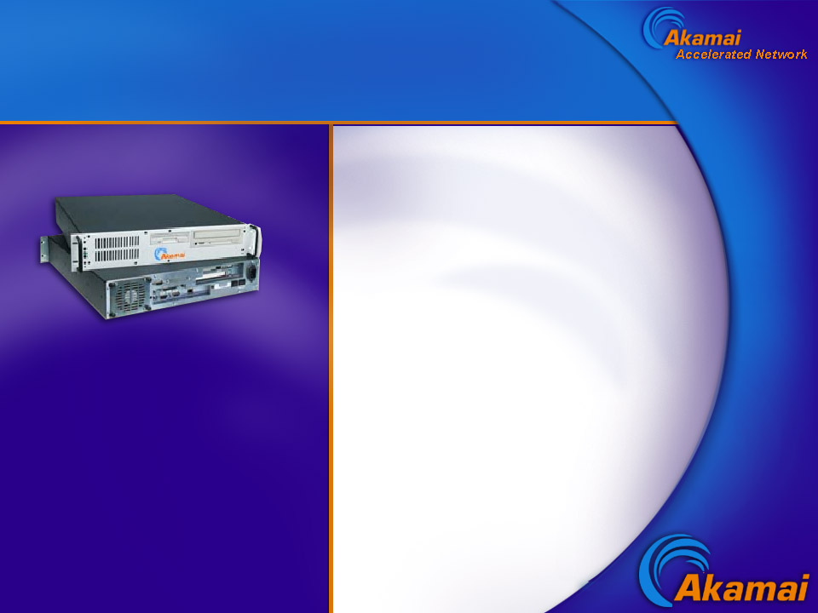
Akamai Cluster
Servers pool resources
RAM
Disk
Throughput

Slide 18
Hashing
Universe U of all possible objects, set B of buckets.
objects: web objects with serial number
buckets: web servers
Hash function h: U → B
Assigns objects to buckets
E.g., h(x) = (((a x + b) mod P) mod |B|) , where
P is prime, P > |U|
a,b chosen uniformly at random from Z_{P}
x is a serial number (designates content provider)

Slide 19
Difficulty changing number of buckets
4
3
2
1
0
bucket
5 7 10 11 27 29 36 38 40 43
object
f(d) = d + 1 mod 5
f(d) = d + 1 mod 4

Slide 20
Consistent Hashing
Idea: Map both objects and buckets to unit circle.
object
bucket
new bucket
Assign object to next bucket on circle in clockwise order.

Slide 21
How it’s really done
a212: 10.10.10.1 10.10.10.4 10.10.10.3 10.10.10.2
a213: 10.10.10.3 10.10.10.4 10.10.10.2 10.10.10.1
a214: 10.10.10.1 10.10.10.2 10.10.10.3 10.10.10.4
a215: 10.10.10.2 10.10.10.1 10.10.10.4 10.10.10.3
random permutations of servers
Why? To spread load for one serial number.

