Slide 1
CSC 536 Lecture 5

Slide 2
Outline
Examples of replication and consistency implementations
Akka case study: distributed key-value store

Slide 3
Replication and consistency implementations
Focus on replication whose goal is improved performance
Examples
Distributed file systems
p2p systems
Web hosting systems and consistent hashing

Slide 4
(Traditional) distributed file systems

Slide 5
Distributed file systems
A hierarchical (i.e. traditional) file system whose files and directories are distributed across a network
Goal is to provide the illusion of a local file system
Supports usual file system operations: open/close, read/write...
Under the hood, file system operations are handled through Remote Procedure Calls (RPCs)
Design goals:
Access/location/concurrency/replication/failure/migration transparency
Heterogeneity
Scalability

Slide 6
Distributed file systems
Examples:
Sun Microsystem’s Network File System (NFS)
Carnegie Mellon’s (then Transac’s, then IBM’s) Andrew File System (AFS), now OpenAFS and Coda
Windows Distributed File System
Lustre Linux cluster parallel distributed file system

Slide 7
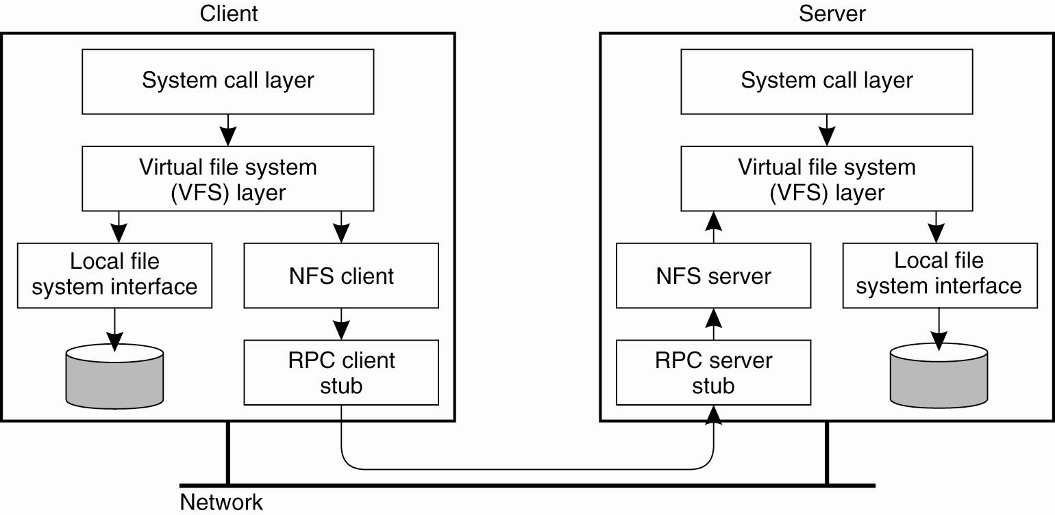
NFS client-server architecture
The basic NFS architecture for UNIX systems.

Slide 8
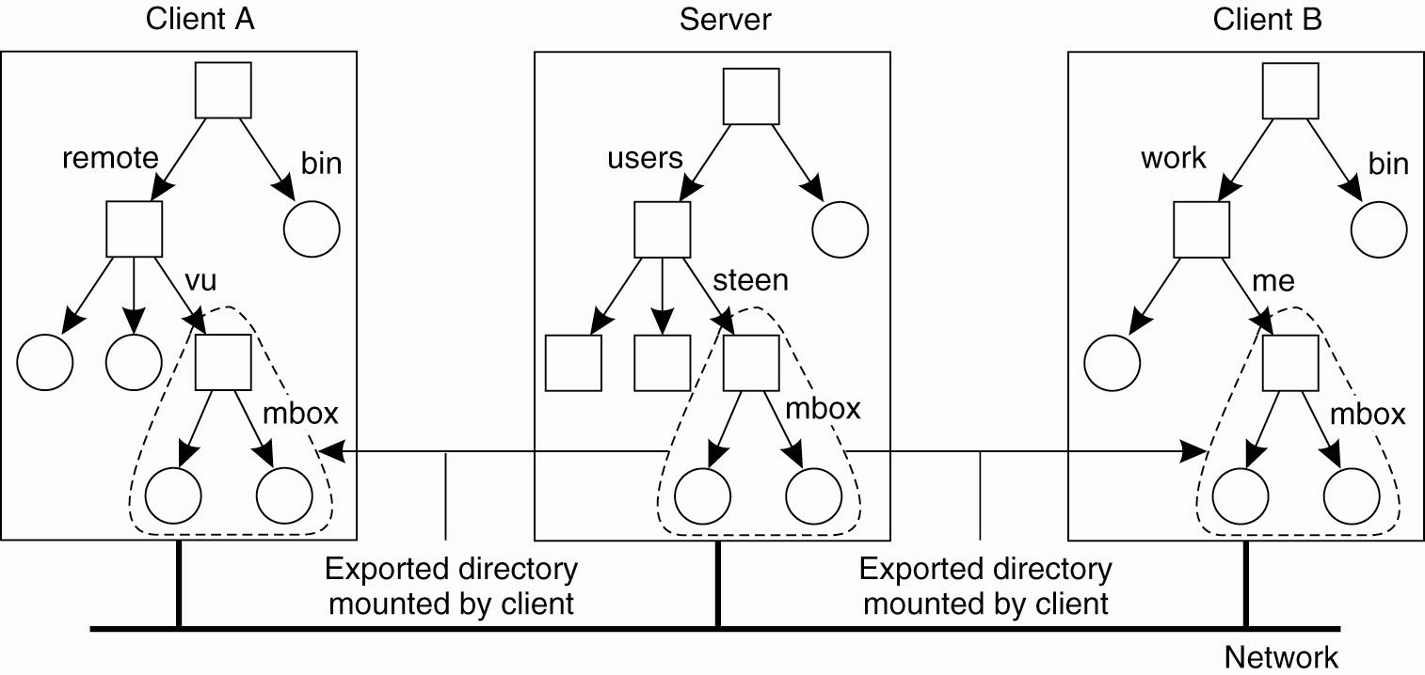
Mounting a directory in NFS
Mounting (part of) a remote file system in NFS

Slide 9
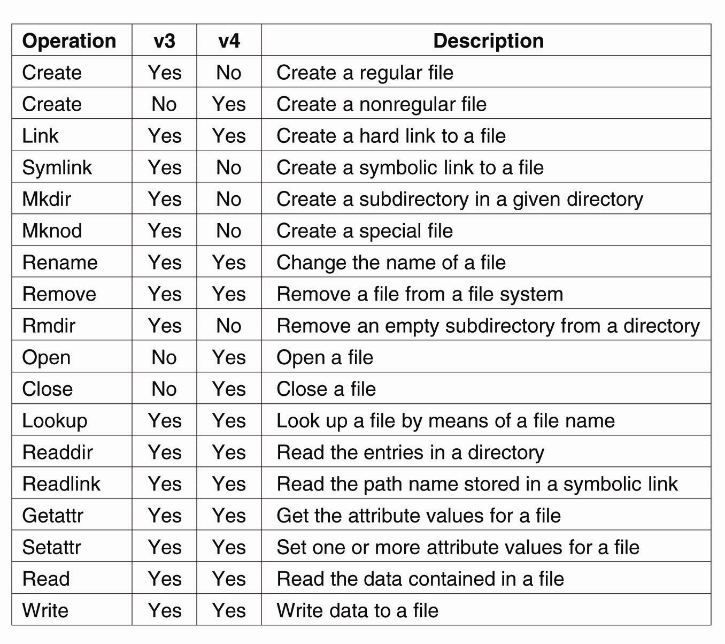
NFS file system model
An incomplete list of file system operations supported by NFS

Slide 10
NFS file system model
An incomplete list of file system operations supported by NFS

Slide 11
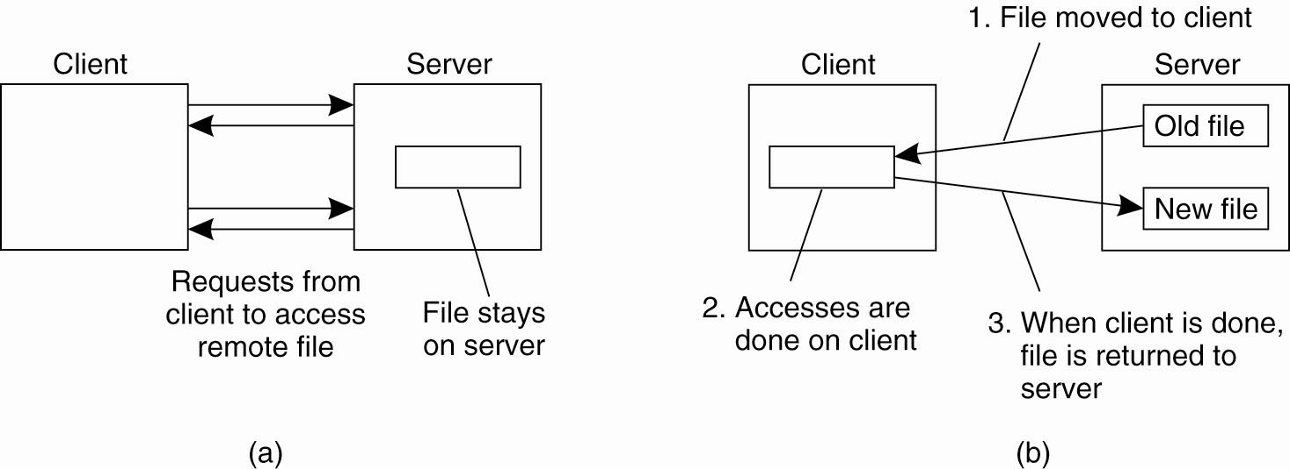
Remote versus local access
(a) The remote access model. (b) The upload/download model.

Slide 12
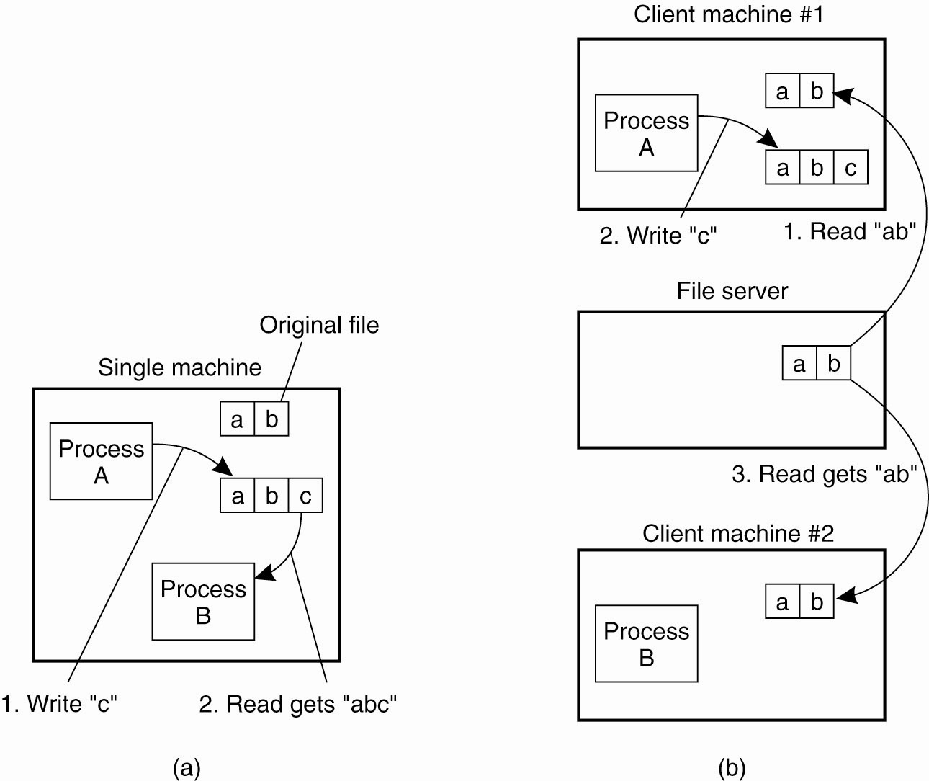
Semantics of file sharing
(a) On a single processor, when a read follows a write, the value returned by the read is the value just written (UNIX semantics)

Slide 13
Semantics of file sharing
(b) In a distributed system with caching, obsolete values may be returned (session semantics)

Slide 14
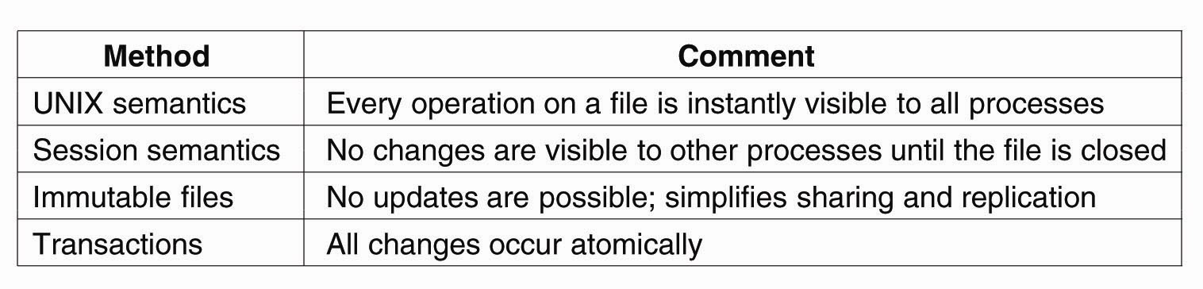
Semantics of file sharing
Four ways of dealing with the shared files in a distributed system

Slide 15
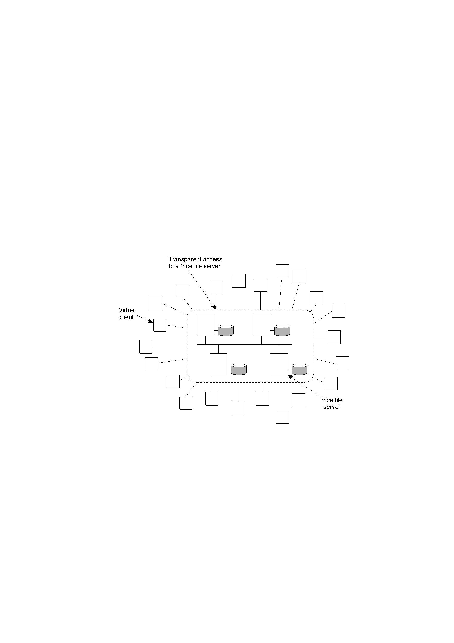
Overview of AFS and Coda
The overall organization of CODA.

Slide 16
Overview of Coda
Replication of files happens in two ways:
Client caching
Server replication

Slide 17
Client Caching
Server keeps track of clients that fetched a file: it records a callback promise for a client
When a client writes to the file, it notifies the server, who, in turn, sends a callback break to the other clients

Slide 18
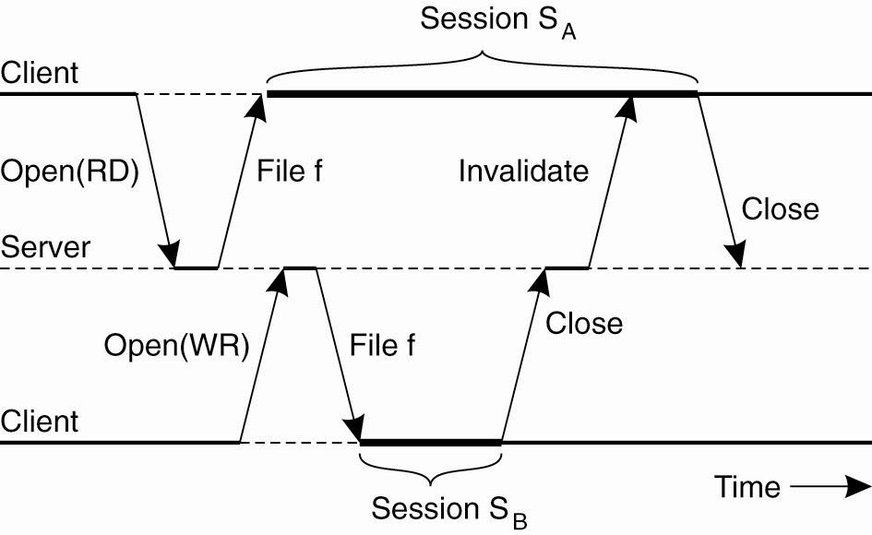
Sharing Files in Coda
The transactional behavior of sharing files in Coda

Slide 19
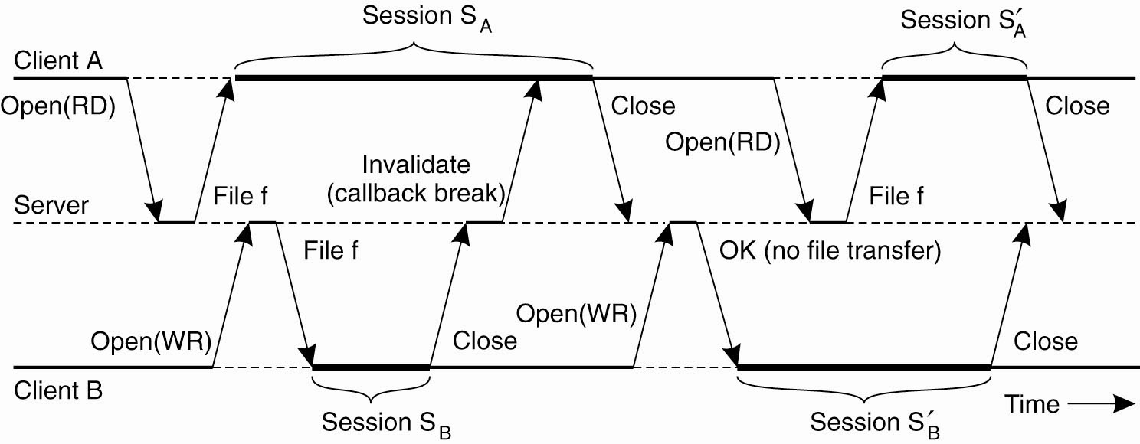
Sharing Files in Coda
The transactional behavior of sharing files in Coda

Slide 20
Server replication
Replicated-write protocol used to maintain consistency
using reliable multicasting implemented at the RPC level
What happens if the servers get disconnected?

Slide 21
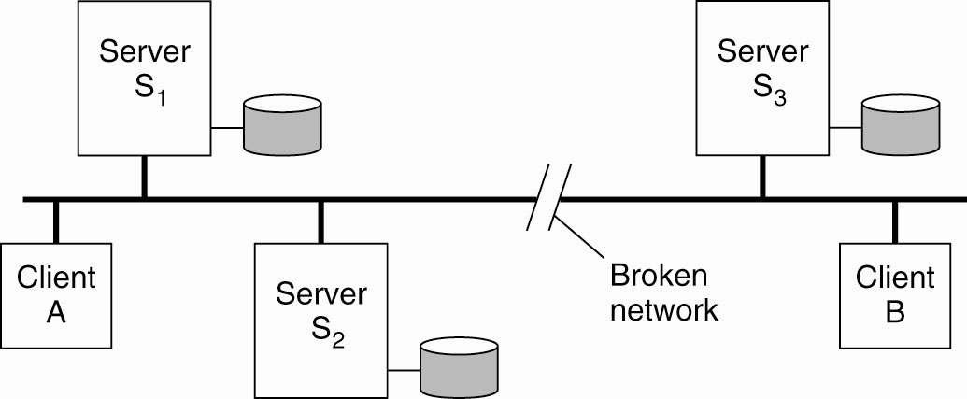
Server Replication
Two clients with different AVSG (Accesible Volume Storage Group) for the same replicated file.

Slide 22
p2p and “gossip” propagation

Slide 23
P2P and gossiping
P2P systems can propagate replicas through “gossip”
Now and then, each node picks some “peer” (at random, more or less)
Sends it a snapshot of its own data
Called “push gossip”
Or asks for a snapshot of the peer’s data
“Pull” gossip
Or both: a push-pull interaction

Slide 24
Gossip “epidemics”
[t=0] Suppose that I know something
[t=1] I pick you… Now two of us know it.
[t=2] We each pick … now 4 know it…
Information spread: exponential rate.
Due to re-infection (gossip to an infected node) spreads as 1.8^{k} after k rounds
But in O(log(N)) time, N nodes are infected

Slide 25
Gossip epidemics
An unlucky node may just “miss” the gossip for a long time

Slide 26
Facts about gossip epidemics
Extremely robust
Data travels on exponentially many paths!
Hard to even slow it down…
Suppose 50% of our packets are simply lost…
… we’ll need 1 additional round: a trivial delay!
Push-pull works best. For push-only/pull-only a few nodes can remain uninfected for a long time

Slide 27
Uses of gossip epidemics
To robustly multicast data
Slow, but very sure of getting through
To implement eventual consistency between replicas
To support “all to all” monitoring and distributed management
For distributed data mining and discovery

Slide 28
p2p and large file propagation

Slide 29
BitTorrent
A p2p file sharing system with:
Load sharing through file splitting
Uses bandwidth of peers instead of a single server
A concept of “fairness”among peers with the goal of improving overall performance

Slide 30
The idea (setup)
A “seed”node has the file
File is split into fixed-size segments (256KB)
Hash calculated for each segment
A “.torrent”meta-file is built for the file – identifies the address of a tracker node
The .torrent file is hosted on a web server and passed around the web: it’s a link to the file
Tracker is a server which tracks currently active clients
Tracker does not participate in actual distribution of file

Slide 31
The idea (setup)
Terminology:
Seed: Client with a complete copy of the file
Leecher: Client still downloading the file and having some but not all fragments of the file
Client contacts tracker and gets a random list of
(50 or so) seeds and leechers
This set of seeds and leechers is called peer set

Slide 32
The idea (download)
Client contacts peers on list to see which segments of the file they have
Client requests segments from peers (via TCP)
Client uses hash from .torrent to confirm that segment is legitimate
Client reports to other peers on the list that it has the segment and becomes a leecher
Other peers start to contact client to get the segment (while client is getting other segments)
Client eventually becomes a seed

Slide 33

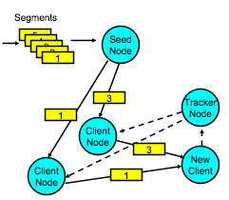
The flow

Slide 34
Load sharing
As the file segments are downloaded by peers, they become the sources for further downloads
To spread the load, clients have to have an incentive to allow peers to download from them
BitTorrent does this with an economic system
A peer serves peers that serve too
Improves overall performance
Encourages cooperation, discourages free-riding
Peers use rarest first policy when downloading chunks
Having a rare chunk makes peer attractive to others
Other wants to download it, peer can then download the chunks it wants
For first chunk, just randomly pick something, so that peer has something to share

Slide 35
Summary
Works quite well
Download a bit slow in the beginning, but speeds up considerably as peer gets more and more chunks
Those who want the file, must contribute
Improves overall performance
Attempts to minimize free-riding
Efficient mechanism for distributing large files to a large number of clients
Popular software, updates, …

Slide 36
Replication for Web Hosting Systems

Slide 37
Replication for Web Hosting Systems
Akamai.ppt

Slide 38
Akka case study
Distributed key-value store: GenericService

Slide 39
Tell: fire-and-forget
actor ! Message
Preferred way of sending messages.
No blocking waiting for a message.
This gives the best concurrency and scalability characteristics.

Slide 40
Ask: send-and-receive future
Future d = (actor ? Request).mapTo[Double]
Using ask will send a message to the receiving Actor as with tell and the receiving actor must reply with sender ! reply in order to complete the returned Future with a value.
The ask operation involves creating an internal actor for handling this reply, which needs to have a timeout after which it is destroyed in order not to leak resources

Slide 41
Ask: send and receive future
Future d = (actor ? Request).mapTo[Double]
Or
Future d = Ask(actor, Request).mapTo[Double]
Can block later in the code using Await (non-blocking approaches possible too):
Await.result(d, timeout)
Example:
val future = ask(master, Join()).mapTo[Stats]
val done = Await.result(future, 60 seconds)

Slide 42
Abstract Class Option and class Some
Abstract class Option[A] represents optional values
Instances of Option[A] are either
instances of case class Some[A] or
case object None
Class Some[A] extends Option[A] and represents existing values of type A.
To get the object of type A use method get of Some[A] class

