Slide 1
CSC 536 Lecture 6

Slide 2
Outline
Fault tolerance
Redundancy and replication
Process groups
Fault tolerance in Akka
“Let it crash” fault tolerance model
Supervision trees
Actor lifecycle
Actor restart
Lifecycle monitoring

Slide 3
Fault tolerance
Partial failure vs. total failure
Automatic recovery from partial failure
A distributed system should continue to operate while repairs are being made

Slide 4
Basic Concepts
What does it mean to tolerate faults?
Dependability includes
Availability
Probability that system is in operation at any given time
Reliability
Mean time between failures
Safety
Maintainability

Slide 5
Basic Concepts
Fault: cause of an error
Fault tolerance: property of a system that provides services even in the presence of faults
Types of faults:
Transient
Intermittent
Permanent

Slide 6
Failure Models
Another view of different types of failures.
Type of failure
Description
Crash failure
A server halts, but is working correctly until it halts
Omission failure Receive omission Send omission
A server fails to respond to incoming requests A server fails to receive incoming messages A server fails to send messages
Timing failure
A server's response lies outside the specified time interval
Response failure Value failure State transition failure
The server's response is incorrect The value of the response is wrong The server deviates from the correct flow of control
Arbitrary failure
A server may produce arbitrary responses at arbitrary times
Crash: fail-stop, fail-safe (no harmful consequences), fail-silent (seems to have crashed), fail-fast (report failure as soon as it is detected)

Slide 7
Redundancy
A fault tolerant system will hide failures from correctly working components
Redundancy is a key technique for masking faults
Information redundancy
Time redundancy
Physical redundancy

Slide 8
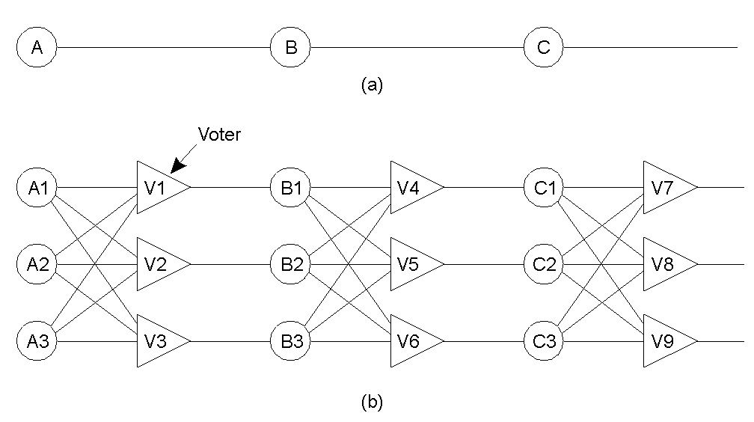
Failure Masking by Redundancy
Triple modular redundancy.

Slide 9
Process fault tolerance

Slide 10
Process resilience
The key approach to tolerating a faulty process is to organize several identical processes into a group
if a process fails, then other (replicated) processes in the group can take over
Groups abstract the collection of individual processes
Process groups can be dynamic

Slide 11
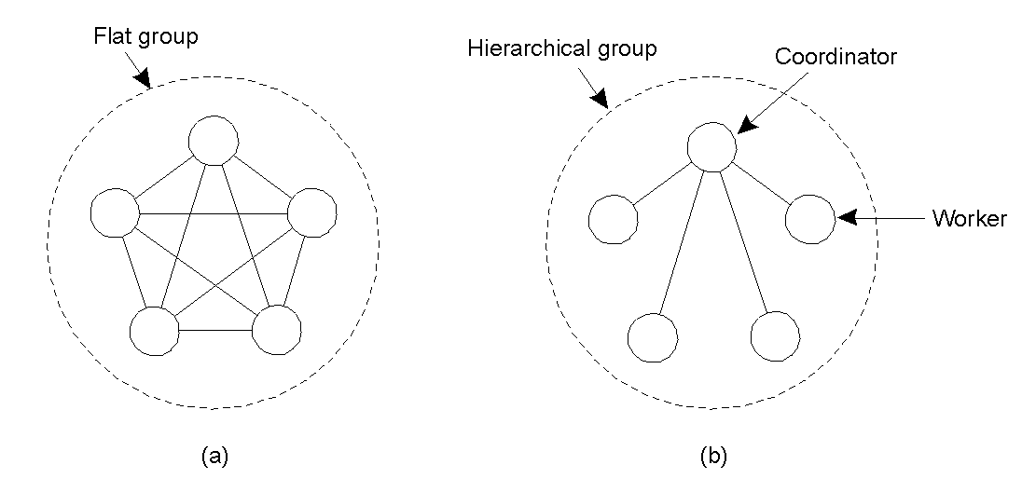
Flat Groups versus Hierarchical Groups
Communication in a flat group.
Communication in a simple hierarchical group

Slide 12
Group Membership
Some method needed to keep track of group membership
Group Server
Distributed solution using reliable multicasting
Problem when a group member crashes
Problem synchronizing sending and receiving messages with joining and leaving the group
We will see how group membership is handled later

Slide 13
Failure masking and replication
Processes in a group are replicas of each other
As seen in the last lecture, we have two ways to achieve replication:
Primary based protocols (they use hierarchical groups in which the primary coordinates all writes at replicas
Replicated-write protocols (they use flat groups)
How much replication is needed?
Crash failures: need ??? replicas to handle k faults
Byzantine failures: need ??? replicas to handle k faults

Slide 14
Failure masking and replication
Processes in a group are replicas of each other
As seen in the last lecture, we have two ways to achieve replication:
Primary based protocols (they use hierarchical groups in which the primary coordinates all writes at replicas
Replicated-write protocols (they use flat groups)
How much replication is needed?
Crash failures: need k+1 replicas to handle k faults
Byzantine failures: need 2k+1 replicas to handle k faults

Slide 15
Fundamental problem: Agreement in faulty systems
Agreement is required for
Leader election
Deciding whether to commit a transaction
Synchronization
Dividing up tasks
The goal is for non-faulty processes to reach consensus
Hardness results today. Algorithms next week

Slide 16
Agreement in Faulty Systems
Perfect processes/imperfect communication
No agreement is possible when communication is not reliable

Slide 17
Two army problem
Perfect processes/imperfect communication example
Red army, with 5000 troops, is in the valley
Two blue armies, each 3000 with troops, are on two hills surrounding the valley
If blue armies coordinate attack, they will win
If either attacks by itself, it loses.
Blue army goal is to reach agreement about attacking
Problem: the messenger must go through the valley who can be captured (unreliable communication)

Slide 18
Byzantine generals problem
Perfect communication/imperfect processes example
The Byzantine generals (processes that may exhibit byzantine failures) need to reach a consensus.
The consensus problem: every process starts with an input and we want an algorithm that satisfies:
termination: eventually, every non-faulty process must decide on a value
agreement: all non-faulty decisions must be the same
validity: if all inputs are the same then the non-faulty decisions must be that input
Assume network is a complete graph.
Can you solve consensus with n = 2?
Can you solve consensus with n = 3?
Can you solve consensus with n = 4?

Slide 19
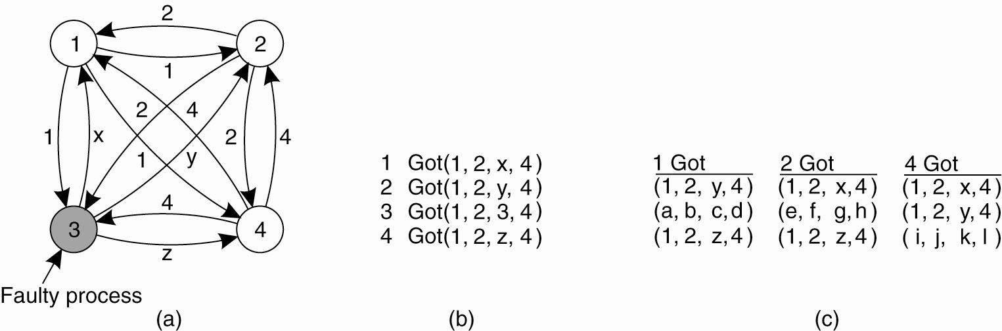
Byzantine generals problem
The Byzantine agreement problem for three non-faulty and one faulty process.
(a) Each process sends their value to the others.

Slide 20
Byzantine generals problem
The Byzantine agreement problem for three non-faulty and one faulty process.
(b) The vectors that each process assembles based on (a).
(c) The vectors that each process receives in step 3.

Slide 21
Byzantine generals problem
Perfect communication/imperfect processes example
The Byzantine generals (processes that may exhibit byzantine failures) need to reach a consensus.
The consensus problem: every process starts with an input and we want an algorithm that satisfies:
termination: eventually, every non-faulty process must decide on a value
agreement: all non-faulty decisions must be the same
validity: if all inputs are the same then the non-faulty decisions must be that input
Assume network is a complete graph.
Can you solve consensus with n = 2?
Can you solve consensus with n = 3?
Can you solve consensus with n = 4?
Theorem: In 3 processor system with up to 1 failure, consensus is impossible

Slide 22
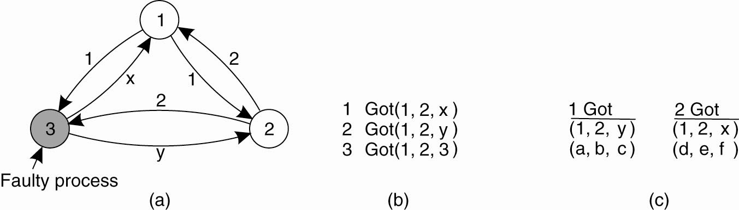
Byzantine generals problem
The Byzantine agreement problem with two correct process and one faulty process

Slide 23
Fault tolerance in Akka

Slide 24
Akka Fault tolerance goals
Fault containment or isolation
Fault should not crash the system
Some structure needs to exist to isolate the faulty component
Redundancy
Ability to replace a faulty component and get it back to the initial state
A way to control the component lifecycle should exist
Other components should be able to communicate with the replaced component just as they did before
Safeguard communication to failed component
All calls should be suspended until the component is fixed or replaced
Separation of concerns
Code handling recovery execution should be separate from code handling normal execution

Slide 25
Actor hierarchy
Motivation for actor systems:
recursively break up tasks and delegate until tasks become small enough to be handled in one piece
A result of this:
a hierarchy of actors in which every actor can be made responsible (the supervisor) of its children
If an actor cannot handle a situation
It sends a failure message to its supervisor, asking for help
“Let it crash” model
The recursive structure allows the failure to be handled at the right level

Slide 26
Supervisor fault-handling directives
When an actor detects a failure (i.e. throws an exception)
it suspends itself and all its subordinates and
sends a message to its supervisor, signaling failure
The supervisor has a choice to do one of the following:
Resume the subordinate, keeping its accumulated internal state
Restart the subordinate, clearing out its accumulated internal state
Terminate the subordinate permanently
Escalate the failure
NOTE:
Supervision hierarchy is assumed and used in all 4 cases
Supervision is about forming a recursive fault handling structure

Slide 27
Supervisor fault-handling directives
Each supervisor is configured with a function translating all possible failure causes (i.e. exceptions) into one of Resume, Restart, Stop, and Escalate
override val supervisorStrategy = OneForOneStrategy() {
case _: IllegalArgumentException => Resume
case _: ArithmeticException => Stop
case _: Exception => Restart
}
FaultToleranceSample1.scala
FaultToleranceSample2.scala

Slide 28
Restarting
Causes for actor failure while processing a message can be:
Programming error for the specific message received
Transient failure caused by an external resource used during processing the message
Corrupt internal state of the actor
Because of the 3rd case, default is to clear out internal state
Restarting a child is done by creating a new instance of the underlying Actor class and replacing the failed instance with the fresh one inside the child’s ActorRef
The new actor then resumes processing its mailbox

Slide 29
One-For-One vs. All-For-One
Two classes of supervision strategies:
OneForOneStrategy: applies the directive to the failed child only (default)
AllForOneStrategy: applies the directive to all children
AllForOneStrategy is applicable when children are bound in tight dependencies and all need to be restarted to achieve a consistent (global) state

Slide 30
Default Supervisor Strategy
When the supervisor strategy is not defined for an actor the following exceptions are handled by default:
ActorInitializationException will stop the failing child actor
ActorKilledException will stop the failing child actor
Exception will restart the failing child actor
Other types of Throwable will be escalated to parent actor
If the exception escalates all the way up to the root guardian it will handle it in the same way as the default strategy defined above

Slide 31
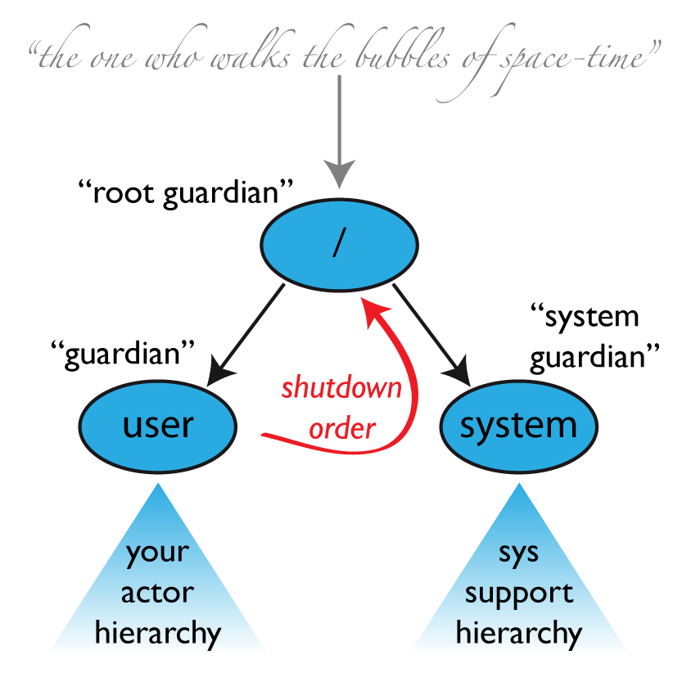
Default Supervisor Strategy

Slide 32
Supervision strategy guidelines
If an actor passes subtasks to children actors, it should supervise them
the parent knows which kind of failures are expected and how to handle them
If one actor carries very important data (i.e. its state should not be lost, if at all possible), this actor should source out any possibly dangerous sub-tasks to children
Actor then handles failures when they occur

Slide 33
Supervision strategy guidelines
Supervision is about forming a recursive fault handling structure
If you try to do too much at one level, it will become hard to reason about
hence add a level of supervision
Sometimes a hierarchical structure does not make sense. If one actor depends on another actor for carrying out its task, it should watch that other actor’s liveness and act upon receiving a termination notice
This is different from supervision, as the watching party is not a supervisor and has no influence on the supervisor strategy
This is referred to as lifecycle monitoring, aka DeathWatch

Slide 34
Akka fault tolerance benefits
Fault containment or isolation
A supervisor can decide to terminate an actor
Actor references makes it possible to replace actor instances transparently
Redundancy
An actor can be replaced by another
Actors can be started, stopped and restarted
Safeguard communication to failed component
When an actor crashes its mailbox is suspended and then used by the replacement
Separation of concerns
The normal actor message processing and supervision fault recovery flows are orthogonal

Slide 35
Lifecycle hooks
In addition to abstract method receive, references self, sender, and context, and function supervisorStrategy,the Actor API provides lifecycle hooks (callback methods):
def preStart() {}
def preRestart(reason: Throwable, message: Option[Any]) {
context.children foreach (context.stop(_))
postStop()
}
def postRestart(reason: Throwable) { preStart() }
def postStop() {}
These are default implementations; they can be overridden

Slide 36
preStart and postStop hooks
Right after starting the actor, its preStart method is invoked.
After stopping an actor, its postStop hook is called
may be used e.g. for deregistering this actor from other services
hook is guaranteed to run after message queuing has been disabled for this actor

Slide 37
preRestart and postRestart hooks
Recall that an actor may be restarted by its supervisor
when an exception is thrown while the actor processes a message
1. The actor is restarted when the preRestart callback function is invoked on the old actor
with the exception which caused the restart and the message which triggered that exception
preRestart is where clean up and hand-over to the fresh actor instance is done
by default preRestart stops all children and calls postStop

Slide 38
preRestart and postRestart hooks
2. actorOf is used to produce the fresh instance.
3. The new actor’s postRestart callback method is invoked with the exception which caused the restart
By default the preStart hook is called, just as in the normal start-up case
An actor restart replaces only the actual actor object
the contents of the mailbox is unaffected by the restart
processing of messages will resume after the postRestart hook returns.
the message that triggered the exception will not be received again
any message sent to an actor during its restart will be queued in the mailbox

Slide 39
Restarting summary
The precise sequence of events during a restart is:
suspend the actor and recursively suspend all children
which means that it will not process normal messages until resumed
done by calling the old instance’s preRestart hook (defaults to sending termination requests, using context.stop() to all children and then calling postStop() hook)
wait for all children which were requested to terminate to actually terminate
create new actor instance by invoking the originally provided factory again
invoke postRestart on the new instance (which by default also calls preStart)
resume the actor
LifeCycleHooks.scala

Slide 40
Lifecycle monitoring
In addition to the special relationship between parent and child actors, each actor may monitor any other actor
Since actors emerge from creation fully alive and restarts are not visible outside of the affected supervisors, the only state change available for monitoring is the transition from alive to dead.
Monitoring is used to tie one actor to another so that it may react to the other actor’s termination

Slide 41
Lifecycle monitoring
Implemented using a Terminated message to be received by the monitoring actor
the default behavior is to throw a special DeathPactException which crashes the monitoring actor and escalates failure
To start listening for Terminated messages from target actor use ActorContext.watch(targetActorRef)
To stop listening for Terminated messages from target actor use ActorContext.unwatch(targetActorRef)
Lifecycle monitoring in Akka is commonly referred to as DeathWatch

Slide 42
Lifecycle monitoring
Monitoring a child
monitoring.MonitoringApp.scala
Monitoring a non-child
monitoring2.MonitoringApp.scala

Slide 43
Example: Cleanly shutting down router using lifecycle monitoring
Routers are used to distributed the workload across a few or many routee actors
SimpleRouter1.scala
Problem: how to cleanly shut down the routees and the router when the job is done

Slide 44
Example: Shutting down router using lifecycle monitoring
akka.actor.PoisonPill message stops receiving actor
The abstract Actor method receive contains
case PoisonPill ⇒ self.stop()
SimplePoisoner.scala
Problem: sending PoisonPill to router stops the router which, in turn stops the routees
typically before they have finished processing all their (job-related) messages

Slide 45
Example: Shutting down router using lifecycle monitoring
akka.routing.Broadcast message is used to broadcast a message to routees
when a router receives a Broadcast, it unwraps the message contained within it and forwards that message to all its routees
Sending Broadcast(PoisonPill) to router results in PoisonPill messages being enqueued in each routee’s queue
After all routees stop, the router itself stops
SimpleRouter2.scala

Slide 46
Example: Shutting down router using lifecycle monitoring
Question: How to clean up after router stops?
Create a supervisor for the router who will be sending messages to the router and monitor its lifecycle
After all job messages have been sent to router, send a Broadcast(PoisonPill) message to router
PoisonPill message will be last in each routee’s queue
Each routee stops when processing PoisonPill
When all routees stop, the router itself stops by default
The supervisor receives a (router) Terminated message and cleans up
SimpleRouter3.scala

