Slide 1
CSC 536 Lecture 7

Slide 2
Outline
Fault tolerance
Reliable client-server communication
Reliable group communication
Distributed consensus
2- and 3-phase commit
Paxos
Raft
Running Akka applications in the cloud
Akka Cluster
Docker (next week)
Etcd (next week)

Slide 3
Reliable client-server communication

Slide 4
Process-to-process communication
Reliable process-to-process communications is achieved using the Transmission Control Protocol (TCP)
TCP masks omission failures using acknowledgments and retransmissions
Completely hidden to client and server
Network crash failures are not masked

Slide 5
Reliable group communication

Slide 6
Reliable group communication
Process replication helps in fault tolerance but gives rise to a new problem:
How to construct a reliable multicast service, one that provides a guarantee that all processes in a group receive a message?
A simple solution that does not scale:
Use multiple reliable point-to-point channels
Other problems that we will consider later:
Process failures
Processes join and leave groups
We assume that unreliable multicasting is available
We assume processes are reliable, for now

Slide 7
Implementing reliable multicasting on top of unreliable multicasting
Solution attempt 1:
(Unreliably) multicast message to process group
A process acknowledges receipt with an ack message
Resend message if no ack received from one or more processes
Problem:

Slide 8
Implementing reliable multicasting on top of unreliable multicasting
Solution attempt 1:
(Unreliably) multicast message to process group
A process acknowledges receipt with an ack message
Resend message if no ack received from one or more processes
Problem:
Sender needs to process all the acks which may be huge
Solution does not scale

Slide 9
Implementing reliable multicasting on top of unreliable multicasting
Solution attempt 2:
(Unreliably) multicast numbered message to process group
A receiving process replies with a feedback message only to inform that it is missing a message
Resend missing message to process
Problems with solution attempt:
Sender must keep a log of all messages it multicast forever, and
The number of feedback message may still be huge

Slide 10
Implementing reliable multicasting on top of unreliable multicasting
We look at two more solutions
The key issue is the reduction of feedback messages!
Also care about garbage collection

Slide 11
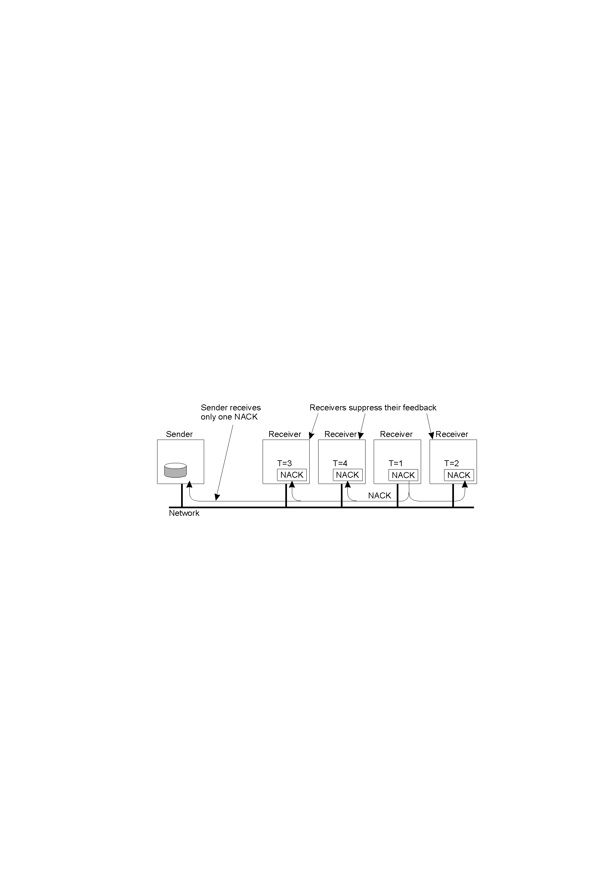
Nonhierarchical Feedback Control
Feedback suppression
Several receivers have scheduled a request for retransmission, but the first retransmission request leads to the suppression of others.

Slide 12
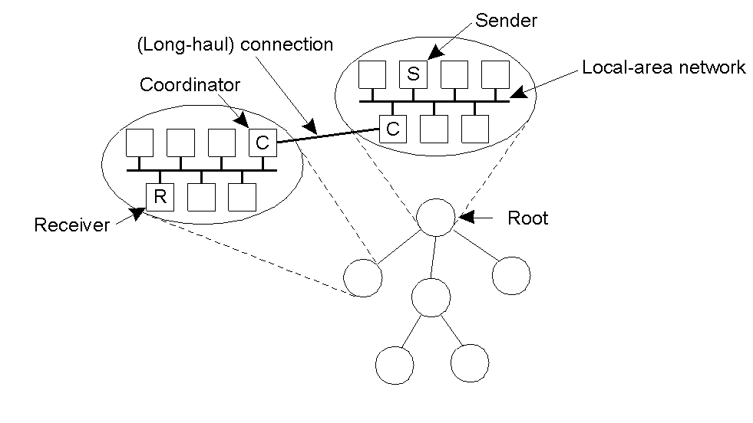
Hierarchical Feedback Control
Each local coordinator forwards the message to its children
A local coordinator handles retransmission requests
How to construct the tree dynamically?

Slide 13
Hierarchical Feedback Control
Each local coordinator forwards the message to its children.
A local coordinator handles retransmission requests.
How to construct the tree dynamically?
Use the multicast tree in the underlying network

Slide 14
Atomic Multicast
We assume now that processes could fail, while multicast communication is reliable
We focus on atomic (reliable) multicasting in the following sense:
A multicast protocol is atomic if every message multicast to group view G is delivered to each non-faulty process in G
if the sender crashes during the multicast, the message is delivered to all non-faulty processes or none
Group view: the view on the set of processes contained in the group which sender has at the time message M was multicast
Atomic = all or nothing

Slide 15
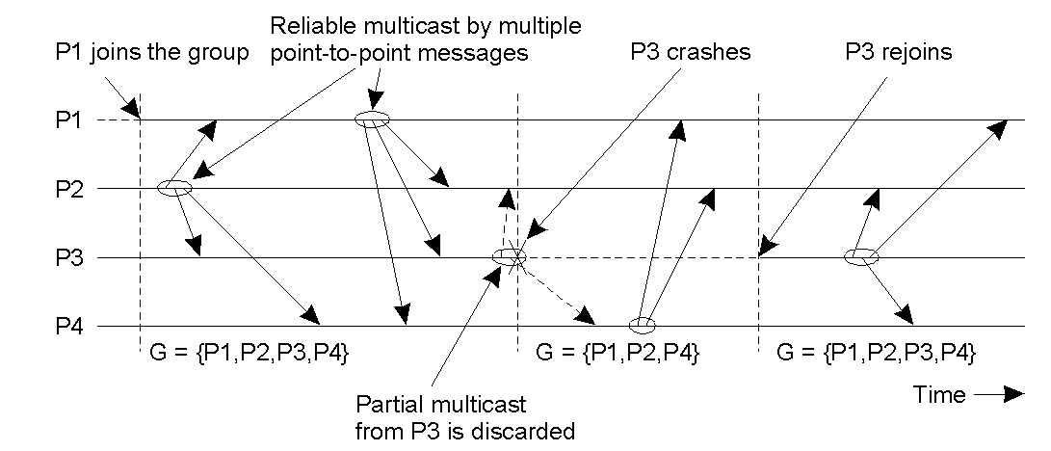
Virtual Synchrony
The principle of virtual synchronous multicast.

Slide 16
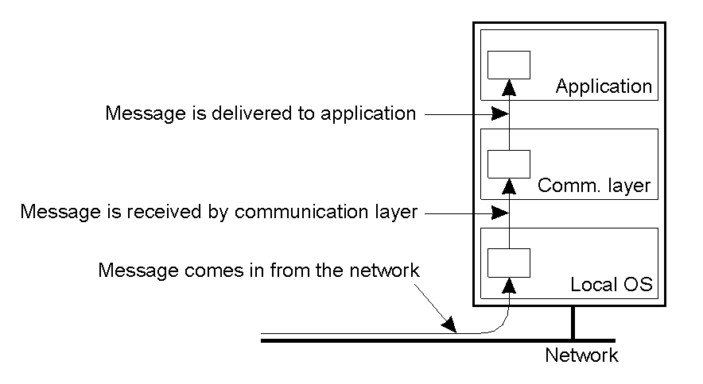
The model for atomic multicasting
The logical organization of a distributed system to distinguish between message receipt and message delivery

Slide 17
Implementing atomic multicasting
How to implement atomic multicasting using reliable multicasting
Reliable multicasting could be simply sending a separate message to each member using TCP or use one of the methods described in slides 19-22.
Note 1: Sender could fail before sending all messages
Note 2: A message is delivered to the application only when all non-faulty processes have received it (at which point the message is referred to as stable)
Note 3: A message is therefore buffered at a local process until it can be delivered

Slide 18
Implementing atomic multicasting
On initialization, for every process:
Received = {}
To A-multicast message m to group G:
R-multicast message m to group G
When process q receives an R-multicast message m:
if message m not in Received set:
Add message m to Received set
R-multicast message m to group G
A-deliver message m

Slide 19
Virtual synchrony
We must especially guarantee that all messages sent to view G are delivered to all non-faulty processes in G before the next group membership change takes place

Slide 20
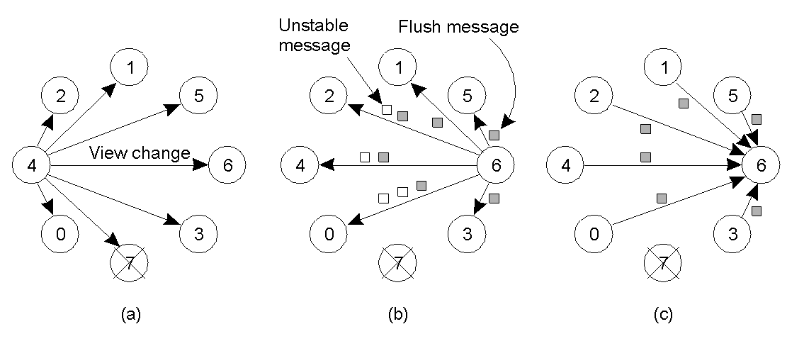
Implementing Virtual Synchrony
Process 4 notices that process 7 has crashed, sends a view change
Process 6 sends out all its unstable messages, followed by a flush message
Process 6 installs the new view when it has received a flush message from everyone else

Slide 21
Distributed Consensus

Slide 22
Distributed Consensus
Recall the problem:
Every process starts with an input and we want an algorithm that satisfies:
termination: eventually, every non-faulty process must decide on a value
agreement: all non-faulty decisions must be the same
validity: if all inputs are the same then the non-faulty decisions must be that input
Mathematical proof: In an asynchronous message-passing distributed system fault-tolerant consensus is impossible

Slide 23
Distributed Commit
Version of distributed consensus that assumes a synchronous message passing system
Used to commit database transactions in a durable way
The problem is to ensure that an operation is performed by all processes of a group, or none at all
Safety property:
The same decision is made by all non-faulty processes
Done in a durable (persistent) way so faulty processes can learn committed value when they recover
Liveness property:
Eventually a decision is made
Examples: atomic multicasting, distributed transactions

Slide 24
The commit problem
An initiating process communicates with a group of actors, who vote
Initiator is often a group member, too
Ideally, if all vote to commit we perform the action
If any votes to abort, none does so
Assume synchronous model
To handle asynchronous model, introduce timeouts
If timeout occurs the leader can presume that a member wants to abort. Called the presumed abort assumption.

Slide 25
Two-Phase Commit Protocol
2PC initiator
p
q
r
s
t

Slide 26
Two-Phase Commit Protocol
Vote?
2PC initiator
p
q
r
s
t

Slide 27
Two-Phase Commit Protocol
Vote?
2PC initiator
p
q
r
s
t
All vote “commit”

Slide 28
Two-Phase Commit Protocol
Vote?
Commit!
2PC initiator
p
q
r
s
t
All vote “commit”

Slide 29
Two-Phase Commit Protocol
Phase 1
Vote?
Commit!
2PC initiator
p
q
r
s
t
All vote “commit”

Slide 30
Two-Phase Commit Protocol
Phase 1
Phase 2
Vote?
Commit!
2PC initiator
p
q
r
s
t
All vote “commit”

Slide 31
Fault tolerance
If no failures, protocol works
However, any member can abort any time, even before the protocol runs
If failure, we can separate this into three cases
Group member fails; initiator remains healthy
Initiator fails; group members remain healthy
Both initiator and group member fail
We also need to handle
Handling recovery of a failed member

Slide 32
Fault tolerance
Some cases are pretty easy
E.g. if a member fails before voting we just treat it as an abort
If a member fails after voting commit, we assume that when it recovers it will finish up the commit protocol and perform whatever action was decided
All members keep a log of their actions in persistent memory.
Hard cases involve crash of initiator

Slide 33
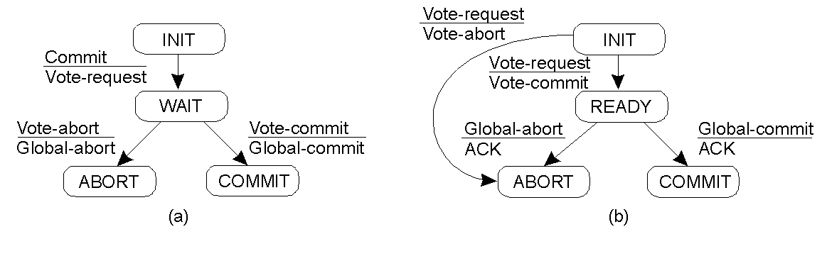
Two-Phase Commit
The finite state machine for the coordinator in 2PC.
The finite state machine for a participant.

Slide 34
Two-Phase Commit
If failure at coordinator, note that participants may block in one of two states: Init or Ready
Use timeouts
If participant blocked in INIT state:
Abort
If participant P blocked in READY:
Wait for coordinator or contact another participant Q

Slide 35
Two-Phase Commit
State of Q
Action by P
COMMIT
Make transition to COMMIT
ABORT
Make transition to ABORT
INIT
Make transition to ABORT
READY
Contact another participant
Actions taken by a participant P when residing in state READY and having contacted another participant Q.
If all other participants are READY, P must block!

Slide 36
As a time-line picture
Phase 1
Phase 2
Vote?
Commit!
2PC initiator
q
p
r
s
t
All vote “commit”

Slide 37
Why do we get stuck?
If process q voted “commit”, the coordinator may have committed the protocol
And q may have learned the outcome
Perhaps it transferred $10M from a bank account…
So we want to be consistent with that
If q voted “abort”, the protocol must abort
And in this case we can’t risk committing
Important: In this situation we must block; we cannot restart the transaction, say.

Slide 38
Two-Phase Commit
actions by coordinator:
while START _2PC to local log; multicast VOTE_REQUEST to all participants; while not all votes have been collected { wait for any incoming vote; if timeout { while GLOBAL_ABORT to local log; multicast GLOBAL_ABORT to all participants; exit; } record vote; } if all participants sent VOTE_COMMIT and coordinator votes COMMIT{ write GLOBAL_COMMIT to local log; multicast GLOBAL_COMMIT to all participants; } else { write GLOBAL_ABORT to local log; multicast GLOBAL_ABORT to all participants; }
Outline of the steps taken by the coordinator in a two phase commit protocol

Slide 39
Two-Phase Commit
actions by participant:
write INIT to local log; wait for VOTE_REQUEST from coordinator; if timeout { write VOTE_ABORT to local log; exit; } if participant votes COMMIT { write VOTE_COMMIT to local log; send VOTE_COMMIT to coordinator; wait for DECISION from coordinator; if timeout { multicast DECISION_REQUEST to other participants; wait until DECISION is received; /* remain blocked */ write DECISION to local log; } if DECISION == GLOBAL_COMMIT write GLOBAL_COMMIT to local log; else if DECISION == GLOBAL_ABORT write GLOBAL_ABORT to local log; } else { write VOTE_ABORT to local log; send VOTE ABORT to coordinator; }
Steps taken by participant process in 2PC.

Slide 40
Two-Phase Commit
actions for handling decision requests: /* executed by separate thread */
while true { wait until any incoming DECISION_REQUEST is received; /* remain blocked */ read most recently recorded STATE from the local log; if STATE == GLOBAL_COMMIT send GLOBAL_COMMIT to requesting participant; else if STATE == INIT or STATE == GLOBAL_ABORT send GLOBAL_ABORT to requesting participant; else skip; /* participant remains blocked */
Steps taken for handling incoming decision requests.

Slide 41
Three-phase commit protocol
Unlike the Two Phase Commit Protocol, it is non-blocking
Idea is to add an extra PRECOMMIT (“prepared to commit”) stage

Slide 42
3 phase commit
Phase 1
Phase 2
Phase 3
Vote?
Prepare to commit
Commit!
3PC initiator
p
q
r
s
t
All vote “commit”
All say “ok”
They commit

Slide 43
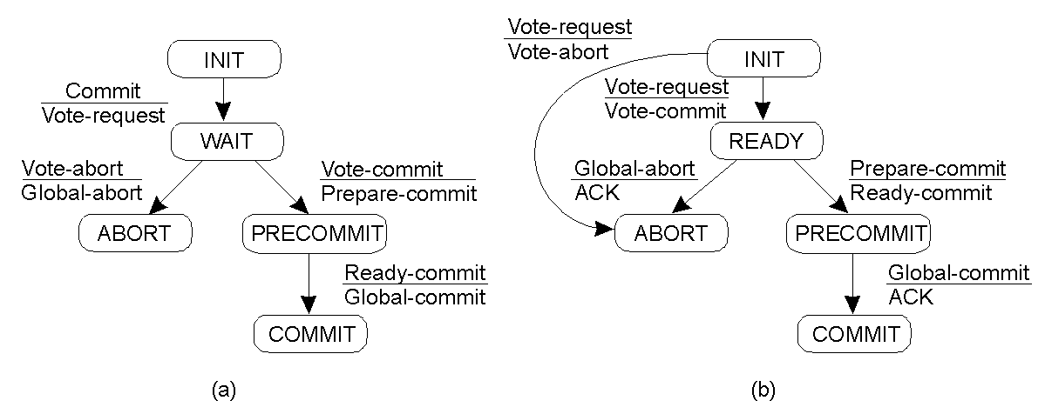
Three-Phase Commit
Finite state machine for the coordinator in 3PC
Finite state machine for a participant

Slide 44
Why 3 phase commit?
A process can deduce the outcomes when this protocol is used
Main insight?
Nobody can enter the commit state unless all are first in the precommit state
Makes it possible to determine the state, then push the protocol forward (or back)

Slide 45
3 phase commit algorithm issues
Details are missing and not clear at all how to implement it rigorously; also, it assumes synchronous, lock-step execution between processes
To address this, Lamport developed the Paxos algorithm
“Paxos contains the first three-phase commit algorithm that is a real algorithm, with a clearly stated correctness condition and a proof of correctness”
Contradiction???
Recall that Consensus not always possible in asynchronous systems
Paxos works by insuring safety (correctness) not liveness (termination)

Slide 46
Paxos distributed consensus algorithm
A fault-tolerant distributed consensus protocol for asynchronous systems
Used by servers managing replicas in order to reach agreement on updates when
messages may be lost, re-ordered, duplicated
servers may operate at arbitrary speed and fail
servers have access to stable persistent storage
Paxos is the core algorithm of Chubby, the key component that keeps track of the state of the Google distributed computing infrastructure

Slide 47
Paxos algorithm issues
“The dirty little secret of the NSDI community is that at most five people really, truly understand every part of Paxos ;-).”
—NSDI reviewer
“There are significant gaps between the description of the Paxos algorithm and the needs of a real-world system...the final system will be based on an unproven protocol.”
—Chubby authors
Paxos is covered in your textbook

Slide 48
Raft consensus algorithm
A fault-tolerant distributed consensus protocol for asynchronous systems
Just like Paxos
Design goals: must be correct, complete, and perform well…
Just like Paxos

Slide 49
Raft consensus algorithm
A fault-tolerant distributed consensus protocol for asynchronous systems
Just like Paxos
Design goals: must be correct, complete, and perform well…
Just like Paxos
Design goals: and also must also be understandable
https://raft.github.io
http://thesecretlivesofdata.com/raft/

Slide 50
Akka Cluster

Slide 51
Akka cluster
A fault-tolerant, elastic, decentralized p2p-based cluster membership service with no single point of failure or bottleneck
Allows Actors/ActorSystems to work together without having to specify the nodes they will live in
Encourages development of peer-to-peer applications instead of client-server ones
Allows peers to automatically discover new nodes and remove dead ones
Introduces the concept of "roles" to distinguish different Akka applications within a cluster
Introduces clustered routers that automatically adjust their routees list based on node availability.

Slide 52
Akka cluster
A fault-tolerant, elastic, decentralized p2p-based cluster membership service with no single point of failure or bottleneck
A layer of abstraction above Akka remoting

Slide 53
Akka cluster membership
A cluster is made up of a set of member nodes.
Each node is an ActorSystem (having the same name)
The identifier for each node is a hostname:port tuple.
An Akka application can be distributed over a cluster with each node hosting some part of the application.
Joining a cluster is initiated by issuing a Join command to one of the nodes in the cluster.

Slide 54
Akka cluster events
The membership service allows actors in member nodes to monitor state transitions of other member nodes
The actor must register as a listener for ClusterEvent events:
MemberJoined - A new member has joined the cluster and its status has been changed to Joining
MemberUp - A new member has joined the cluster and its status has been changed to Up
MemberExited - A member is leaving the cluster and its status has been changed to Exiting
MemberRemoved - Member completely removed from the cluster.
UnreachableMember - A member is considered as unreachable, detected by the failure detector of at least one other node.
ReachableMember - A member is considered as reachable again, after having been unreachable.

Slide 55
Akka cluster example
Add dependency to build.sbt:
libraryDependencies += "com.typesafe.akka" %% "akka-cluster" % "2.6.4”
Additional project dependencies:
libraryDependencies ++= Seq(
"com.typesafe.akka" %% "akka-actor" % akkaVersion,
"com.typesafe.akka" %% "akka-serialization-jackson" % akkaVersion,
"com.typesafe.akka" %% "akka-cluster" % akkaVersion,
"com.typesafe.akka" %% "akka-cluster-metrics" % akkaVersion,
"com.typesafe.akka" %% "akka-cluster-tools" % akkaVersion
)

Slide 56
Akka cluster example
Application.conf:
akka {
actor {
provider = cluster
serializers {
jackson-json = "akka.serialization.jackson.JacksonJsonSerializer"}
serialization-bindings {
"sample.cluster.transformation.Messages" = jackson-json
"sample.cluster.stats.Messages" = jackson-json}}
remote {
artery {
canonical.hostname = "127.0.0.1"
canonical.port = 0}}
cluster {
seed-nodes = [
"akka://ClusterSystem@127.0.0.1:2551",
"akka://ClusterSystem@127.0.0.1:2552"]}}
The seed nodes are configured contact points for initial, automatic, join of the cluster

Slide 57
Akka cluster example
SimpleClusterApp.scala
SimpleClusterListener.scala
SimpleClusterListener2.scala
To run example:
$ runMain sample.cluster.simple.SimpleClusterApp
Or, in separate JVMs:
$ runMain sample.cluster.simple.SimpleClusterApp 2551
$ runMain sample.cluster.simple.SimpleClusterApp 2552
$ runMain sample.cluster.simple.SimpleClusterApp 0
$ runMain sample.cluster.simple.SimpleClusterApp 0

Slide 58
Seed nodes
The seed nodes are configured contact points for new nodes joining the cluster
When a new node is started it sends a message to all seed nodes and then sends a join command to the seed node that answers first
The seed nodes configuration value is only relevant for new nodes joining the cluster as it helps them to find contact points to send the join command to
A new member can send this command to any current member of the cluster, not only to the seed nodes

Slide 59
Akka cluster example 2
How to make use of cluster membership events?
Example application with backend workers who detect, and then register with, new frontend master nodes
TransformationMessages.scala
TransformationBackend.scala
TransformationFrontend.scala
In separate windows:
$ runMain sample.cluster.transformation.TransformationFrontend 2551
$ runMain sample.cluster.transformation.TransformationBackend 2552
$ runMain sample.cluster.transformation.TransformationBackend 0
$ runMain sample.cluster.transformation.TransformationBackend 0
$ runMain sample.cluster.transformation.TransformationFrontend 0

Slide 60
Node roles
Nodes in cluster need not perform the same function
Some nodes could run the web front-end, others could run the data access layer, and some others could run the number-crunching
Deployment of actors—for example by cluster-aware routers—can take node roles into account to achieve this distribution of responsibilities
The roles of a node is defined in the configuration property named akka.cluster.roles
The roles of the nodes are part of the membership information in MemberEvent that you can subscribe to.

Slide 61
Akka cluster implementation
Cluster membership is communicated using a gossip protocol
The current state of the cluster is gossiped randomly through the cluster
The gossip protocol is a variation of push-pull gossip
used to reduce the amount of gossip information sent around the cluster
a digest is sent representing current versions but not actual values
the recipient of the gossip can then send back any values for which it has newer versions and also request values for which it has outdated versions
based on Amazon’s Dynamo system as well as Riak (both to be discussed in future lecture)

Slide 62
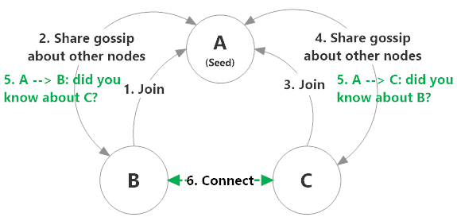
Akka cluster implementation

Slide 63
Akka cluster implementation
Vector clocks are used to reconcile and merge differences in cluster state during gossiping
Each update to the cluster state has an accompanying update to the vector clock
The digest used by the push-pull gossip consists of vector timestamps so the the actual state is pushed only as needed

Slide 64
Akka cluster implementation
The recipient of the gossip vector timestamp needs to determine whether:
it has a newer version of the gossip state, in which case it sends that back to the gossiper
it has an outdated version of the state, in which case the recipient requests the current state from the gossiper by sending back its version of the gossip state

Slide 65
Akka cluster implementation
Information about the cluster converges locally at a node at certain points in time
This is when a node can prove that the cluster state it is observing has been observed by all other nodes in the cluster
Convergence is implemented by passing a set of nodes that have seen the current state version during gossip
This information is referred to as the seen set
When all nodes are included in the seen set there is gossip convergence

Slide 66
Akka cluster implementation
Gossip convergence cannot occur while any nodes are unreachable
The nodes need to become reachable again, or moved to the down and removed states
Until then the leader is prevented from performing its cluster membership management role
For example this means that during a network partition it is not possible to add more nodes to the cluster

Slide 67
Akka cluster implementation
After gossip convergence a leader for the cluster is chosen
There is no leader election process: the leader is just the first node in the seen set (in sorted order) whenever there is gossip convergence
The role of the leader is to shift members in and out of the cluster, changing joining members to the up state or exiting members to the removed state.

Slide 68
Akka cluster implementation
To detect whether a node is unreachable
Nodes send each other heartbeats on an ongoing basis
If a node “misses enough” heartbeats, as determined by the accrual failure detector, this will trigger unreachable gossip messages from its peers
If a quorum of cluster nodes agree that the node is unreachable, the leader will mark it as down and begin removing the node from the cluster.

Slide 69
Akka cluster implementation
An accrual failure detector is used to detect if a node is unreachable from the rest of the cluster
an implementation of The Phi Accrual Failure Detector by Hayashibara et al.
An accrual failure detector decouples monitoring and interpretation
Makes “educated” guesses about whether a specific node is up or down
By keeping a history of failure statistics, calculated from heartbeats received from other nodes
It returns a phi value representing the likelihood that the node is down

Slide 70
Membership lifecycle
Normal Lifecycle:
A node begins in the joining state
Once all nodes have seen that the new node is joining (through gossip convergence) the leader will set the member state to up
If a node is leaving the cluster in a safe, expected manner then it switches to the leaving state
Once the leader sees the convergence on the node in the leaving state, the leader will then move it to exiting
Once all nodes have seen the exiting state (convergence) the leader will remove the node from the cluster, marking it as removed

Slide 71
Membership lifecycle
Failure Lifecycle:
If a node is unreachable then gossip convergence is not possible and therefore any leader actions are also not possible
To be able to move forward, the state of the unreachable nodes must be changed
It must become reachable again or marked as down.
The cluster can, through the leader, remove a node after a configured time of unreachability

Slide 72
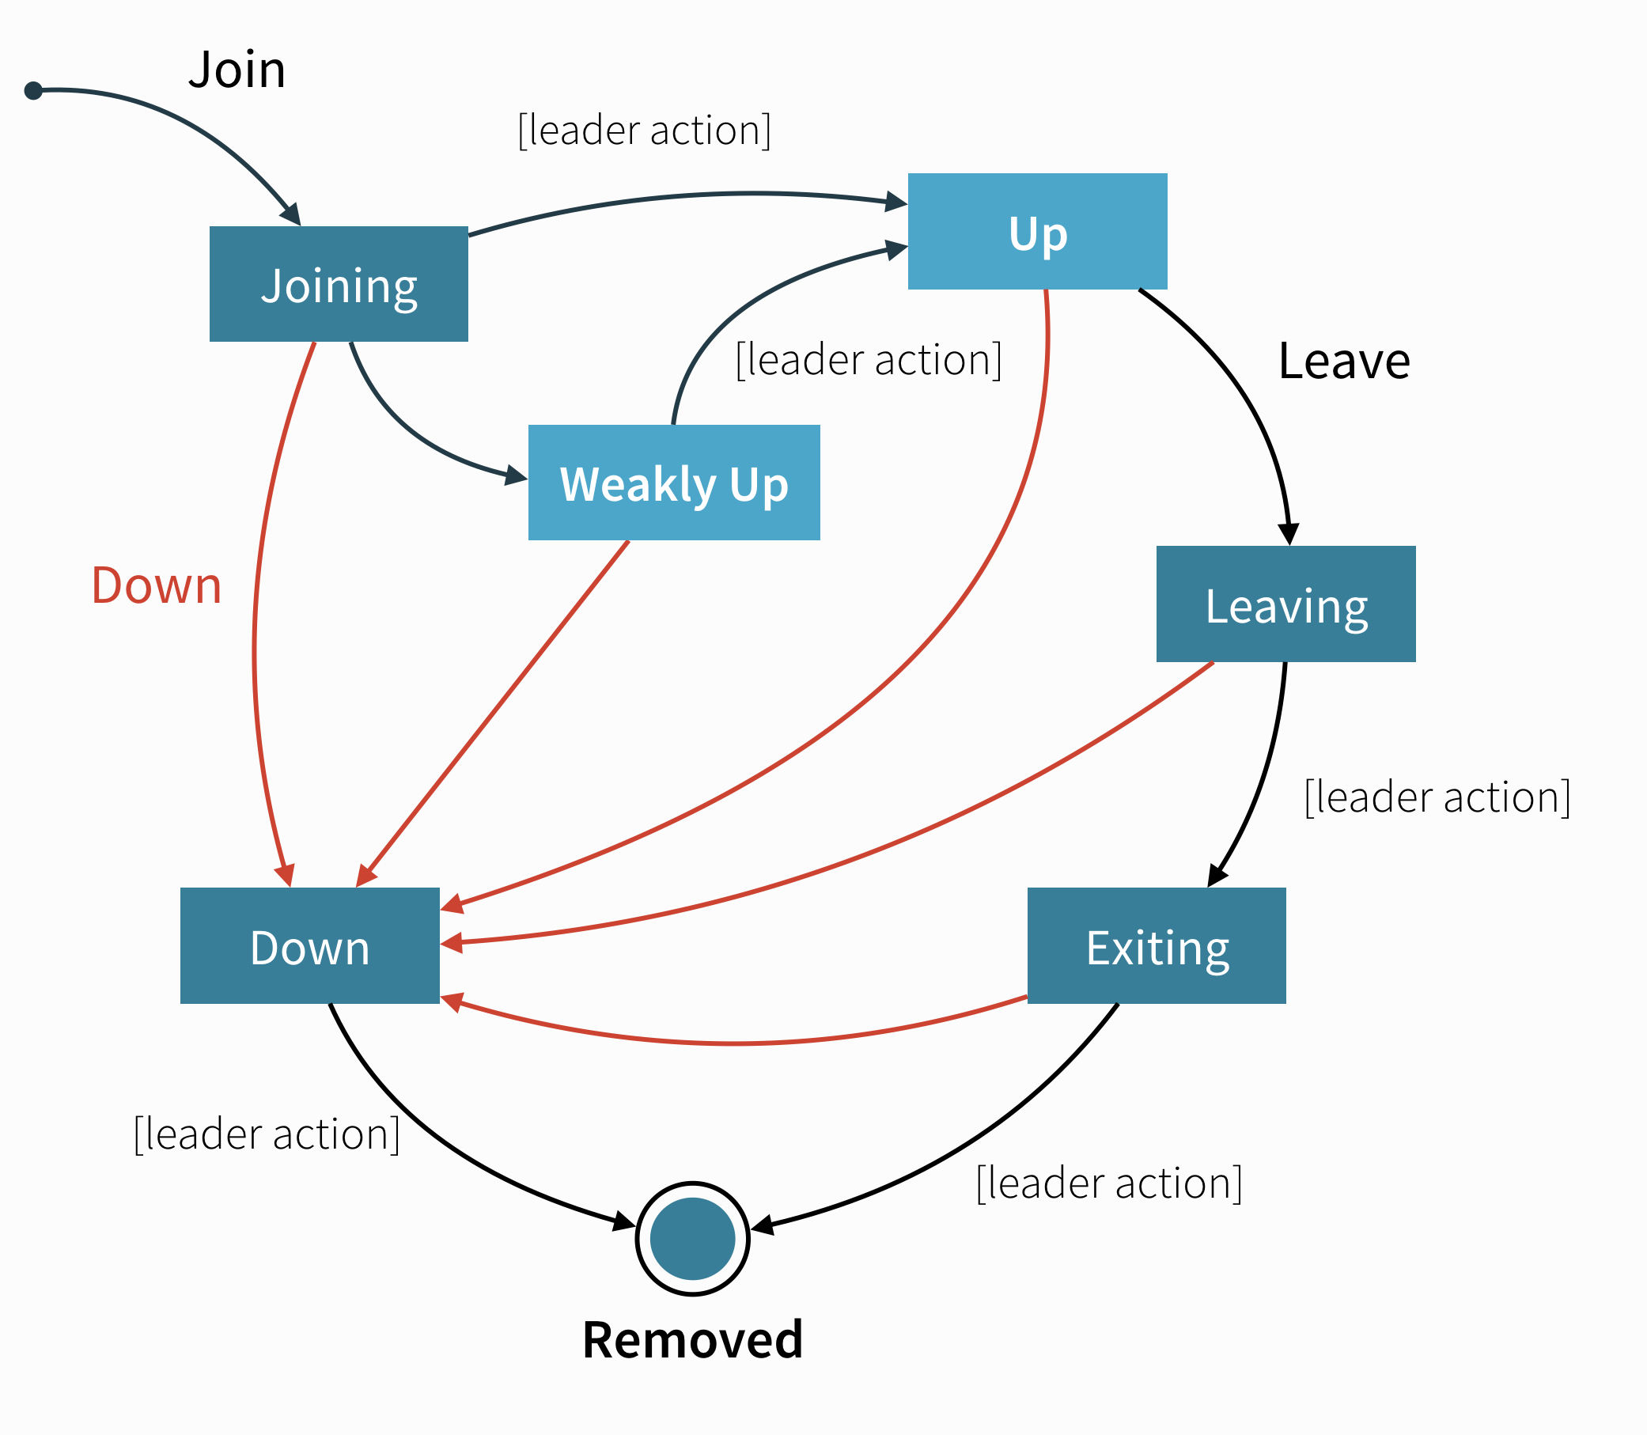
Akka cluster node states

Slide 73
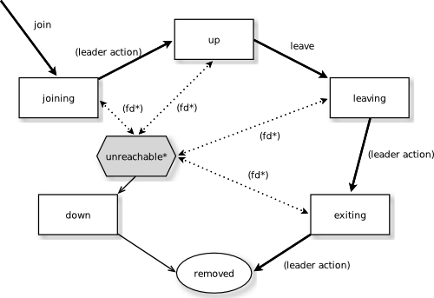
Akka cluster node states

Slide 74
Cluster aware routers
All routers can be made aware of member nodes in the cluster
When a node becomes unreachable or leaves the cluster the routees of that node are automatically unregistered from the router
When new nodes join the cluster, additional routees are added to the router, according to the configuration
Routees are also added when a node becomes reachable again, after having been unreachable.

Slide 75
Cluster aware routers
There are two distinct types of routers
Group - router that sends messages to the specified path using actor selection
The routees can be shared among routers running on different nodes in the cluster
Example: worker service running on backend nodes in the cluster and used by routers running on front-end nodes
Pool - router that creates routees as child actors and deploys them on remote nodes
Each router will have its own routee instances
Example: single master that coordinates jobs and delegates the actual work to routees running on other cluster nodes

Slide 76
Router with Group of Routees
Configuration (stats1.conf):
akka.actor.deployment {
/statsService/workerRouter {
router = consistent-hashing-group
routees.paths = ["/user/statsWorker"]
cluster {
enabled = on
allow-local-routees = on
use-role = compute
}
}
}

Slide 77
Router with Group of Routees
StatsMessage.scala
StatsWorker.scala
StatsService.scala
StatsSample.scala
In separate windows:
$ runMain sample.cluster.stats.StatsSample 2551
$ runMain sample.cluster.stats.StatsSample 2552
$ runMain sample.cluster.stats.StatsSampleClient
$ runMain sample.cluster.stats.StatsSample 0

Slide 78
Router with Pool of Remote Deployed Routees
Configuration (stats2.conf):
akka.actor.deployment {
/statsService/singleton/workerRouter {
router = consistent-hashing-pool
cluster {
enabled = on
max-nr-of-instances-per-node = 3
allow-local-routees = on
use-role = compute
}
}
}

Slide 79
Router with Pool of Remote Deployed Routees
StatsMessage.scala
StatsWorker.scala
StatsService.scala
StatsSampleOneMaster.scala
In separate windows:
$ runMain sample.cluster.stats.StatsSampleOneMaster 2551
$ runMain sample.cluster.stats.StatsSampleOneMaster 2552
$ runMain sample.cluster.stats.StatsSampleOneMasterClient
$ runMain sample.cluster.stats.StatsSampleOneMaster 0

