Slide 1
CSC 536 Lecture 8

Slide 2
Outline
Running Akka applications in the cloud
Akka Cluster (see last week’s lecture)
Docker
etcd
Kubernetes
Overview of Google’s distributed systems (part 1)

Slide 3
Docker

Slide 4
Problem
How to deploy Akka cluster (or other distributed applications) to production servers or the cloud?
Server OS is likely configured differently that the developer’s OS
Server OS may change between runs
Goal: package code into a Docker image and run and test it locally and then deploy it to production servers knowing that the code is running in the same environment

Slide 5
Solution
Containers such as Docker
separate your applications from your infrastructure and treat your infrastructure like a managed application

Slide 6
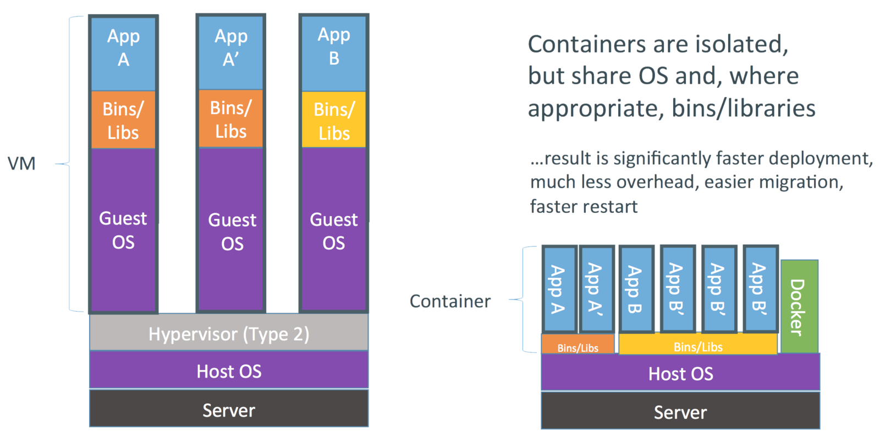
Docker overview

Slide 7
Akka cluster with Docker
akka-docker-cluster-example

Slide 8
etcd

Slide 9
Problem
Running an Akka cluster requires establishing a set of seed nodes
all nodes joining the cluster do so by contacting any of the seed nodes over the network, and
one of the seed nodes bootstraps the cluster by "joining itself" - establishing a new cluster of size 1
Problem: When running a distributed application on a cloud platform, the IP address of the container where the seed node(s) will execute is generally not known beforehand

Slide 10
A solution
Need an external, fault-tolerant key-value store that can be used to
elect the initial seed node, and then
publish a list of seed nodes afterwards
This would enable a zero-configuration deployment scenario for an Akka cluster

Slide 11
More generally
Need a fault-tolerant service for cluster coordination and state management
systems “source of truth”

Slide 12
etcd
Fault-tolerant distributed key-value store designed to reliably and quickly preserve and provide access to critical data
The keys form together a hierarchical keyspace with directories and keys.
Implementation: a replicated state machine that runs Raft underneath the hood
Allows developers to write systems that agree on the state of values

Slide 13
etcd
The name comes from the idea of distributing the Unix "/etc" directory, where many configuration files live, across multiple machines – /etc distributed
The CoreOS developers used it to make their distributed "/etc" plan work.

Slide 14
etcd API
From the command line to a local etcd instance:
$ etcdctl put mykey "this is awesome"
OK
$ etcdctl get mykey
mykey
this is awesome
In addition: set, rm, mk, mkdir, rmdir, ls, setdir, update, updatedir, watch and watch-exec, (atomic) compareAndSwap, (atomic) compareAndDelete, and others
https://etcd.io/docs/v3.4.0/dev-guide/interacting_v3/

Slide 15
etcd API
read/write a value
$ etcdctl get /folder/key
$ etcdctl set /folder/key
read/create directory
$ etcdctl mkdir /folder
$ etcdctl ls /folder
listen to changes
$ etcdctl watch /folder/key
$ etcdctl exec-watch /folder/key -- /bin/bash -c “touch /tmp/test”

Slide 16
Akka cluster with etcd
The known seed nodes are replaced by a known etcd service
Node A attempts to join the cluster, no one is there, so it puts itself into etcd and starts a single node cluster as a seed
B joins, finds A in etcd and joins A
C joins, finds A....
A gets shut down
After a timeout, B or C are put into etcd as new seed node
D joins, finds B or C....

Slide 17
Kubernetes

Slide 18
Kubernetes
Open-source system for automating deployment, scaling, and management of containerized applications.
In other words, a container orchestration platform
originally developed at Google
Master Kubernetes node uses etcd to store reliably the state of the system

Slide 19
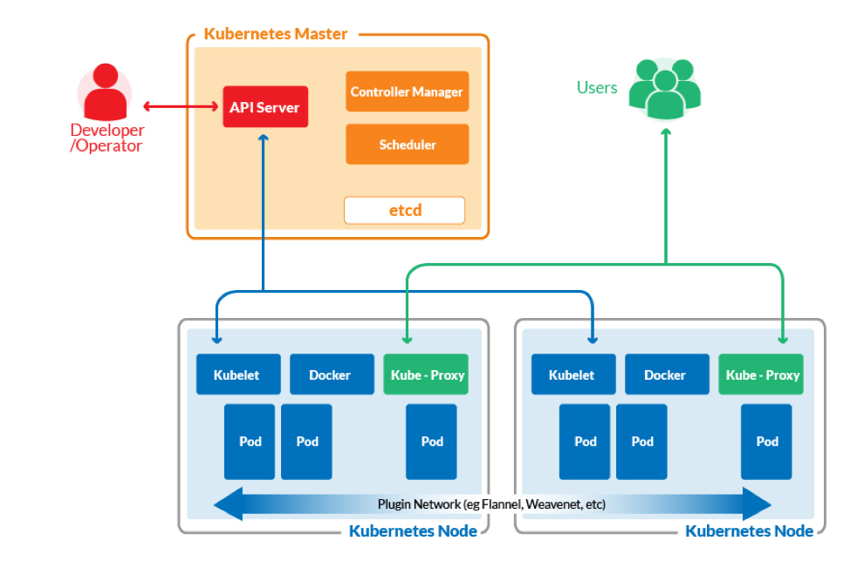
Kubernetes architecture

Slide 20
Kubernetes
Open-source system for automating deployment, scaling, and management of containerized applications.
In other words, a container orchestration platform
originally developed at Google
Master Kubernetes node uses etcd to store reliably the state of the system
https://github.com/akka/akka-sample-cluster-kubernetes-scala

Slide 21
Overview of Google’s distributed systems

Slide 22
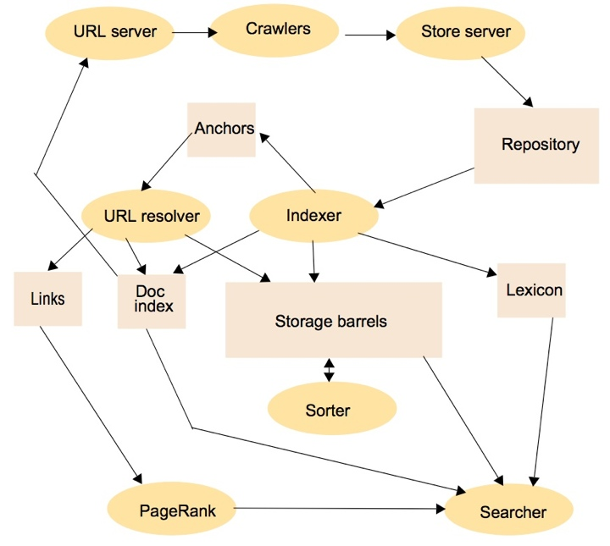
Original Google search engine architecture

Slide 23
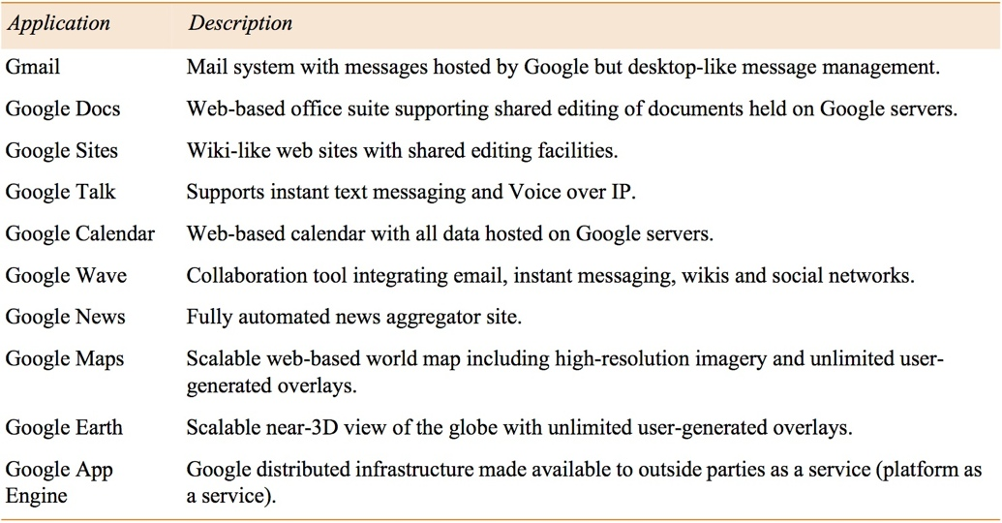
More than just a search engine

Slide 24
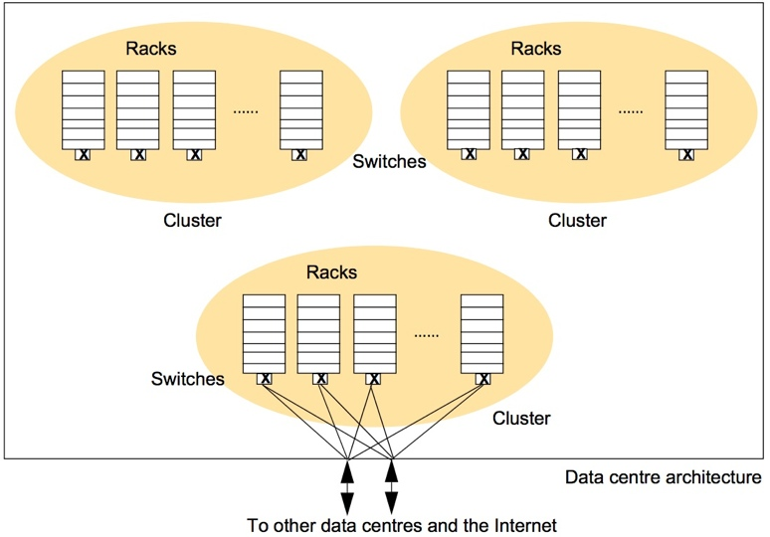
Organization of Google’s physical infrastructure
40-80 PCs
per rack
(terabytes of
disk space each)
30+ racks
per cluster
Hundreds
of clusters
spread across
data centers
worldwide

Slide 25
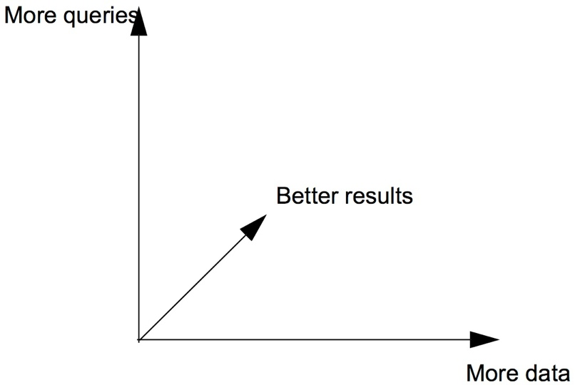
System architecture requirements
Scalability
Reliability
Performance
Openness (at the beginning, at least)

Slide 26
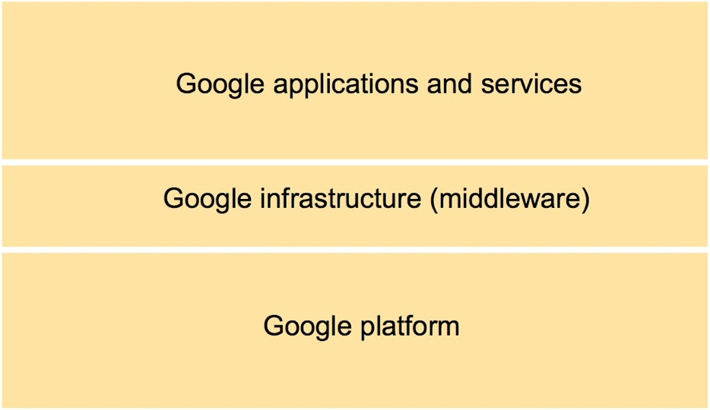
Overall Google systems architecture

Slide 27
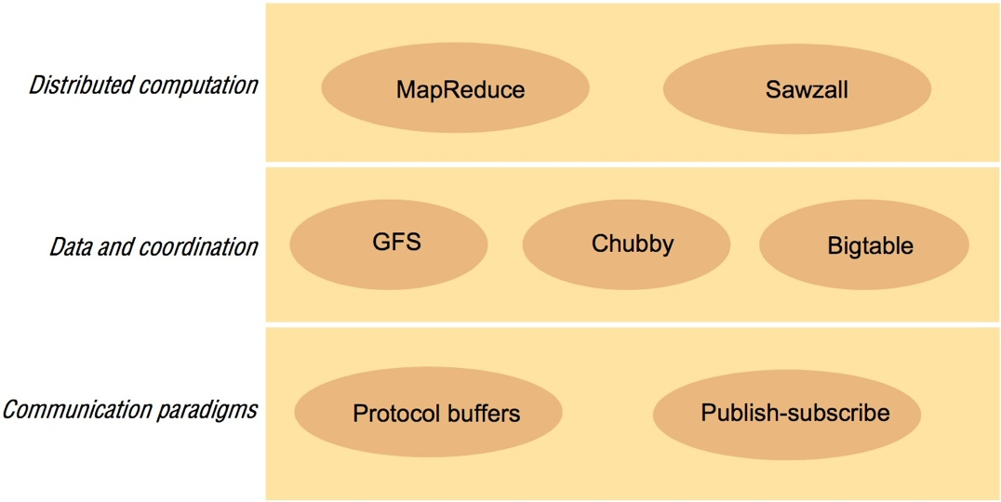
Google infrastructure

Slide 28
Design philosophy
Simplicity
Software should do one thing and do it well
Provable performance
Estimate performance costs (accessing memory and disk, sending packet over network, locking and unlocking a mutex, etc.)
“every millisecond counts”
Testing
Stringent testing
”if it ain’t broke, you’re not trying hard enough”

Slide 29
Data and coordination services
Google File System (GFS)
Broadly similar to NFS and AFS
Optimized to type of files and data access used by Google
BigTable
A distributed database that stores (semi-)structured data
Just enough organization and structure for the type of data Google uses
Chubby
a locking service, a leader election service, … actually a complete replicated state machine that maintains system state reliably for GFS and BigTable

Slide 30
GFS requirements
Must run reliably on the physical platform
Must tolerate failures of individual commodity components
So application-level services can rely on the file system
Optimized for Google’s usage patterns
Huge files (100+MB, up to 1GB)
Relatively small number of files
Accesses dominated by sequential reads and appends
Appends done concurrently by hundreds of writers
Meets the requirements of the whole Google infrastructure
scalable, reliable, high performance, open
Important: throughput has higher priority than latency

Slide 31
GFS API
Familiar file system interface
usual file operations to create, delete, open, close, read, and write files
Files are organized hierarchically in directories and identified by pathnames
GFS also has snapshot and record append operations
Snapshot creates a copy of a file or a directory tree at low cost
Record append is an atomic append operation

Slide 32
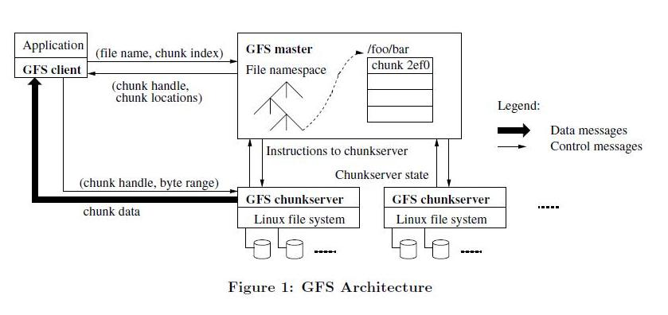
GFS architecture
File stored in 64MB chunks in a cluster with
a master node (operations log replicated on remote machines)
hundreds of chunk servers
Chunks replicated 3 times

Slide 33
GFS master
The master maintains all file system metadata (in memory)
namespace (also kept persistently)
access control information(also kept persistently)
mapping from files to chunks (also kept persistently)
current locations of chunks (NOT kept persistently)
It also controls system-wide activities
chunk lease management
garbage collection of orphaned chunks
chunk migration between chunkservers
After recovering from a crash, the master will
poll chunkservers to find out who has a replica of a given chunk
periodically communicate with each chunkserver in HeartBeat messages to give it instructions and collect its state

Slide 34
GFS client
GFS client code linked into each application
Implements the file system API
communicates with the master and chunkservers to read or write data on behalf of the application
Clients interact with the master for metadata operations
All data-bearing communication goes directly to the chunkservers
So the master is not a bottleneck when doing reads and writes

Slide 35
Reading and writing
When the client wants to access a particular offset in a file
The GFS client translates this to a (file name, chunk index)
And then send this to the master
When the master receives the (file name, chunk index) pair
It replies with the chunk identifier and replica locations
The client then accesses the closest chunk replica directly
No client-side caching
Caching would not help in the type of (streaming) access GFS has

Slide 36
Keeping chunk replicas consistent
When the master receives a mutation request from a client
the master grants a chunk replica a lease (replica is primary)
returns identity of primary and other replicas to client
The client sends the mutation directly to all the replicas
Replicas cache the mutation and acknowledge receipt
The client sends a write request to primary
Primary orders mutations and updates accordingly
Primary then requests that other replicas do the mutations in the same order
When all the replicas have acknowledged success, the primary reports an ack to the client
What consistency model does this implement?

Slide 37
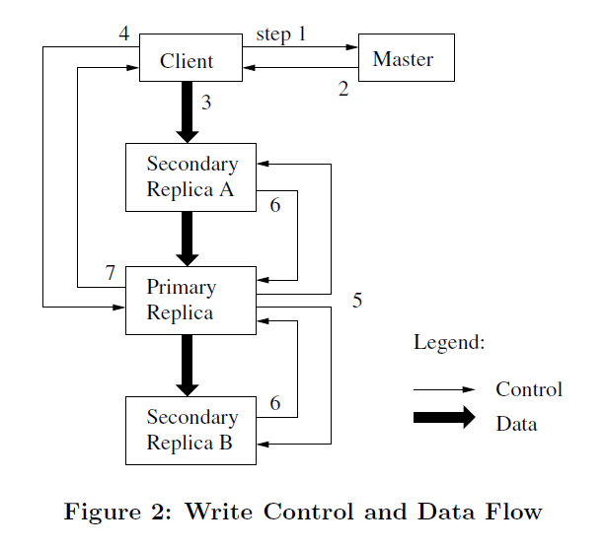
Keeping chunk replicas consistent

Slide 38
GFS (non-)guarantees
Writes (at a file offset) are not atomic
Concurrent writes to the same location may corrupt replicated chunks
If any replica is left inconsistent, the write fails (and is retried a few times)
Appends are executed atomically “at least once”
Offset is chosen by primary
May end up with non-identical replicated chunks with some having duplicate appends
GFS does not guarantee that the replicas are identical
It only guarantees that some file regions are consistent across replicas
When needed, GFS needs an external locking service (Chubby)
As well as a leader election service (also Chubby) to select the primary replica

Slide 39
GFS locking needs
Each node in the namespace tree has associated read/write locks
absolute file names and
absolute directory names
To create a file in a directory the master obtains a write lock on the directory
The read lock on a directory name suffices to prevent the directory from being deleted, renamed, or snapshotted
A snapshot operation has to revoke chunkserver leases on all chunks covered by the snapshot; read locks over regions of the namespace are used to ensure proper serialization
Chubby provides the locking service

Slide 40
Bigtable
GFS provides raw data storage
Also needed:
Storage for structured data ...
... optimized to handle the needs of Google’s apps ...
... that is reliable, scalable, high-performance, open, etc

Slide 41
Examples of structured data
URLs:
Content, crawl metadata, links, anchors, PageRank, ...
Per-user data:
User preference settings, recent queries/search results, …
Geographic locations:
Physical entities (shops, restaurants, etc.), roads, satellite image data, user annotations, …

Slide 42
Commercial DB
Why not use commercial database?
Not scalable enough
Too expensive
Full-featured relational database not required
Low-level optimizations may be needed

Slide 43
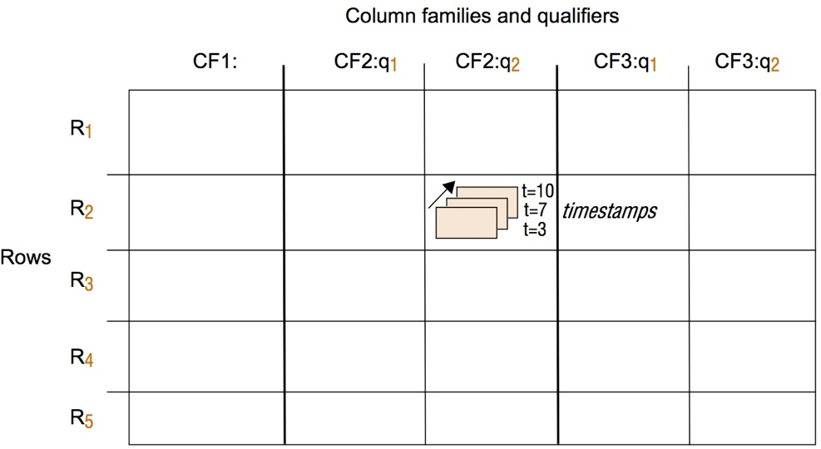
Bigtable table
Implementation: Sparse, distributed, persistent, multi-dimensional map
(row, column, timestamp) → cell contents

Slide 44
Rows
Each row has a key
A string up to 64KB in size
Access to data in a row is atomic
Rows ordered lexicographically by key
Rows that are close together in the table reside on one or neighboring machines (locality)

Slide 45
Columns
‘contents:.’
‘anchor:com.cnn.www/sport’
‘anchor:com.cnn.www/world’
“com.cnn.www”
“<html>…”
“CNN Sports”
“CNN world”
Columns have two-level name structure:
family:qualifier
Column family
logical grouping of data
groups unbounded number of columns (named with qualifiers)
may have a single column with no qualifier

Slide 46
Timestamps
Used to store different versions of data in a cell
default to current time
can also be set explicitly set by client
Garbage Collection
Per-column-family GC settings
“Only retain most recent K values in a cell”
“Keep values until they are older than K seconds”
...

Slide 47
API
Create / delete tables and column families
Table *T = OpenOrDie(“/bigtable/web/webtable”);
RowMutation r1(T, “com.cnn.www”);
r1.Set(“anchor:com.cnn.www/sport”, “CNN Sports”);
r1.Delete(“anchor:com.cnn.www/world”);
Operation op;
Apply(&op, &r1);

Slide 48
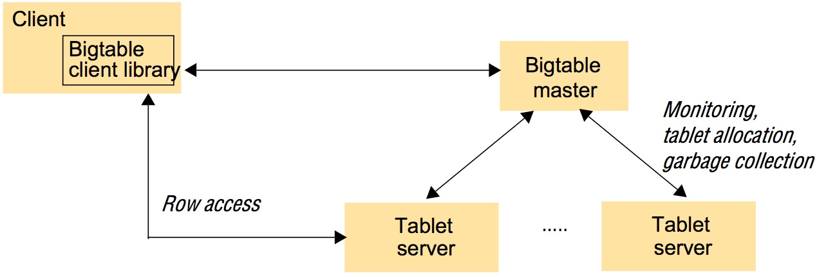
Bigtable architecture
An instance of BigTable is a cluster that stores tables
library on client side
master server
tablet servers
table is decomposed into tablets

Slide 49
Tablets
A table is decomposed into tablets
Tablet holds contiguous range of rows
100MB - 200MB of data per tablet
Tablet server responsible for ~100 tablets
Each tablet is represented by
A set of files stored in GFS
The files use the SSTable format, a mapping of (string) keys to (string) values
Log files

Slide 50
Tablet Server
When a tablet server starts, it creates and acquires an exclusive lock on a uniquely-named file in a specific Chubby directory
The master monitors this directory to discover tablet servers
Master assigns tablets to tablet servers
Tablet server
Handles reads / writes requests to tablets from clients
Clients obtain server info (i.e., tablet location info) from Chubby
No data goes through master
Bigtable client requires a naming/locator service (Chubby) to find the root tablet, which is part of the metadata table
The metadata table contains metadata about actual tablets
including location information of associated SSTables and log files

Slide 51
Master
Upon startup, must grab master lock to insure it is the single master of a set of tablet servers
provided by locking service (Chubby)
Monitors tablet servers
periodically scans directory of tablet servers provided by naming service (Chubby)
keeps track of tablets assigned to its tablet servers
obtains a lock on the tablet server from locking service (Chubby)
lock is the communication mechanism between master and tablet server
Assigns unassigned tablets in the cluster to tablet servers it monitors
when a tablet server hosting the tablet goes down or to…
… move tablets around to achieve load balancing or
Garbage collects underlying files stored in GFS

Slide 52
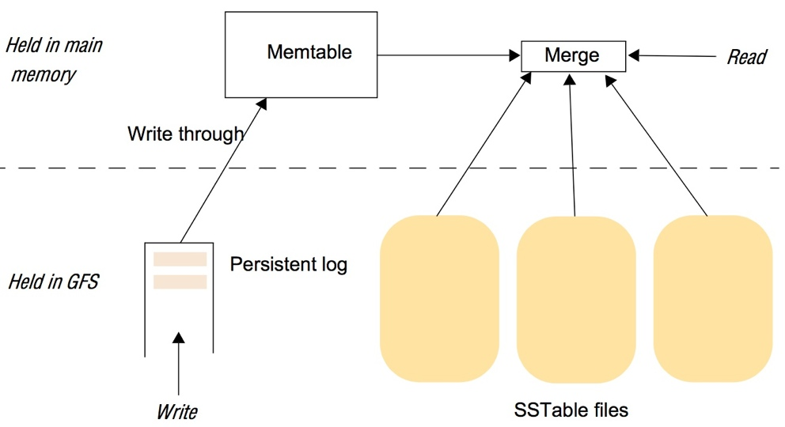
BigTable tablet architecture
Each is an ordered and immutable mapping of keys to values

Slide 53
Tablet Serving
Writes committed to log
Memtable: ordered log of recent commits (in memory)
SSTables really store a snapshot of recent changes
When Memtable gets too big do minor compaction
Create new empty Memtable
Merge old Memtable with recent SSTables to create new SSTable
A major compaction results in a single SSTable

Slide 54
Bigtable locking/metadata storage needs
Bigtable uses a locking service/key-value store (Chubby) for a variety of tasks
to ensure that there is at most one active master at any time
to store the bootstrap location of Bigtable data
to discover tablet servers and finalize tablet server deaths (i.e., to keep the system state)
to store Bigtable schema information (the column family information for each table)
to store access control lists
If Chubby becomes unavailable for an extended period of time, Bigtable becomes unavailable

Slide 55
Chubby
Chubby provides to the infrastructure
a locking service
a file system for reliable storage of small files
a leader election service (e.g. to select a primary replica)
a name service
Seemingly violates “simplicity” design philosophy but...
... What Chubby really provides is a …
Replicated state machine
… that at its core provides …
An asynchronous distributed agreement service
… about the state of Google’s distributed systems (GFS, BigTable, etc.)

Slide 56
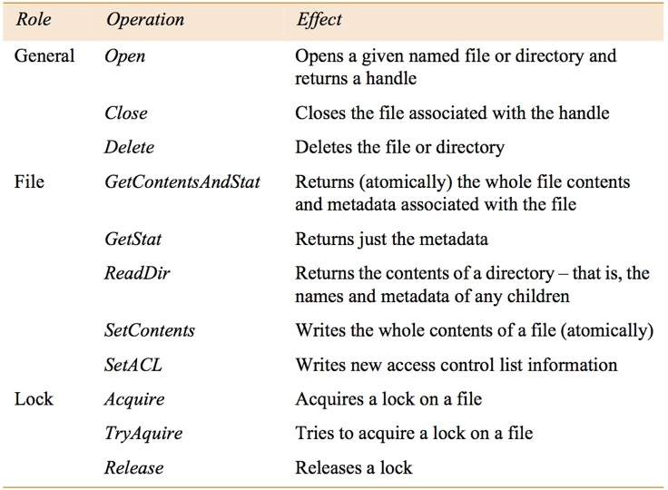
Chubby API

Slide 57
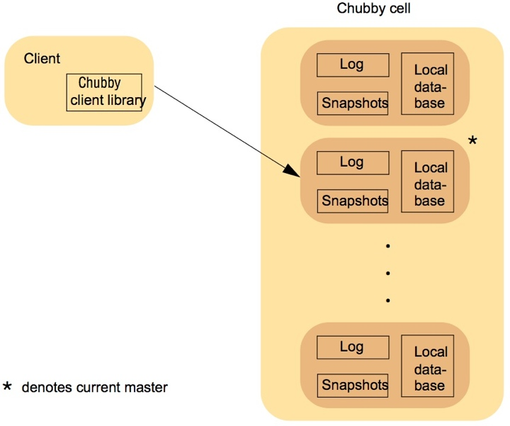
Overall architecture of Chubby
Cell: single instance
of Chubby system
5 replicas
1 master replica
Each replica maintains a database
of directories and files/locks
Consistency achieved using Lamport’s Paxos consensus protocol that uses an operation log
Chubby internally supports snapshots to periodically GC
the operation log

Slide 58
The Big Picture
Customized solutions for Google-type problems
GFS: Stores data reliably
Just raw files
BigTable: provides a database API via a key/value map
Database like, but doesn’t provide everything we need
Chubby: replicate state machine that stores the states of Google’s systems
Handles all synchronization needs

Slide 59
Common Principles
One master, multiple workers
MapReduce: master coordinates work amongst map / reduce workers
Chubby: master among five replicas
Bigtable: master knows about location of tablet servers
GFS: master coordinates data across chunkservers
Strong consistency models
Sequential consistency

