Slide 1
CSC 536 Lecture 9

Slide 2
Outline
Case study
Amazon Dynamo
Brewer’s CAP theorem
Case study
Google Spanner

Slide 3
Dynamo: Amazon’s key-value storage system

Slide 4
Amazon Dynamo
A data store for applications that require:
primary-key access to data
data size < 1MB
scalability
high availability
fault tolerance
and really low latency
No need for
Relational DB
Complexity and ACID properties imply little parallelism and low availability
Stringent security because it is used only by internal services

Slide 5
Amazon Dynamo
Goal: Perform simple read/write ops on single, small ( < 1MB) data objects which are identified by a unique key.
Example apps:
best seller lists
shopping carts
customer preferences
session management
sales rank
product specs and reviews
etc.

Slide 6
Design Considerations
“ … customers should be able to view and add items to their shopping cart even if disks are failing, network routes are flapping, or data centers are being destroyed by tornados.”

Slide 7
Design Considerations
“Always writeable”
users must always be able to add/delete from the shopping cart
no update is rejected because of failure or concurrent write
data must be replicated across data centers
resolve conflicts during reads, not writes
Let each application decide for itself
Single administrative domain
all nodes are trusted (no Byzantine failure) because service is not intended for external users

Slide 8
Design Considerations
Unstructured data
No need for hierarchical namespaces
No need for relational schema
Very-high availability and low latency
“At least 99.9% of read and write operations to be performed within a few hundred milliseconds”
“average” or “median” is not good enough
Avoid routing requests through multiple nodes
which would slow things down
Avoid ACID guarantees
ACID guarantees tend to have poor availability

Slide 9
Design Considerations
Incremental scalability
Adding a single node should not affect the system significantly
Decentralization and symmetry
All nodes have the same responsibilities
Favor P2P techniques over centralized control
No single point of failure
Take advantage of node heterogeneity
E.g., nodes with larger disks should store more data

Slide 10
Dynamo API
A key is associated with each stored item
Operations that are supported:
get(key)
return item associated with key
put(key, context, item)
write key,value pair into storage
The context encodes system metadata about the item
including version information

Slide 11
Dynamo API
A key is associated with each stored item
Operations that are supported:
get(key)
locates object replicas associated with key and returns the object or list of objects along with context (e.g, version numbers)
put(key, context, item)
determines where the item replicas should be placed based on the item key and writes the replicas with context info to disk
The context encodes system metadata about the item
including version information

Slide 12
Partitioning Algorithm
For scalability, Dynamo makes use of a large number of nodes
across clusters and data centers
Also for scalability, Dynamo must balance the loads
using a hash function to map data items to nodes
To ensure incremental scalability, Dynamo uses consistent hashing

Slide 13
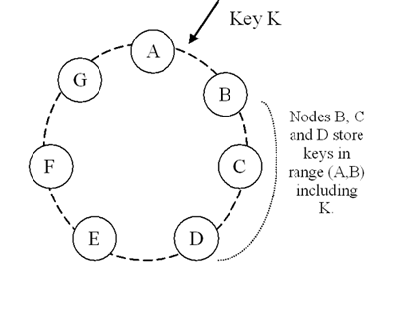
Partitioning Algorithm
Consistent hashing
Hash function produces an m-bit number
which defines a circular name space
Each data item has a key and is mapped to a number in the name space obtained using Hash(key)
Nodes are assigned numbers randomly in the name space
Data item is then assigned to the first clockwise node
the successor Succ() function
In consistent hashing the effect of adding a node is localized

Slide 14
Load Distribution
Problem: Random assignment of node to position in ring may produce non-uniform distribution of data
Solution: virtual nodes
Assign several random numbers to each physical node
Advantages
If node becomes unavailable, its load is easily and evenly dispersed across the available nodes
When a node becomes available, it accepts a roughly equivalent amount of load from the other available nodes
The number of virtual nodes that a node is responsible for can be decided based on its capacity

Slide 15
Failures
Amazon has a number of data centers
Consisting of a number of clusters of commodity machines
Individual machines fail regularly
Sometimes entire data centers may fail due to power outages, network partitions, tornados(!), etc.
To handle failures
items are replicated
replicas are not only spread across a cluster but across multiple data centers

Slide 16
Replication
Data is replicated at N nodes
Succ(key) = coordinator node
The coordinator replicates the object at the N-1 successor nodes in the ring, skipping virtual nodes corresponding to already used physical nodes
Preference list: the list of nodes that store a particular key
There are actually > N nodes on the preference list, in order to ensure R/W quorums at all times.

Slide 17
Data Versioning
Dynamo guarantees eventual consistency
Updates can be propagated to replicas asynchronously
put( ) call may return before all replicas have been updated
Why? provide low latency and high availability
Implication: a subsequent get( ) may return stale data
Some apps can be designed to work in this environment
e.g., the “add-to/delete-from cart” operation
It’s okay to add to an old cart, as long as all versions of the cart are eventually reconciled (in the worst case at checkout)

Slide 18
Data Versioning
Dynamo treats each modification as a new (& immutable) version of the object
Multiple versions can exist at the same time
Usually, new versions contain the old versions – no problem
Sometimes concurrent updates and failures generate conflicting versions
e.g., if there’s been a network partition

Slide 19
Parallel Version Branches
Vector clocks are used to identify causally related versions and parallel (concurrent) versions
For causally related versions, accept the final version as the “true” version
For parallel (concurrent) versions, use some reconciliation technique to resolve the conflict
Reconciliation technique is app dependent
Typically this is handled by merging
For add-to-cart operations, nothing is lost
For delete-from cart, deleted items might reappear after the reconciliation

Slide 20
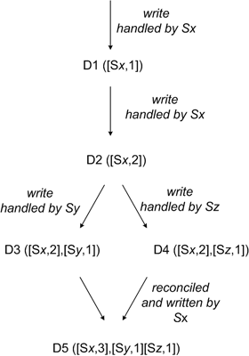
Parallel Version Branches example
D_{k}([S_{x},i], [S_{y},j]):
Object D_{k}
with vector clock ([S_{x},i], [S_{y},j])
where
[S_{x},i] indicates i updates by server S_{x}
and
[S_{y},j] indicates j updates by server S_{y}

Slide 21
Execution of get( ) and put( )
Operations can originate at any node in the system
Clients may
Route request through a load-balancing coordinator node
Use client software that routes the request directly to the coordinator for that object
The coordinator needs R nodes for reading and W nodes for writing, where R + W > N. A version of the quorum protocol called Sloppy Quorum is used.

Slide 22
Sloppy Quorum
put( ): the coordinator writes to the first N healthy nodes on the preference list
If W writes succeed, the write is considered to be successful
get( ): coordinator reads from N nodes
waits for R responses.
If they agree, return value
If they disagree, but are causally related, return the most recent value
If they are causally unrelated apply app-specific reconciliation techniques and write back the corrected version

Slide 23
Hinted Handoff
What if a write operation can’t get W of the first N nodes to agree on the write?
To preserve availability and durability, store the replica temporarily on another node in the preference list
accompanied by a metadata “hint” that remembers where the replica should be stored
this (another) node will eventually deliver the update to the correct node when it recovers
Hinted handoff ensures that read and write operations don’t fail because of network partitioning or node failures.

Slide 24
Handling Permanent Failures
Hinted replicas may be lost before they can be returned to the right node.
Other problems may cause replicas to be lost or fall out of agreement
Merkle trees allow two nodes to compare a set of replicas and determine fairly easily
Whether or not they are consistent
Where the inconsistencies are

Slide 25
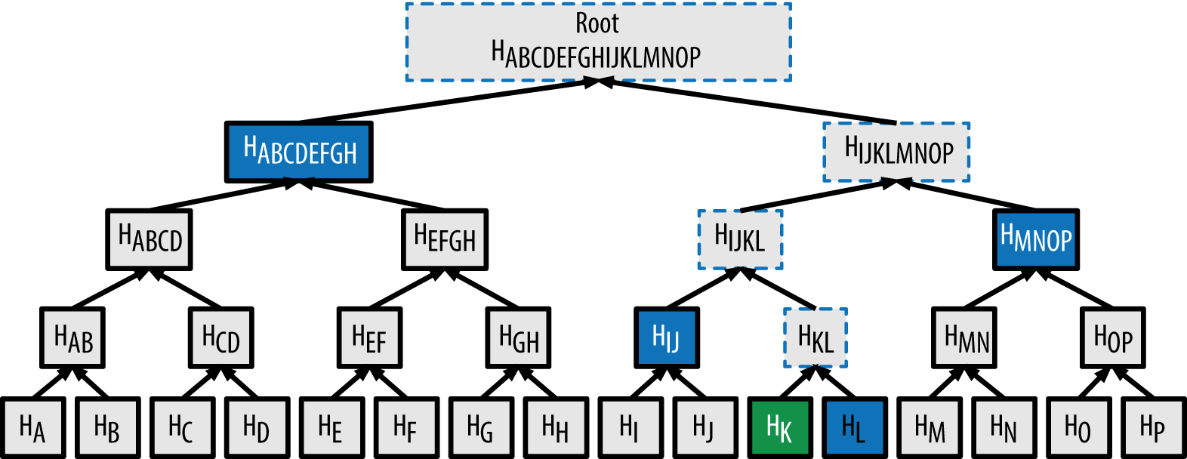
Merkle trees
Merkle trees have leaves whose values are hashes of the values associated with keys (one key/leaf)
Parent nodes contain hashes of their children
Eventually, root contains a hash that represents everything in that replica

Slide 26
Merkle trees
Each node maintains a separate Merkle tree for each key range (the set of keys covered by a virtual node) it hosts

Slide 27
Merkle trees
To detect inconsistency between two sets of replicas, compare the roots
Source of inconsistency can be detected by recursively comparing children

Slide 28
Membership and Failure Detection
Temporary failures of nodes are possible but shouldn’t cause load re-balancing
Additions and deletions of nodes are also explicitly executed by an administrator
A gossip-based protocol is used to ensure that every node eventually has a consistent view of its membership list
Members are the keys assigned to the ranges the node is responsible for

Slide 29
Gossip-based Protocol
Periodically, each node contacts another node in the network, randomly selected
Nodes compare their membership histories and reconcile them

Slide 30
Load Balancing for Additions and Deletions
When a node is added, it acquires key values from other nodes in the network.
Nodes learn of the added node through the gossip protocol, contact the node to offer their keys, which are then transferred after being accepted
When a node is removed, a similar process happens in reverse
Experience has shown that this approach leads to a relatively uniform distribution of key/value pairs across the system

Slide 31
Dynamo can be customized
Dynamo is used by several services with different configurations and usage patterns:
Business logic specific reconciliation
In case of divergent versions, the client application performs its own reconciliation logic.
Example: shopping cart service
Timestamp based reconciliation
In case of divergent versions, Dynamo performs simple timestamp based reconciliation logic of “last write wins”
Example: customer session information service
High performance read engine
Some services are tuning the Dynamo quorum characteristics and using it as a high performance read engine. In this configuration, typically R is set to be 1 and W to be N
Example: product catalog service

Slide 32
Summary
Problem Technique Advantage
Partitioning Consistent Hashing Incremental scalability
High availability Vector clocks, reconciled Version size is decoupled
for writes during reads from update rates
Temporary Sloppy quorum, Provides high availability &
failures hinted handoff durability guarantee when
some of the replicas are
not available
Permanent Merkle trees Synchronizes divergent replicas
failures in the background
Membership & Gossip-based protocol Preserves symmetry and avoids
failure detection having a centralized registry for
storing membership and node
liveness information

Slide 33
Summary
High scalability, including incremental scalability
Very high availability is possible, at the cost of consistency
App developers can customize the storage system to emphasize performance, durability, or consistency
The primary parameters are N, R, and W
Dynamo shows that decentralization and eventual consistency can provide a satisfactory platform for hosting highly-available applications.
https://www.allthingsdistributed.com/2007/10/amazons_dynamo.html

Slide 34
Riak
A distributed, highly available, eventually consistent, highly scalable, open source key-value database
written primarily in Erlang
Modeled after Amazon Dynamo
https://docs.riak.com/riak/kv/2.2.3/learn/dynamo/
https://docs.riak.com/riak/kv/2.2.3/learn/
Akka cluster membership algorithm based on Riak approach

Slide 35
Dynamo vs BigTable
Different types of data storage, designed for different needs
Dynamo optimizes latency
BigTable emphasizes throughput
More precisely
Dynamo tends to emphasize network partition fault-tolerance and availability, at the expense of consistency
BigTable tends to emphasize network partition fault-tolerance and consistency over availability

Slide 36
CAP theorem

Slide 37
Dynamo vs BigTable
Different types of data storage, designed for different needs
Dynamo optimizes latency
BigTable emphasizes throughput
More precisely
Dynamo tends to emphasize network partition fault-tolerance and availability, at the expense of consistency
BigTable tends to emphasize network partition fault-tolerance and consistency over availability

Slide 38
CAP theorem
Impossible for a distributed data store to simultaneously provide
Consistency (C)
Availability (A)
Partition-tolerance (P)
Conjectured by Brewer in 2000
Formally “proven” by Gilbert&Lynch in 2002

Slide 39

CAP Theorem
A simple example:
Hotel Booking: are we double-booking the same room?
Bob
Dong

Slide 40
CAP Theorem
A simple example:
Hotel Booking: are we double-booking the same room?
Bob
Dong

Slide 41

CAP Theorem
A simple example:
Hotel Booking: are we double-booking the same room?
Bob
Dong

Slide 42
Brewer’s CAP theorem
Assume two nodes storing replicated data on opposite sides of a partition
Allowing at least one node to update state will cause the nodes to become inconsistent, thus forfeiting C
Likewise, if the choice is to preserve consistency, one side of the partition must act as if it is unavailable, thus forfeiting A
Only when nodes communicate is it possible to preserve both consistency and availability, thereby forfeiting P
Naïve Implication (“2 out of 3” view)
Since, for wide-area systems, designers cannot forfeit P, they must make a difficult choice between C and A

Slide 43
What about latency?
Latency and partitions are related
Operationally, the essence of CAP takes place during a partition-caused timeout, a period when the program must make a fundamental decision:
block/cancel the operation and thus decrease availability or
proceed with the operation and thus risk inconsistency
The first results in high latency (waiting until partition is repaired) and the second results in possible inconsistency

Slide 44
Brewer’s CAP theorem
BigTable is a “CP type system”
Hbase, VoltDB/H-Store are similar
Dynamo is an “AP type system”
Cassandra, Riak are similar
Yahoo’s PNUTS is an “AP type system”
maintains remote copies asynchronously
makes the “local” replica the master, which decreases latency
works well in practice because single user data master is naturally located according to the user’s (normal) location
Facebook uses a “CP type system”
the master copy is always in one location
user typically has a closer but potentially stale copy
when users update their pages, the update goes to the master copy directly as do all the user’s reads for about 20 seconds, despite higher latency. After 20 seconds, the user’s traffic reverts to the closer copy.
“AP”, “CP” are really rough generalizations

Slide 45
ATM example
In design of an Automated Teller Machine (ATM):
Strong consistency appear to be a natural choice
However, in practice, A beats C
Higher availability means higher revenue
ATM will allow you to withdraw money even if the machine is partitioned from the network
However, it puts a limit on the amount of withdraw (e.g., $200)
The bank might also charge you a fee when an overdraft happens

Slide 46
Brewer’s CAP theorem
A more sophisticated view
Because partitions are rare, there is little reason to forfeit C or A when the system is not partitioned
The choice between C and A can occur many times within the same system at very fine granularity
not only can subsystems make different choices, but the choice can change according to the operation or specific data or user
The 3 properties are more continuous than binary
Availability is a percentage between 0 to 100 percent
Different consistency models exist
Different kinds of system partition can be defined

Slide 47
Dynamic Tradeoff between C and A
An airline reservation system:
When most of seats are available: it is ok to rely on somewhat out-of-date data, availability is more critical
When the plane is close to be filled: it needs more accurate data to ensure the plane is not too overbooked, consistency is more critical

Slide 48
Google Spanner

Slide 49
Google Spanner
Scalable globally-distributed multi-versioned database
Main features:
Focus on cross-datacenter data replication
for availability and geographical locality
Automatic sharding and shard migration
for load balancing and failure tolerance
Scales to millions of servers across hundreds of datacenters
and to database tables with trillions of rows
Schematized, semi-relational (tabular) data model
to handle more structured data (than Bigtable, say)
Strong replica consistency model
synchronous replication

Slide 50
Google Spanner
Scalable globally-distributed multi-versioned database
Follow-up to Google’s Bigtable and Megastore
Detailed DB features
SQL-like query interface
to support schematized, semi-relational (tabular) data model
General-purpose distributed ACID transactions
even across distant data centers
Externally consistent global write-transactions with synchronous replication
Sequential consistency < external consistency = linearizability < strong consistency
Lock-free read-only transactions
Timestamped multiple-versions of data

Slide 51
Google Spanner
Scalable globally-distributed multi-versioned database
Follow-up to Google’s Bigtable and Megastore
Detailed DS features
Auto-sharding, auto-rebalancing, automatic failure response
Replication and external consistency model
App/user control of data replication and placement
number of replicas and replica locations (datacenters)
how far the closest replica can be (to control reading latency)
how distant replicas are from each other (to control writing latency)
Wide-areas system

Slide 52
Google Spanner
Scalable globally-distributed multi-versioned database
Follow-up to Google’s Bigtable and Megastore
Key implementation design choices
Integration of concurrency control, replication, and 2PC
Transaction serialization via global, wall-clock timestamps
using TrueTime API
Satisfies linearizability: if a transaction T1 commits before another transaction T2 starts, then T1’s commit timestamp is smaller than T2’s.
TrueTime API uses GPS devices and Atomic clocks to get accurate time
acknowledges clock uncertainty and guarantees a bound on it

Slide 53
Google Spanner
Scalable globally-distributed multi-versioned database
Follow-up to Google’s Bigtable and Megastore
Production use
Unrolled in Fall 2012
Used by Google F1, Google’s advertising backend
Replaced a sharded MySQL database
5 replicas across the US
Less critical app may only need 3 replicas in a single region which would decrease latency (but also availability)

Slide 54
Google Spanner
spanner-osdi2012.pptx
https://www.youtube.com/watch?v=NthK17nbpYs
d

