Slide 1
Logging in Enterprise Apps

Slide 2
Q What are the JavaScript console.log or the Java System.out statements that we keep using in our code?
Ans Debugging statements, Diagnostic messages, Error messages
Q Where and why?
Ans
In calculations to print out and verify the result.
While calling a method with parameters to check whether the called method got the expected parameters.
To verify return values of methods.
To check program flow. Method A calls method B, method B calls C, and so on. And we want to verify whether the sequence of call is being done as expected.

Slide 3
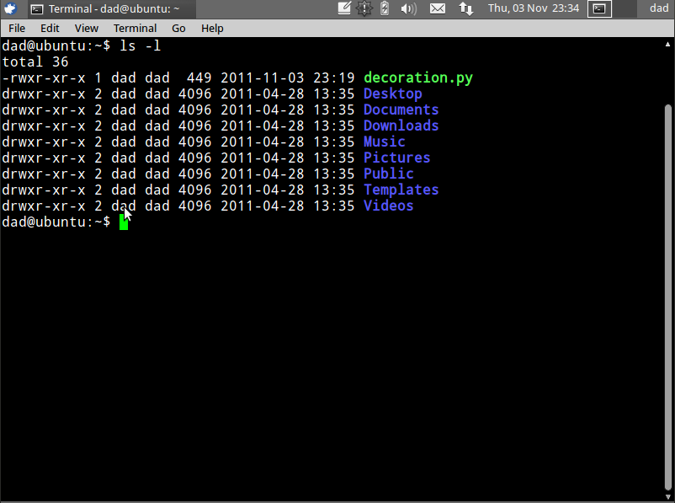
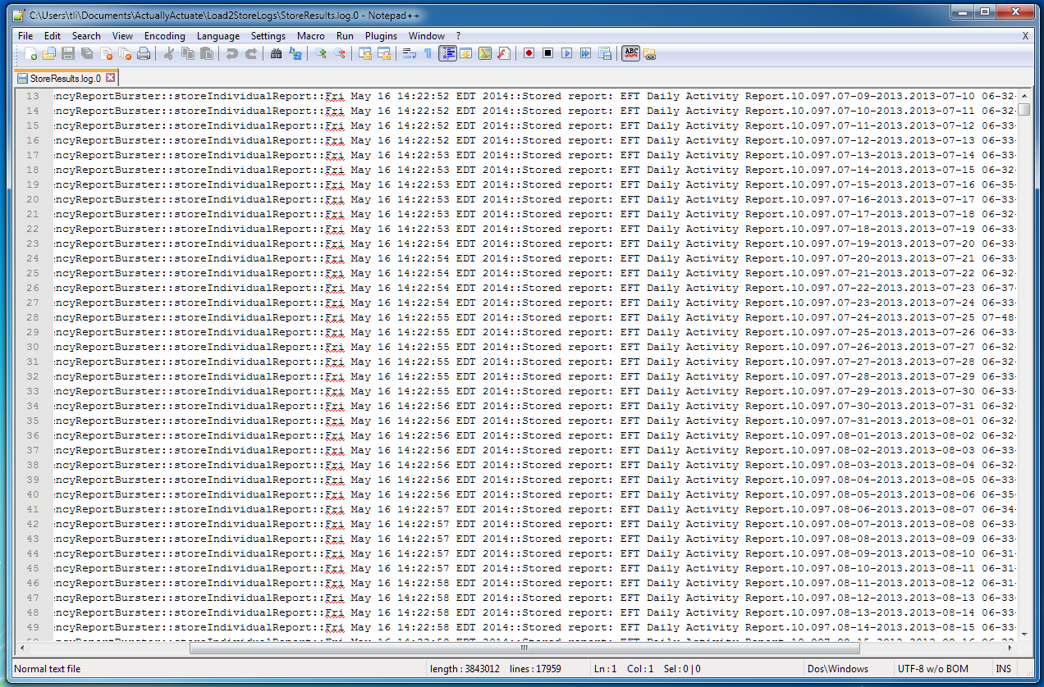
Problems
console.log(“An error occurred.”);
VS
console.log(“Processing completed.”);
console.log(“An error occurred.”);
Console
File
Database

Slide 4
Logging Components
Logger
Appender
Layout

Slide 5
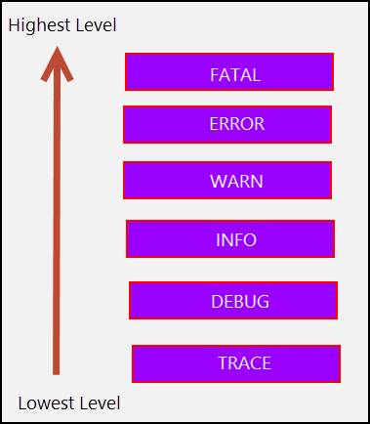
Log Levels

Slide 6
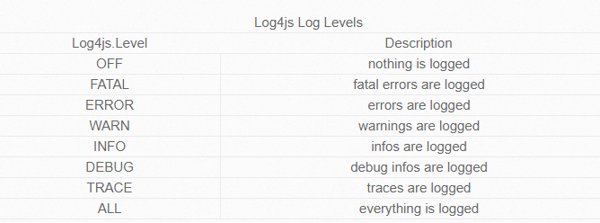
Log4JS Levels

Slide 7
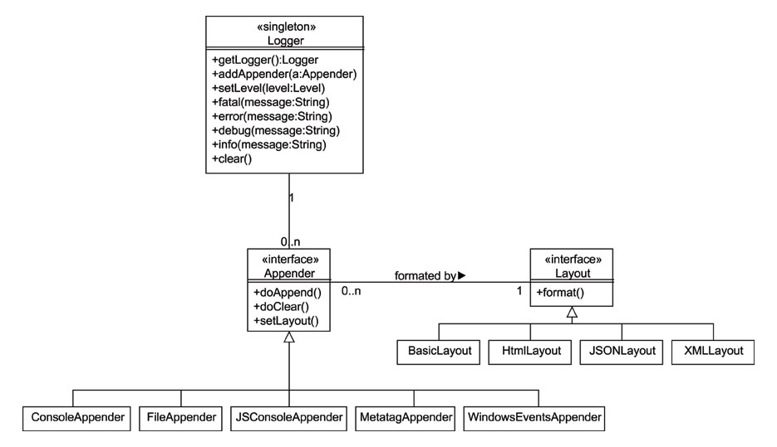
Log4js API

Slide 8
Log4js - Usage
Add log4js Dependency in package.json
Create a log4js configuration file (By convention log4js.conf.json)
Require the log4js library
let log4js = require("log4js");
Configure the library with your configurations:
log4js.configure('log4js.conf.json');
Best Practice (Only for Complex Messages)
Get the logger component for the script:
logger = log4js.getLogger('index');
if( myLogger.isDebugEnabled()) {
myLogger.debug(...);
}
Start logging.
logger.debug(“Debug message");
logger.info(“Info message");
logger.warn("Warning message");
logger.fatal("Fatal message");

Slide 9
Thanks Contact me: simanta.sarma@stackroute.in ximanta.sarma@gmail.com Follow me on Twitter: @ximanta.sarma Follow me on Github: https://github.com/ximanta Get the Demo Code and Slide: https://github.com/ximanta/presentations
References:
https://www.balabit.com/blog/why-logging-is-important/
http://stritti.github.io/log4js/docu/users-guide.html http://scratchpad.wikia.com/wiki/Log4js

