Slide 1
The Conditional Probability Bias in Risk Valuation
With Yaxuan Ran and Emily Prinsloo

Slide 2
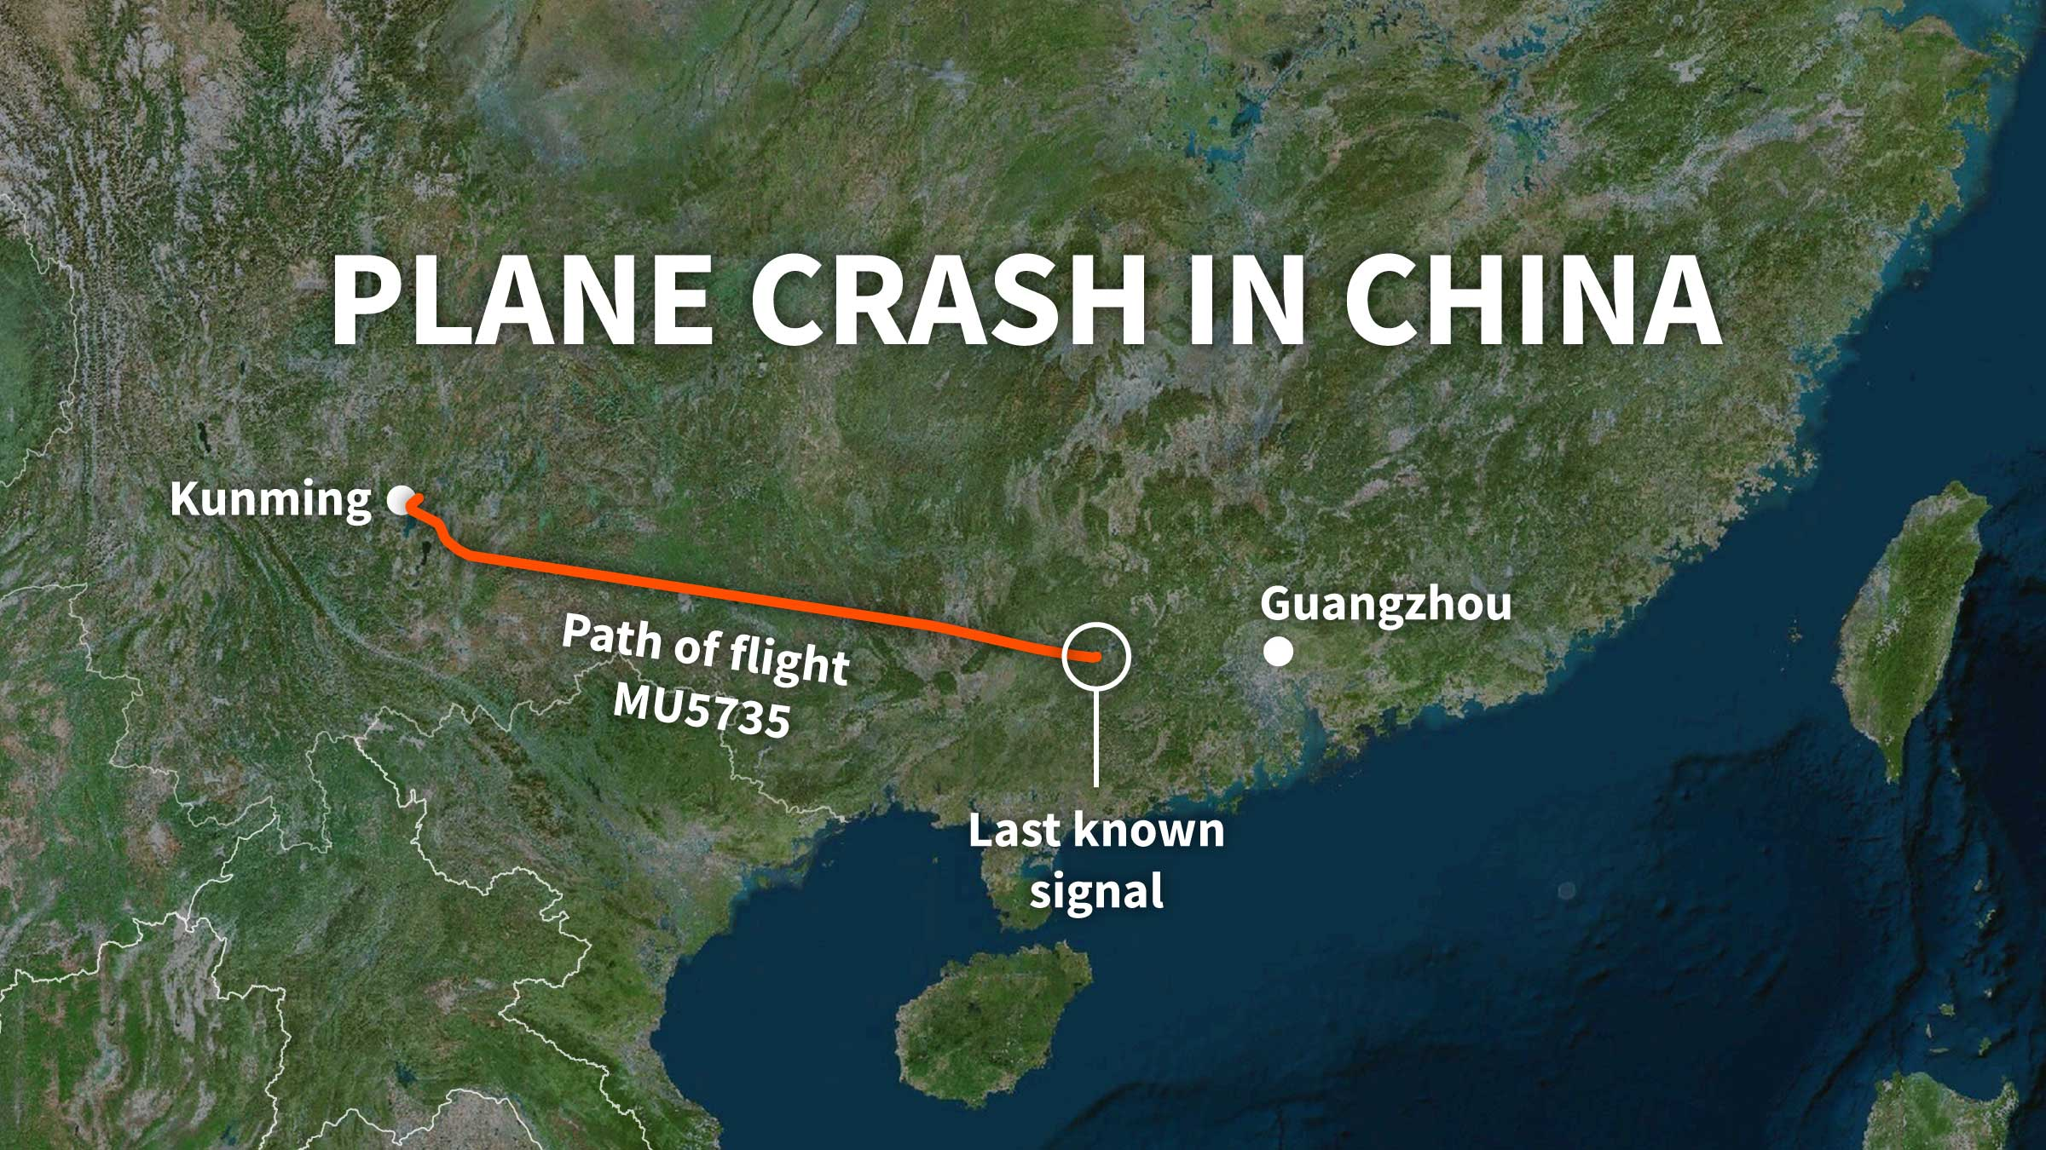
Motivating Example 1: China Eastern Airline Accident March 21, 2022, 132 killed

Slide 3
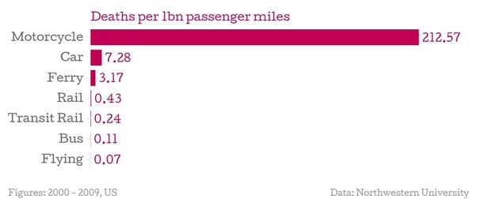
Why people are afraid of flying?
We frequently hear that flying is the safest way of traveling.
Yet, many people are afraid of flying.
We even have a word “aerophobia” to describe fear with flying…

Slide 4
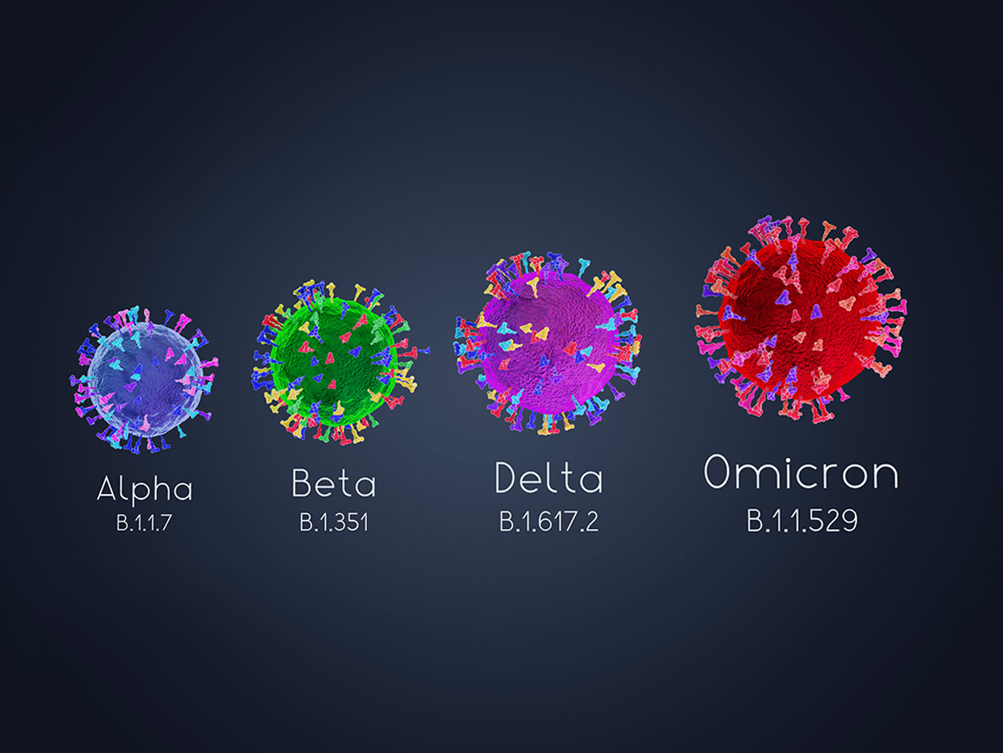
Motivating Example 2: The Spread of COVID-19 Omicron

Slide 5

Motivating Example 2: The Spread of COVID-19 Omicron

Slide 6
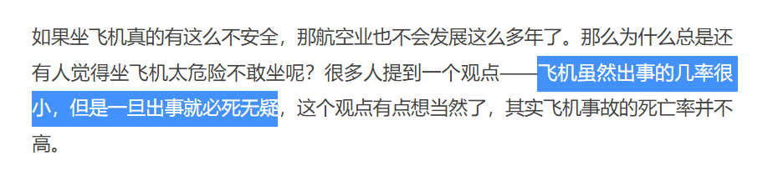
A potential explanation:
People are afraid of flying because the chance of surviving a plane crash is very low…
In other words, the fatality rate conditional on having an accident is higher!

Slide 7
A potential explanation:
As for the comparison between Omicron and Delta, although Omicron leads to more deaths and infections, its fatality rate conditional on getting the disease is lower.

Slide 8
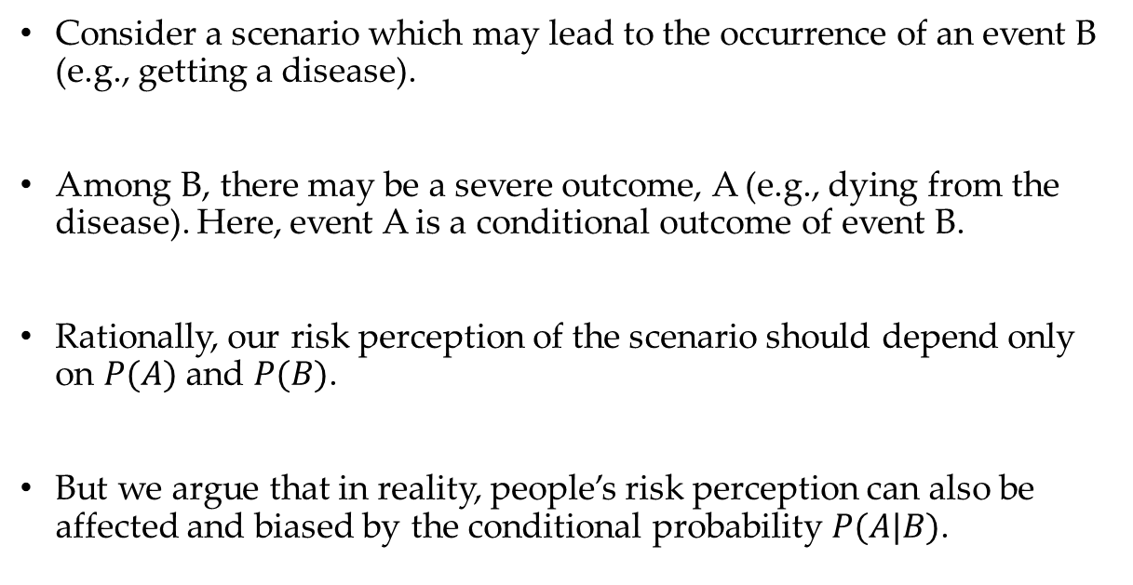
Our hypothesis:
Consider a scenario which may lead to the occurrence of an event B (e.g., getting a disease).
Among B, there may be a severe outcome, A (e.g., dying from the disease). Here, event A is a conditional outcome of event B.
Rationally, our risk perception of the scenario should depend only on $P(A)$ and $P(B)$.
But we argue that in reality, people’s risk perception can also be affected and biased by the conditional probability $P(A|B)$.

Slide 9
But Why?
The conditional probability bias arises because conditional probability is diagnostic in risk judgment.
Here, diagnosticity refers to the extent to which information is sufficient to draw conclusions.
In judgment and decision-making, information’s diagnosticity is represented as relevance or importance or in terms of the ambiguity of classifying an object based on information cues.

Slide 10
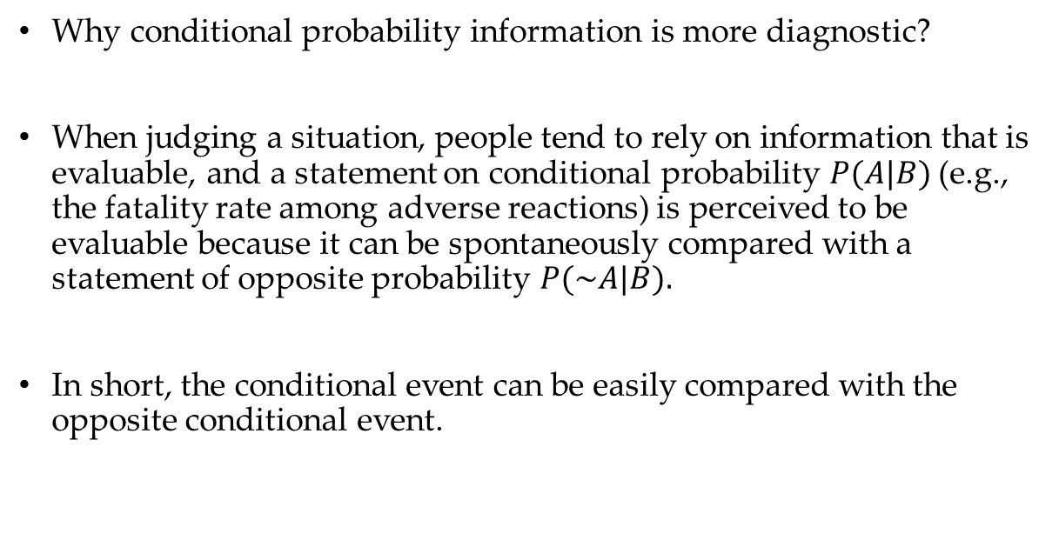
As for conditional probability:
Why conditional probability information is more diagnostic?
When judging a situation, people tend to rely on information that is evaluable, and a statement on conditional probability $P(A|B)$(e.g., the fatality rate among adverse reactions) is perceived to be evaluable because it can be spontaneously compared with a statement of opposite probability $P(\sim A|B).$
In short, the conditional event can be easily compared with the opposite conditional event.

Slide 11
As for conditional probability:
Why conditional probability information is more diagnostic?
Since A is a more concrete outcome of B, the occurrence of A (e.g., dying from the disease) being conditional on B (e.g., contracting the disease) is thought to be imaginable and easy to conceive of.
This explanation is consistent with the research on availability, a typical explanation of heuristics and biases proposed by Tversky and Kahneman (1974).

Slide 12
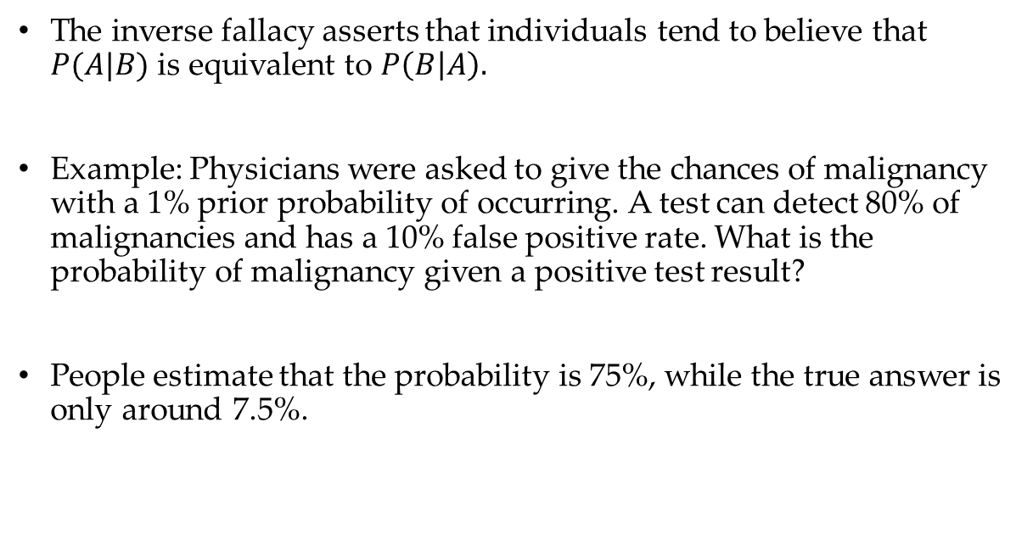
Literature: Inverse Fallacy (Dawes, 1993; Gigerenzer and Hoffrage, 1995; Hamm, 1993; Villejoubert and Mandel, 2002)
The inverse fallacy asserts that individuals tend to believe that $P(A|B)$ is equivalent to $P\left(B | A\right).$
Example: Physicians were asked to give the chances of malignancy with a 1% prior probability of occurring. A test can detect 80% of malignancies and has a 10% false positive rate. What is the probability of malignancy given a positive test result?
People estimate that the probability is 75%, while the true answer is only around 7.5%.

Slide 13
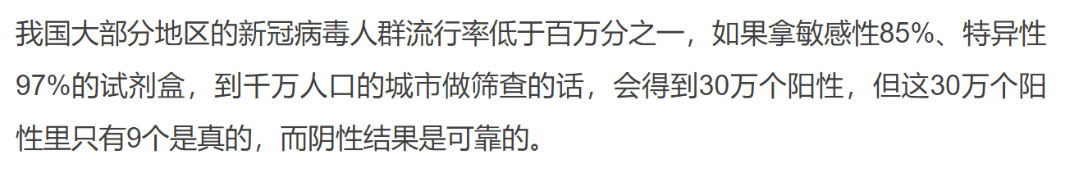
Literature: Base Rate Fallacy (Fiedler et al. 2002; Bar-Hillel, 1980; Macchi, 1995; Koehler, 1996)
People tend to ignore the base rate (i.e., general prevalence) in favor of the individuating information
Even if a COVID-19 test identifies negative cases with an accuracy rate of 99.9%, the test result will have far more false positives than true positives (because of the base rate of positive cases is low). However, people tend to ignore the base rate information when judging the accuracy of the test.

Slide 14
Study 1: Lottery Tickets
We recruited 220 participants via Prolific.
This experiment adopts a 2-level (i.e., low vs. high conditional probability) between-subjects design.
All participants were told that a fictitious lottery company, LuckyGOGO, has designed a new lottery. Then, participants were asked to read the following passage:

Slide 15
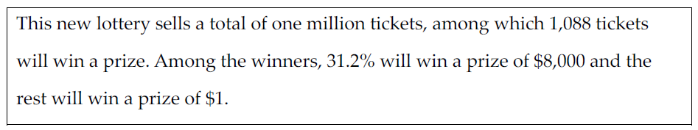
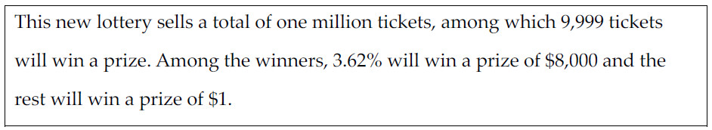
Study 1: Lottery Tickets
High-conditional-probability condition:
Low-conditional-probability condition:

Slide 16
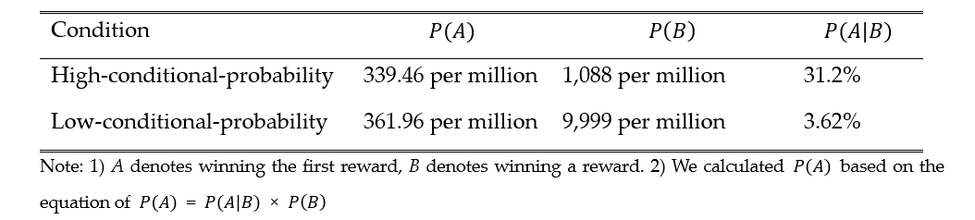
Study 1: Lottery Tickets
From any perspective, the high-conditional-probability condition is less attractive than the low-conditional probability condition: It has higher likelihoods of winning a first reward and winning a reward.

Slide 17
Study 1: Lottery Tickets
Q: Do you find the lottery attractive?
Q: How likely would you buy the lottery?

Slide 18
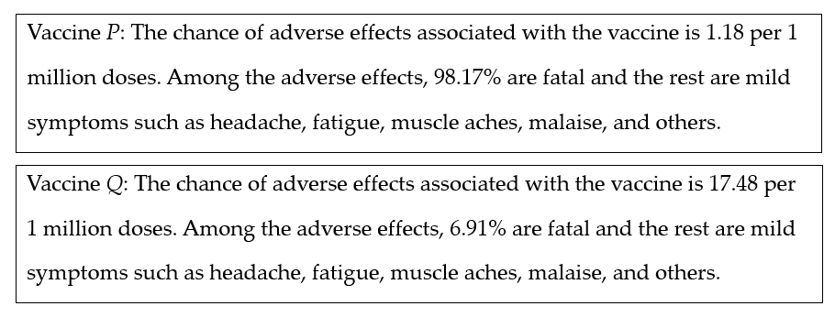
Study 2: Vaccines
Within-subjects design; 153 participants; negative scenario.
Evaluating two vaccines for H. pylori infection.

Slide 19
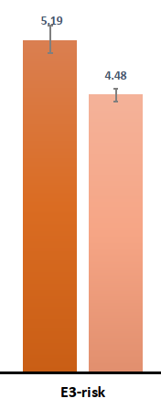
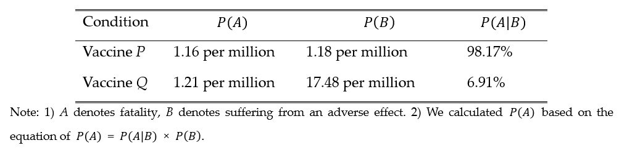
Study 2: Vaccines
It is obvious that vaccine P dominates vaccine Q:

Slide 20
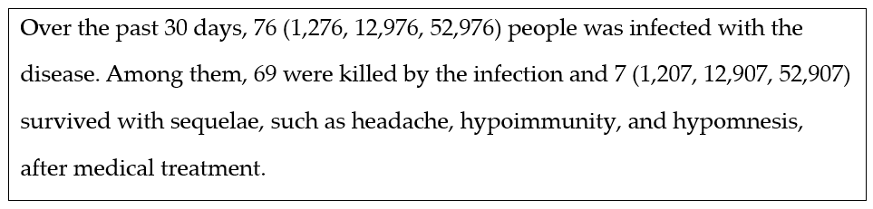
Study 3: Infectious disease
Between-subjects design with 4 conditions: High, slightly low, low, and very low conditional probability.
The study is designed to answer the following question: “Does the bias arise because high conditional probability raises risk valuation, or low conditional probability decreases risk valuation?”

Slide 21
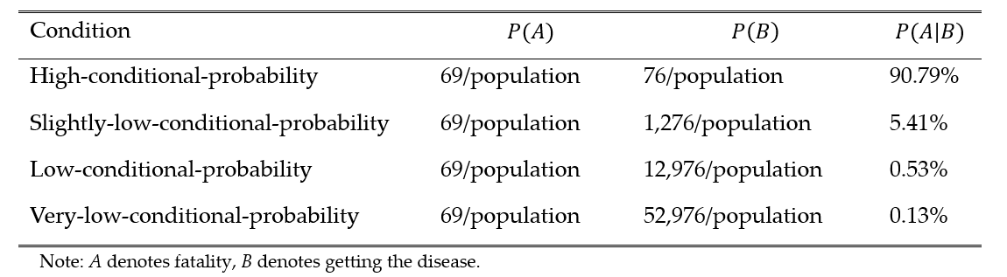
Study 3: Infectious disease
From a rational perspective, the high-conditional-probability condition is least severe, while the very-low-conditional probability is most severe.

Slide 22
Study 3: How risky is the disease?
Q: Which vaccine would you prefer?

Slide 23
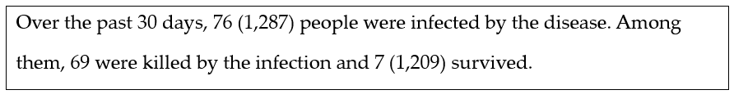
Study 4: Bacterial Infection
We adopt a mediation approach to test the diagnosticity of conditional probability, which is the mechanism underlying the conditional probability bias.
Between-subjects design with 220 participants.
Consider a fictious infectious disease:

Slide 24
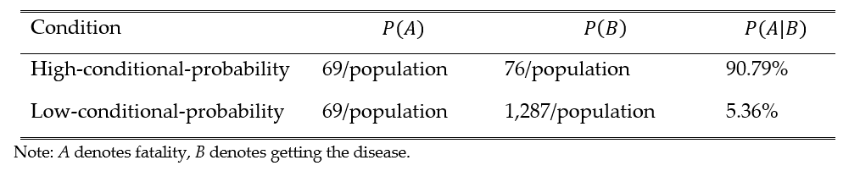
Study 4: Bacterial Infection
Clearly, the low-conditional-probability condition is more severe than the high-conditional-probability condition:

Slide 25
Study 4: Bacterial Infection
Participants were asked about their fear of the disease.
Then, they were asked to rate their perceived diagnosticity of P(A|B) : What you feel depends a lot on the information of ‘number of people who died because of the disease’?
As a comparison measure, participants also rate their perceived diagnosticity of P(B): How important is the information of ‘number of people who got the disease’ in your judgment?”

Slide 26
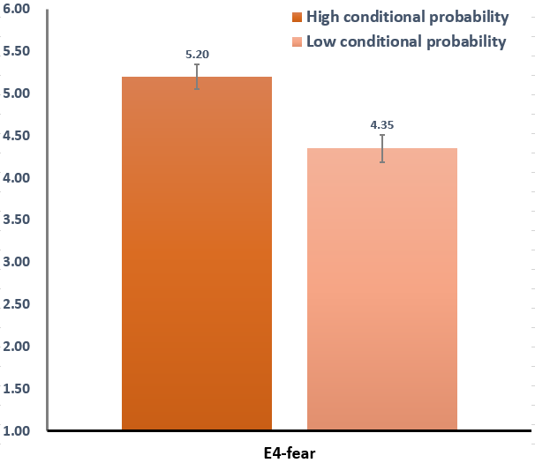
Study 4: Main Effect

Slide 27
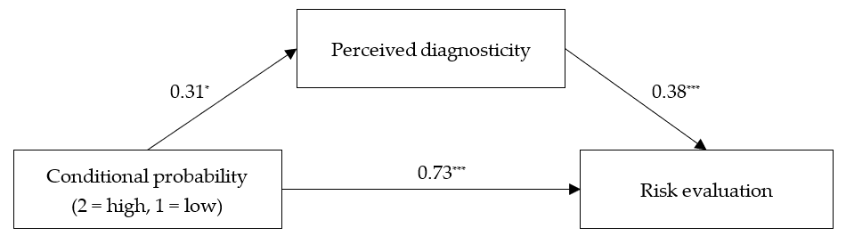
Study 4: Mediation Analysis

Slide 28
Study 5
Study 5 includes 2 experiments (Study 5A and 5B).
The purpose is to show that the conditional probability bias should emerge only when the conditional event is diagnostic.
How to test that? We manipulate the severity of the opposite conditional event, ~A|B. Basically, we assert that the conditional probability bias only arises when A|B is much more severe than ~A|B.

Slide 29
Study 5A: Eye disease
3 groups, between-subjects design.
Participants were randomly assigned to one of three conditions within a three-level (i.e., high conditional probability vs. low conditional probability with a severe conditional outcome and a mild conditional outcome [high diagnosticity] vs. low conditional probability with two severe conditional outcomes [low diagnosticity]) between-subjects design.

Slide 30
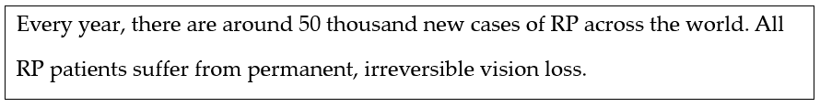
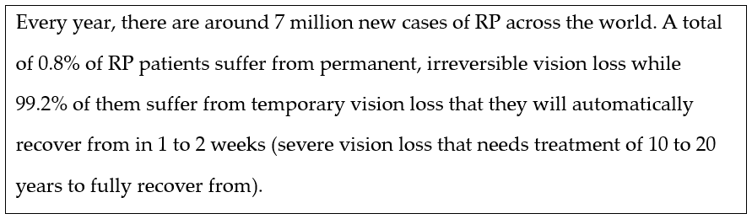
Study 5A: Eye disease
High conditional probability condition:
Low conditional probability conditions:

Slide 31
Study 5A: Eye disease
Participants were asked to rate their perceived fear of RP (are you afraid of RP?), and perceived importance of fighting against the disease (do you agree that World Health Organization (WHO) should put RP as one of its top priorities?).

Slide 32
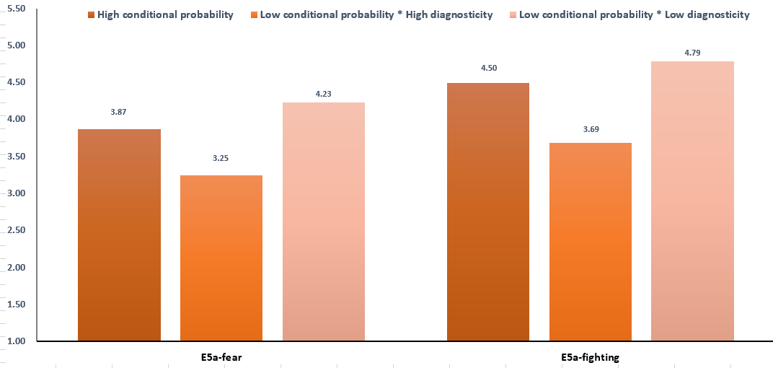

Slide 33
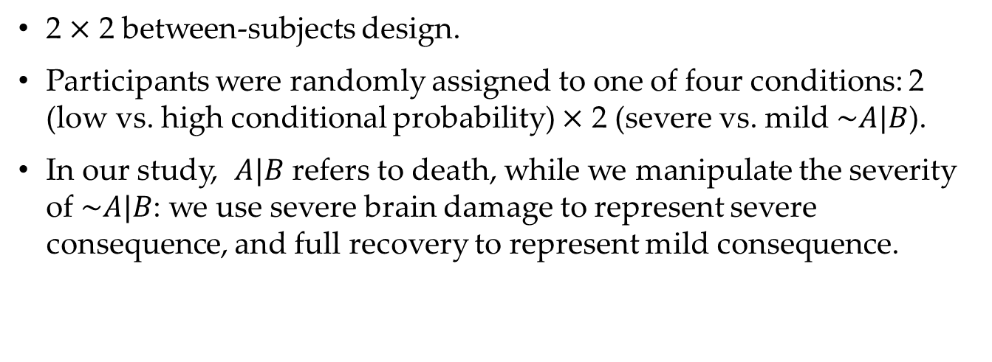
Study 5B: Herbicide exposure
2 $×$ 2 between-subjects design.
Participants were randomly assigned to one of four conditions: 2 (low vs. high conditional probability) $×$ 2 (severe vs. mild $\sim A|B$).
In our study, $A|B$ refers to death, while we manipulate the severity of $\sim A|B$: we use severe brain damage to represent severe consequence, and full recovery to represent mild consequence.

Slide 34
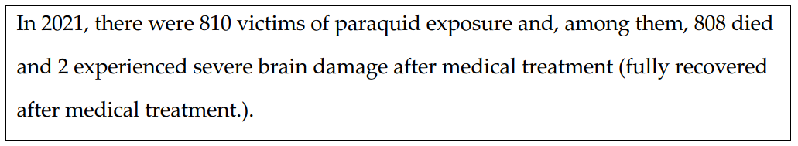
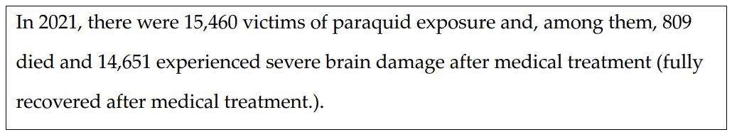
Study 5B: Herbicide exposure
Participants in the high-severe (high-mild) condition read:
Participants in the low-severe (low-mild) condition read:

Slide 35
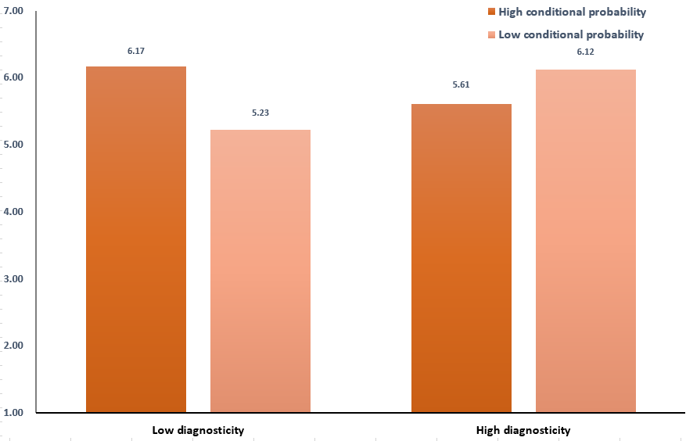
Study 5B: Herbicide exposure
Participants were asked to rate their perceived risk of the herbicide.

Slide 36
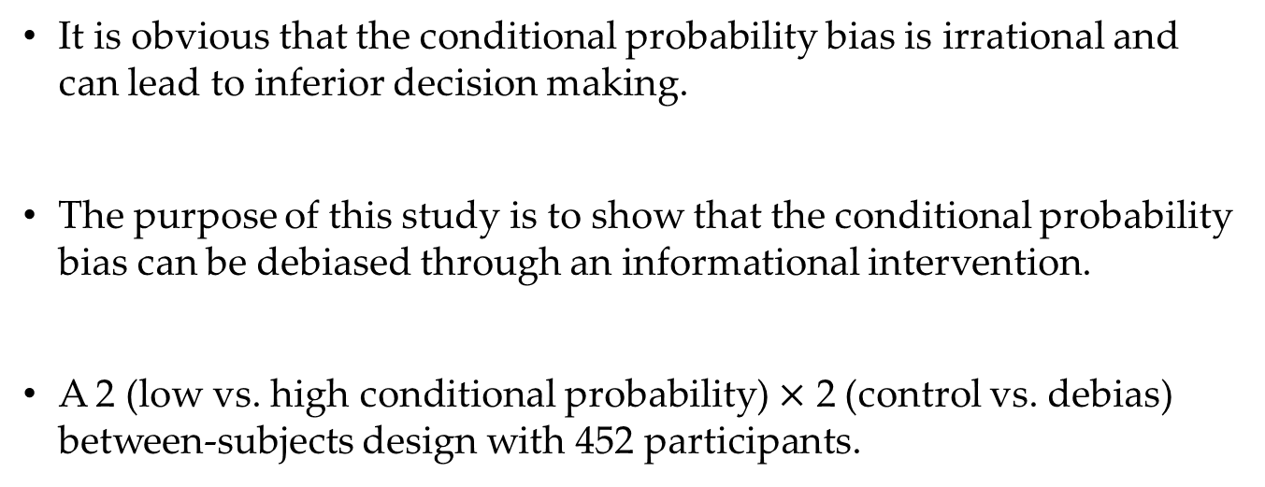
Study 6: Snake attack
It is obvious that the conditional probability bias is irrational and can lead to inferior decision making.
The purpose of this study is to show that the conditional probability bias can be debiased through an informational intervention.
A 2 (low vs. high conditional probability) $×$ 2 (control vs. debias) between-subjects design with 452 participants.

Slide 37
Study 6: Snake attack
It the debias condition, participants read a passage which explains that “human judgment is often misled by the conditional probability bias.” The article introduces a case of conditional probability bias and recommends “focus[ing] on not only the death rate in an accident (e.g., the fatality rate in a plane crash), but also the probability of an accident (e.g., the chances for a plane crash).”
Participants in the control condition skip the passage and proceed directly to the evaluation task.

Slide 38
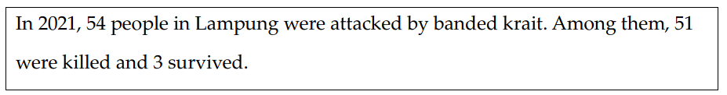
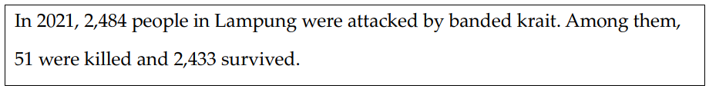
Study 6: Snake attack
Participants in the high-conditional-probability condition read:
Participants in the low-conditional-probability condition read:

Slide 39
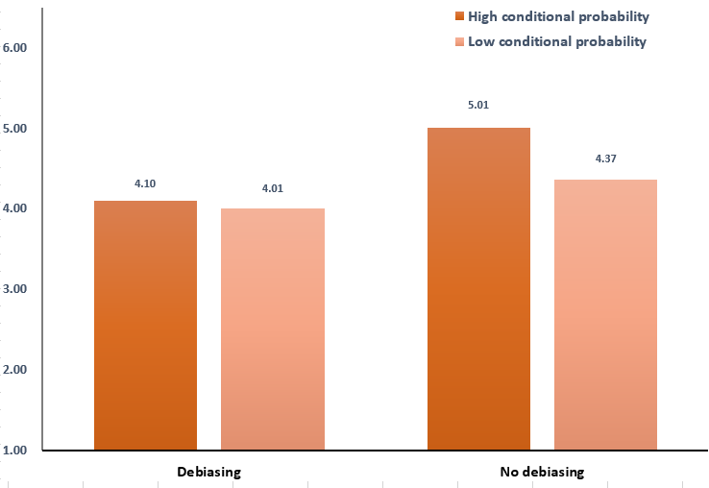
Study 6: Snake attack
Participants were asked to rate their perceived fear of the snake:

Slide 40
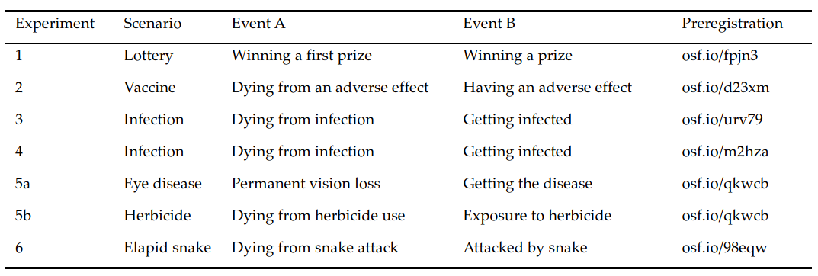
Discussion
The conditional probability bias is replicated in a number of scenarios:

Slide 41
Discussion
We also rule out several alternative explanations:
Risk aversion: This explanation is ruled out since the bias occurs in both negative (i.e., Experiments 2 to 6) and positive (i.e., Experiment 1) risk scenarios.
Calculation insensitivity: This explanation is unlikely, given that the bias pattern persists even within a context where participants are directly given P(A) and P(B) (i.e., Experiments 3, 4, 5b, and 6).

Slide 42
Discussion
We also rule out several alternative explanations:
Distinction in single-joint evaluation modes: Our experiments included both between-subjects (i.e., Experiment 1 and 3 to 6) and within-subjects designs (i.e., Experiment 2), thus invalidating this explanation.
Framing of conditionals: This explanation is eliminated since we intentionally sought to remove words such as “among them” (e.g., Experiment 5a) when presenting scenarios to our participants.

Slide 43
Discussion
We also rule out several alternative explanations:
Differences in information processing between frequency and percentage formats: Although extant research suggests this explanation, our conditional probability bias persists in risk valuation scenarios with frequency-based formats (i.e., Experiments 3, 4, 5b, and 6), percentage-based formats (i.e., Experiment 2), and combinations of the two (i.e., Experiments 1 and 5a).

Slide 44
Discussion
We also rule out several alternative explanations:
People’s inference of risk through the use of existing knowledge or real-life experiences: We ruled out this alternative explanation in two ways. On one hand, the effect of conditional probability is examined in certain contexts that most audiences are unfamiliar with, such as the dangers of a herbicide used in India (i.e., Experiment 5b) and the banded krait in Indonesia (i.e., Experiment 6). On the other hand, we directly measured participants’ existing experiences and excluded their influence in Experiment 1.

Slide 45
Contribution
We contribute to the literature on conditional probability.
To the best of our knowledge, this work is the first to show that conditional probability leads to biased risk valuations.
Although researchers from various disciplines have long explored the phenomenon of conditional probability, prior work has primarily focused on exploring how people understand, reason, and estimate conditional probabilities.

Slide 46
Contribution
We also offer a new driver of risk perception: conditional probability.
Extant literature has suggested that risk perceptions are influenced by a variety of factors, including incidental mood, individual factors, culture, information framing, and risky options.

Slide 47
Contribution
Our research also offers policy implications.
Although far more people have been infected and killed by the COVID-Omicron variant than those by the COVID-Delta variant across the world, many people exhibit greater fear of COVID-Delta than COVID-Omicron only since COVID-Delta has a higher fatality rate conditional on infection.
People are more likely to avoid a vaccine with a high conditional probability of severe adverse effects.

Slide 48
Thanks!

