Slide 1
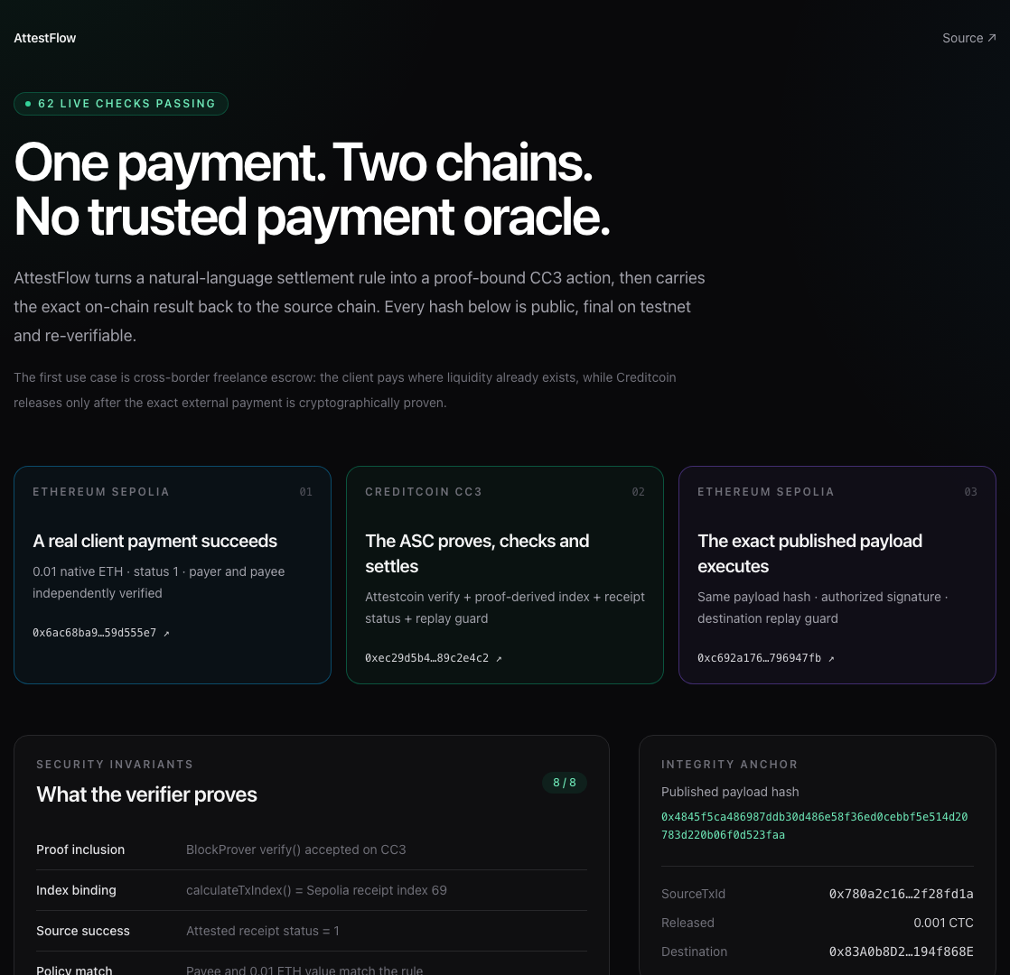
BUIDL CTC 2026 FALL · AI
AttestFlow
Proof-gated cross-chain payments for autonomous agents
Natural language for intent.
Attestcoin for truth.
Deterministic contracts for money.
5 gates · 62 live checks · 32 tests · 2 exact matches
ATTESTFLOW · BUIDL CTC 2026 FALL 01
Notes:
[Sources]
- https://github.com/ximilu0114-droid/ximilu-hackson/blob/main/scripts/judge-verify.mjs
- https://github.com/ximilu0114-droid/ximilu-hackson/blob/main/evidence/live-e2e-v2.json
- https://repo.sourcify.dev/102031/0x4E7410Ebf41C213378E1D8aA4423323303086bF6
- https://repo.sourcify.dev/11155111/0x83A0b8D26Dd28094eE0CA74E57e79028194f868E
- https://dorahacks.io/hackathon/buidl-ctc-2026-fall/detail

Slide 2
THE TRUST GAP
Autonomous payments have a truth problem
An AI agent can understand a payment rule.
It cannot be trusted to assert that the payment happened.
01
Centralized indexers
A service assertion becomes the settlement trigger.
02
Bridge operators
Custody or relayer trust replaces source-chain truth.
The usability layer may be probabilistic. The truth and money paths must be cryptographic and deterministic.
03
Unchecked LLM output
A fluent answer can still be financially false.
ATTESTFLOW · BUIDL CTC 2026 FALL 02
Notes:
[Sources]
- https://dorahacks.io/hackathon/buidl-ctc-2026-fall/detail (AI track: verified cross-chain data without centralized oracle operators)
- https://github.com/ximilu0114-droid/ximilu-hackson/blob/main/README.md

Slide 3
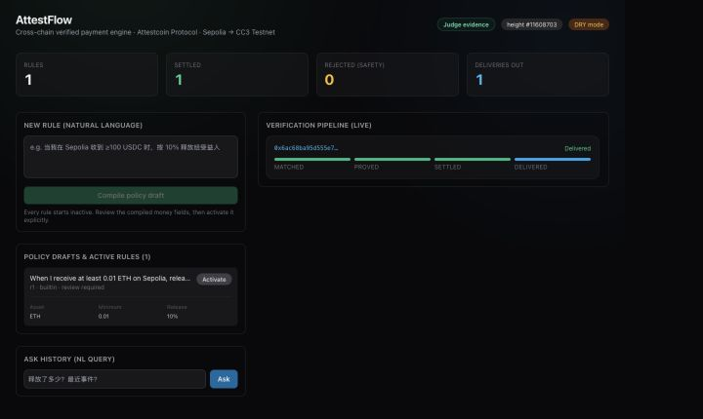
THE PRODUCT
Natural language never reaches money unchecked
1
Intent becomes a draft
Exact money fields stay inactive until explicit activation.
2
Only attested blocks scan
Discovery cannot race ahead of Creditcoin attestation.
3
Proof gates settlement
The ASC—not the model—decides whether funds can move.
4
The exact result returns
Published bytes execute behind a second replay guard.
Optional LLM for parsing and Q&A. Mandatory deterministic validation at every financial boundary.
ATTESTFLOW · BUIDL CTC 2026 FALL 03
Notes:
[Sources]
- https://github.com/ximilu0114-droid/ximilu-hackson/blob/main/agent/src/rules.ts
- https://github.com/ximilu0114-droid/ximilu-hackson/blob/main/agent/src/agent.ts
- https://github.com/ximilu0114-droid/ximilu-hackson/blob/main/web/app/page.tsx
- https://github.com/ximilu0114-droid/ximilu-hackson/blob/main/evidence/demo-dashboard-state.json

Slide 4
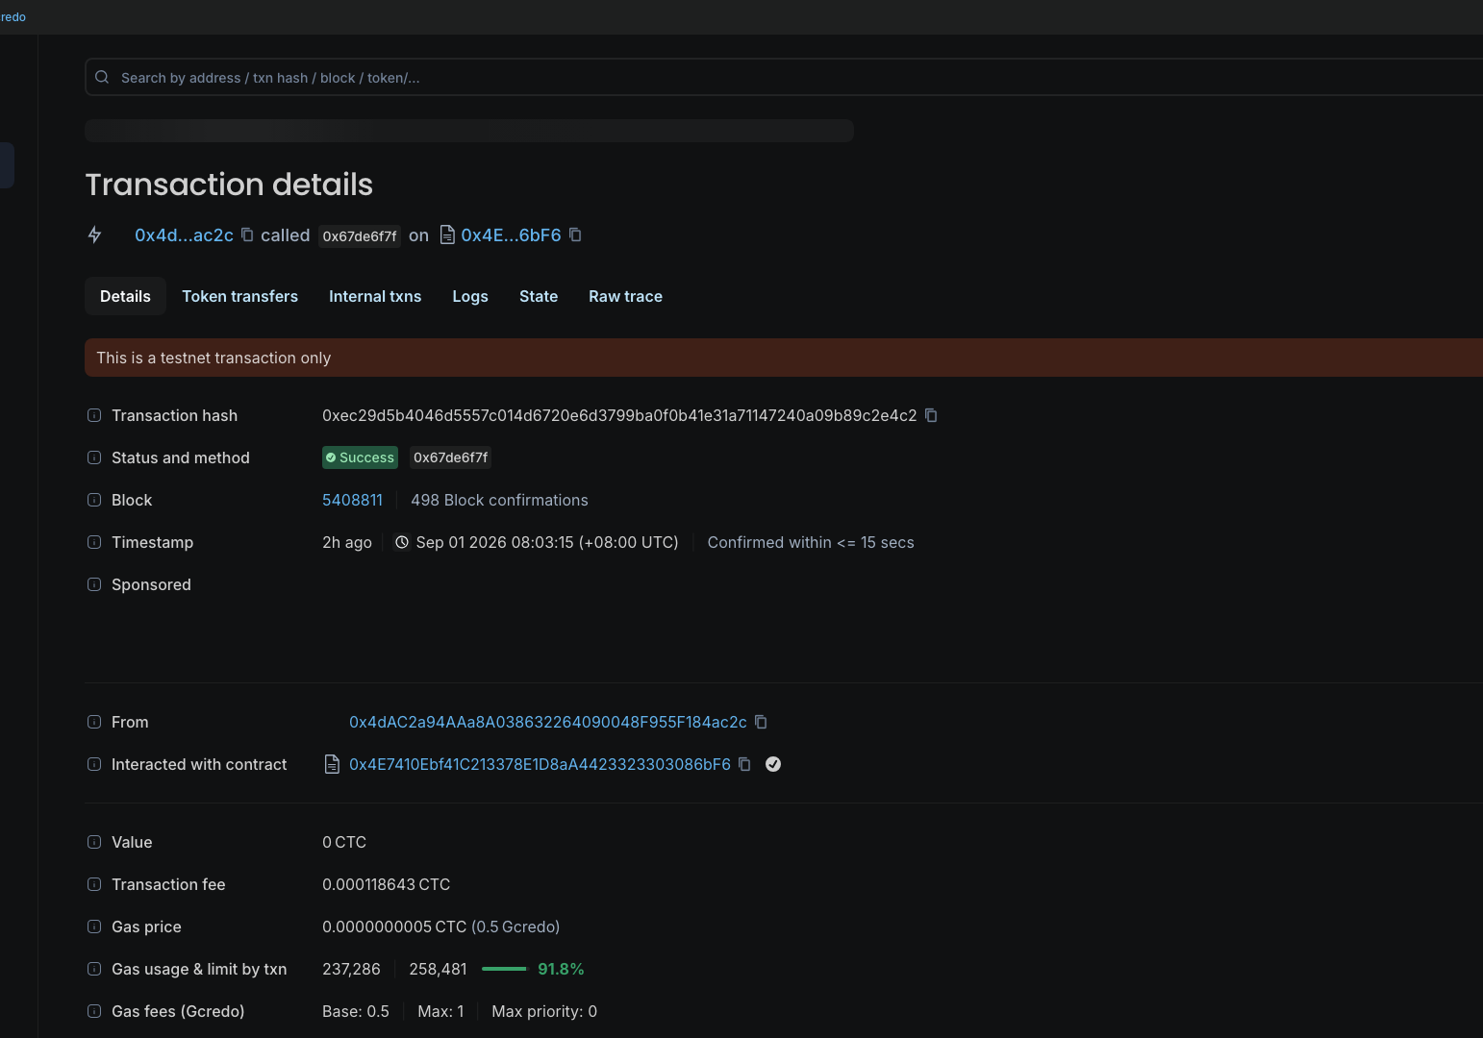
PROTOCOL DEPTH
Attestcoin is the trust root—not a logo in the stack
01
ChainInfo · 0x0FD3
Sepolia chainId 11155111 must resolve to chainKey 1.
02
ProofBuilder
Builds single and shared multi-block proofs.
03
BlockProver · 0x0FD2
verify() gates settlement; verifyBatch() gates backlogs.
04
calculateTxIndex()
Derives the replay identity from the Merkle path.
05
Encoding v1
Exposes transaction fields and receipt status to the ASC.
LIVE ASC 0x4E7410Ebf41C213378E1D8aA4423323303086bF6
ATTESTFLOW · BUIDL CTC 2026 FALL 04
Notes:
[Sources]
- https://github.com/ximilu0114-droid/ximilu-hackson/blob/main/docs/attestcoin-depth.md
- https://github.com/ximilu0114-droid/ximilu-hackson/blob/main/scripts/e2e-batch-proof.ts
- https://github.com/ximilu0114-droid/ximilu-hackson/blob/main/agent/src/prover.ts
- https://github.com/ximilu0114-droid/ximilu-hackson/blob/main/contracts/contracts/AttestFlowASC.sol
- https://docs.attestcoin.org/attestcoin-protocol/dapp-builder-infrastructure/attestcoin-sdk-usc-sdk

Slide 5
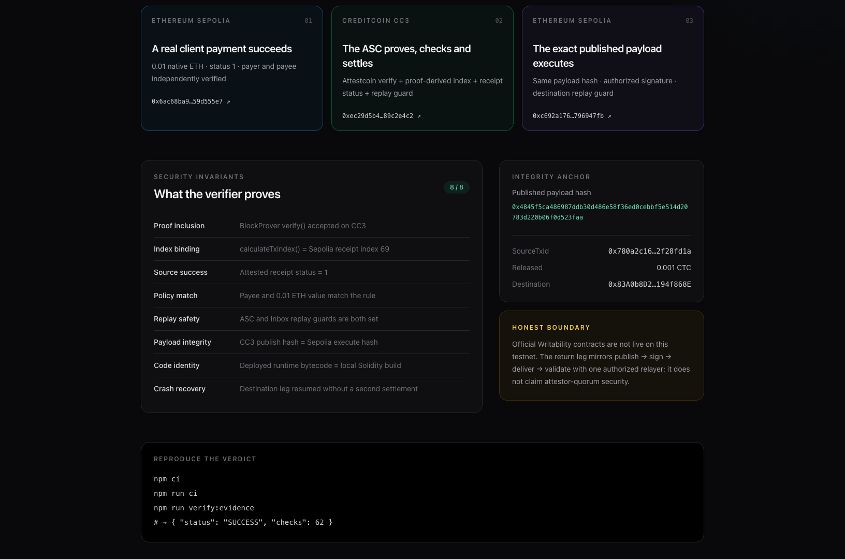
DEFENSE IN DEPTH
The ASC closes the gaps the precompile leaves open
BLOCKPROVER PROVES
Transaction inclusion + source-chain continuity
THE ASC ALSO ENFORCES
Proof-derived transaction index
Receipt status == 1
Recipient · asset · calldata · amount
Stored policy · beneficiary · destination
Source replay guard · escrow solvency
A failed source transaction—or an operator-invented replay key—cannot settle.
ATTESTFLOW · BUIDL CTC 2026 FALL 05
Notes:
[Sources]
- https://github.com/ximilu0114-droid/ximilu-hackson/blob/main/contracts/contracts/AttestFlowASC.sol
- https://github.com/ximilu0114-droid/ximilu-hackson/blob/main/contracts/test/AttestFlowASC.ts
- https://github.com/ximilu0114-droid/ximilu-hackson/blob/main/docs/integration.md

Slide 6
PUBLIC TESTNET EVIDENCE
One payment. Three linked public-testnet legs.
The source payment, proof-gated settlement and destination execution are public—and tied by proof-derived identity plus one payload hash.
1
2
3
ETHEREUM SEPOLIA
CREDITCOIN CC3
ETHEREUM SEPOLIA
0.01 ETH received
0.001 CTC released
Payload executed
Source tx
0x6ac68b…55e7
block 11,608,703 · index 69
receipt status = 1
Settlement
0xec29d5…e4c2
proof + policy + escrow + replay checks
Destination tx
0xc692a1…47fb
Inbox signature + destination replay guard
PAYLOAD HASH 0x4845f5ca486987ddb30d486e58f36ed0cebbf5e514d20783d220b06f0d523faa
ATTESTFLOW · BUIDL CTC 2026 FALL 06
Notes:
[Sources]
- https://github.com/ximilu0114-droid/ximilu-hackson/blob/main/evidence/live-e2e-v2.json
- https://sepolia.etherscan.io/tx/0x6ac68ba923494389999206236504123521d8ecdb9463f60aa52da47d59d555e7
- https://creditcoin-testnet.blockscout.com/tx/0xec29d5b4046d5557c014d6720e6d3799ba0f0b41e31a71147240a09b89c2e4c2
- https://sepolia.etherscan.io/tx/0xc692a176f78b1541104e9e0a18f9a8404c585b15e9be2c695df3d118796947fb

Slide 7
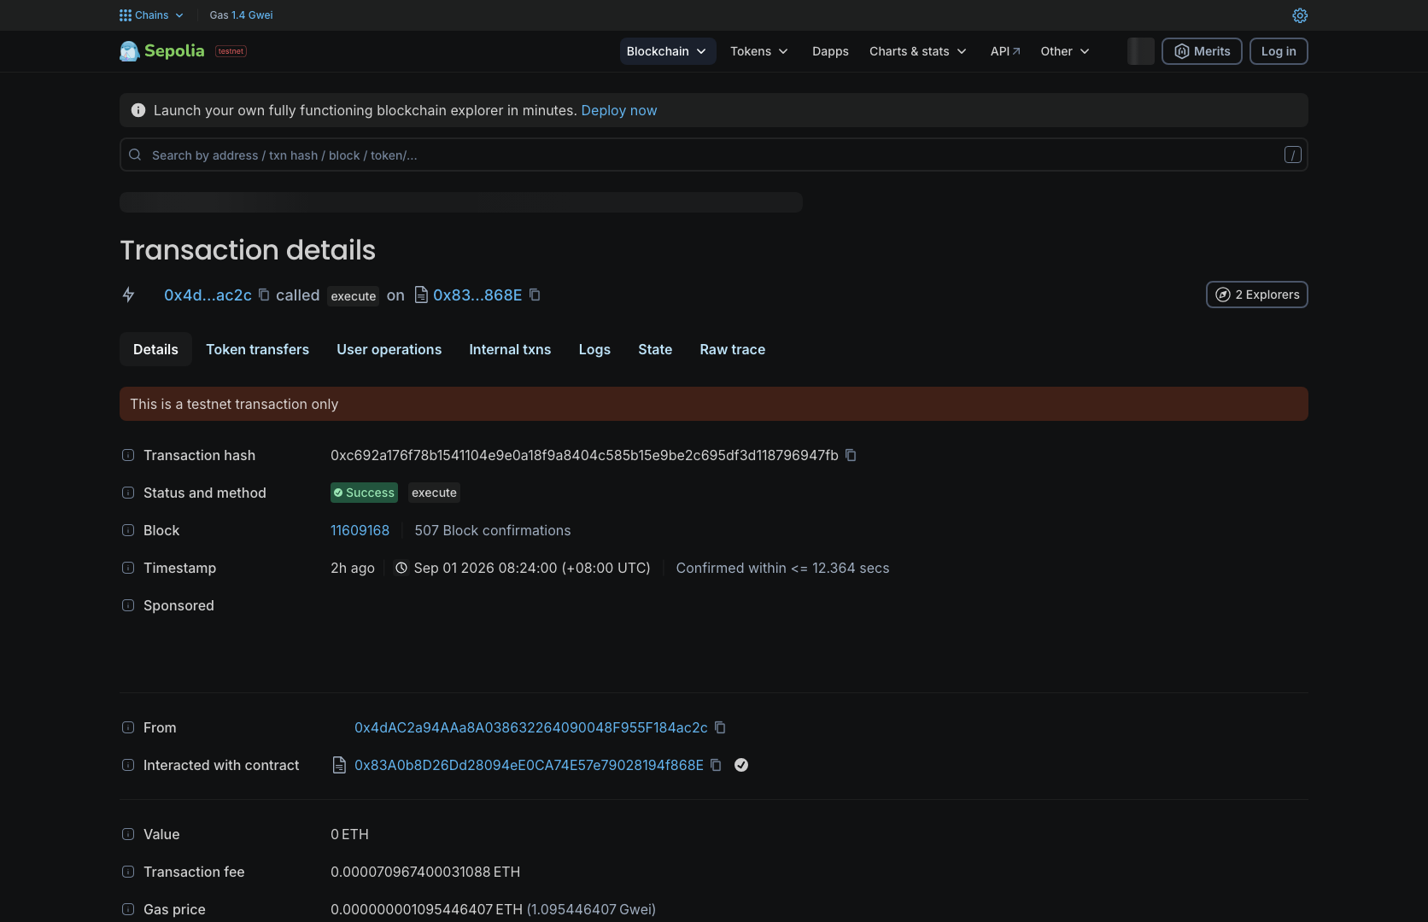
TWO-WAY LOOP
The return leg is honest—and crash-resumable
CURRENT TESTNET BOUNDARY
Official Outbox/Inbox contracts are not deployed here. The adapter uses one authorized relayer—not attestor-quorum security.
RECOVERY EXERCISED IN THE LIVE RUN
01
CC3 settlement finalized
02
Sepolia RPC timed out
03
Restart recovered MessagePublished from chain logs
04
Only the missing destination leg completed
Published payload hash = executed payload hash
ATTESTFLOW · BUIDL CTC 2026 FALL 07
Notes:
[Sources]
- https://github.com/ximilu0114-droid/ximilu-hackson/blob/main/docs/integration.md
- https://github.com/ximilu0114-droid/ximilu-hackson/blob/main/agent/src/agent.ts
- https://github.com/ximilu0114-droid/ximilu-hackson/blob/main/evidence/live-e2e-v2.json
- https://sepolia.etherscan.io/tx/0xc692a176f78b1541104e9e0a18f9a8404c585b15e9be2c695df3d118796947fb

Slide 8
INDEPENDENT VERIFICATION
A judge can reproduce the verdict with one command
5
attestflow — five independent gates
independent judge gates
$ npm run judge:verify
1/5 CI + 32 tests + build + audit SUCCESS
2/5 62 public-chain checks SUCCESS
3/5 2 Sourcify exact matches SUCCESS
4/5 3-block batch · verifyBatch() SUCCESS
5/5 fresh single · verifySingle() SUCCESS
{ "status": "SUCCESS" }
62
live cross-chain checks
2
exact source matches
32 tests · production build · 0 vulnerabilities · chain evidence · compiler identity · fresh batch + single proofs
ATTESTFLOW · BUIDL CTC 2026 FALL 08
Notes:
[Sources]
- https://github.com/ximilu0114-droid/ximilu-hackson/blob/main/scripts/judge-verify.mjs
- https://github.com/ximilu0114-droid/ximilu-hackson/blob/main/scripts/verify-live-evidence.ts
- https://github.com/ximilu0114-droid/ximilu-hackson/blob/main/scripts/verify-sourcify-v2.mjs
- https://github.com/ximilu0114-droid/ximilu-hackson/blob/main/scripts/e2e-batch-proof.ts
- https://github.com/ximilu0114-droid/ximilu-hackson/blob/main/.github/workflows/ci.yml
- https://github.com/ximilu0114-droid/ximilu-hackson/blob/main/.github/workflows/codeql.yml
- https://repo.sourcify.dev/102031/0x4E7410Ebf41C213378E1D8aA4423323303086bF6
- https://repo.sourcify.dev/11155111/0x83A0b8D26Dd28094eE0CA74E57e79028194f868E

Slide 9
THE CEIP PATH
Built for CEIP—not a one-off demo
Freelancer escrow is the wedge. The product is a reusable proof-gated payment engine for invoices, marketplaces, treasuries and agent-to-agent commerce.
NOW
NEXT
SCALE
Deployed testnet loop
Quorum-backed Writability
Payment policy infrastructure
Sepolia → Attestcoin → CC3 settlement → Sepolia return
Swap the adapter for official Outbox/Inbox when available
Multi-chain assets, invoice workflows and agent commerce
Natural language for intent. Attestcoin for truth. Deterministic contracts for money.
github.com/ximilu0114-droid/ximilu-hackson
ATTESTFLOW · BUIDL CTC 2026 FALL 09
Notes:
[Sources]
- https://dorahacks.io/hackathon/buidl-ctc-2026-fall/detail (CEIP fast-track description)
- https://github.com/ximilu0114-droid/ximilu-hackson/blob/main/README.md
- https://github.com/ximilu0114-droid/ximilu-hackson/blob/main/docs/whitepaper.md

