Slide 1
Developing a prototype based deep learning model for sarcasm detection
Ximing Wen

Slide 2
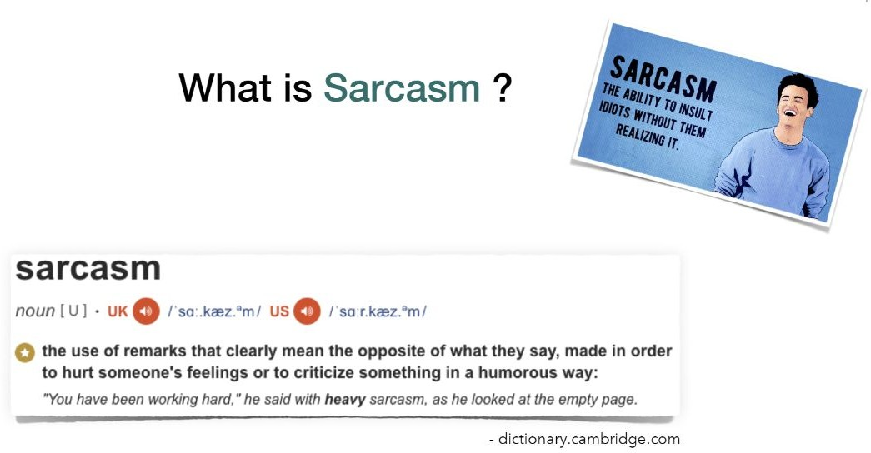
Introduction

Slide 3

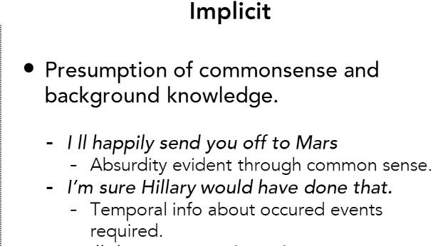
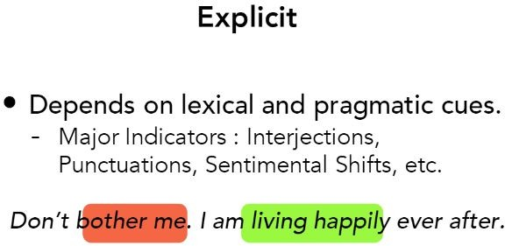
Introduction
Content-based sarcasm
Context-based sarcasm

Slide 4
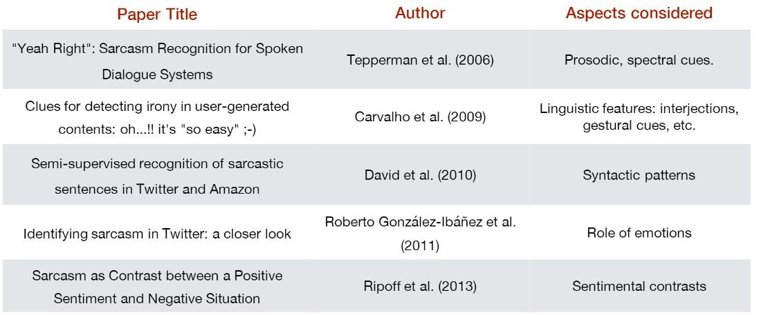
Background and Related Work

Slide 5


Methodology
Overall Structure
Embedding layer
Multi-conv
flatten-layer
K initialized prototypes
Distance layer
Fully connected layer

Slide 6
Methodology
Target comment first will be put into an embedding layer(Glove)
Sentential representations are extracted from the target comment by using several CNN blocks
Feature maps from CNN blocks are concatenated together and then flattened into a single vector V (Rv)
k protos in the prototype layer vectors are initialized with the same dimension of vector V, resulting in shape k * v
Euclidean distance are calculated between this single vector V and k prototypes, resulting in a distance vector D ( Rk)
Distance vector D will be put into a fully connected layer for predictions

Slide 7
Experiment
Dataset: SARC dataset comments from Reddit
Train + Valid: 139232 Test: 15470
Two Model:
A baseline that has the same CNN structure which is a benchmark for using only contect-based features and have 65% reported accuracy.
Our new interpretable model. Optimizer: adam
Batch size: 4096
Epochs: first 2000 epchos

Slide 8
Results and Discussion
Accuracy for baseline is 0.65132
Accuracy for our approach is 0.64604

Slide 9
Results and Discussion
Visualizations:
Visualize the 10 prototypes by finding the most similar 100 sentences from the dataset by computing the euclidean distances between them
Find the nearest 10 sentences of each prototypes for the input comment by computing the euclidean distances between them

Slide 10
Results and Discussion - Case study:
"i guess no one at google 's ever been on a plane and wanted to listen to their music library”
label : sarcastic our prediction: sarcastic Visualized prototypes:
[('better let as many of them into europe as possible', 0.3523066, 1), ('onlinebots living up to their name', 0.3604018, 1),
('everything happens for a reason', 0.3676815, 1), ("you could n't make up a title like that", 0.3228807, 1), ('why not put the full thing on it', 0.34032157, 1), ('really terrible stuff in there', 0.35132548, 1),
('you know i think this guy has a chance of making it', 0.34213576, 1), ('i came here to cringe not to think', 0.3506609, 1),
('deserves to crash with a shirt like that', 0.35434902, 1),
('your not supposed to mention that', 0.36335245, 1)]

Slide 11
Results and Discussion
Case study:
"it 's like windows phone 7 and that worked great"
label : sarcastic prediction: sarcastic
Visualized prototypes:
[("i 've been thinking about this all day", 0.35759634, 1),
('by doing the same thing i do every night and day nothing', 0.3557903, 1), ('now that looks like a president i could have a beer with', 0.3606794, 1), ('this person is going to go far in life', 0.33753684, 1),
('a superior phone , like say , a galaxy would have been able to take that', 0.36363792,1), ('burning man became terrible exactly the year after i went that one time', 0.35728908, 1), ('i cant stay and work here for ever', 0.35292253, 1),
('better let as many of them into europe as possible', 0.3523066, 1), ('sounds like jesus himself said this', 0.3607124, 1),
('should have shot him or strung him up from a tree just in case',0.35523936, 1)]

Slide 12
Results and Discussion - Case study:
"'religion must have the answer'”
label : sarcastic our prediction: sarcastic Visualized prototypes:
[('can i request one for my school', 0.35782492, 1), ('your not supposed to mention that', 0.36335245, 1),
('i cant stay and work here for ever', 0.35292253, 1),
('sad thing is , i can actually belive this', 0.34167826, 1), ("you go first and then i 'll think about it", 0.36763626, 1),
('funniest thing ive ever seen in my entire life', 0.33317474, 1),
('you know i think this guy has a chance of making it', 0.34213576, 1),
('i just love that it takes the video that long to get to the point', 0.3287512, 1),
('everything happens for a reason', 0.3676815, 1),
("i do n't think i 'd take my salt any other way", 0.35186923, 1)]

Slide 13
Results and Discussion - Case study:
"'until a republican does it'
'”label : sarcastic our prediction: sarcastic Visualized prototypes:
[('right that almost the same thing', 0.35840473, 1),
('while i read this during a shit', 0.34476843, 1),
('your not supposed to mention that', 0.36335245, 1), ('just the fucking way i like it', 0.3665198, 1),
("you could n't make up a title like that", 0.3228807, 1), ('sad thing is , i can actually belive this', 0.34167826, 1),
('something for meth or something like that', 0.32828987, 1), ('she really seems to be enjoying it', 0.33070856, 1),
('see what happens when you do spinning shit', 0.36211467, 1), ('that was me , i got high and started drawing on shit', 0.344531, 1)]

Slide 14
Conclusion and Future Work
What we achieve:
An interpretable prototyped based CNN model that could provide explanations for sarcasm detection and achieve comparable accuracy at the same time
A prototype visualization method for finding the best projections for these prototypes.
Limitations:
Could the prototypes be further refined to provide better results?

Slide 15
Thank you for listening!

