Slide 1
分数
满分710 425分及格
425/710
= 0.5985915493

Slide 2
得分
策略
11%
15%
25%
9%
写作
听力
阅读
翻译
分值
15%
35%
35%
15%

Slide 3
8：40——9：00 试音时间
9：00——9：10 阅读考场注意事项，发放考卷，贴条形码
9：10——9：40 作文考试阶段
9：40——10：05 听力测试
10：05——10：10 收答题卡1
听力结束后完成剩余考项（阅读和翻译）
11：20全部考试结束
做听力时，直接涂卡

Slide 4
写作
听力
阅读
翻译
分值
15%
35%
35%
15%

Slide 5
副班长
干货预警

Slide 6
替换词

Slide 7
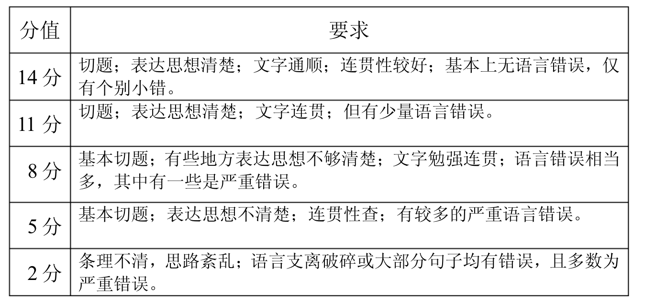
分值
分值
15%
15%
写作
大学英语四级作文评分标准
听力
阅读
翻译

Slide 8
1) 大多数人 most people→ the majority of the population
2) 我相信 I believe→ from my standpoint, from my perspective
I believe most people… → from my perspective, the majority of the population…
3) 经常 often→frequently
4) 必须 must→ it is a must for us to…
5) 知道 know→ be aware of
6) 因为 because→in that
7) 最后 at last→eventually
8) 然而 but→however
9) 如果 if→provided that
10) 各行各业的人 all kinds of people→people from all walks of life
11) 引起，导致 lead to→contribute to
12) 人 people→individuals
13) 好的 good→desirable, beneficial
14) 坏的 bad→undesirable
15) 很多many→ numerous
写作
听力
阅读
翻译

Slide 9
16) 越来越 more and more→ a(n) increasing/mounting number of
17) 很 very→extremely
18) 方面 side→aspects
19) 表明 show→demonstrate, indicate
20) 利用 use→utilize
21) 因此/结果 so→therefore
22) 部分 part→proportion
23) 提高 improve→enhance
24) 改变 change→transform
25) 强调/重视 emphasize→ attach great importance to
26) 培养 develop→cultivate
27) 破坏 destroy→undermine
28) 解决 deal with →tackle /figure out
29) 普遍的 everywhere→universal
30) 明显的 obvious→apparent
写作
听力
阅读
翻译

Slide 10
万能句

Slide 11
一、常见开头
1 ： It is well-known to us that…… （我们都知道 …… ） ==As far as my knowledge is concerned, … （ 就我所知 … ）
2 ： Recently the problem of…… has been brought into focus. ==Nowadays there is a growing concern over …… （最近 …… 问题引起了关注）
3 ： Nowadays （ overpopulation ） has become a problem we have to face. （现今，人口过剩已成为我们不得不面对的问题）
4 ： Internet has been playing an increasingly important role in our day-to-day life. It has brought a lot of benefits but has created some serious problems as well. （互联网已在我们的生活扮演着越来越重要的角色，它给我们带来了许多好处但也产生了一些严重的问题）
5 ： With the rapid development of science and technology ， more and more people believe that…… （随着科技的迅速发展，越来越多的人认为 …… ）
6 ： It is a common belief that……==It is commonly believed that…… （人们一般认为 …… ）

Slide 12
二、阐述观点
1 ： People's views on……vary from person to person. Some hold that……However, others believe that…… （人们对 …… 的观点因人而异，有些人认为 …… 然而其他人却认为 …… ）
2 ： People may have different opinions on…… （人们对 …… 可能会持有不同见解）
3 ： Attitudes towards （ drugs ） vary from person to person.==Different people hold different attitudes towards （ failure ）（人们对待吸毒的态度因人而异）
4:There are different opinions among people as to…… （对于 …… 人们的观点大不相同）

Slide 13
三、结束语
1 ： In short, it can be said that…… （总之，他的意思是 …… ）
2 ： From what has been mentioned above, we can come to the conclusion that…… （从上面提到的，我们可以得出结论 …… ）
3 ： Taking all these factors into consideration, we naturally/reasonably come to the conclusion that…… （把所有的这些因素加以考虑，我们自然可以得出结论 …… ）
4 ： Hence/Therefore, we'd better come to the conclusion that…… （因此，我们最好的出这样的结论 …… ）
5:There is no doubt that (job-hopping)has its drawbacks as well as merits. （毫无疑问，跳槽有优点也有缺点）
6 ： All in all, we cannot live without……,but at the same time we must try to find out new ways to cope with the problems that would arise. （总之，我们没有 …… 无法生活，但同时我们必须寻求新的解决办法来面对可能出现的新问题）

Slide 14
四、提出建议
1 ： It is high time that we put an end to the (trend). （该是我们停止这一趋势的时候了）
2 ： There is no doubt that enough concern must be paid to the problem of…… （毫无疑问，对 …… 问题应予以足够重视）
3 ： Obviously ,if we want to do something … it is essential that…… （显然，如果我们 想要做么事，很重要的是 …… ）
4 ： Only in this way can we …… （只有这样，我们才能 …… ）
5 ： Spare no effort to + V （不遗余力的）
五、推测后果
1 ： Obviously ， if we don't control the problem, the chances are that……will lead us in danger. （很明显，如果我们不能控制这一问题，很有可能我们会陷入危险）
2 ： No doubt, unless we take effective measures, it is very likely that …… （毫无疑问，除非我们采取有效措施，否则我们很可能会 …… ）
3 ： It is urgent that immediate measures should be taken to stop the situation （很紧迫的是应立即采取措施阻止这一事态的发展）

Slide 15
六、表示论证
1 ： From my point of view, it is more reasonable to support the first opinion rather than the second.( 在我看来，支持第一种观点比第二种更有道理 )
2 ： I cannot entirely agree with the idea that…… （我无法完全同意这一观点）
3 ： As far as I am concerned/In my opinion,…… （就我来说 …… ）
4 ： I sincerely believe that……==I am greatly convinced (that) 子句 . （我真诚地相信 …… ）
5 ： Finally, to speak frankly, there is also a more practical reason why …… （最后，坦率地说，还有另外一个实际的原因 …… ）
七、给出原因
1 ： The reason why + 句子 ~~~ is that + 句子 （ ... 的原因是 ... ）
2:This phenomenon exists for a number of reasons .First,…….Second,…….Third ， …… 。这一现象存在有很多原因的，第一 …… 第二 …… 第三 ……
3 ： For one thing,…… For another thing ， …… ==On the one hand,……On the other hand…… 一方面 …… 另一方面 ……
4 ： I quite agree with the statement that……The reasons are chiefly as follows. 我十分赞同这一论述，即 …… 。其主要原因如下。

Slide 16
八、列出解决办法和批判错误观点做法
1 ： The best way to solve the troubles is…… 解决这些麻烦的最好办法是 ……
2 ： As far as something is concerned,…… 就某事而言， ……
3;It is obvious that…… 很显然 ……
4 ： It may be true that……but it doesn't mean that…… 可能 …… 是对的，但这并不意味着 ……
5;It is natural to believe that……but we shouldn't ignore that…… 认为 …… 是自然的，但我们不应忽视 ……
6 ： There is no evidence to suggest that…… 没有证据表明 ……
九、表示好处和坏处
1 ： It has the following advantages. 它有如下优势
2 ： It is beneficial/harmful to us.==It is of great benefit/harm to us. 它对我们有益处
3:It has more disadvantages than advantage. 他有很多不足之处
十、表示重要、方便、可能
1 ： It is important(necessary/difficult/convenient/possible)for sb to do sth. 对于某人做 …… 是 ……
2 ： It plays an important role in our life.

Slide 17
十一、采取措施
1 ： We should take some effective measures. 我们应该采取有效措施
2 ： We should try our best to overcome/conquer the difficulties. 我们应该尽最大努力去克服困难
3 ： We should do our utmost in doing sth. 我们应该尽力去做 ……
4 ： We should solve the problems that we are confronted/faced with. 我们应该解决我们面临的困难
十二、显示变化
1 ： Some changes have taken place in the past five years. 过去五年发生了很多变化
2 ： Great changes will certainly be produced in the international communications. 在国际交流中理所当然会发生很多大的变化
3 ： It has increased/decreased from…to… 他已经从 … 增加 / 减少到 …
4 ： The output of July in this factory increased by 15%. 这个工厂 7 月份产量以增加了 15%
十三、表明事实现状
1;We cannot ignore the fact that…… 我们不能忽略这个事实 ……
2 ： No one can deny the fact that…… 没人能否认这个事实 ……
3 ： This is a phenomenon that many people are interested in.
4:be closely related to ~~ （与 ... 息息相关）

Slide 18
十四、进行比较
1 ： Compared with A,B…… 与 A 比较， B……
2;I prefer to read rather than watch TV.
十五、常用英语谚语
1 ： Actions speak louder than words. 事实胜于雄辩
2 ： All is not gold that glitters. 发光的未必都是金子
3 ： All roads lead to Rome. 条条大路通罗马
4 ： A good beginning is half done. 良好的开端是成功的一半
5 ： Every advantage has its disadvantage 有利必有弊
6 ： A miss is as good as a mile. 失之毫厘，差之千里
7 ： Failure is the mother of success. 失败是成功之母
8:Industry is the parent of success. 勤奋是成功之母
9:It is never too old to learn. 活到老，学到老
10:Knowledge is power. 知识就是力量
11:Nothing in the world is difficult for one who sets his mind to it.
世上无难事，只怕有心人

Slide 19
怕用错
不知道怎么用

Slide 20
作文模板

Slide 21
利弊型 模版一
Nowadays many people prefer __________ ( 主题 ) because it plays a significant role in our daily life. Generally, its advantages can be seen as follows. On the one hand, ________________ ( 主题的优点 1). On the other hand, ___________________ ( 主题的优点 2). But everything can be divided into two. The negative aspects are also apparent. One of the important disadvantages is that ___________________ ( 主题的缺点 1). To make matters worse, __________________________ ( 主题的缺点 2). Through the above analysis, I believe that the positive aspects far outweigh its negative aspects. Whatever effects it has, one thing is certain, ________ ( 主题 ) itself is neither good nor bad. It is the uses to which it is put that determine its value to our society.

Slide 22
利弊型 模版二
With the development of science and human civilization, many formerly unimaginable things come into reality. Some of them have positive effects on our life, but some are distasteful. The phenomenon of ___________ ( 主题现象 ) is an example of the former / latter one. There are many factors that may account for it, and the following are the most conspicuous aspects. To start with, __________________ ( 原因 1). Furthermore, ______________________ ( 原因 2). Eventually, ________________________________ ( 原因 3). Good as ____________ ( 主题现象 ) is, it has, unfortunately, its disadvantages. The apparent example is that ______________ ( 缺点例子 1). In addition, _____________________ ( 缺点例子 2).
On the whole, the phenomenon is one of the results of the progress of the modern society. There is still a long way for us to improve / eliminate __________ ( 主题现象 ) and make our life more comfortable.

Slide 23
图表型 作文模板一 ( 适用于单一图表题型 )
As is seen from the table / graph / chart _____________ ( 图表所描述的事物 A) ascent significantly from __________ ( 数字 1) in __________ ( 年份 1) to ____________ ( 数字 2) in __________ ( 年份 2) while over the same period _______________ ( 图表所描述的事物 B) shrank slightly from _________ ( 数字 3) to ___________ ( 数字 4). It can be observed easily that _____________________________________ ( 分析图表所反映的问题 ).
There are many reasons responsible for this. In the following paragraphs I’ll venture to explore the reasons.
For one thing _________________ ( 原因 1). For another ________________ ( 原因 2). In addition _________________________ ( 原因 3).
However this table / graph / chart may not predict the entire situation in the future I believe ____________________________________ ( 前瞻性猜测和展望 ).

Slide 24
图表型 作文模板二 ( 适用于多个图表题型 )
The figure of the first graph shows that ________________________ ( 简述图表 1 概况 ) while the figure of the second graph shows that _____________________ ( 简述图表 2 概况 ). The relationship between these two figures warns us that ________________________________ ( 指出两表所反映的问题 ).
However there are many effective methods to _____________ ( 解决这一问题 ). For instance ___________________ ( 解决方法 1). At the same time ________________________ ( 解决方法 2).
In a word ________________________________ ( 总结 ). As far as I am concerned the more we understand the situation the better we can do to improve it in the future. Given all these points above I hold the opinion that __________________ ( 重申自己的观点 ).

Slide 25
现象解释型模板一
Recently,__________.What amaze us most is_________. It is true that_________. There are many reasons explaining_________.
The main reason is________.What is more__________.Thirdly,__________.As a result_________.
Considering all these,_________.For one thing,________.For another,_________.
In conclusion,__________.
现象解释型模板二
As is known to all,_______.________seem to get accustomed to_________. In fact,_______.
The reasons of________lie in several aspects.
Firstly,________.Secondly,________.Thidly,_______.Finaly,_______. As a matter of fact, ______.On the one hand,_________. On the other hand,__________.
Therefore,___________.
现象解释型模板三
Nowadays,_________.For one thing,__________.For another,_________.It is bvious__________.
Many remarkable factors contribute to_________. First of all,________.In ddition,_________.Thirdly,_________.As to me,_________.As we know,_________.Besides,__________.
In a word,__________.

Slide 26
现象解释型叙事类作文专用模板
It so happened that_________. Just at the moment,_________. It impressed me most because________.What hanppened was_________.
At first,__________.Almost at the same time,_________.What’s more,___________.As a result,___________.As I understand,___________. On the one hand,___________. On the other hand,___________.
Therefpre,____________.

Slide 27
对比选择型模板一
Recently,we may hear quite different opinions__________.Most people take it for granted that________.However,others hold________.A dominant idea is that_______.In this view,_______.Nevertheless,the objectors think________. They argue that________.As to me,I prefer________. On the one hand,________.On the other hand,________.Therefore,_________.
In conclusion,_________.
对比选择型模板二
There is a heated debate over_________. It is commonly accepted that_________. In contrast,others_________.Those who hold the first opinion suggest________.In their view,__________.However,others think__________.They argue that___________.Considering one after another,I stand on the side of_______.First of all,__________.Further more,__________.Thirdly,___________.Therefore,___________.
对比选择型模板三
Different people will offer quite different ideas________.Many people assert__________.However,others believe__________.Some may proclaim___________.They mainlain such an idea because_________.In contrast,the objectors think__________.The argue that_________.As far as I am concerned,I agree to_________.First,________.Second,________.
Last but least,________.In a word,_________.

Slide 28
问题解决型模板一
With the_______of________,________.( 问题出现的背景 ) So it is of graet importance for us to_________.On the one hand,________.On the other hand,_________. However,we have figured out many ways to________. Firstly,________. So long as__________.Secondly,_________.Thirdly,_________.In fact,________.That is because________.In a word,_________.
问题解决型模板二
There has been a discussion recently about________.It is true to the present situation that_________.But_________.As is known to all,there are many ways________.First of all,_______.Further more,_______.Last but not least,________.So it is high time for us to_______.That is because_______.Secondly,_________. Thirdy,__________. All in all,_________.
问题解决型模板三
Nowadays,there is a growing concern on_______.It is certain that________.However,_________.
It well cause many serious results if_______.Firstly,________.Secondly,________.Finaly,________.In spite of all these,there are still many ways________.First of all,________.In addition,________.Thirdly,_________.Only in this way,_________.
12.In a word__________.

Slide 29
全国大学英语四、六级考试作文题评分原则
CET 检查考生是否达到大学英语教学大纲规定的四级和六级教学要求，对作文的评判应以此要求为准则。
2. CET 作文题采用总体评分 (Global Scoring) 方法。
阅卷人员就总的印象给出奖励分 (Award Scores), 而不是按语言点的错误数目扣分。
3. 从内容和语言两个方面对作文进行综合评判。内容和语言是一个统 一 体。作文应表达题目所规定 的内容，而内容要通过语言来表达。要考虑作文是否切题，是否充分表达思想，也要考虑是否用英语 清楚而合适地表达思想，也就是要考虑语言上的错误是否造成理解上的障碍。
4. 避免趋中倾向。该给高分的给高分，包括满分；该给低分给低分，包括零分。一名阅卷人员在所 评阅的全部作文卷中不应只给中间的几种分数。
5. 所发样卷一律不得翻印，严禁出版，一经发现，必予追究。
写作
听力
阅读
翻译

Slide 30
全国大学英语四、六级考试作文题评分原则
CET 检查考生是否达到大学英语教学大纲规定的四级和六级教学要求，对作文的评判应以此要求为准则。
2. CET 作文题采用总体评分 (Global Scoring) 方法。
阅卷人员就总的印象给出奖励分 (Award Scores), 而不是按语言点的错误数目扣分。
3. 从内容和语言两个方面对作文进行综合评判。内容和语言是一个统 一 体。作文应表达题目所规定 的内容，而内容要通过语言来表达。要考虑作文是否切题，是否充分表达思想，也要考虑是否用英语 清楚而合适地表达思想，也就是要考虑语言上的错课是否造成理解上的障碍。
4. 避免趋中倾向。该给高分的给高分，包括满分；该给低分给低分，包括零分。一名阅卷人员在所 评阅的全部作文卷中不应只给中间的几种分数。
5. 所发样卷一律不得翻印，严禁出版，一经发现，必予追究。
写作
听力
阅读
翻译

Slide 31
分值
分值
15%
15%
写作
大学英语四级作文评分标准
听力
阅读
翻译

Slide 32
分值
分值
15%
15%
写作
大学英语四级作文评分标准
听力
阅读
完全符合题意
高级词汇句式，名人名言
翻译
表达清晰
字写工整

Slide 33
写作
切题
分值
15%
2019四级 卷II
For this part,you are allowed 30 minutes to
write a news report to your compus newspaper on a visit to a local farm organized by your Student Union .
You should write at least 120 words but no more than 180 words.
Organized by the student union, a group of volunteers in our university paid a visit to the local farm. This farm is situated in a livable city surrounded with lakes and mountains, a famous summer resort located in the northern part of Jiangxi province.
听力
阅读
翻译

Slide 34
写作
分值
表达思想清楚 文字连贯
15%
叙述：目的，时间，地点，人物交代清楚
听力
解释问题：第一，第二，第三
一方面，另一方面
阅读
阐述自己观点：一个观点。尽量不要模棱两可
翻译

Slide 35
写作
分值
十天 时间安排
15%
每天精做一个作文题
听力
掐表做题。25分钟内完成
从答案摘抄2-3个句子
阅读
泛做3篇作文题
先看题目，构思3分钟
翻译
直接看答案，和自己的构思对比

Slide 36
写作
19年6月 | 18年12月 | 18年6月 | 17年12月 | 17年6月
剪纸 | 手机阅读 | 飞机 | 泰山 | 珠江
灯笼 | 移动支付 | 公交车 | 华山 | 长江
舞狮 | 手机依赖 | 地铁 | 黄山 | 黄河
听力
阅读
翻译

Slide 37
写作
人文地理
科技发展
2019.6
剪纸是中国民间艺术的一种独特形式，已有2000多年历史。
剪纸很可能源于汉代，继纸张发明之后。从此，它在中国的许多地方得到了普及。
剪纸用的材料和工具很简单：纸和剪刀。剪纸作品通常是用红纸做成的，因为红色在中国传统文化中与幸福相联。
因此，在婚礼、春节等喜庆场合，红颜色的剪纸是门窗装饰的首选。
听力
阅读
泰山位于山东省西部。海拔1500余米，方圆约400平方公里。
泰山不仅雄伟壮观，而且是一座历史文化名山，过去3000多年一直是人们前往朝拜的地方。
据记载，共有72位帝王曾来此游览。许多作家到泰山获取灵感，写诗作文，艺术家也来此绘画。山上因此留下了许许多多的文物古迹。
泰山如今已成为中国一处主要的旅游景点。
翻译
2017.6

Slide 38
写作
人文地理
科技发展
2019.6
由于通信网络的快速发展，中国智能手机用户数量近年来以惊人度增长。
这极大地改变了许多人的阅读方式。他们现在经常智能手机上看新闻和文章，而不买传统报刊。
大量移动应用程序的开发使人们能用手机读小说和其他形式的文学作品。因此，纸质书籍的销售受到了影响。
但调查显示，尽管能手机阅读市场稳步增长，超半数成年人仍喜欢读纸质书。
听力
阅读
过去，乘飞机出行对大多数中国人来说是难以想象的。
如今随着经济的发展和生活水平的提高，越来越多的中国人包括许多农民和外出务工人员都能乘飞机出行。
他们可以乘飞机到达所有大城市，还有许多城市也在筹建机场。航空服务不断改进，而且经常会有特价机票。
近年来，节假日期间选择乘飞机外出旅游的人不断增加。
翻译
2018.6

Slide 39
写作
分值
十天 时间安排
15%
大量阅读翻译题
听力
每天看3篇同类翻译题
通过标准答案总结：
固定搭配
词组
阅读
翻译

Slide 40
常用句型

Slide 41
1）It is＋形容词＋that
It is conceivable that knowledge plays an important role in our life.
可想而知，知识在我们的一生中扮演着一个重要的角色。
2）It is＋形容词＋to do/ doing
She had said what it was necessary to say.
她已经说了一切有必要说的话。
3）祈使句／名词＋and/ or
Work hard, and you will finally be able to reach your destination.
努力工作，你就能实现自己的目标。
4）as＋many/ much＋名词＋as
It is said that visitors spend only half as much money in a day in Leeds as in Lon-don.
据说，游客每天在利兹的花销仅为在伦敦的一半。
5）倍数词＋as＋形容词＋as
The reservoir is three times as big as it was ten years ago.
这个水库的面积是十年前三倍。

Slide 42
6) 倍数词+ more +名词／形容词十than
Smoking is so harmful to personal health that it kills seven times more people each year than automobile accidents.
吸烟对人体健康的危害极大，每年死于吸烟的人比死于车祸的人多七倍。
7）（not）as/ so...as（和……（不）一样）
The environmental problems are not as serious as they suggested in their report.
环境问题没有他们在报告中说得那么严重。
8）no more...than（与……一样不）
She is no more fit to be a manager than a schoolgirl would be
一个女学生固然不宜当经理，她也同样不宜。
9）Nothing is more...than（没有比……更……的；……是最……的）
Nothing is more important thanto receive education.
没有比接受教育更重要的事。
10）感官动词＋of＋名词
They hurriedly escaped into a cave that smelt of terror.
他们仓皇地逃人一个充满恐怖气氛的山洞。

Slide 43
11）without/ not so much as（甚至没有）
Disappointed with her husband，Mary left home without so much as looking back at him．
出于对丈夫的失望，玛丽离开了家，甚至都没有回头看他一眼。
12）may/ might as well（…as）（与其……还不如……）
One may as well not know a thing at all as know but imperfectly.
与其一知半解还不如彻底蒙在鼓里。
13）too...to（太……而不能……；极其地）
It was not too bright of them to settle in an area where earthquakes frequently occur
他们选择在地震多发的地区定居，这可不是个明智的决定。
14）only to find/ see（结果却；没想到会）
He spent almost all his money to buy the hen which was said to be able to lay gold eggs, only to find it could not lay eggs at all.
为了买那只据说能下金蛋的母鸡，他几乎倾家荡产，没想到这只鸡根本不会下蛋。
15）It is undoubted that/ There is no doubt that（毫无疑问，……）
There is no doubt that war can be avoided if we get down to peace talk.
毫无疑问，如果我们肯认真和谈就能避免战争。

Slide 44
16）rather than（而不是……）
Rather than pursue money to achieve happiness，we should focus on the improvement of ourselves.
我们应该集中精力改善自我，而不是追求金钱的享乐。
17）not... until（直到……才）
We can't release the film until we have the approval from the authority concerned.
直到获得有关当局的批准我们才能发行那部电影。
18）so/ such（…）that（如此……以至于）
With the rumor spreading fast, their anxiety was such that they could not sleep/they became so anxious that they could not sleep.
在谣言迅速散播的情况下，他们焦虑异常，无法人睡。
19）(The) chances are that（很可能……）
Chances are that she has already known it, and there is no need for us to keep the secret.
她很可能已经知道了，所以我们没有必要再保守这个秘密。
20）It occurred to sb. that（突然想到……）
It had never occurred to Cinderella she would become a princess someday.
辛德瑞拉从来没有想到她会成为一位王妃。

Slide 45
21）not...but...（不是……而是……）
To our disappointment, the plan caused not development but destruction.
让我们失望的是，这个计划带来的不是进步而是破坏。
22）It is taken for granted that（……被认为是理所当然的）
It has been taken for granted that women should take on all the housework.
多年来人们一直认为女性做家务是理所当然的。
23）It is/ was said that（据说）
It is said that man is the least biologically determined species of all because he possesses features absent in other natural species.
据说人类是生物学上最难归类的物种，因为人类拥有其他天然物种所缺乏的特性。
24）When it comes to...（提及，当提到……的时候）
When it comes to physics, I know nothing.
谈到物理学，我一无所知。
25）be not much of a...（是个不太好的……）
Mike is not much of a teacher for he often skips from one subject to another.
麦克不是个好老师，因为他总是从一个话题跳转到另一个话题。

Slide 46
26）As far as sb.／sth. is concerned（就……而言，在……看来）
As far as I am concerned, fashion belongs to women.
在我看来，时尚是属于女性的。
27）not only...but also（不但……而且……）
Shakespeare is not only a great playwright but also a brilliant poet.
莎士比亚不仅是一位伟大的剧作家而且是一位才华横溢的诗人。
28）(n) either...(n) or...（既不……也不……；或者……或者……）
Liking neither the story nor the background music, he fell asleep in the cinema.
他既不喜欢故事情节也不喜欢背景音乐, 所以在电影院里睡着了。
29）no sooner than/ hardly when/ scarcely when（刚……就……）
I had hardly opened the door when he rushed in.
我刚开门他就冲进来了。
30）the more…the more（越……越……）
The fastera country’s economy develops, the slower its population grows.
一个国家的经济发展越快，它的人口增长就越慢

Slide 47
写作
分值
35%
听力
短新闻3段 7题 分值7%
长对话2篇 8题 分值8%
阅读
长篇文章3篇 10题 分值20%
翻译

Slide 48
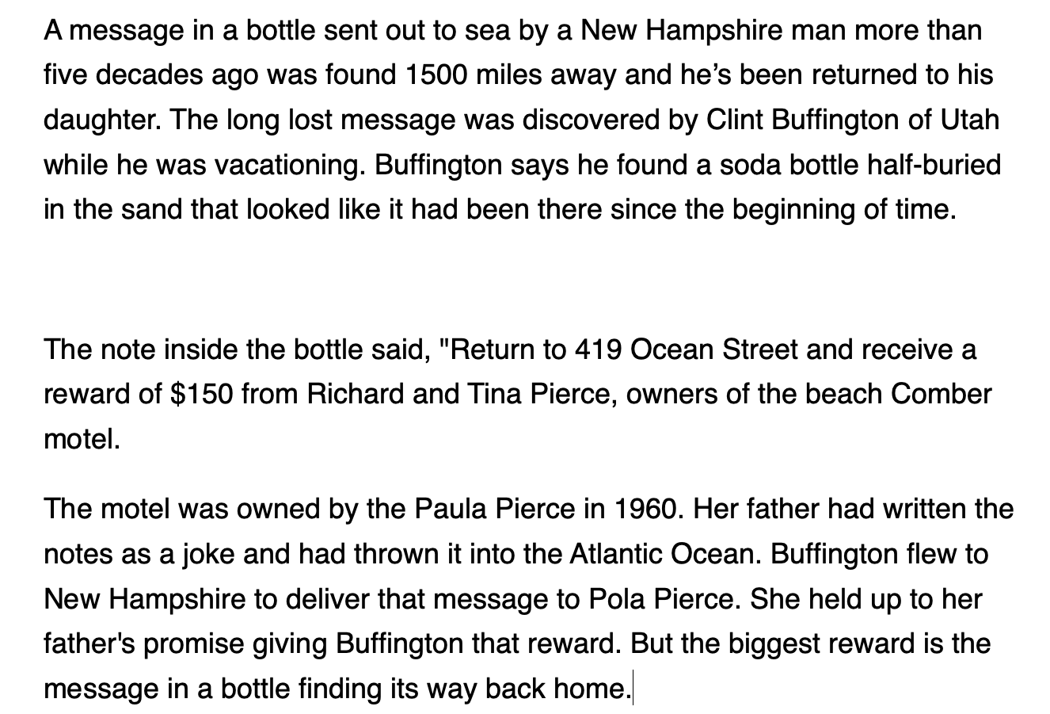
写作
分值
35%
听力
四级语速比高考快
句子长
阅读
翻译

Slide 49
写作
听力
阅读
翻译

Slide 50
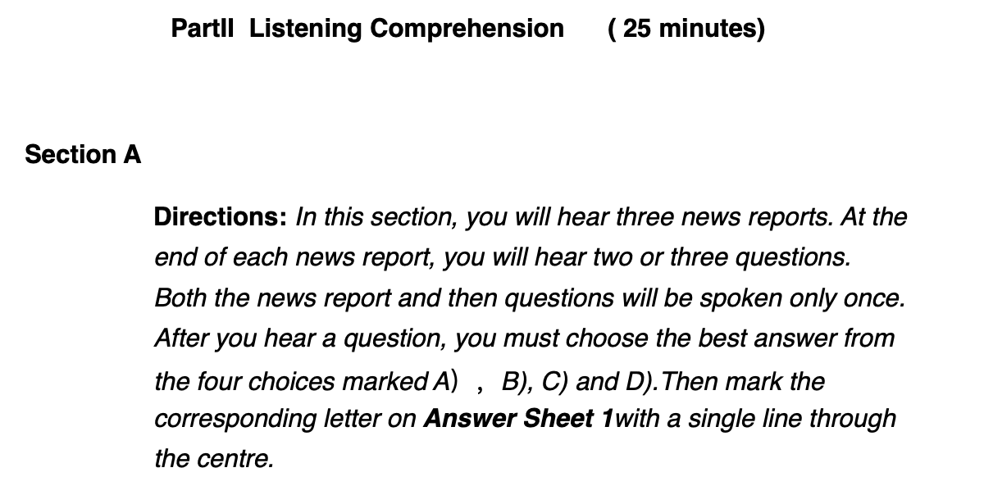
听力完毕，收答题卡1（写作 听力）
直接涂卡
写作
每一题，提前读答案
听力
阅读
翻译

Slide 51
写作
分值
35%
找3分听力真题精听
听力
找到听力原文
反复听，直到每个单词都认识为止
阅读
泛听
翻译

Slide 52
写作
听力
选词填空 5%
段落匹配 10%
阅读
仔细阅读 15%
翻译

Slide 53
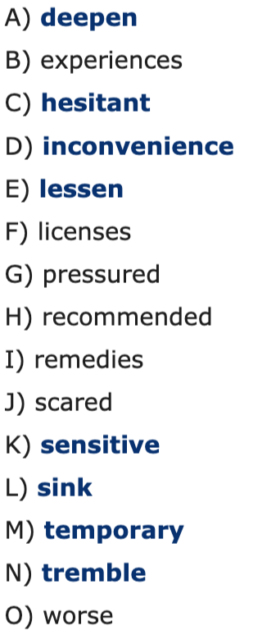
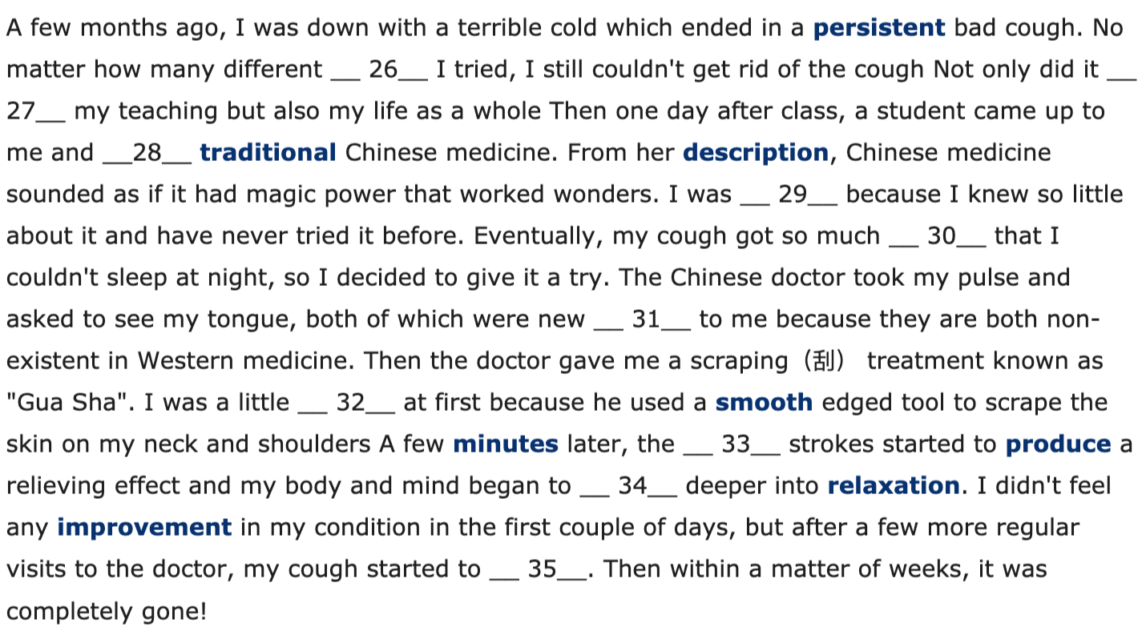
选词填空 5%
写作
听力
阅读
翻译

Slide 54
写作
段落匹配 10%
听力
阅读
翻译

Slide 55
写作
听力
选词填空 5%
每天一套题 背单词
段落匹配 10%
慢速练习，熟练后加快做题速度
阅读
仔细阅读 15%
按照习惯复习
翻译

Slide 56
原文
我们遇到什么困难也不要怕
微笑着面对它！
消除恐惧的最好办法就是面对恐惧！
加油！奥利给！

Slide 57
当你不会语法时
遇到我们困难什么也不要怕
面对它微笑着！
恐惧的消除最好办法就是恐惧面对！
加油！奥利给！

Slide 58
背单词技巧
从核心词汇/高频词汇开始背
通过试卷背单词

Slide 59
原文
我们遇到什么困难也不要怕
微笑着面对它！
消除恐惧的最好办法就是面对恐惧！
加油！奥利给！

Slide 60
当你不会单词时
我们遇到什么困难
也不要怕，微笑着面对它！
消除恐惧的最好办法就是面对恐惧！
加油！奥利给！

