Slide 1
Learning of robot-to-human handovers
Simon Simonsson
KTH
12-04-2019

Slide 2
Outline
Introduction and background
Methods
Results and discussion
Conclusions and future work

Slide 3
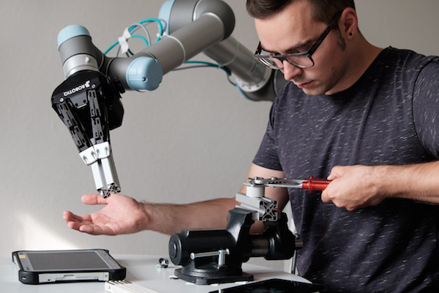
Introduction
A model for robots to learn handover features through demonstrations and image data

Slide 4
Background
Many possibilities for the use of robots in collaborative tasks with humans
  Help handing over tools
  Help disabled with manipulating objects
  Help elderly with fetching things around the home

Slide 5
Background
Problem: There are many possible objects
  But we do not want to teach it for each object
  A better way would be to show it a couple of objects and it can scale this to new ones
We will only be concentrating on the presentation of the object to the receiver

Slide 6
Research questions
Can we classify objects depending on the way they are handed over?
Are objects in the same class visually similar enough to predict its class from images?
Is this applicable to new objects?

Slide 7
Methods

Slide 8
Methods
Data collection
Classification
Prediction

Slide 9
Methods
Semi-supervised approach
  Unsupervised learning for classification of objects
  Supervised learning to predict class

Slide 10
Data collection
Objects were gathered randomly around the home.
Pairs of volunteers were recorded while handing over objects.
Application was written to extract features from the video – more specifically the handover moment.

Slide 11
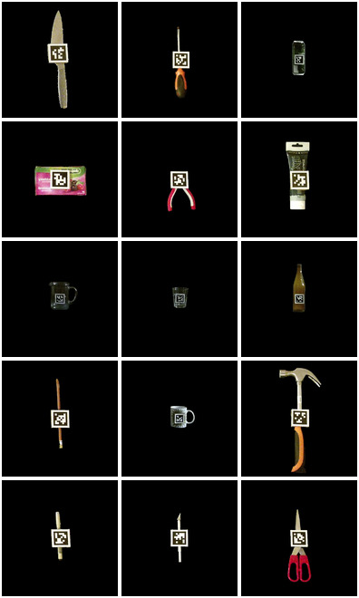
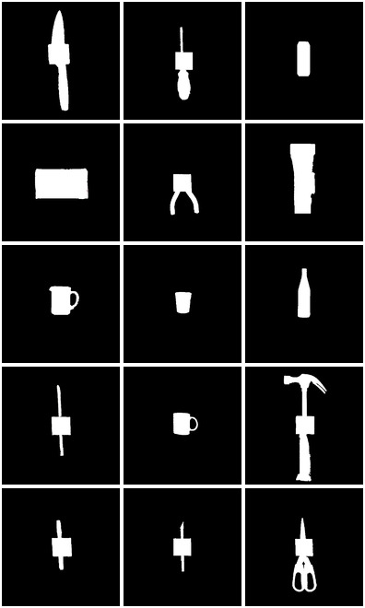
Data collection
Ground truth versions and binary masks of the objects were created in order to extract features.

Slide 12
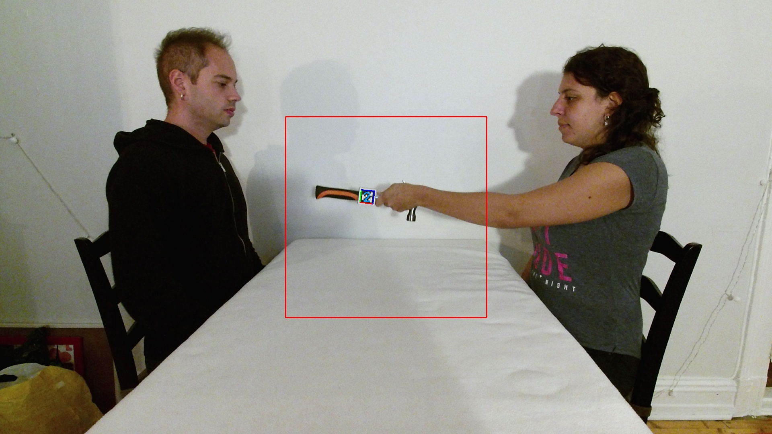
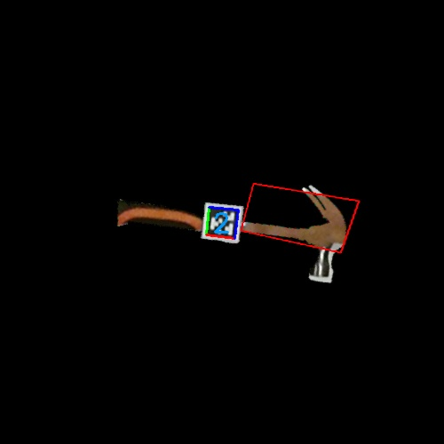
Data collection
Objects are looked for in the region of interest and features are extracted about the handover.

Slide 13
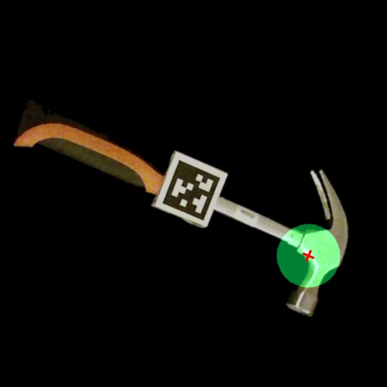
Data collection – Feature extraction
Rotation of object in z-axis.
Direction in x-axis between center of object and center of grasp.
Direction in y-axis between center of object and center of grasp.
Ratio of area of grasp region over area of the object.
Ratio of distance between center of the object and the center of grasp region over the diagonal of the object.

Slide 14
Classification of objects
Samples are clustered using an unsupervised algorigthm. In our case K-means was used.
The objects are assigned a class depending on which cluster a majority of their samples are part of.

Slide 15
Class prediction
Given an image of the object we want the model to give us the handover class.
RGBD images were taken of the objects from different angles.
Blue channel was replaced with depth.

Slide 16
Class prediction
Convolutional Neural Network (CNN) was used for predicting class from RGD image.
AlexNet architecture with pre-trained weights.
Output layer added for the number of classes of objects we find.

Slide 17
Testing and evaluation
Can we classify the objects?
  Distribution of samples over clusters
  Do more than half of the samples for one object belong to the same cluster?

Slide 18
Testing and evaluation
Predicting class from images
  For objects in the training set
  For new objects
  Aim for 90% accuracy with a standard deviation of 5%

Slide 19
Results

Slide 20
Results
Clustering of samples (3466 frames in total)
Classification of objects
Prediction of class
  Recorded objects
  Foreign objects

Slide 21
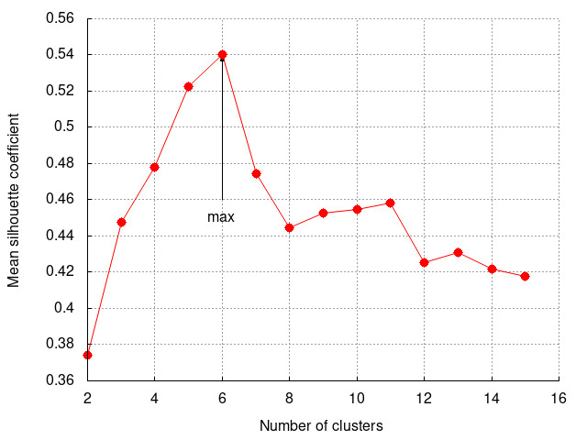
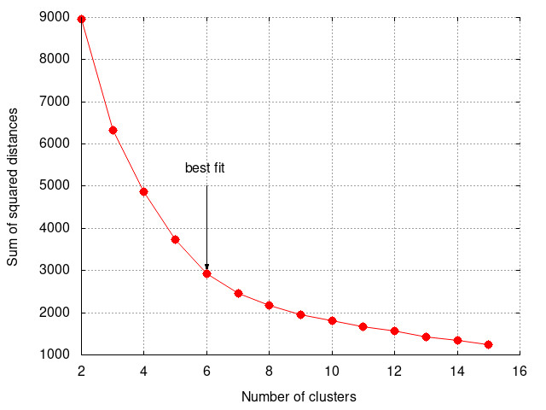
Results – Clustering of samples

Slide 22
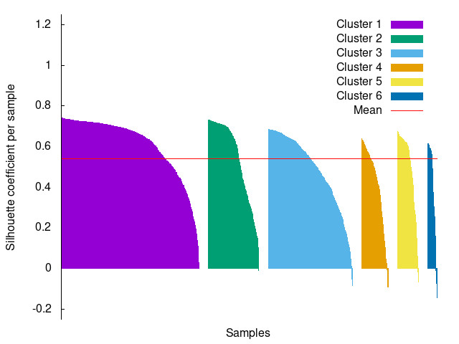
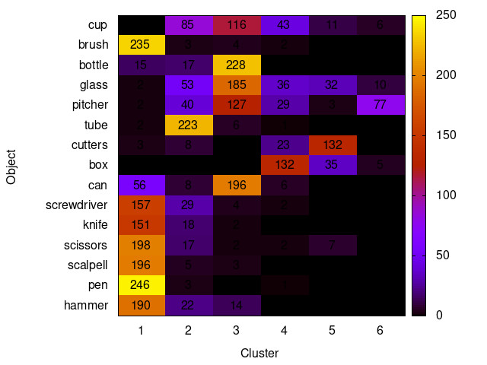
Results – Clustering of samples

Slide 23
Results – Object classification
Cluster | Objects
One | Hammer, pen, scalpel, scissors, knife, screwdriver, brush
Two | Tube
Three | Can, pitcher, glass, bottle, cup
Four | Box
Five | Cutters
Six | -

Slide 24
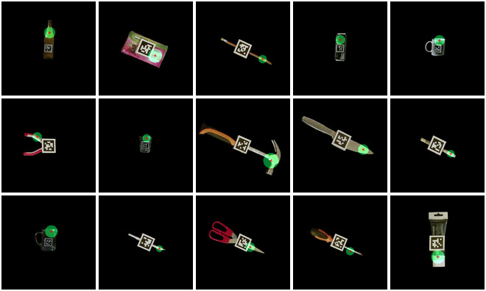
Results – Object classification

Slide 25
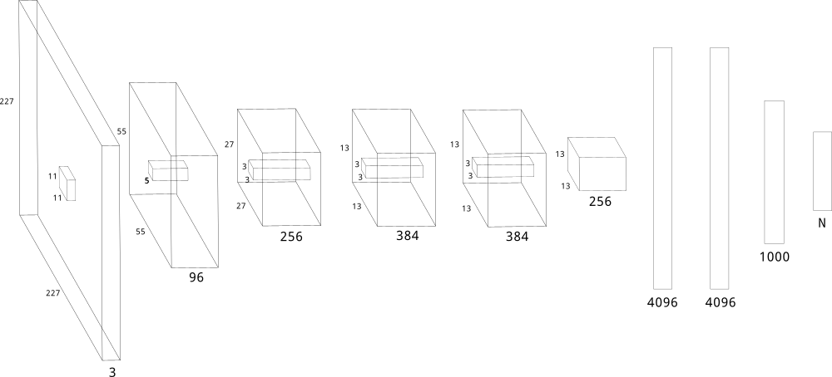
Results – Prediction of class

Slide 26
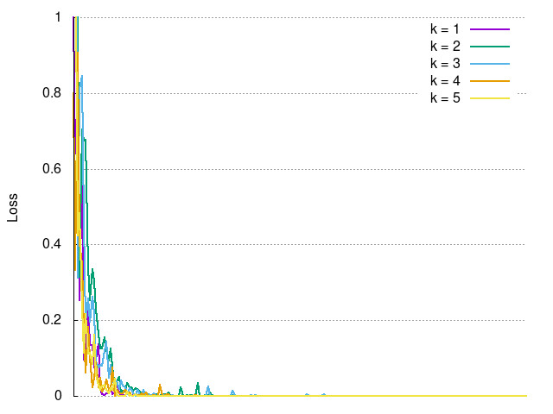
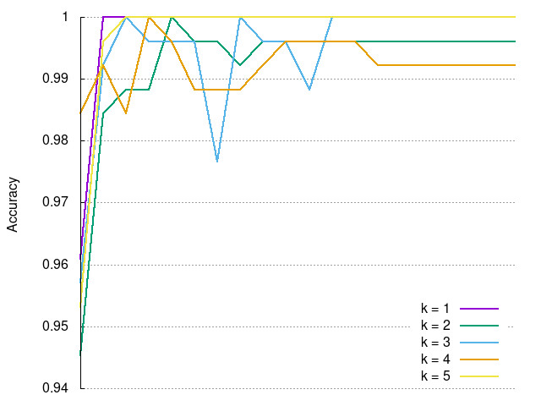
Results – Prediction of class

Slide 27
Results – Prediction of class
Test set of objects was introduced
  Belonging to the same classes as training set
  Manually labelled
  How well does the method scale
  Make sure same kind of objects are still correctly predicted
Beer glass
Bottle
Carafe
Cup
Fork
Glass
Knife
Scissors
Spatula
Spoon
Wineglass
Wooden spoon

Slide 28
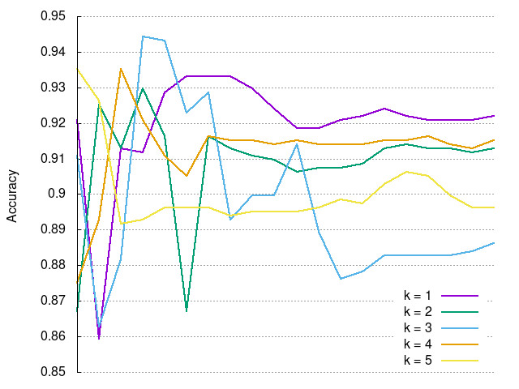
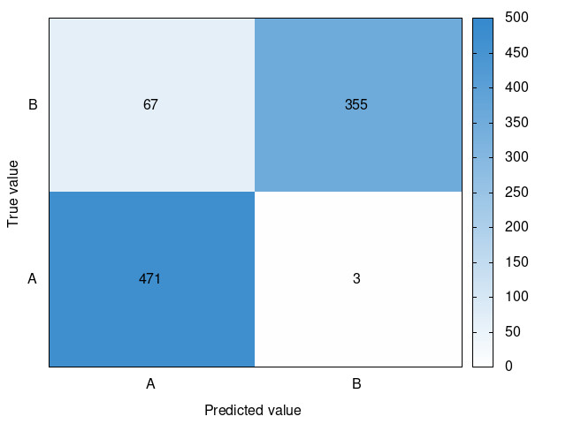
Results – Prediction of class
90.6%, std: 1.3%

Slide 29
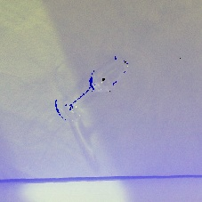
Results – Prediction of class
Glassware were problematic
  Under-represented in training set
  Combination of both classes

Slide 30
Results – Prediction of class
Testing object impact on end-results:
Training the network in pairs of objects

Slide 31
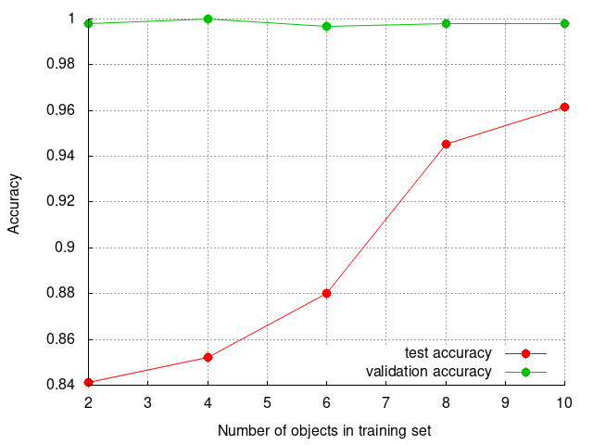
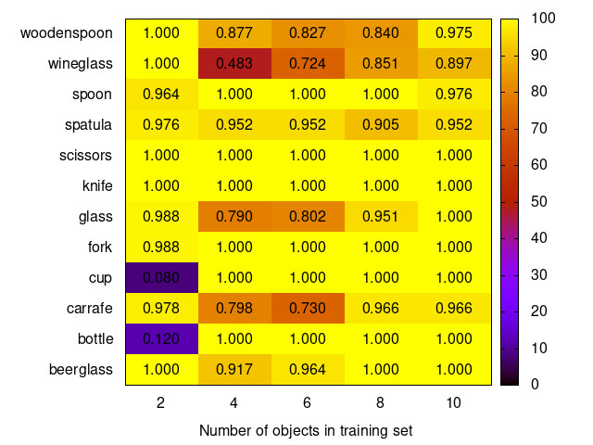
Results – Prediction of class

Slide 32
Conclusions
We were able to classify the objects using handover features
  Unsupervised learning
  Two exceptions: cup and pitcher
  Noisy data

Slide 33
Conclusions
We could correctly predict handover class from image data
  Visual similarities between object within the same class

Slide 34
Conclusions
Applicable on new objects
  Scales well to objects outside the dataset
  Importance of balancing the dataset so important features are not under-represented

Slide 35
Limitations and future work
A lot of manual work when into classification of objects though it was meant to be purely unsupervised.
Better way of recording handovers
  AprilTags caused some discomfort
Ways of balancing the dataset
How well does it perform on more classes?

Slide 36
Limitations and future work
Calculating how the robot is actually going to grasp the object
The movement is of great importance and needs to be taken into account as well

Slide 37
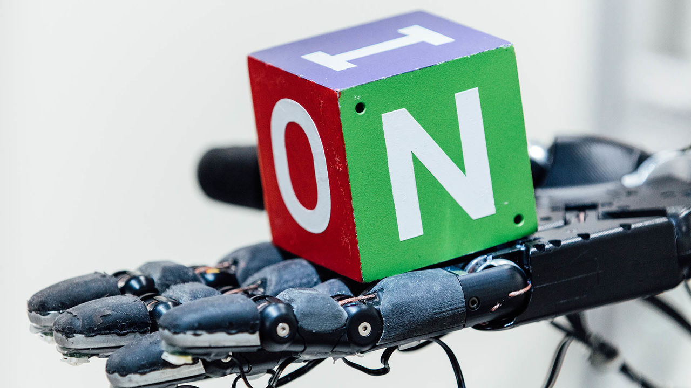
Thank you for listening!

