Slide 1
Voice-Call Chat & Social Interaction Platform Database
Designing for Interaction, Monetization, and Analytics
Team3 members: Hang Bao, Yixin Mao, Xin Wen, Xiaopeng Wang

Slide 2
Business Problem
Challenges in Voice-Based Social Platforms
Our DataBase Focus
Real-time voice platforms are complex
High-frequency interactions (messages, calls)
Need accurate tracking of calls and payments
Difficult to connect user activity with revenue
Room-based voice interaction system
Supports users, providers, and calls
Tracks sessions, messaging, and payments
Enables structured reporting and analytics

Slide 3
System Overview
How the Platform Works
User registers and logs in → User table stores credentials, status, and contact info
User takes on a role → Member (audience) or Provider (host) extends User with role-specific data
User joins a room → Room stores type, tags, and max provider count; RoomProvider tracks who is on stage
Users send messages → RoomMessage records text and media with IDENTITY PK for ordered audit trail
Member starts a private audio call → AudioCall records start/end time; duration_seconds auto-calculated
Member pays based on duration → AudioCallProvider records tokens charged; artist_earn auto-calculated at 80% share
Member sends tips → Tip ledger is immutable; amount validated by fn_ValidateTipAmount (1–9999 tokens)
Data stored for analytics → 3 views aggregate earnings, room activity, and member spending for BI reporting

Slide 4
Mission Objectives
User & Identity Management
User profiles, Member/Provider role specialization, account status control
Room & Session Tracking
Room types (public/private/premium), tags, provider participation tracking
Audio Call Recording
Session-level call data with auto-calculated duration_seconds
Financial Monetization
Token-based economy, per-call earnings, tip ledger with validation
Searchability & Tagging
Standardized tag catalogs for providers and rooms
Analytics & Reporting
3 views for provider earnings, room activity, and member spending

Slide 5
Entity List & Relationship Descriptions
User & Identity Module
User: Core identity and authentication. Stores credentials, contact info, and account status.
Member: Role extension for audience. Adds nickname, token balance, and VIP level.
Provider: Role extension for hosts. Stores bio, service type, pricing, rating, and availability.
Room Module
Room: Virtual session environment. Supports group and 1-on-1 modes. Linked to User via owner_user_id (Non-identifying).
RoomProvider: Junction table tracking provider participation. Stores join/leave times and tip totals. Composite PK (Identifying).
RoomMessage: Stores messages within rooms. Uses IDENTITY PK for chronological ordering. Preserved independently for auditing (Non-identifying).

Slide 6
Tag Module
ProviderTagCatalog: Predefined tag library for providers (e.g., coaching, wellness). Supports color and category for UI.
ProviderTagAssignment: Junction table resolving M:N between Provider and ProviderTagCatalog. Composite PK (Identifying).
RoomTagCatalog: Predefined category library for rooms (e.g., Motivation, Finance).
RoomTagAssignment: Junction table resolving M:N between Room and RoomTagCatalog. Composite PK (Identifying).
Financial Module
AudioCall: Records session-level call data. duration_seconds is a computed column. Preserved for financial auditing even if room is closed (Non-identifying).
AudioCallProvider: Per-provider earnings per call. artist_earn is a computed column. Composite PK (Identifying).
Tip: Immutable financial ledger for tips. Records sender_user_id for full audit trail. Amount validated by fn_ValidateTipAmount.

Slide 7
Final ERD

Slide 8
SQL File Structure:
0 CREATE DATABASE
1 statement
1 DROP TABLES
13 tables in dependency order
2 DROP + CREATE FUNCTIONS
4 scalar functions: fn_ComputeCallDuration fn_ComputeArtistEarn fn_ValidateTipAmount fn_ValidateCallDuration
3 CREATE TABLES
13 tables with PK · FK · CHECK Computed Columns
4 INSERT DATA
10+ rows per table (15 Users, 10 each others)
5 CREATE VIEWS
3 views: vw_ProviderEarningsSummary vw_ActiveRoomOverview vw_MemberRoomActivitySummary
6 VERIFICATION QUERIES
Row counts Computed column check View previews
Notes:
Hi everyone, I will be walking you through the implementation details of our database.
here is the overall structure of our SQL file. It has 7 sections. We start by creating the database, then drop any existing objects to allow safe re-runs, then define 4 scalar functions, create all 13 tables with constraints, insert sample data with at least 10 rows per table, create 3 views, and finally run verification queries to confirm everything works correctly.

Slide 9
SQL DDL Implementation
-- 1. Computed Column: AudioCall
duration_seconds
AS fn_ComputeCallDuration(start_time, end_time)
-- fn_ComputeCallDuration
RETURNS INT: DATEDIFF(SECOND, @start, @end)
-- 2. Computed Column: AudioCallProvider
artist_earn
AS fn_ComputeArtistEarn(price_tokens, duration_seconds)
-- fn_ComputeArtistEarn
RETURNS INT:
CAST(price_tokens * duration_seconds
/ 60.0 * 0.80 AS INT)
-- 80% revenue after 20% platform fee
-- 3. CHECK: fn_ValidateTipAmount
CONSTRAINT CK_Tip_Amount CHECK (
fn_ValidateTipAmount(tip_amount_tokens) = 1)
RETURNS 1 if amount > 0 AND amount <= 9999
-- 4. CHECK: fn_ValidateCallDuration
CONSTRAINT CK_ACP_Duration CHECK (
duration_seconds IS NULL OR
fn_ValidateCallDuration(duration_seconds) = 1)
RETURNS 1 if seconds > 0
-- 5. RoomMessage IDENTITY PK
message_id INT NOT NULL IDENTITY(1,1)
-- auto-increment = chronological order
CONSTRAINT PK_RoomMessage PRIMARY KEY (message_id)
Implementation Highlights
13 Tables · 3 Modules
User Module: User, Member, Provider
Room Module: Room, RoomProvider, RoomMessage, Tag tables
Financial Module: AudioCall, AudioCallProvider, Tip
Computed Columns (Requirement #1)
duration_seconds → fn_ComputeCallDuration(start, end)
artist_earn → fn_ComputeArtistEarn(tokens, secs) = 80% share
CHECK Constraints (Requirement #2)
fn_ValidateTipAmount: tip must be 1–9999 tokens
fn_ValidateCallDuration: duration must be > 0
RoomMessage IDENTITY PK
Auto-increment defines chronological message order
Essential for compliance and safety auditing
Notes:
Now let me talk about the implementation requirements we fulfilled.
The first requirement is computed columns based on functions. We have two. In the AudioCall table, duration_seconds is automatically calculated by fn_ComputeCallDuration, which takes start time and end time and returns the difference in seconds using DATEDIFF. In the AudioCallProvider table, artist_earn is calculated by fn_ComputeArtistEarn, which multiplies price tokens by duration in minutes, then applies 80%, meaning the platform takes 20% and the provider keeps 80%.
The second requirement is CHECK constraints based on functions. fn_ValidateTipAmount returns 1 if the tip amount is between 1 and 9999 tokens, otherwise 0. The CHECK constraint rejects any tip outside this range. fn_ValidateCallDuration ensures the call duration is a positive number.
And RoomMessage uses an auto-increment IDENTITY as primary key. This not only uniquely identifies each message, but the ascending ID also defines chronological message order, which is essential for compliance and safety auditing.

Slide 10
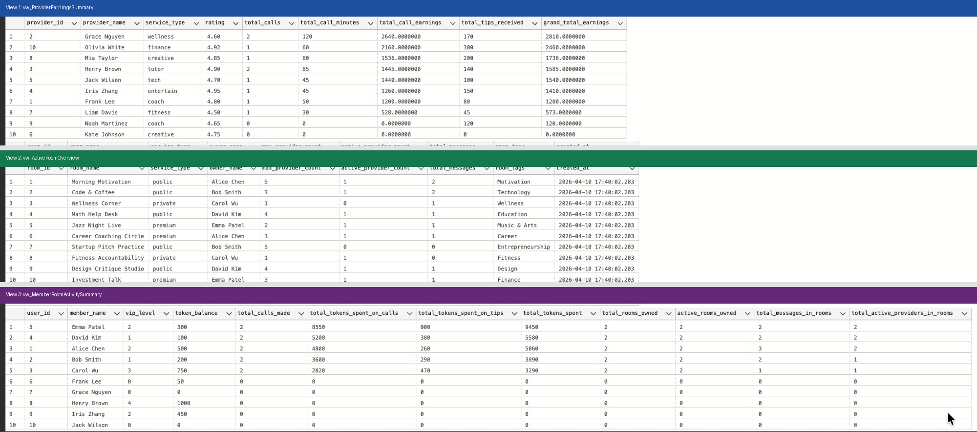
Views: Query Results
Notes:
Here are the actual query results from our 3 views running against the sample data.
The first view, vw_ProviderEarningsSummary, shows each provider ranked by grand total earnings, combining call earnings and tips. Grace is the top earner with 2810 tokens, combining call earnings and tips.
The second view, vw_ActiveRoomOverview, shows all 10 active rooms with their owner, provider count, message count, and tags. You can see each room has exactly one tag assigned and the room types are public, private, or premium.
The third view, vw_MemberRoomActivitySummary, shows member spending combined with room ownership. Emma Patel spent the most, 9450 tokens, and owns 2 active rooms.

Slide 11
View 3: Member Room Activity Summary
-- View 3: Member Room Activity Summary
CREATE VIEW dbo.vw_MemberRoomActivitySummary AS
-- CTE 1: Member token spending
WITH MemberSpend AS (
SELECT u.id, u.name, m.vip_level, m.token_balance,
COUNT(DISTINCT ac.id) AS total_calls_made,
COALESCE(SUM(ac.total_cost_tokens),0)
AS total_tokens_spent_on_calls,
COALESCE(SUM(t.tip_amount_tokens),0)
AS total_tokens_spent_on_tips
FROM dbo.Member m JOIN dbo.[User] u ON m.user_id=u.id
LEFT JOIN dbo.AudioCall ac ON u.id=ac.owner_user_id
LEFT JOIN dbo.Tip t ON u.id=t.sender_user_id
GROUP BY u.id, u.name, m.vip_level, m.token_balance
),
-- CTE 2: Room ownership stats
RoomStats AS (
SELECT r.owner_user_id,
COUNT(DISTINCT r.id) AS total_rooms_owned,
COUNT(DISTINCT CASE WHEN r.status='active'
THEN r.id END) AS active_rooms_owned,
COUNT(DISTINCT rp.provider_id)
AS total_active_providers_in_rooms
FROM dbo.Room r
LEFT JOIN dbo.RoomProvider rp ON r.id=rp.room_id
GROUP BY r.owner_user_id
)
SELECT ms.*, COALESCE(rs.total_rooms_owned,0),
COALESCE(rs.active_rooms_owned,0), ...
FROM MemberSpend ms LEFT JOIN RoomStats rs
ON ms.user_id = rs.user_id;
vw_MemberRoomActivitySummary
Design: 2 CTEs
MemberSpend: token spending on calls + tips
RoomStats: rooms owned, messages, active providers
Tables Joined (7 total)
Member, User, AudioCall, Tip
Room, RoomMessage, RoomProvider
Business Use Cases
VIP segmentation: identify high-spending members
Spending vs. room activity correlation
Platform engagement analytics
Supersedes vw_MemberSpendingSummary
Contains all previous fields + room ownership stats
Notes:
This slide shows the SQL code for the third view. It uses two CTEs. MemberSpend aggregates token spending from calls and tips per member. RoomStats calculates room ownership metrics per user. The final SELECT joins them together into one unified summary. This view supports VIP segmentation and platform engagement analytics.
That's the implementation. Then I’ll hand it over to my teammate Xiaopeng.

Slide 12
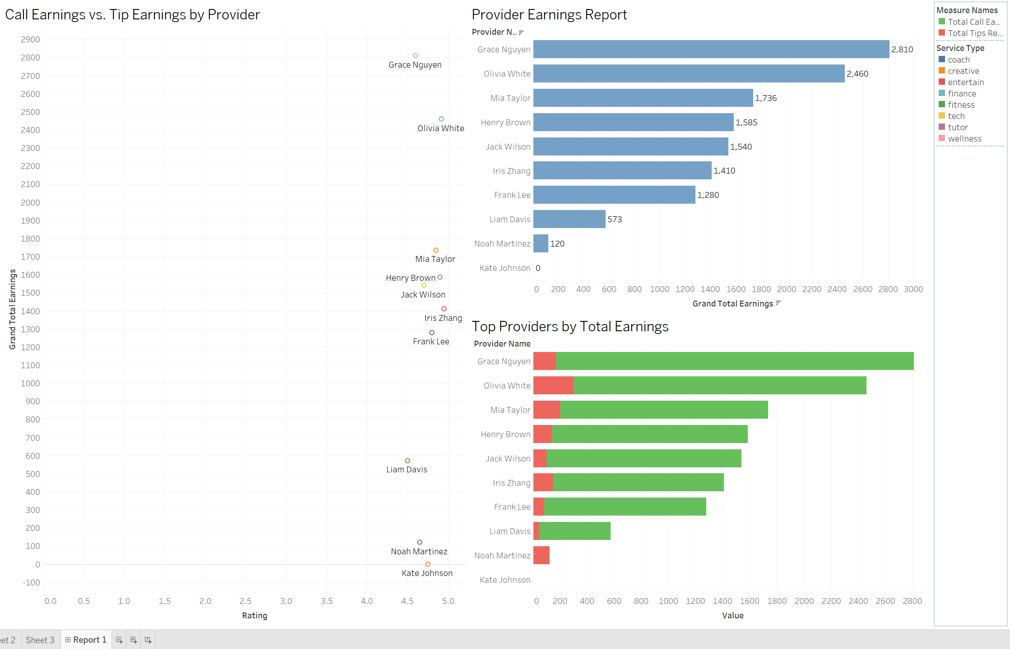
Report 1
Notes:
Call Earnings vs. Tip Earnings by Provider: compares each provider’s income from calls and tips. It shows the earnings structure of providers and whether their revenue comes mainly from service fees or user tips.
Provider Earnings Report: analyzes the earnings performance of service providers on the platform. It shows total provider earnings, compares call income with tip income, and helps identify the highest-earning providers.
Top Providers by Total Earnings: ranks providers by their total earnings. It helps highlight which providers generate the most revenue through calls and tips.

Slide 13
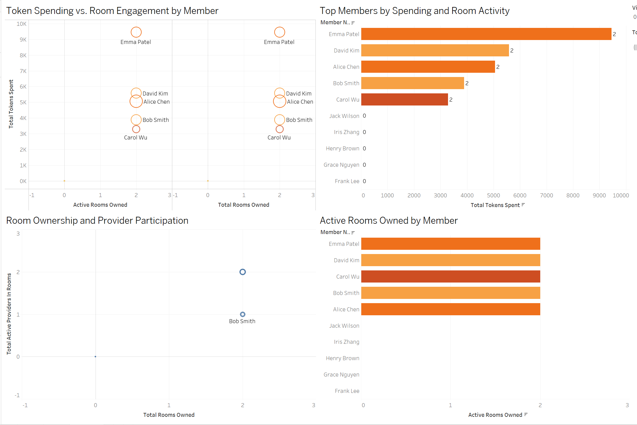
Report 2
Notes:
Token Spending vs. Room Engagement by Member: This bubble chart shows the relationship between member spending and room engagement. Each bubble represents a member, while size and color provide additional engagement insights.
Top Members by Spending and Room Activity: highlights members with high token spending and strong room activity, combining financial and engagement performance in a single view.
Room Ownership and Provider Participation: compares the number of rooms owned by members with the number of active providers participating in those rooms.
Active Rooms Owned by Member: shows how many active rooms are owned by each member. It helps analyze room ownership and activity contribution across users.

Slide 14
Further Improvements
Add Data Encryption
Column-level encryption for password and email fields to meet GDPR requirements
Transaction Table
Add a Transaction entity to track all token movements (top-ups, purchases, payouts)
Moderation Auditing
Add ModerationAction table to log Mute/Kick/Ban events with admin ID for compliance
Notification Logging
Add Notification table for missed calls, new tips, and system alerts
Provider Level System
Expand level field with automated tier upgrades based on total_minutes
Full-Text Search Index
Add indexed views or full-text search on tags for faster BI queries

Slide 15
Thank You For Your Time

