Slide 1
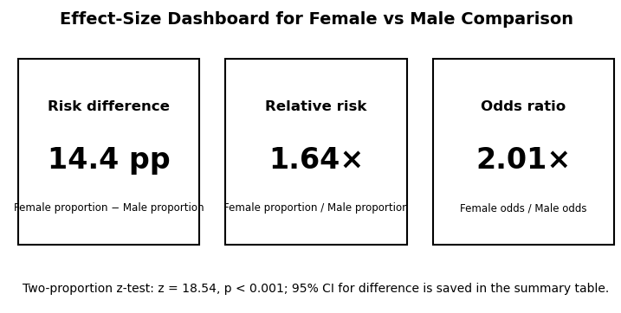
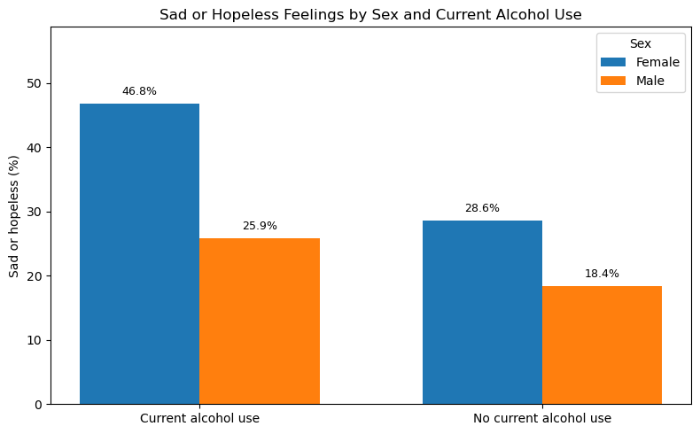
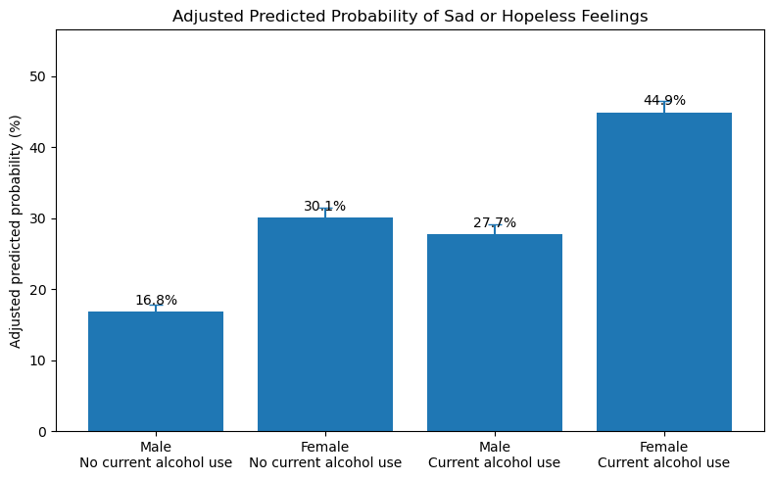
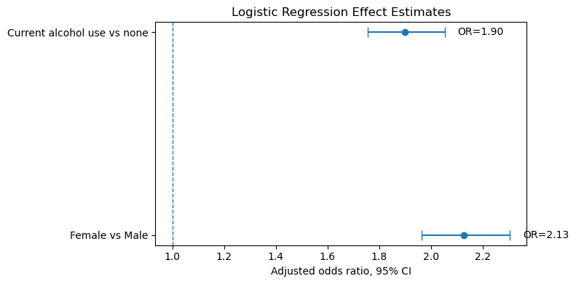
Gender, Current Alcohol Use, and Sad or Hopeless Feelings
among High School Students
113370209 王心妤
112310316梁展育
research question
Statistical Methods
Hypotheses
Main question
Extension question
MAIN ANALYSIS
EXTENSION
H₀: pFemale = pMale
No difference in proportions
H₁: pFemale ≠ pMale
A difference exists (two-sided)
Is the proportion of sad or hopeless feelings different between female and male students?
After considering current alcohol use, does the association between sex and sad/hopeless feelings still remain?
Adjusted predicted probability
1
Two-proportion Z-test — test for significant difference
3
2
Logistic regression
Statistical conclusion
Data Collection · Variables
Data Collection
Variables
Main Results — Two-Proportion Z-Test
Reject H₀
Source
YRBS 2007
X — Group variable
+14.4 pp
p < 0.001 · z = 18.54
6,940
WhatIsYourSex
22.7%
Female
Female / Male
37.2%
18.54
< 0.001
Male
6,893
Y — Response variable
Type I / II error
Total
13,833
SadOrHopeless
Female proportion
Male proportion
Z-statistic
p-value
Difference
Type I (α)
0.05
1 = Yes / 0 = No
n = 6,940
n = 6,893
Reject H₀
Female − Male
Type II (β)
Very low
Z — Extension variable
Power
Near 1
CurrentAlcoholUse
1 = Yes / 0 = No
Figures
Key Results & Conclusion
Limitations
① Female consistently higher
② Alcohol use → higher risk
• Observational survey data support association, not causation
• Responses were self-reported
• Some potentially important variables were not included
• The dataset was collected in 2007
37.2% vs 22.7% (+14.4 pp)
Higher in both alcohol groups
Both sexes show higher rates
with current alcohol use
③ Both independently significant
④ Highest-risk group
Adj. OR: Female 2.13×
Adj. OR: Alcohol 1.90×
Female + alcohol use: 44.9%
Highest predicted probability
Female students reported sad/hopeless feelings more often than male students. The association remains clear after considering current alcohol use. Observational survey data support association, not causation.

