Slide 1
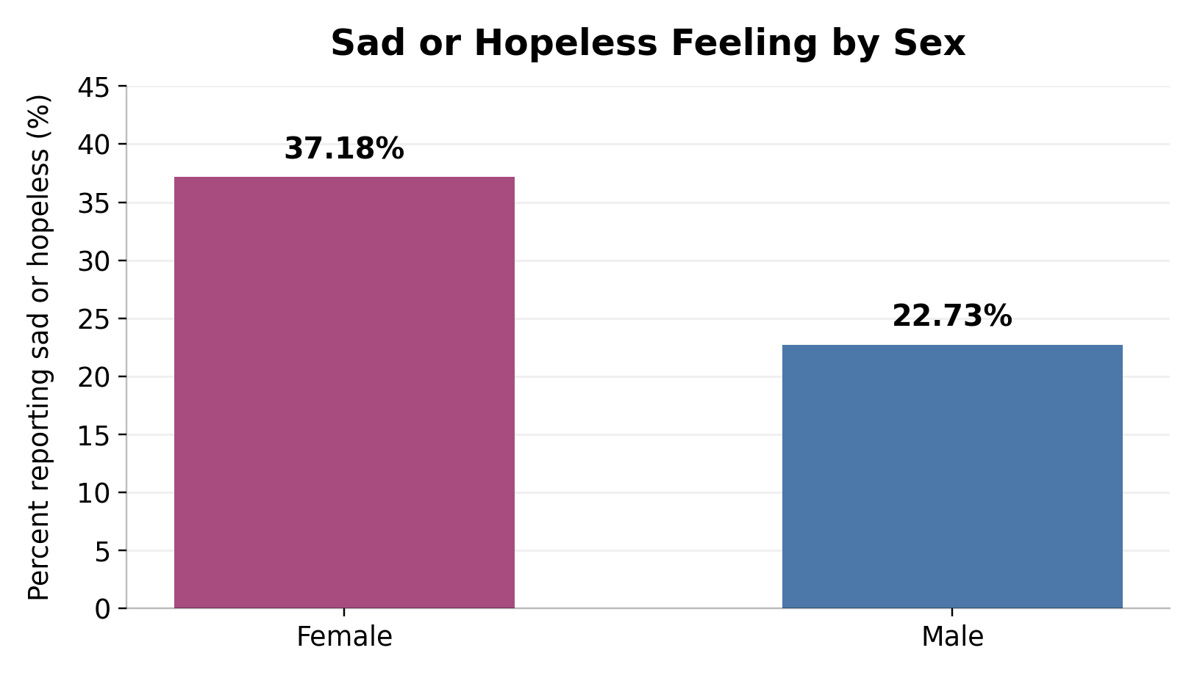
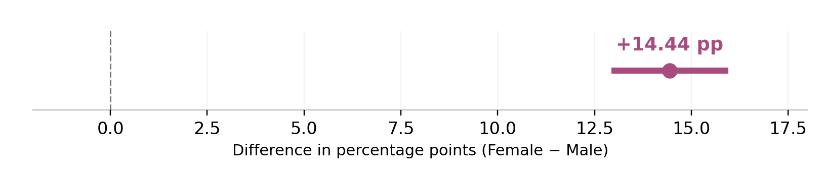
Project Cycle 3 • Two-Sample Inference
Q3
Sad or Hopeless Feelings
Female vs. Male Students
approved question
Is the proportion of students who felt sad or hopeless different between female and male students?
Observed proportions
Key result
+14.44
percentage points
Female proportion was higher than male proportion.
Female
37.18%
Male
22.73%
p-value
< 0.001
Inference: confidence interval
Group variable: WhatIsYourSex → Female vs. Male
Reject H0. In this dataset, female students reported sad or hopeless feelings at a significantly higher proportion. This is an association, not causation.
Response: SadOrHopeless, recoded Yes = 1 / No = 0
Conclusion
Method: two-proportion z-test, α = 0.05

