Slide 1
Queensborough Community College (The City University Of New York) Department of Engineering Technology ET 110 – Introduction to circuit analysis Pre-Exam 1 Academic dishonesty is prohibited in The City University of New York and is punishable by penalties, including failing grades, suspension, and expulsion. Some examples of academic dishonesty are cheating, plagiarism, Internet plagiarism, obtaining unfair advantage, falsification of records and official documents, and collusion. (By signing below, I acknowledge the academic dishonesty law in CUNY) Student’s name: DUE DATE: Monday 9/26/16 Professor Huixin Wu
INSTRUCTION
Show all work and calculation
Round off all your answer in engineering notation to the hundredth place, except for question 2.
All answers should have units, otherwise points will be deducted.
Box or circled your answer.

Slide 2

GIVEN
1 mile = 5280 ft
1 ft = 12 in
1 meter = 39.37 in
1 in = 2.54 cm
1 yard = 3 ft
1 mil = 1 *10⁻³ in
Coulomb’s law
$F= \frac{kQ_{1}Q_{2}}{r^{2}}$ k=9*10⁹ Nm²/C²
Voltage
$$V= \frac{w}{Q}$$
Current
$$I= \frac{Q}{t}$$
Ampere-hour rate
$life= \frac{Ah}{A}$
Resistance
$R= \frac{ρ∗ι}{A}$ A = (mil)²
Color | 1st band | 2nd band | Multiplier | Tolerance
Black | 0 | 0 | 10⁰
Brown | 1 | 1 | 10¹ | 1%
Red | 2 | 2 | 10² | 2%
Orange | 3 | 3 | 10³
Yellow | 4 | 4 | 10⁴
Green | 5 | 5 | 10⁵ | 0.5%
Blue | 6 | 6 | 10⁶ | 0.25%
Violet | 7 | 7 | 10⁷ | 0.10%
Grey | 8 | 8 | 10⁸ | 0.05%
white | 9 | 9 | 10⁹
Gold |  |  | 10⁻¹ = 0.1 | 5%
Silver |  |  | 10⁻² = 0.01 | 10%
None |  |  | 10⁻³= 0.001 | 20%
Material | Resistivity of material (Ω-CM)/ft @ room temperature
Silver | 9.9
Copper | 10.4
Gold | 14.7

Slide 3
A car is traveling 55 mph, what will be the distance, in meter, travelled in 23 minutes? ( 8 pts)

Slide 4
2.
Convert 0.0003697581 km to mm (millimeters) (3 pts)
Convert 13623.58 Ω to kΩ (3 pts)

Slide 5
3. Determine the distance between two different charges of 350 mC and 28 µC, if the force of attraction between them is 367.20 N. (8 pts)

Slide 6
4. If the potential energy between two points is 12.5 V, how much energy is expected to bring 750.8 mC from one point to the other? (5 pts)

Slide 7
5. If a current of 18.75 mA exists for 2.25 hours in a wire, how many coulombs of charge have passed through the wire? (7 pts)

Slide 8
6. How many minutes will a charge of 22.662 mC passes through a light bulb if the current is constant at 125.9 µA (7 pts)

Slide 9
7. For how many minutes of constant use will a battery with an Ah rating of 60 theoretically provide a current of 2.38 mA (7 pts)

Slide 10

8. A technician is trying to find the resistivity material of a wire. He measured the resistance and found it to be 8.2 Ω. A tape measure indicated that the thickness of the wire was $\frac{1}{16}$ inches with a length was approximate 2.18*10³ ft. What resistivity material is the wire made of? (10 pts)

Slide 11
9. For the following carbon made resistor:
(2 pts) Write is color band: (1st band) ______ (2nd band) _____ (3rd band) ______ (4th band)______
(4 pts) Its nominal resistance value is (engineering notation):
(2 pts) Its tolerance resistance is:
(3 pts) Its maximum resistance value is:
(3 pts) Its minimum resistance value is:

Slide 12
10. Find the color coding for the following resistors:
(6 pts) 560 MΩ + 0.25% _____ , ____ , _____ , _____
(6 pts) 0.78 Ω + 10 % _____ , ____ , _____ , _____
(6 pts) 3.9 kΩ + 1% _____ , ____ , _____ , _____

Slide 13
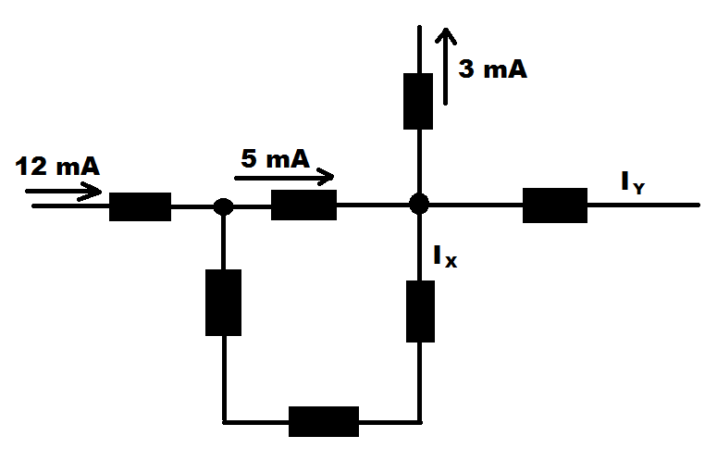
Multiple choices Circle only ONE answer
11. The current through I_{Y} is: (3 points)
12 mA (flowing from left to right)
12 mA (flowing from right to left)
9 mA (flowing from left to right)
9 mA (flowing from right to left)
2 mA (flowing from left to right)
2 mA (flowing from right to left)
12. The current through I_{X} is: ( 3 points)
7 mA (flowing down)
5 mA (flowing from left to right)
3 mA (flowing up)
12 mA (flowing from right to left)
3 mA (flowing down)
7 mA (flowing up)

Slide 14
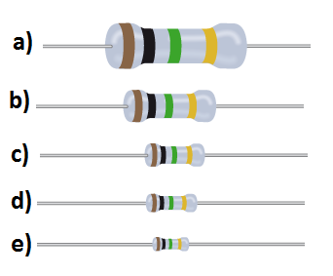
13. From the following resistors, which resistor will dissipate the lowest power (2 points)
14. If an element permits a generous flow of electrons with very little external force is known as ___________ , and if it does not permit a generous flow of electrons is known as __________. (2 points)
Insulator, conductor
Conductor, insulator
Conductor, semiconductor
Insulator, semiconductor
Conductor, conductor

