Slide 1
Topological Insulators
组员：马润泽 金佳霖 孙晋茹 宋化鼎 罗巍 申攀攀 沈齐欣 生冀明 刘易

Slide 2
Outline
Introduction
Brief history of topological insulators
Band theory
Quantum Hall effect
Superconducting proximity effect

Slide 3
introduction
Close relation between topological insulators and several kinds of Hall effects.
Hall effect
Anomalous Hall effect
Spin Hall effect
Quantum Hall effect
Quantum Anomalous Hall effect
Quantum Spin Hall effect

Slide 4
Brief history of topological insulators

Slide 5
The History of Topological Insulator
？
QHE
……
……
3D TI
1980 整数量子霍尔效应
1982 分数量子霍尔效应
2007 Fu和Kane 预言Bi1-xSbx 第一代 3D TI
2008 Hasan ARPES证实
2009 方忠和张首晟Bi2Se3、Bi2Te3、Sb2Te3
2009 ARPES Hasan Bi2Se3、
沈志勋 Bi2Te3
Hasan Sb2Te3
QSHE
2005 Kane & Mele 理论预言 石墨烯
2006 张首晟 理论预言 HgTe / CdTe
2007 Molenkamp 实验证实

Slide 6
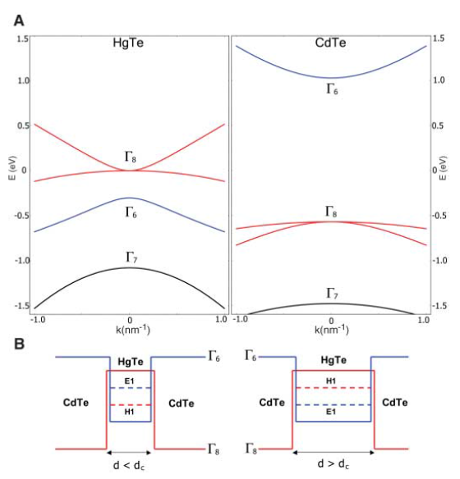
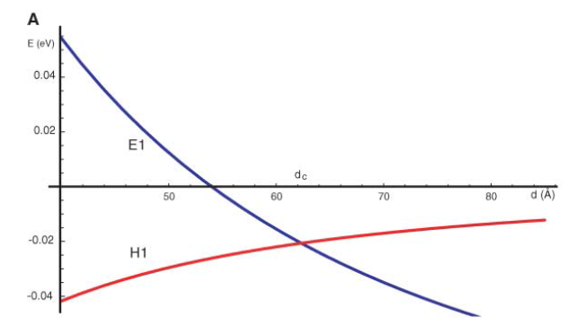
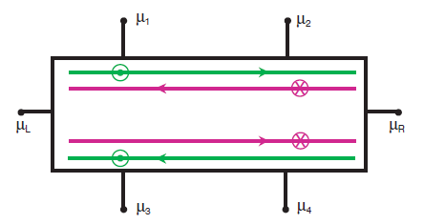
2D topological insulator
Shou-Cheng Zhang Group. Science 314, 1757 (2006)

Slide 7
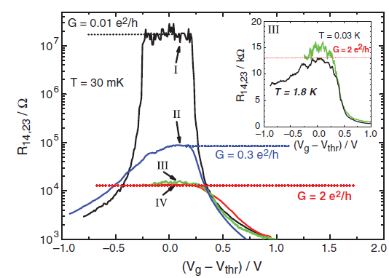
2D topological insulator
Molenkamp Group. Science 318, 766 (2007)

Slide 8
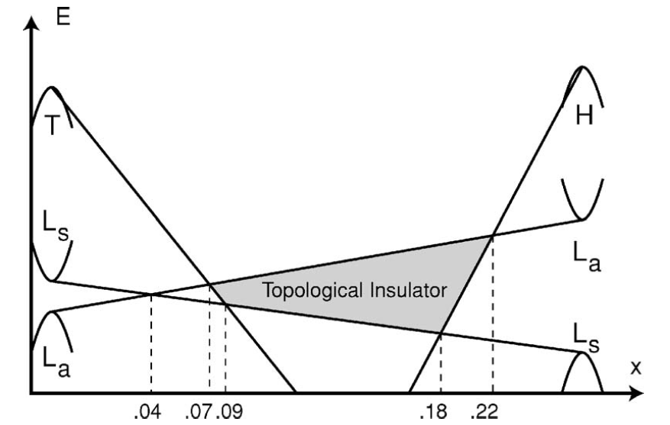
3D topological insulator
Liang Fu and C. L. Kane Physical Review B, 2007, 76(4): 045302.

Slide 9
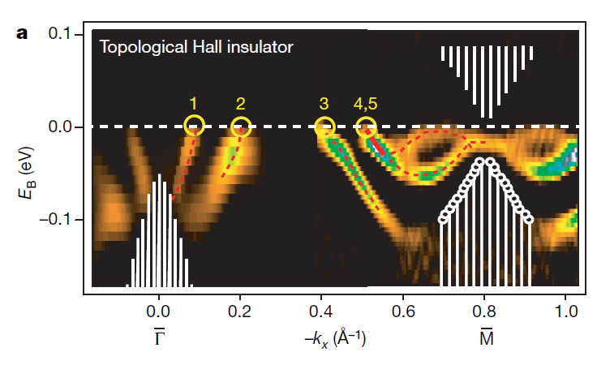
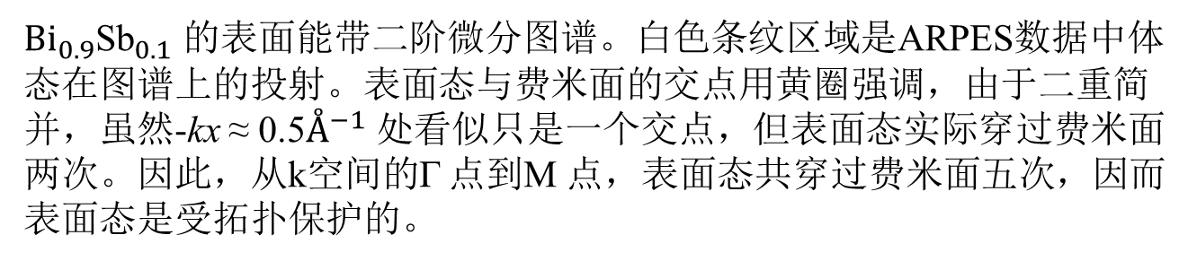
3D topological insulator
${Bi}_{0.9}{\text{Sb}}_{0.1}$ 的表面能带二阶微分图谱。白色条纹区域是ARPES数据中体态在图谱上的投射。表面态与费米面的交点用黄圈强调，由于二重简并，虽然-kx ≈ 0.5$Å^{−1}$ 处看似只是一个交点，但表面态实际穿过费米面两次。因此，从k空间的Г 点到M 点，表面态共穿过费米面五次，因而表面态是受拓扑保护的。
Hasan Group. Nature, 2008, 452(7190): 970-974.

Slide 10
Band theory

Slide 11
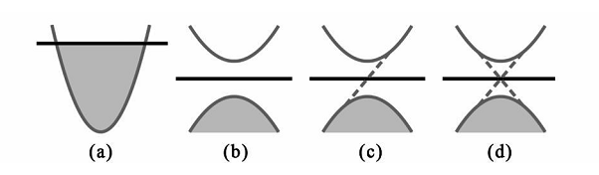



Band structures
Figure 1: the band structures of four kinds of material (a) conductors, (b) ordinary insulators, (c) quantum Hall insulators, (d) T invariant topological insulators。

Slide 12

The Chern invariant — n
Berry phase
Berry flux
The Chern invariant is the total Berry flux in the Brillouin zone
TKNN showed that σ_{xy}, computed using the Kubo formula, has the same form, so that N in Eq.(1) is identical to n in Eq.(2).
Chern number n is a topological invariant in the sense that it cannot change when the Hamiltonian varies smoothly.
For topological insulators, n≠0, while for ordinary ones(such as vacuum), n=0.

Slide 13

Haldane model
tight-binding model of hexagonal lattice
a quantum Hall state with
introduces a mass to the Dirac points

Slide 14
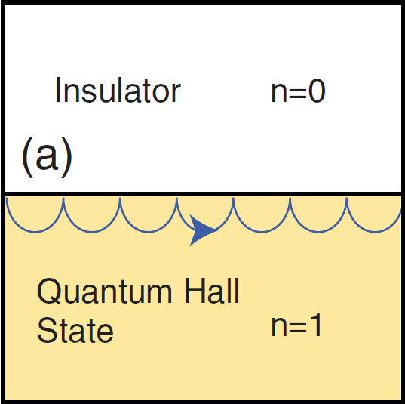
Edge states
skipping motion electrons bounce off the edge
chiral:propagate in one direction only along the edge
insensitive to disorder :no states available for backscattering
deeply related to the topology of the bulk quantum Hall state.

Slide 15
Z₂ topological insulator
T symmetry operator:
Sy is the spin operator and K is complex conjugation
for spin 1/2 electrons:
A T invariant Bloch Hamiltonian must satisfy

Slide 16

Z₂ topological insulator
for this constraint,there is an invariant with two possible values:
ν=0 or 1
two topological classes can be understood,νis called Z2 invariant.
define a unitary matrix:
There are four special points in the bulk 2D Brillouin zone.
define:

Slide 17

Z₂ topological insulator
the Z2 invariant is:
if the 2D system conserves the perpendicular spin Sz
Chern integers n↑, n↓are independent,the difference
defines a quantized spin Hall conductivity.
The Z2 invariant is then simply

Slide 18
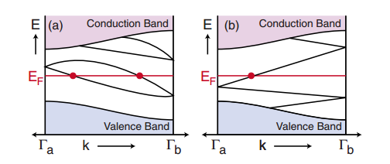

Z₂ topological insulator

Slide 19
Surface quantum Hall effect
Notes:
在量子霍尔效应中，拓扑绝缘体表面态/边界态发挥了十分重要的作用。外加磁场打破了时间反演对称性，也就是说此时E(k)$≠$E(-k)，或者说在经典观点中，电子前进和后退不再动力学等价，电子轨迹出现“单行线”

Slide 20
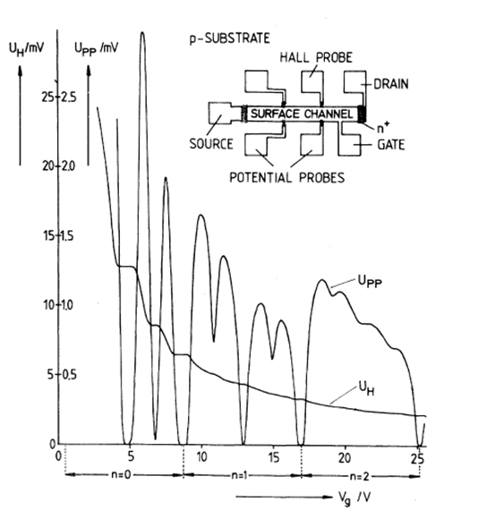
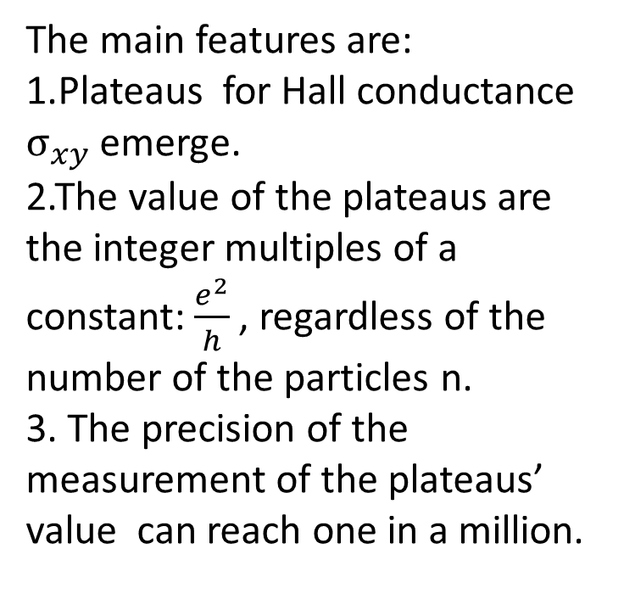
Integer Quantized Hall Effect
The main features are:
1.Plateaus for Hall conductance $σ_{xy}$ emerge.
2.The value of the plateaus are the integer multiples of a constant: $\frac{e^{2}}{h}$, regardless of the number of the particles n.
3. The precision of the measurement of the plateaus’ value can reach one in a million.
Notes:
左图是实验的原理图和测量结果图，图中画出的是横向电导（霍尔电导）$σ_{xy}$关于纵向电压的关系
实验结果特点：
1.霍尔电导率$σ_{xy}$出现与粒子数密度n无关的平台，即霍尔平台；
2.此一定的平台值是物理常数$\frac{e^{2}}{h}$的整数倍；
3.$\frac{e^{2}}{h}$值的测量精度可以达百万分之一。

Slide 21
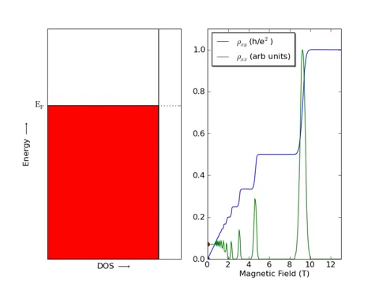
The explanation for the integer quantized Hall effect can be found in solid state physics textbooks. Here we will use a video for illustration ：
Notes:
关于整数量子霍尔效应的解释在固体物理书中都有，这里我们展示一段小视频。值得注意的一点是在量子霍尔效应中，费米能级和朗道能级每相交一次霍尔电导会改变一个$\frac{e^{2}}{h}$

Slide 22
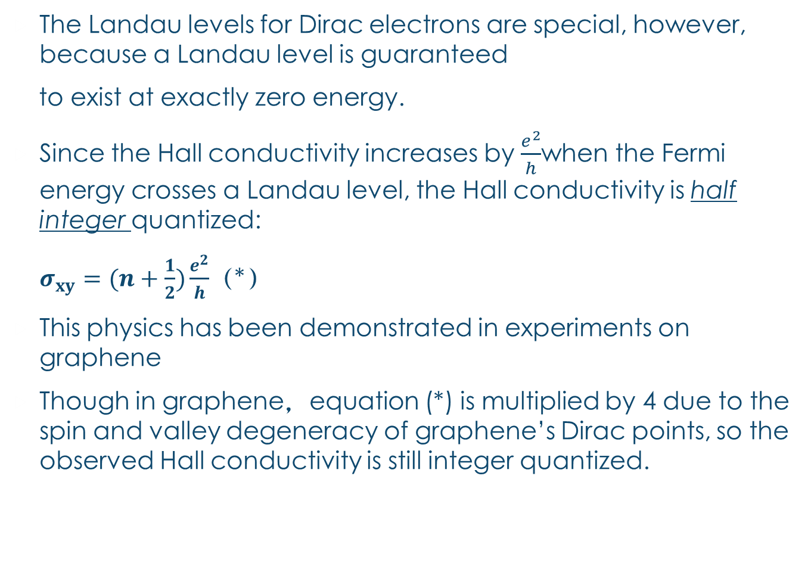
The Landau levels for Dirac electrons are special, however, because a Landau level is guaranteed
to exist at exactly zero energy.
Since the Hall conductivity increases by $\frac{e^{2}}{h}$when the Fermi energy crosses a Landau level, the Hall conductivity is half integer quantized:
$σ_{xy}=(n+\frac{1}{2})\frac{e^{2}}{h}$（*）
This physics has been demonstrated in experiments on graphene
Though in graphene，equation (*) is multiplied by 4 due to the spin and valley degeneracy of graphene’s Dirac points, so the observed Hall conductivity is still integer quantized.
Notes:
但之前讨论的是折合质量非零的电子，对狄拉克电子来讲在零能处有一个朗道能级，其霍尔电导是半整数量子化的，也就是（*）式。实验方面在石墨烯上已经有证实。（在固体物理中大家应该都听说过，石墨烯能带中有所谓‘狄拉克点’，其附近的电子色散关系是相对论性的）只不过（*）式右边由于石墨烯狄拉克点的自旋-谷简并应该乘以4，所以表观霍尔电导还是整数量子化的。

Slide 23
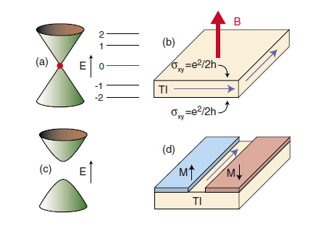

Fig： （c） A thin magnetic film can induce an energy gap at the surface. （d） A domain wall in the surface magnetization exhibits a chiral fermion mode.
Anomalous quantum Hall effect：induced with the proximity to a magnetic insulator. A thin magnetic film on the surface of a topological insulator will give rise to a local exchange field that lifts the Kramers degeneracy at the surface Dirac points. This introduces a mass term m into the Dirac equation.
There is a half integer quantized Hall conductivity $σ_{xy}$= $\frac{e^{2}}{2h}$
This can be probed in a transport experiment by introducing a domain wall into the magnet.
Notes:
反常量子霍尔效应，本质上是利用磁性薄膜的交换场替代外加磁场，同时借助畴壁，形成一种如同把（b）图下表面绕与上表面的公共边旋转180°使其与上表面并排放置，同时感受到从上向下的磁场的情景，或者把（d）中的蓝面看做（b）中上表面，红面看做（b）中下表面即可。
//我认为此时仍会有两部分半整数霍尔电导叠加形成整数电导，所以ppt中的式子后面加了for a single surface

Slide 24
Superconducting proximity effect and majorana fermions

Slide 25

Majorana 费米子
1937年，意大利物理学家 Ettore Majorana提出一种神奇的费米子，这种粒子是其本身的反粒子。这类费米子是其本身的反粒子，且不可思议地没有质量、没有电荷、没有自旋，并且处于零能量态。
由于Majorana费米子服从非阿贝尔统计，可能被用于量子计算。
长久以来没有实验观测到的确切证据。

Slide 26
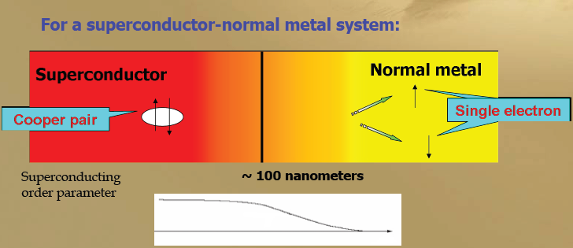
超导近邻效应
when a superconductor (S) is placed in contact with a "normal" (N) non-superconductor. Typically the critical temperature of the superconductor is suppressed and signs of weak superconductivity are observed in the normal material over mesoscopic distances.

Slide 27
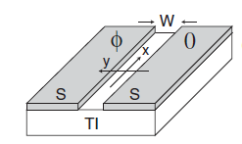
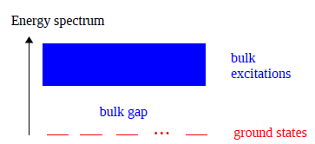
即使Majorana费米子不以基本粒子的形式出现在这个世界上，人们仍可能在凝聚态体系中以集体运动模式的准粒子激发形式将其制备出来。
超导体与强自
旋－轨道耦合材料
之间的邻近效应，
可能引出Majorana
费米子。
拓扑绝缘体是一种
强自旋－轨道耦合材料。

Slide 28
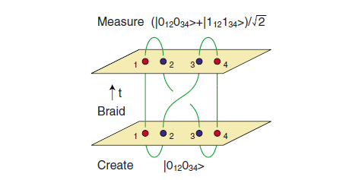
Majorana费米子的应用

Slide 29
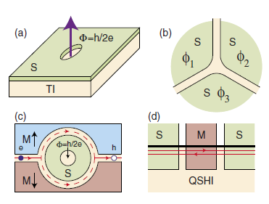
理论上能够实现Majorana费米子的几种可能结构

Slide 30
Thanks!

