Slide 1
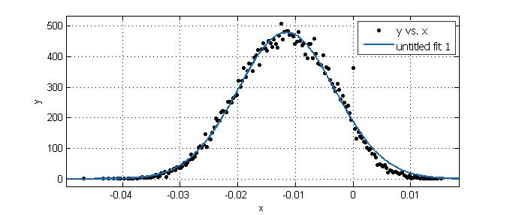
校准针尖功函
WAu=5.2eV
VCPD=-0.0116V
VCPD=(Wtip-Wsample)/e
Wtip=5.19eV

Slide 2
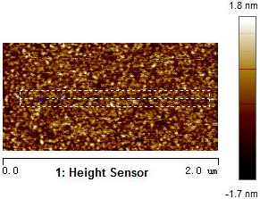
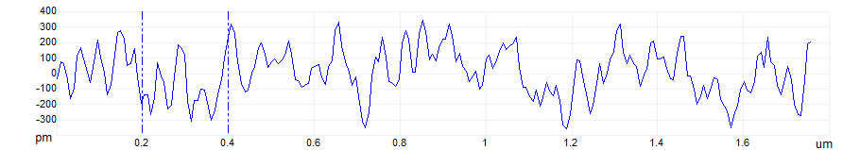
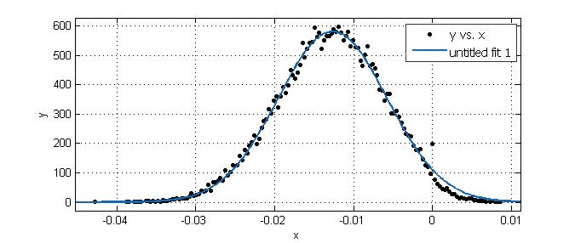
Roughness Ra=0.384nm Rq=0.484nm
VCPD=-0.01267V/-0.003702V
WAu/Fe=5.20eV/5.19eV

