Slide 1
English Lexicology and Culture
Room 314
Science Building

Slide 2
Goals
This course introduces students to the systemic study of English vocabulary, its structure, history and cultural context.
The course will focus on the structure and meaning of English words, including word formation, types of meaning and sense relations.
Broader topics will also be explored, such as the history of English, semantic change, meaning and context and varieties of English.

Slide 3
Goals
It offers students an insight into the origin and development of the English vocabulary.
Students are expected to read the textbook before class. Class components include lectures, discussions and oral presentations.
At the end of the course students will be able to analyze morphologically complex words, have a firm grasp of basic patterns of English word formation, enrich their vocabulary and acquire a better understanding of the English language and culture.

Slide 4
Course Introduction
English Lexicology and Culture consists of two spheres: lexicology (vocabulary) and English culture.
I. Lexicology: Language study involves the study of speech sounds, grammar and vocabulary.
Without grammar very little can be conveyed;
Without vocabulary nothing can be conveyed. ?
D.A. Wilkins, (1972) Linguistics in Language Teaching
II. Culture context

Slide 5

English Lexicology
Word Formation mainly deals with the morphological structures of words, especially compound/complex words.
1
Word Meaning mainly discuss the types of meaning, components of meaning, and changes of meaning.
2
Sense Relations deal with relations between words, like
synonyms and antonyms.
3

Slide 6
I. Lexicology
First, what is lexicology?
Lexicology is the study of lexis or stock of words in a language. We will also use the word vocabulary interchangeably with lexis.
Lexicology [1820s, from Greek lexikós of words, -logia study], is an area of language study concerned with the nature, meaning, history and use of words and word elements and often also with the critical description of lexicography (McArthur 1992: 602)

Slide 7
What is Lexicology?
That branch of knowledge which treats words, their form, history, and meaning. (OED online)
1. the study of the history and meaning of words.
2. the analytical study of lexicography.
(Chambers 21st century dictionary, 1996)
The literal meaning is the “science of the word”.
It is the study of the signification (meaning) and application (usage) of words. (a branch of linguistics dealing with the vocabulary of a given language.)

Slide 8
Six Related Branches of Lexicology
Morphology: The study of the structure and form of words in languages or a language, including inflection, derivation, and the formation of compounds, etc.
Semantics: the study of the meanings of words and other parts of language.
Etymology: studies the meanings, origin and history of individual words and their development.
Historical lexicology: studies from a historical point of view the development of vocabulary
Phraseology(成语学): mainly deals with set expressions and idioms.
Lexicography: studies the writing and making of dictionaries.

Slide 9
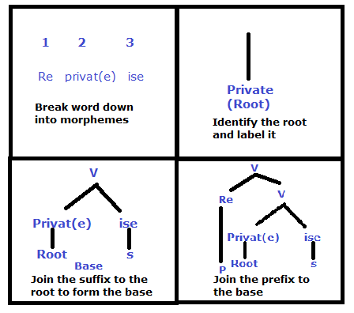
Morphology: The study of the structure and form of words in languages or a language, including inflection, derivation, and the formation of compounds, etc.
e.g. reprivatize: (Industrial Relations & HR Terms) to make (a
company or industry)
private again; return (a
company or industry) to
private management;
denationalize
https://all-about-linguistics.group.shef.ac.uk/branches-of-linguistics/morphology/what-is-morphology/

Slide 10
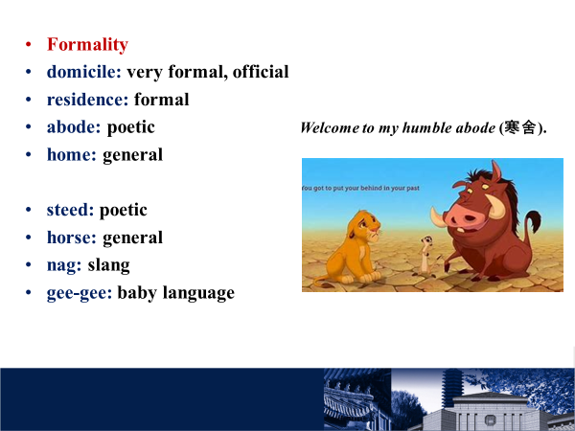
Semantics
Semantics: the study of the meanings of words and other parts of language.
  1. Conceptual meaning
  2. Connotative meaning
  3. Social meaning
  4. Affective meaning
  5. Reflective meaning
  6. Collocative meaning
  7. Thematic meaning

Slide 11
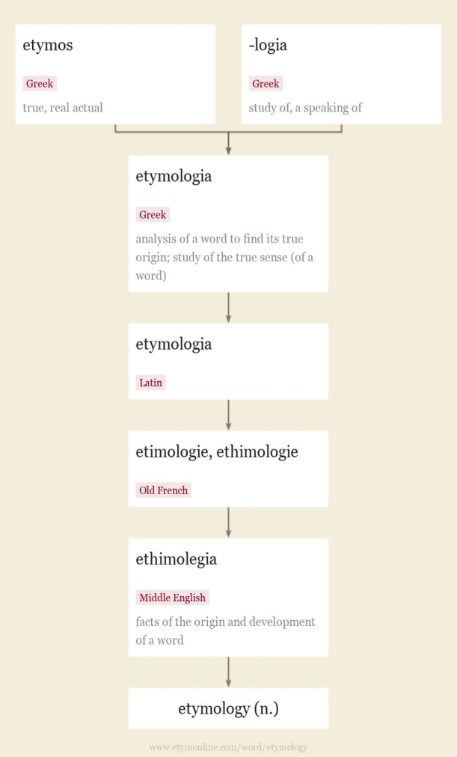
Etymology
Etymology studies the meanings, origin and history of individual words and their development.
etymology (n.) true, real actual + study of, a speaking of
Late 14c., ethimolegia "facts of the origin and development of a word," from Old French etimologie, ethimologie (14c., Modern French étymologie), from Latin etymologia, from Greek etymologia "analysis of a word to find its true origin," properly "study of the true sense (of a word)," with -logia "study of, a speaking of" (see -logy) + etymon "true sense, original meaning," neuter of etymos "true, real, actual," related to eteos "true," which perhaps is cognate with Sanskrit satyah, Gothic sunjis, Old English soð "true," from a PIE *set- "be stable." Latinized by Cicero as veriloquium.

Slide 12
Historical lexicology
Historical lexicology studies from a historical point of view the development of vocabulary
Nice: This word used to mean “silly, foolish, simple.” Far from the compliment it is today!
Silly: Meanwhile, silly went in the opposite direction: in its earliest uses, it referred to things worthy or blessed; from there it came to refer to the weak and vulnerable, and more recently to those who are foolish.
Spinster: As it sounds, spinsters used to be women who spun. It referred to a legal occupation before it came to mean “unmarried woman” — and often not in the most positive ways, as opposed to a bachelor …
Bachelor: A bachelor was a young knight before the word came to refer to someone who had achieved the lowest rank at a university — and it lives on in that meaning in today’s B.A. and B.S degrees. It’s been used for unmarried men since Chaucer’s day.

Slide 13
Phraseology
Phraseology(成语学): mainly deals with set expressions and idioms.
(1) The phraseological composition of language.
(2) The branch of linguistics that studies the phraseological composition of language in its existing state and its historical development.
Linguists specializing in phraseology distinguish phraseological units from word groups formed but not regularly used in speech, and on this basis
define the features of phraseological units.
kill the goose that laid the golden eggs（杀鸡取卵、涸泽而鱼）
sour grapes（聊以自慰的话，狐狸吃不到葡萄就说葡萄是酸的）
bell the cat（替别人冒风险，老鼠要给猫带上铃铛的寓言故事）
the last straw （终于使人不能忍受的最后一击）
a wolf in sheep’s clothing （披着羊皮的狼，比喻危险人物、面善心毒的人）
cry wolf（狼来了！比喻发假警报）

Slide 14
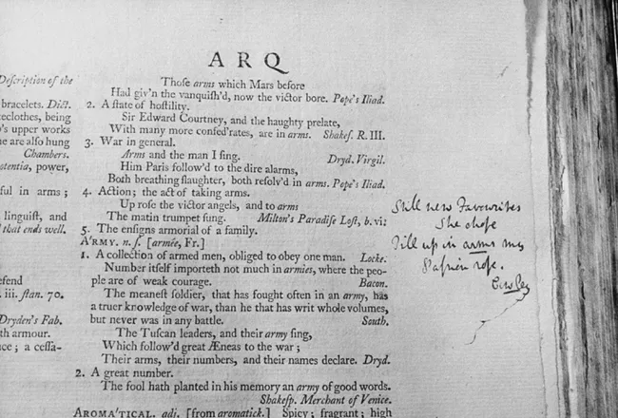
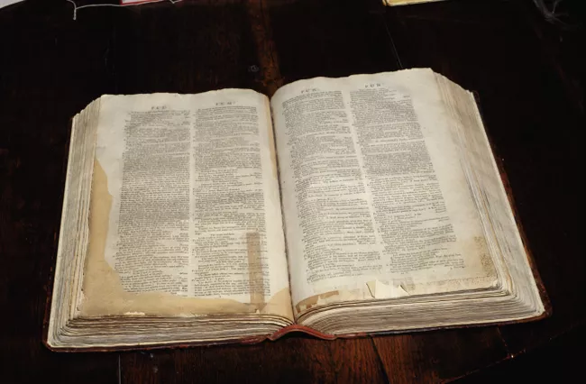
Lexicography
Lexicography: studies the writing and making of dictionaries.
A Dictionary of the English Language (1755) by Samuel Johnson (Dr. Johnson)
https://www.thoughtco.com/samuel-johnson-4770437

Slide 15
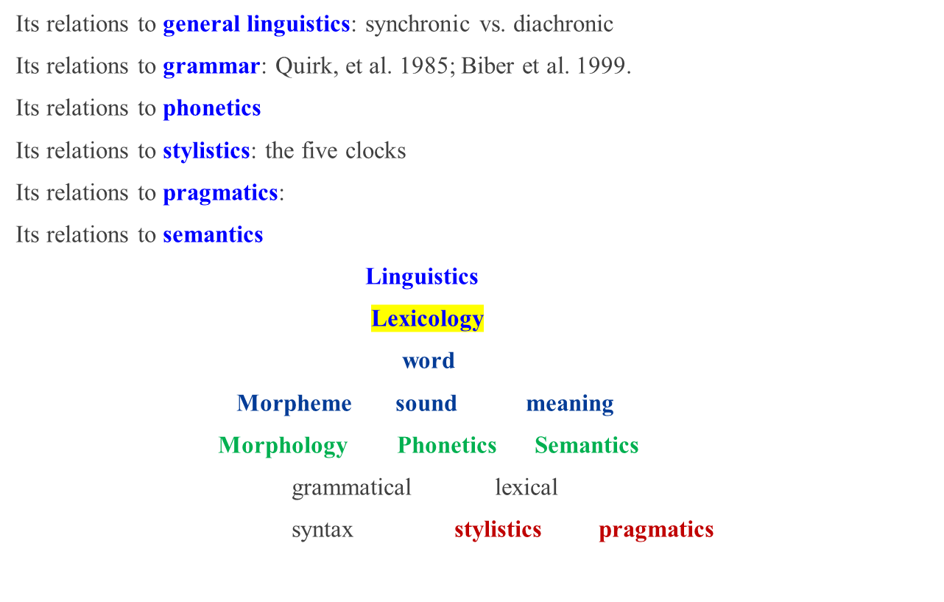
Relations of Lexicology to other Branches of Linguistics

Slide 16

Culture Context
1
English Today tells you the geographic distribution of the English-speaking population, and the status of English in the Modern world.
2
The Development of the English Vocabulary reviews the history of the English language and vocabulary.
3
Idioms and proverbs reflect the life and culture of the English and American people.
4
Varieties of English give you an overview of the varieties of English spoken all over the world.

Slide 17
II. Culture context
Language is a part of culture?
The use of words and the mastery of the vocabulary can not be clearly separated from the cultural context in which they are used.
It is greatly influenced and directly shaped by culture. On the other hand, language reflects culture.
In the broadest sense, language is the symbolic representation of a people, and it comprises their historical and cultural background as well as their approach to life and their way of living and thinking.
Is language the only symbolic system to represent culture?

Slide 18
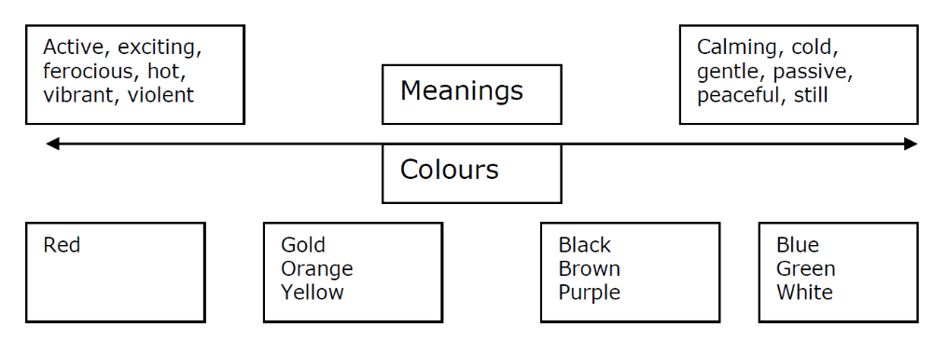
Language and culture:
Color connotation

Slide 19
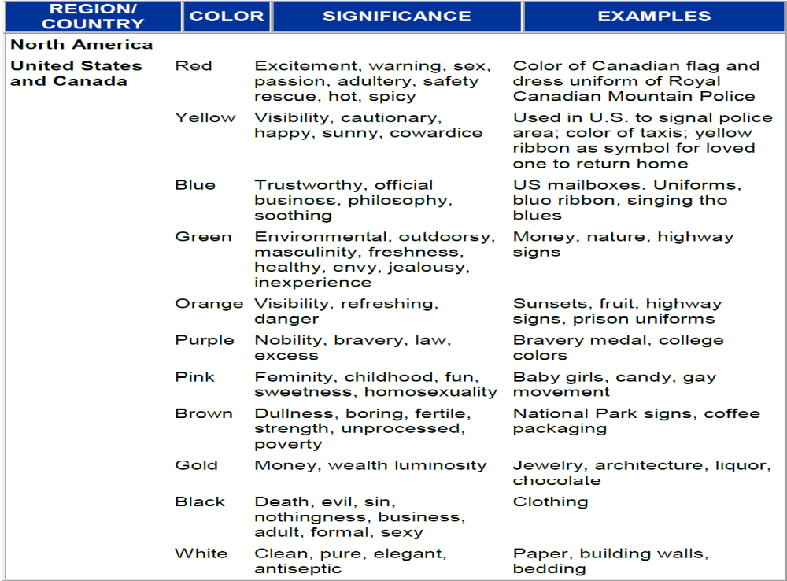

Slide 20
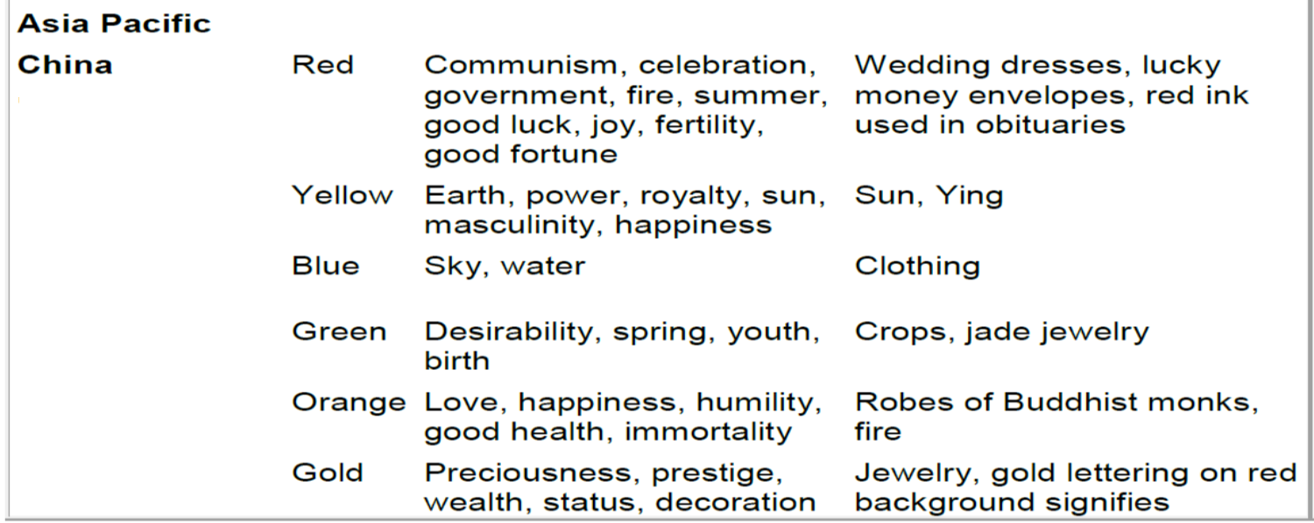
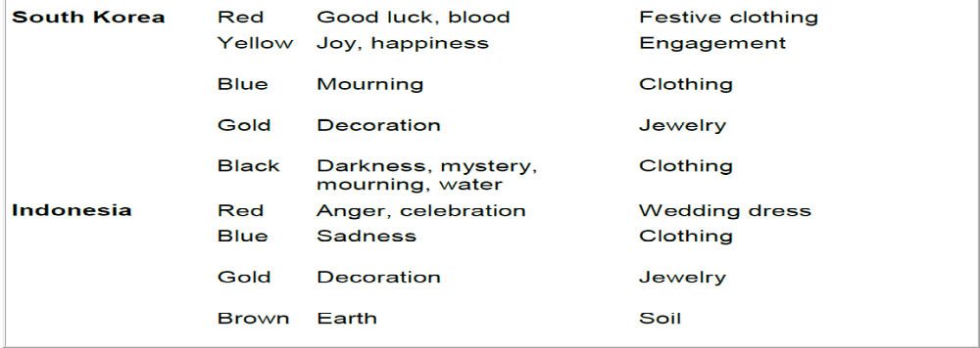

Slide 21
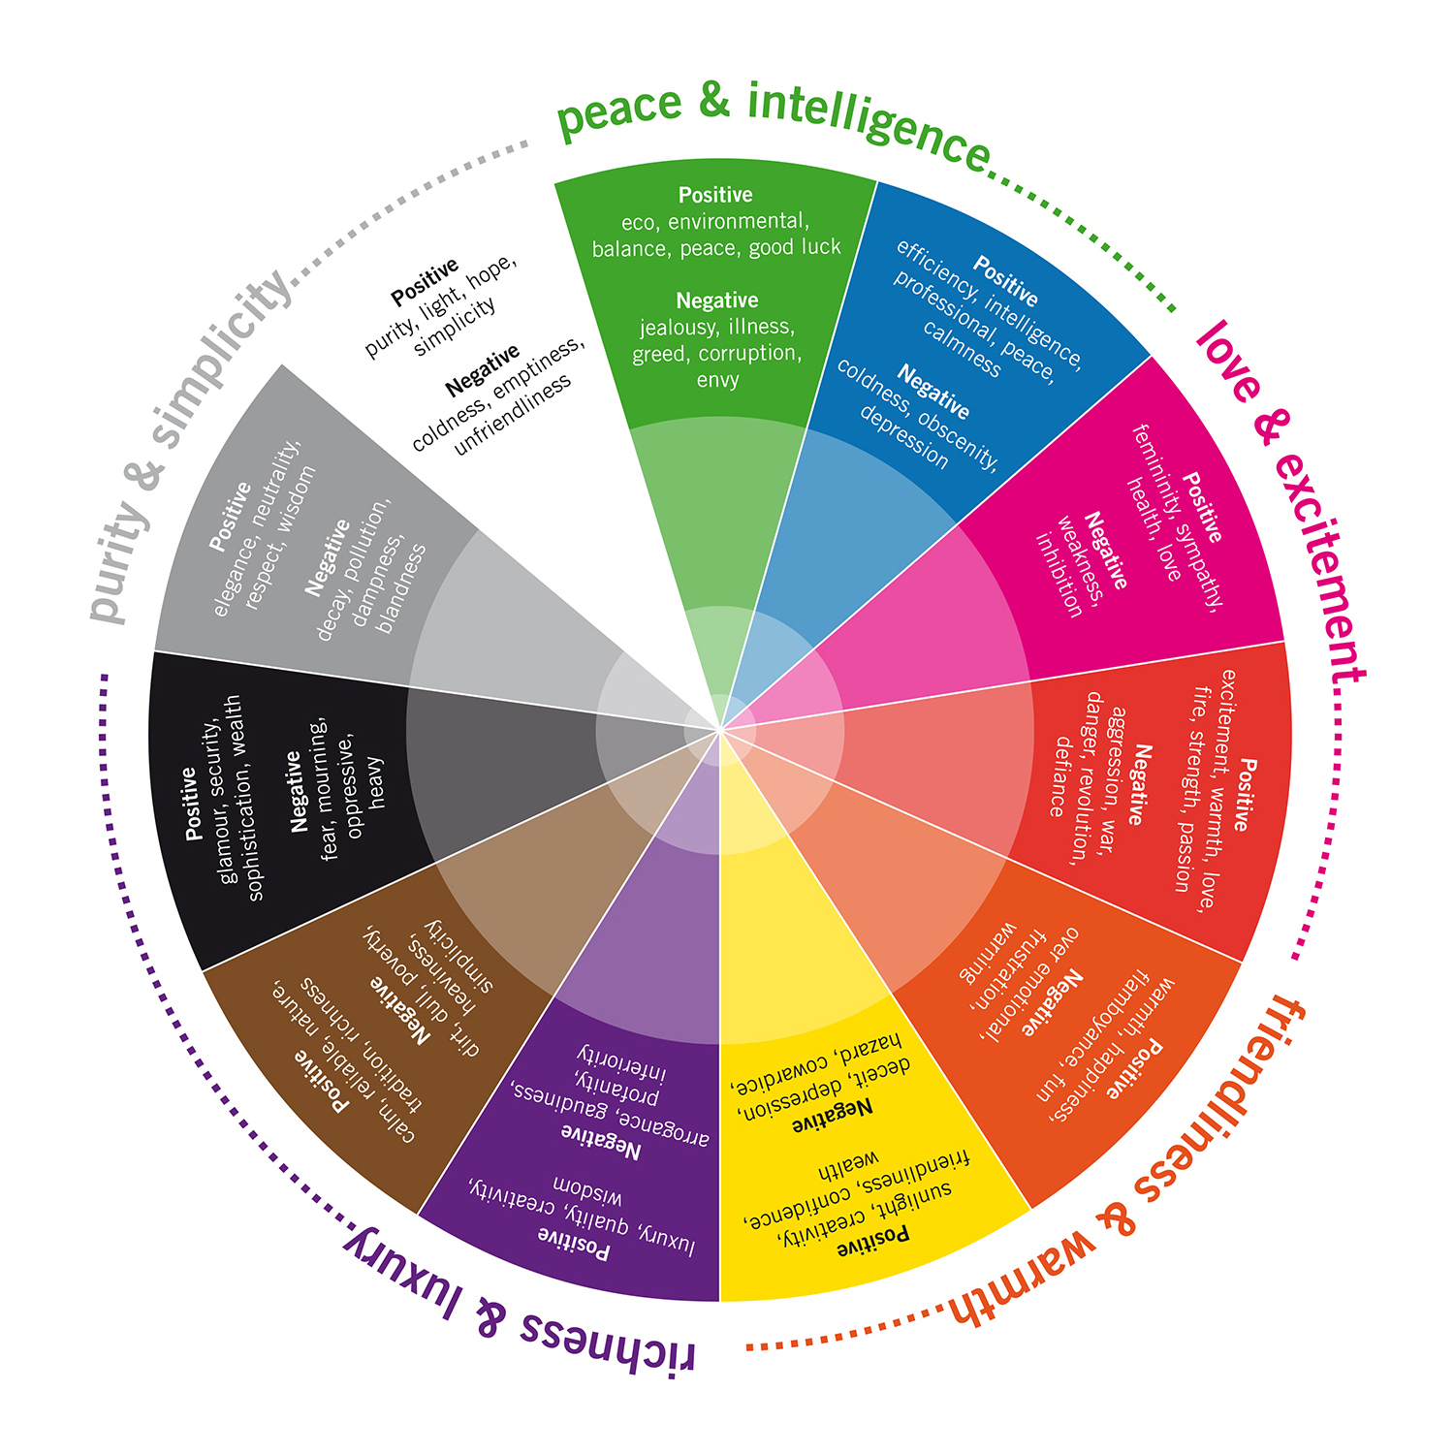
Color and Emotion
https://cn.bing.com/images

Slide 22
Contents
Lecture 1 English Today
Lecture 2 Basic Concepts and Vocabulary
Lecture 3 The Development of English Vocabulary 1
Lecture 4 The Development of English Vocabulary 2
Lecture 5 Structure of English Words

Slide 23
Contents
Lecture 6 Word Formation 1
Lecture 7 Word Formation 2
Lecture 8 Word Meaning and Motivation
Lecture 9 Types of Word Meaning and Semantic Field
Lecture 10 Sense Relations 1

Slide 24
Contents
Lecture 11 Sense relations 2
Lecture 12 Changes in Word Meaning
Lecture 13 Meaning and Context
Lecture 14 English Idioms
Lecture 15 Varieties of English

Slide 25
Approaches to the Study of English Lexicology
A synchronic approach is an approach to the study of a language at one period of time.
A diachronic approach is an approach to the study of the change in a language that took place over a period of time.
Eventful, talkative
Synchronically: as derivatives
Diachronically: hybrids (words which are made of two parts, each from a different language)
Event is a Latin root, -ful is an OE suffix, Talk is an OE root, -ative is a Latin suffix.

Slide 26
A synchronic approach
pandemic (adj.)of diseases: incident to a whole people or region
Synchronically: derivative
Pan-: all
Demos: people
Diachronically: 1660s, from Late Latin pandemus, from Greek pandemos "pertaining to all people; public, common," from pan- "all" (see pan-) + dēmos "people" (see demotic). Modeled on epidemic;
OED reports that it is "Distinguished from epidemic, which may connote limitation to a smaller area." The noun, "a pandemic disease," is recorded by 1853, from the adjective.

Slide 27
A diachronic approach
pain (n.)late 13c., peine, "the agony suffered by Christ;" c. 1300, [(精神或肉体的)极度痛苦]
"punishment," especially for a crime, "legal punishment of any sort" (including fines and monetary penalties); also "condition one feels when hurt, opposite of pleasure," including mental or emotional suffering, grief, distress;
from Old French peine "difficulty, woe, suffering, punishment, Hell's torments" (11c.),
from Latin poena "punishment, penalty, retribution, indemnification" (in Late Latin also "torment, hardship, suffering.
The early "punishment" sense in English survives in phrase on pain of death. Also c. 1300 the word was used for the torments of eternal damnation after death. The sense of "exertion, effort" is from late 14c.; pains "great care taken (for some purpose), exertion or trouble taken in doing something" is recorded from 1520s.
Phrase give (someone) a pain "be annoying and irritating" is by 1895; as a noun, localized as pain in the neck (1924) and pain in the ass (1934), though this last might have gone long unrecorded and be the original sense and the others euphemisms. First record of pain-killer "drug or herb that reduces pain" is by 1845.
https://www.etymonline.com/search?q=pain

Slide 28
Assessment 考试及分值构成
Oral presentation 5
Homework and quizzes 15%
Test 1 (10%)
Test 2 (10%)
Test 3 (10%)
Course project—Term Paper (50%)

Slide 29
Oral Presentation and Group Work
Oral Presentation
1. Word formation in a specific field, such as history, chemistry, physics, biology, economics, medical sciences, etc.
2. Varieties of English
Group Work:
1. Word formation in a specific field: group report in academic writing format
Introduction—Literature Review—Method—Findings and Discussions—Conclusions—References
2. Reading and discussion: summarize the main ideas of the researches and comment on their achievements and drawbacks

Slide 30
Course Project
Topics include but are not limited to
1) The role of English (Language) in knowledge building and knowledge polularization;
2) Lexical features in a particular field / discipline (e.g. science, medicine, arts, history, advertisement, information technology, Mathematics, Chemistry, Physics, scientific blogging, etc.)
Perspective: the role of language /vocabulary in the construction of new knowledge
3) Telling China's story to the world: cultural differences and their implication for cross-cultural communication.
Length: 1500 words
Rules of style: APA style http://www.apastyle.org/

Slide 31
Goals revisited
At the end of the course students will be able to
⠂analyze morphologically complex words,
⠂ have a firm grasp of basic patterns of English word formation,
⠂ enrich their vocabulary and
⠂ acquire a better understanding of the English language and culture.

Slide 32
Big-data approaches lead to an increased understanding of the ecology of animal movement
Nathan et al., Science 375, 734 (2022) 18 February 2022
High-throughput wildlife tracking technologies are opening new research frontiers in biology and ecology. Their advantages, however, come with typical big-data costs such as computational load, intensive data management and processing, and challenging statistical analyses. Enlisting fields with a longer history of big data offers new prospects to address these challenges. Progress will arise from combining observational and experimental movement ecology and data-rich studies revealing behavioral shifts across individuals, species, scales, ecosystems, and life stages.
High-resolution wildlife tracking is currently infeasible at large to global scales, a key limitation that can be addressed by combining low- and high-rate sampling, increasing interoperability between technologies, standardizing and sharing data, and promoting multidisciplinary international collaboration. Coupling movement and environmental big data could help determine impacts of major environmental and climate changes on animal–environment interactions, whereas real-time movement data could uniquely inform biodiversity conservation and ecosystem management.

Slide 33
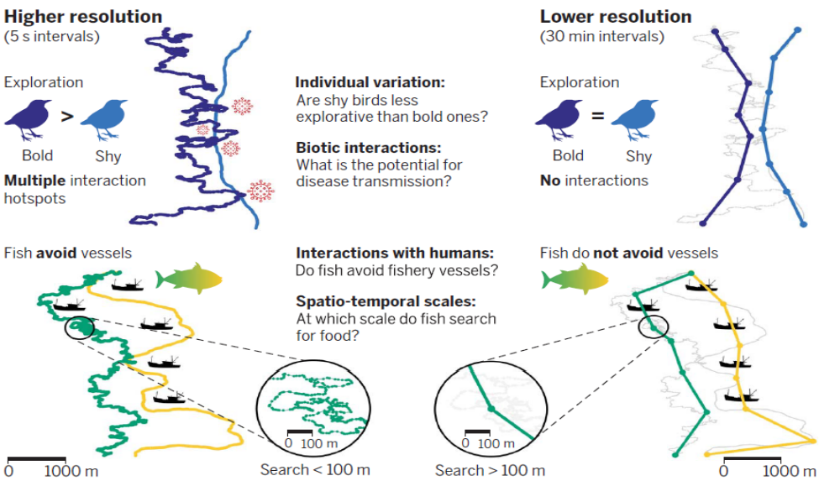
Words in scientific English e.g. interoperability 〔计〕互用性;互操作性；互通性；互可操作性

Slide 34
Nominalization: affixation
High-throughput wildlife tracking technologies are opening new research frontiers in biology and ecology. Their advantages, however, come with typical big-data costs such as computational load, intensive data management and processing, and challenging statistical analyses. Enlisting fields with a longer history of big data offers new prospects to address these challenges. Progress will arise from combining observational and experimental movement ecology and data-rich studies revealing behavioral shifts across individuals, species, scales, ecosystems, and life stages.
High-resolution wildlife tracking is currently infeasible(不可行) at large to global scales, a key limitation that can be addressed by combining low- and high-rate sampling, increasing interoperability between technologies, standardizing and sharing data, and promoting multidisciplinary international collaboration. Coupling movement and environmental big data could help determine impacts of major environmental and climate changes on animal–environment interactions, whereas real-time movement data could uniquely inform biodiversity conservation and ecosystem management.

Slide 35
Textbooks and References
Textbooks:
张维友, 2022.《英语词汇学教程》。武汉：华中师范大学出版社。
夏阳、邵林, 2018.《英语词汇学教程》。北京：北京大学出版社。
References:
陆国强。2004。《现代英语词汇学》。上海：上海外语教育出版社。
丁建新。2004。《现代英语词汇学教程》。重庆：重庆大学出版社。
汪榕培、卢晓娟。2004。《英语词汇学教程》。上海：上海外语教育出版社。
钱军. 2008.《英语词的构成与搭配》。北京：商务印书馆。
钱军. 2015. 《英语词的意义与用法》。北京：商务印书馆。

Slide 36
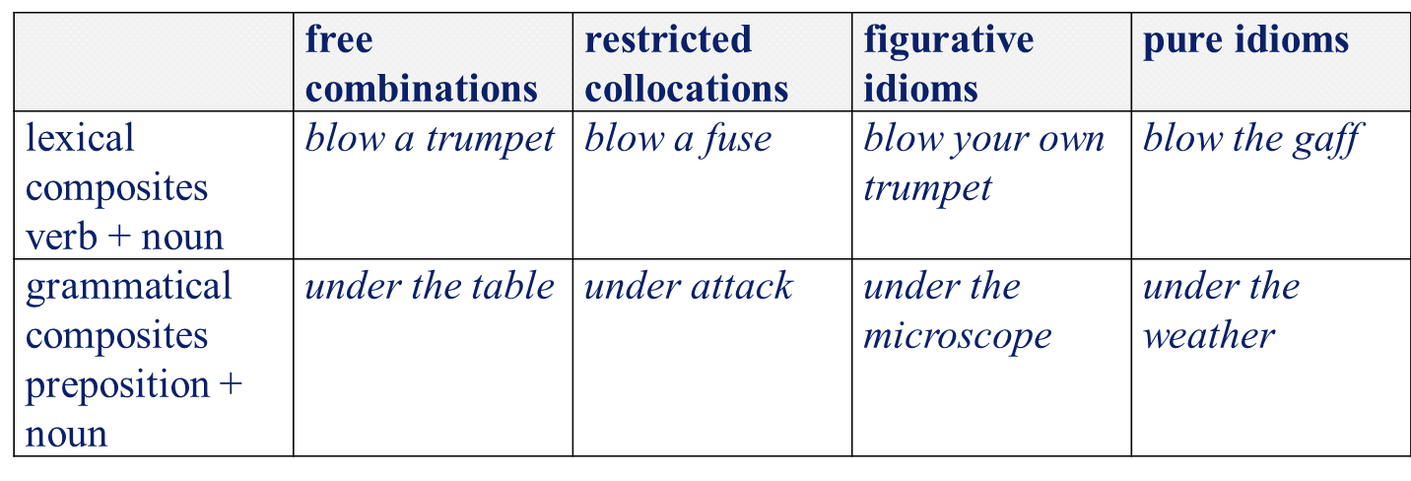
Awareness to develop
1. Collocation
You shall know a word by the company it keeps. (Firth, J. R. 1957:11)
Collocation is concerned with lexical patterning of words;
Colligation is concerned with the typical grammatical patterning of words (or word classes)

Slide 37
Collocation
Powerful, strong
a powerful car (BNC 14, a fast, powerful car, a big/little powerful car),
a *strong car (BNC 2-1 example, strong car sales)
*powerful tea, strong tea
Extremely, completely, entirely, utterly
extremely rare, greatly appreciated
Lexical bundles—multi-word sequences
Apologies for any inconvenience caused

Slide 38
A + __ + of
a piece of, a shred of, a cup of, a bunch of,
a school of, a college of
a + ___ + of is associated with words of measurements or parts
an item of information/ business / news
a bar of chocolate / soap / gold / iron
a blade of grass a cake of soap / tobacco / cheese
a cut of meat / lamb 一块肉
a team of ducks an army of ants / bees
Do they have affective connotations?
a pack of robbers / thieves / liars a mob of gangsters / rioters

Slide 39
Collocation： Fill in the blank with a suitable collocation.
1. There is ____________ / ______________ / ___________ (adj) evidence
2. Recent research _____________ / _____________ / ___________ (verb) a correlation between earnings and qualifications.
3. This can _________ /___________ / ___________ (verb) a negative result on…
4. This can _________ / ___________ / ___________ (verb) a funding crisis
5. This is considered to be a __________ / __________ / _________ (adj) benefit
6. This __________ / ___________ /_________ (verb) unemployment
7. There are two _________ / ___________ / _________ (adj) points
8. There are two ________ / ____________ / ___________ (adj) arguments
9. Many students are _________ / ___________ / _________ (verb) debt)
10. It is important to _________ /___________ / ________ (verb) a certificate / qualification
11. The government ________ / __________ / __________ (verb) this policy in 1990
12. Student loans were ___________ / ____________ / _________ (verb) in 1996
13. Students should ___________ / ____________ (verb) to the cost
14. This argument is ___________ / __________ / ___________ (verb) the human capital theory.

Slide 40
1. overwhelming, persuasive, positive, powerful, solid, striking, strong, insufficient, direct,
2. demonstrate sth, indicate sth, prove sth, reveal sth, show sth, suggest st, carry out, conduct,
3. produce, give, show
4. cause, create, lead to, precipitate, provoke
5. considerable, enormous, great, major, real, substantial, potential, long-term, short-term
6. be faced with, cause, create, alleviate , cut, keep down, reduce, increase, combat, tackle
7. interesting, valid, important, central, crucial, key, major, salient, controversial
8. basic, general, main, major, powerful, sound, strong, valid, compelling, conclusive, convincing, persuasive, plausible
9. be burdened with, have, owe, repay, reduce, clear, suffer from
10. Issue, award, achieve, gain, study for, earn
11. develop, formulate, frame, shape | establish, implement, introduce | adopt, carry out, follow
12. Introduce, instigate, create, develop, formulate, implement, establish, adopt
13. Contribute to, pay, put money
14. Endorse by, support by, define by, connect to, associated with

Slide 41
Colligation
Colligation is a type of collocation where a lexical item is tied to a grammatical one.
It’s not the end of the world is a common locution,
however, its synonym it’s not Armageddon is not.
(世界末日的善恶大决战；（足以毁灭世界的）大决战)
The phrase the end of the world colligates with the negative, whereas Armageddon doesn’t.
Armageddon (n.)"cataclysmic (灾难性的) final conflict," 1811, figurative use of the place-name in Revelation xvi.16, site of the great and final conflict, from Hebrew Har Megiddon "Mount of Megiddo," a city in central Palestine, site of important Israelite battles.
Collocation and colligation are therefore useful ways of looking at synonyms: words may mean the same thing, but turn out to keep different company.
-- https://www.english.cam.ac.uk/elor/lo/collocation/index.html

Slide 42
Semantic prosody
The following words have been claimed to have a negative (‘unpleasant’, or ‘unfavourable’) semantic prosody. For each case, investigate whether this is true.
be bent on
cause
commit
dealings
happen
make off with
peddle
be rife with
set in
symptomatic

Slide 43
COCA
be bent on | I'm your path to living and you seem to be bent on playing the dying game. …those who may be bent on causing trouble here in L.A Saddam is said to be bent on making weapons of mass destruction;
happen | These attacks are very real and do happen. At times a physical death may happen in one’s own defense.
make off with 拐走;拿走；偷 | The burglar did make off with several televisions, cameras, antique watches The Beast will make off with your children.
be rife with 普遍的；流行的；丰富的 | And heaven knows that is rife with horrible characters and no hopeless situations These stories are often rife with guilt and regret or plagued with anxiety.
set in 嵌入 | Anxiety set in when the recruiter told him it would take several months to get everything in… Deflation(通货紧缩) will set in. # The government needs to set up a solid social security system

Slide 44
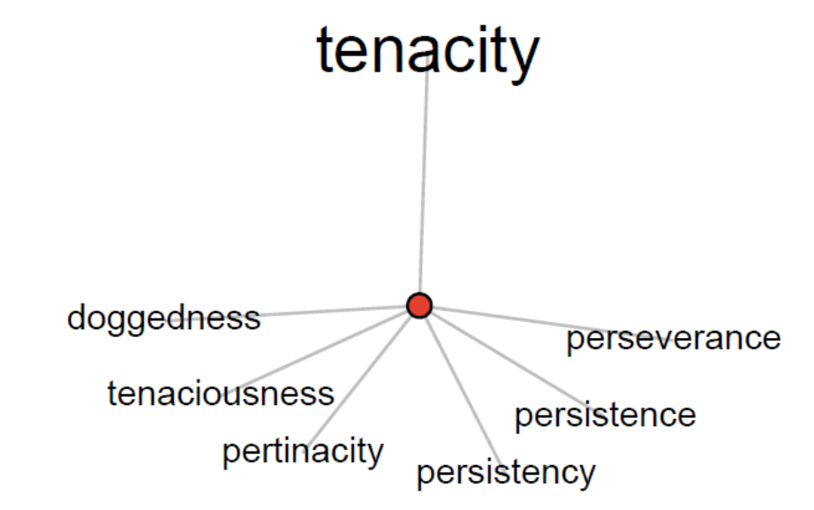
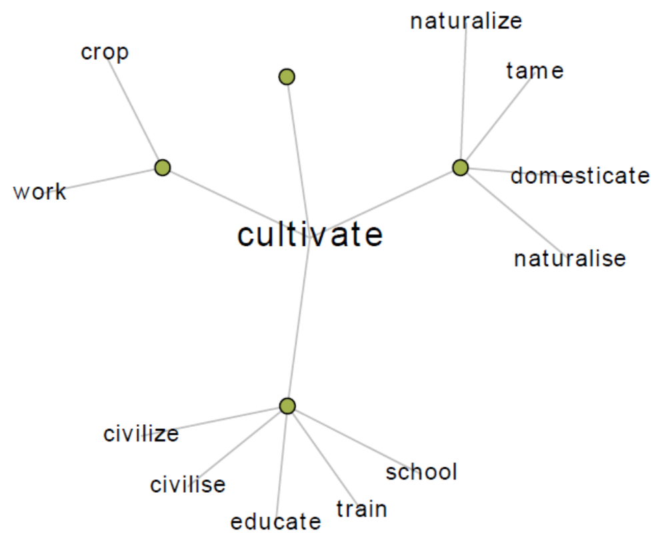
Awareness to develop
2. synonyms: tenacity， cultivate
http://www.visualthesaurus.com

Slide 45
Awareness to develop
3. Frame
Frames impose perspective on situation
– John spent four hours on land.
– John spent four hours on the ground.
• Frames provide alternative ways of understanding or construing the “same” objective situation
– He’s not stingy; he’s thrifty.
• Frames often presume larger cultural frames
Breakfast: in China, in Beijing, in Chengdu, in Fuzhou?

Slide 46
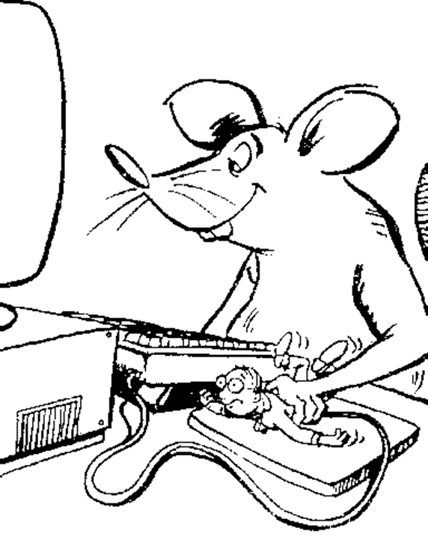
Awareness to develop
3. Frames
revenge: to inflict punishment in return for (injury or insult)

Slide 47
Online Resources
COCA: Corpus of Contemporary American English
http://corpus.byu.edu/coca/
BNC: British National Corpus
https://www.english-corpora.org/bnc/
http://www.visualthesaurus.com/
http://wordnet.princeton.edu/
https://framenet.icsi.berkeley.edu/fndrupal/

Slide 48
New words from the introduction
lexicology
lexis
lexicography
signification (meaning)
application (usage)
morphology
semantics
etymology
phraseology
formality
stylistics
pragmatics
connotation
synchronic
diachronic
derivative
hybrid
collocation
colligation

