Slide 1
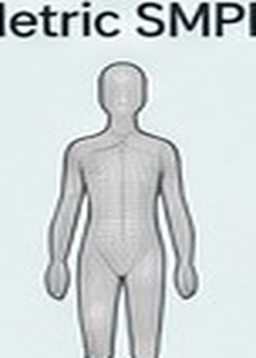






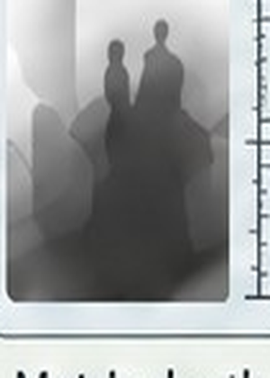
Prior-Guided Metric Scale Calibration
parameter-free metric prior + human-conditioned residual refinement
Validity-Aware Metric Prior Tokenizer
analytic · parameter-free
Metric SMPL
Raw depth
Paired geometry tokens
+
zₛₘₚₗ
zdepth
zₛₘₚₗ
zdepth
zₛₘₚₗ
zdepth
zₛₘₚₗ
zdepth
zₛₘₚₗ
zdepth
zₛₘₚₗ
zdepth
Validity mask
1
1
0
1
1
0
Scale hypothesis tokens {sᵢ}
Robust median
pool
Metric prior
C coarse
Human-Conditioned Residual Calibration
initializes
Anchor–Scene Interaction
Raw VGGT
depth Dᵥggt
Coarse depth
Dcoarse
24 body-anchor tokens
Local scene probes
Residual
scale
Rₕₛᵢ
Metric depth
Dmetric
Apply
metric prior
Attention
Metric Composition
Dmetric = Rhsi · Dcoarse
+ bhsi
Depth
bias
bₕₛᵢ
Human state {θ, β, τ}
coarse-to-fine residual correction
Figure palette
#E7DAAC
#E9D36E
#AFCAB2
#A9CFD8
#99ADD4
#CBBAD8
#D9ACA6
#2F3438
Notes:
All labels, panels, tokens, masks, arrows, and formulas are editable PowerPoint shapes. Embedded raster crops are limited to SMPL/depth/probe thumbnails.

