Slide 1
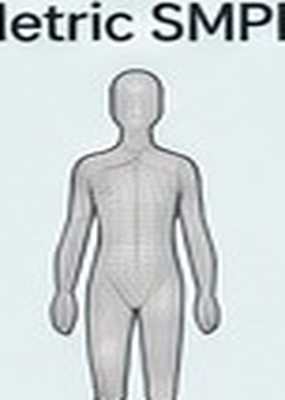

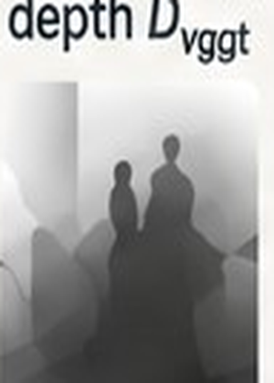
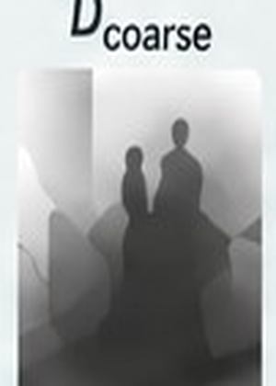
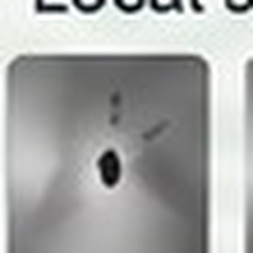
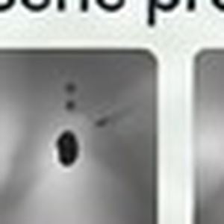
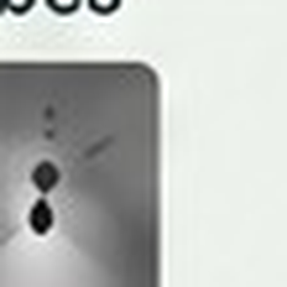
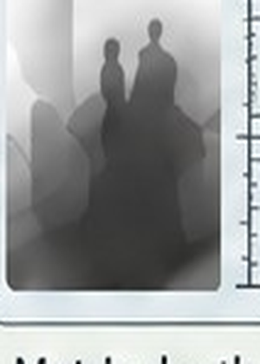
Prior-Guided Metric Scale Calibration
parameter-free metric prior + human-conditioned residual refinement
Validity-Aware Metric Prior Tokenizer
analytic · parameter-free
Metric SMPL
Raw depth
Paired geometry tokens
+
zₛₘₚₗ
zdepth
zₛₘₚₗ
zdepth
zₛₘₚₗ
zdepth
zₛₘₚₗ
zdepth
zₛₘₚₗ
zdepth
zₛₘₚₗ
zdepth
Validity mask
1
1
0
1
1
0
Scale hypothesis tokens {sᵢ}
Robust median
pool
Metric prior
C coarse
Human-Conditioned Residual Calibration
initializes
Anchor–Scene Interaction
Raw VGGT
depth Dᵥggt
Coarse depth
Dcoarse
24 body-anchor tokens
Local scene probes
Residual
scale
Rₕₛᵢ
Metric depth
Dmetric
Apply
metric prior
Attention
Metric Composition
Dmetric = Rhsi · Dcoarse
+ bhsi
Depth
bias
bₕₛᵢ
Human state {θ, β, τ}
coarse-to-fine residual correction
Figure palette
#E7DAAC
#E9D36E
#AFCAB2
#A9CFD8
#99ADD4
#CBBAD8
#D9ACA6
#2F3438
Notes:
All labels, panels, tokens, masks, arrows, and formulas are editable PowerPoint shapes. Embedded raster crops are limited to SMPL/depth/probe thumbnails.

Slide 2
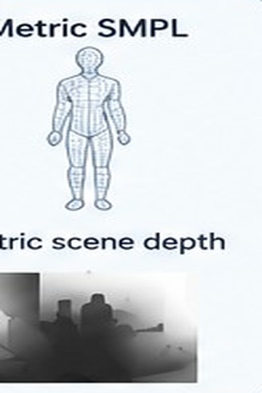
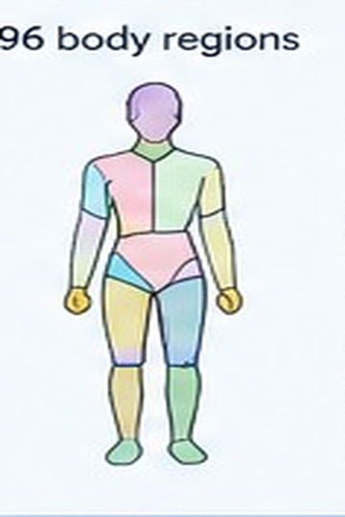
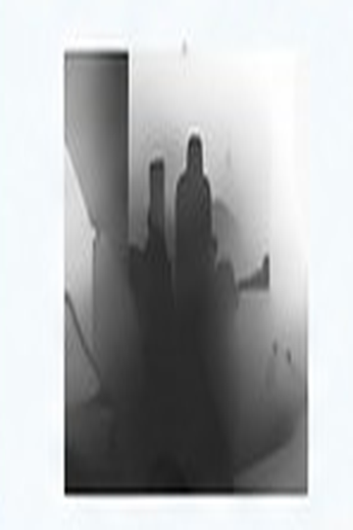
Detailed architecture
TRSTR
TRSTR Regional Translator
2×
re-probe
Metric SMPL
Region Construction
Human–Scene Interaction
Encoder
Regional Correction Heads
Robust Aggregation
96 body regions
multi-scale probes
vote Δτᵣ
3×3
region geometry
weighted
fusion
concat
MLP
interaction token
refined
translation
τ*
7×7
local scene
gate gᵣ
person
gate
Metric scene depth
adaptive
owner mask
interaction
token
annulus
uncertainty σᵣ
▣ pose θ and shape β unchanged
Temporal
Track-wise Temporal Fusion
Track Window
Motion Proposal
Conservative Fusion
Stable sequence
t−4 ··· t ··· t+4
Mₜ
Oₜ
ID 1
Masked
Temporal
MLP
Gate
MLP
αₜ ≤ 0.5
ID 2
Mₜ
ID 3
×
X*ₜ = Oₜ + αₜ(Mₜ − Oₜ)
neighbors only
(C) Spatial–Temporal Refinement
Notes:
Editable reconstruction of the detailed TRSTR and track-wise temporal refinement architecture.

Slide 3
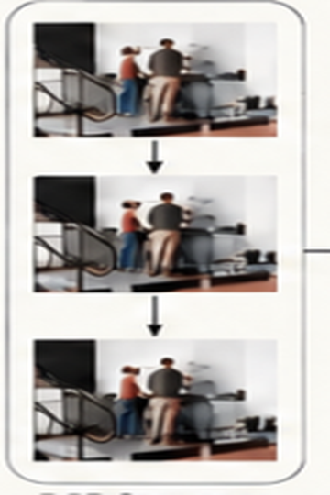
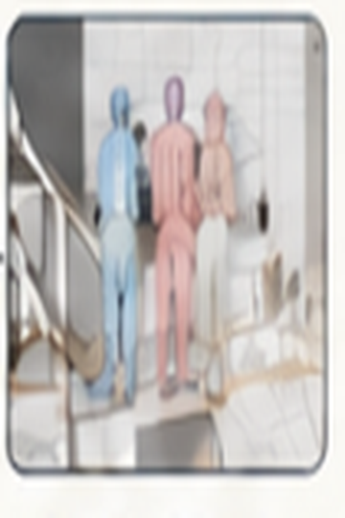
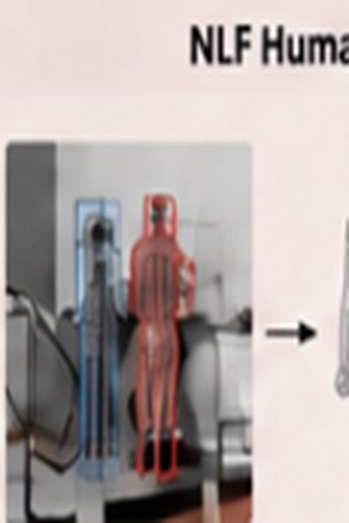
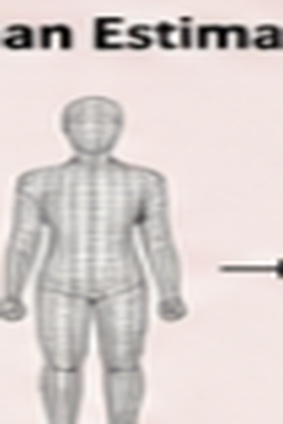
RGB Sequence
Parallel Human–Scene Encoding
Metric Human–Scene
Evidence
VGGT Scene Encoder
HSI Scale
Calibration
TRSTR Spatial Refinement
Camera K
Scene evidence
{Dᵥggt, Fscene}
Segmented
SMPL
96-region
token matrix
Track-wise
Temporal Stabilizer
Raw depth Dᵥggt
Coarse evidence
{Ccoarse, Fscene}
Metric depth
Dmetric
9-frame window
Scene tokens Fscene
Camera evidence {K}
Oₜ
intrinsics
Residual affine
Rhsi, bhsi
NLF Human Estimator
Human evidence
{θ, β, τ, c}
Multi-scale
probes
Weighted
voting
Neighbor-only proposal
Mₜ
Stable Metric
Human–Scene
Sequence
pose θ
Metric
SMPL
shape β
Gating
αₜ ≤ 0.5
translation τ
confidence c
▣ θ, β fixed
(A) Overall Architecture
Notes:
Editable reconstruction of the overall RGB–VGGT–NLF–HSI–TRSTR–temporal architecture.

