Slide 1
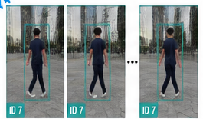
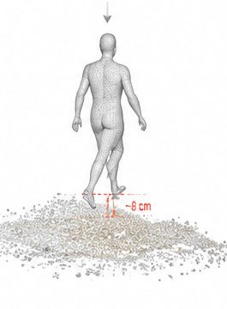
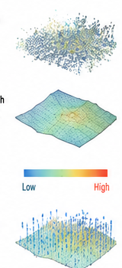
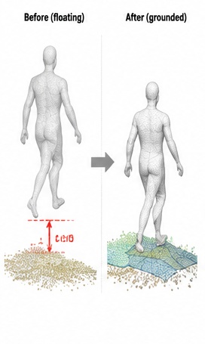
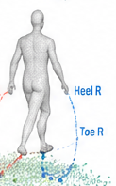
TSMR: Track-aware Support Manifold Refinement
Frozen inputs
+
Metric point cloud
Track ID
Human mask
Neighbor frames
Stage2 trans
RGB track
Aligned SMPL
1
Build support
2
Propose candidates
3
Select, update, verify
No-op
Candidate
selector
Left / right foot
same ID over time
Both feet
Choose / abstain
Update translation
Before -> Grounded
Body support
Aligned human + scene
Local support surface
Probe feet / body
Re-probe
Remove human points
Fit ground / support
Geometry gives a small candidate set
re-probe and repeat x3
Output: support point, normal, confidence
The network does not invent a large translation
Only translation is changed
Pose, shape, and scene stay fixed
TRAIN
candidate selection
translation
clean no-op
temporal consistency
INFERENCE
support mode | refined translation | confidence

