Slide 1
Loop condition block
Loop body block
Loop end block
True branch
False branch
Direct jump
Outer loop
Two-level loops
Inner loop

Slide 2
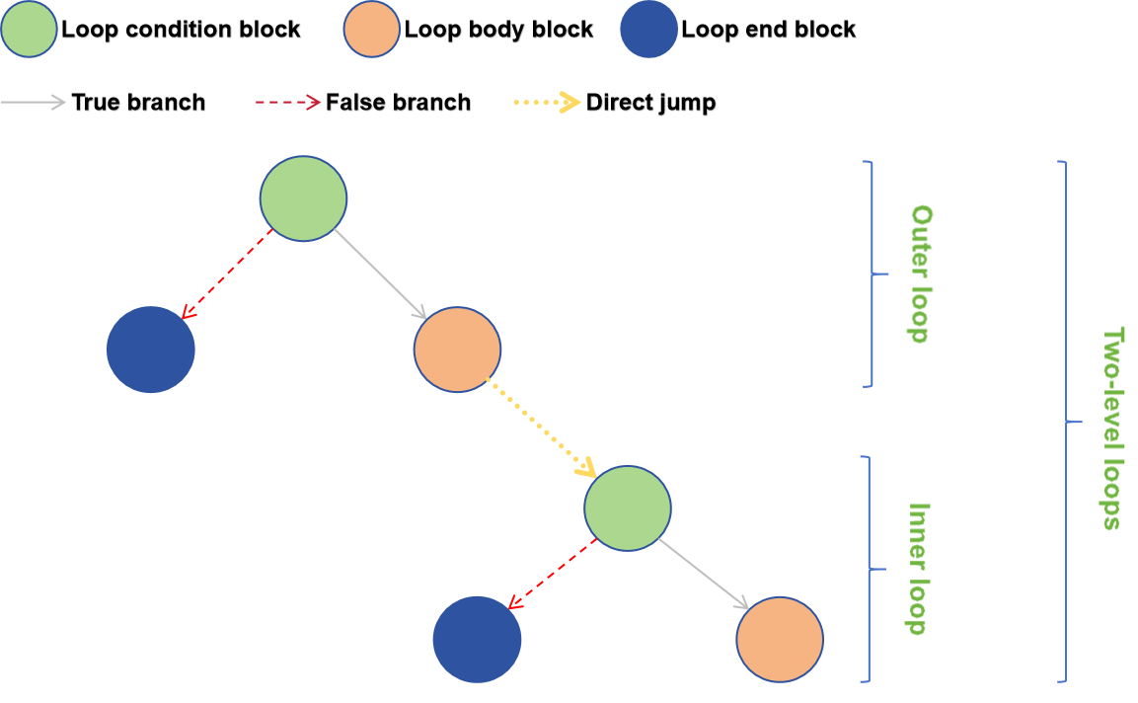

Slide 3
Loop condition block
Loop body block
Loop end block
True branch
False branch
Direct jump
Outer loop
Three-level loops
Two-layer loop
Inner loop

Slide 4
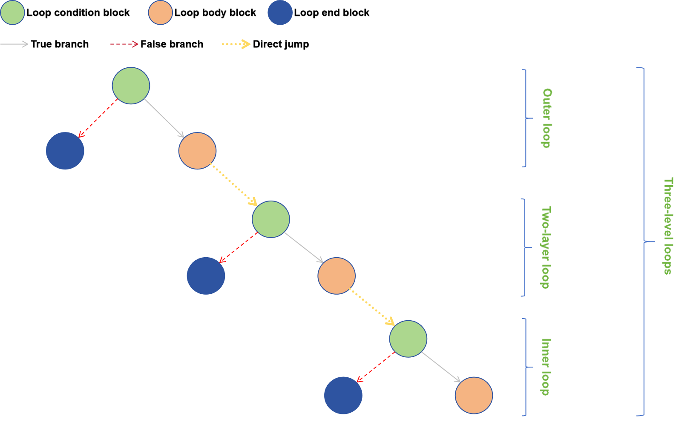

Slide 5
TF Op
XLA HLO
Target-Independent Optimizations & Analysis
XLA HLO
Target-Dependent Optimizations & Analysis
Target-Specific Code Generation
XLA Backend
TPU

Slide 6
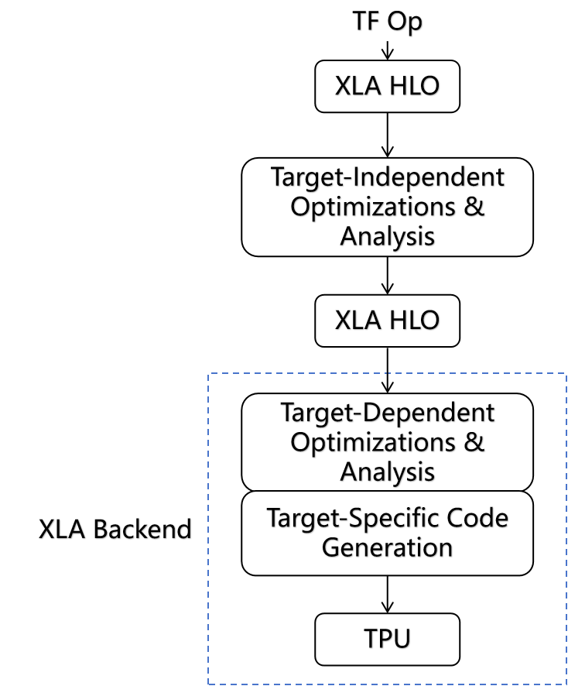

Slide 7
TF/PyTorch/ONNX
Relay IR
Tensor Expression
AutoTVM/ AutoScheduler
TE + Schedule
TIR
Machine Code
LLVM IR
CUDA/
OpenGL/Metal
Accelerator
Backend

Slide 8
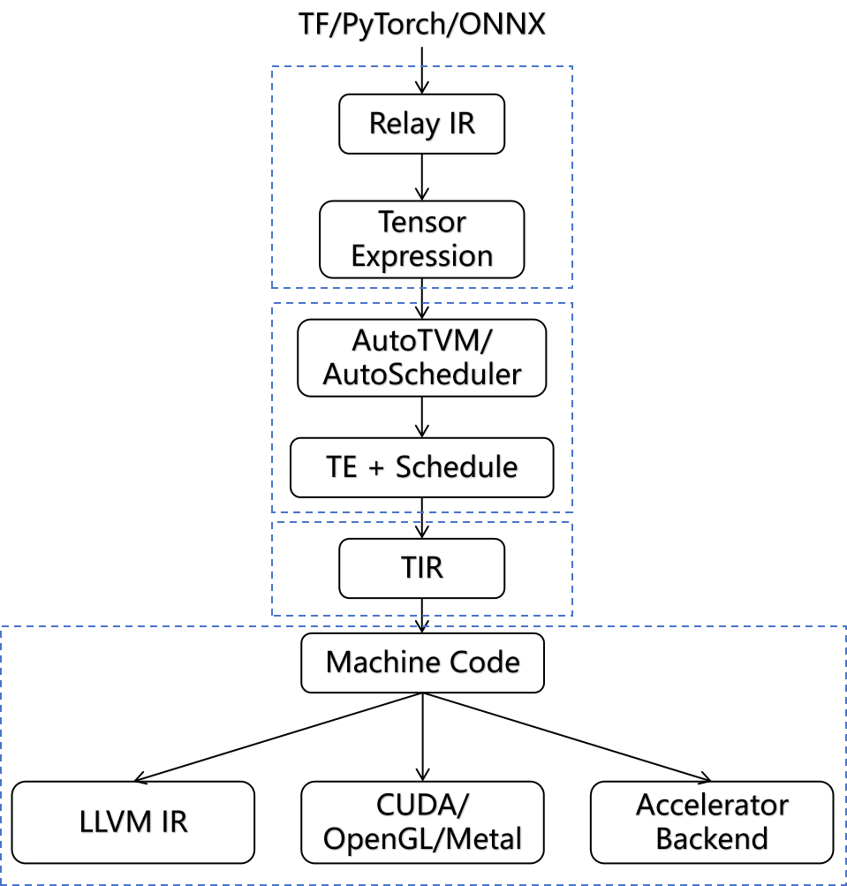

Slide 9
TF/PyTorch/Caffe
Tensor Expression
Normalization
Auto Schedule
Backend Optimization
CUDA Code

Slide 10
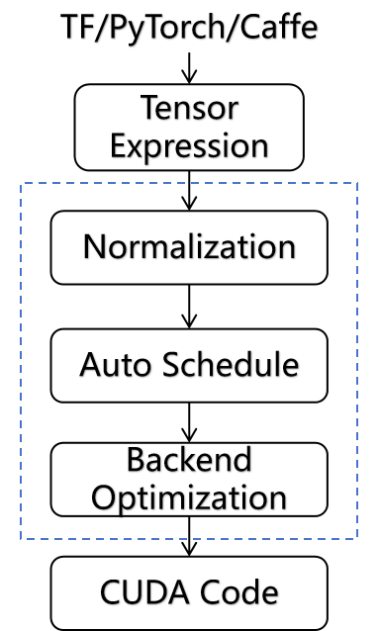

Slide 11
Off Model
MLIR
IREE Modules
(C Sorce/VM Bytecode/...)
IREE Runtime
CUDA

Slide 12
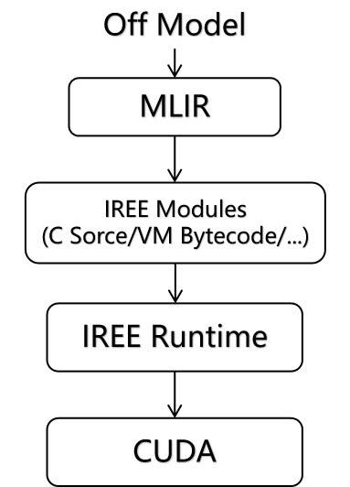

Slide 13
第二章
RISC-V 指令集
存算一体架构
LLVM 编译器
理论
基础
第三章
编译器前端
NPU指令的智能识别
第四章
编译器中端
指令调度
第五章
编译器后端
指导
实验
第六章
编译器功能测试
编译器性能测试

Slide 14
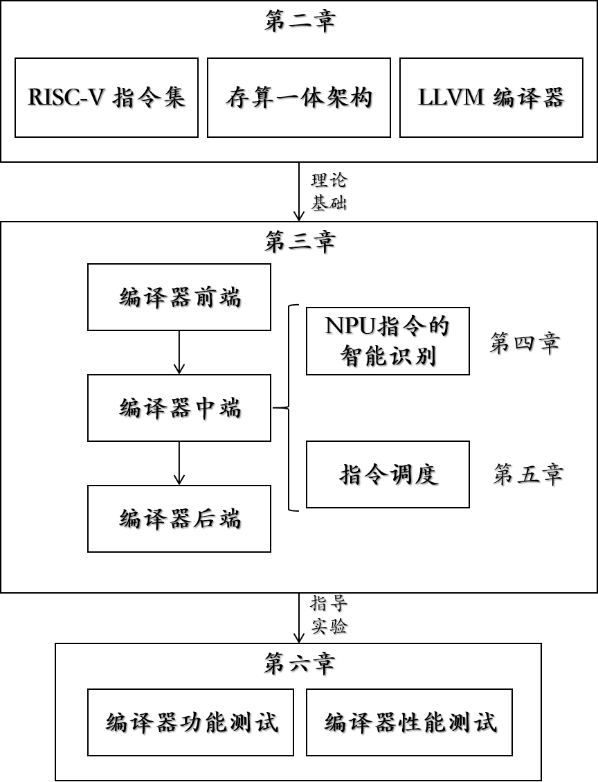

Slide 15
Python Kernel
Frontend
Triton IR
Optimizer
Triton Compiler
TritonGPU IR
Backend
cubin

Slide 16
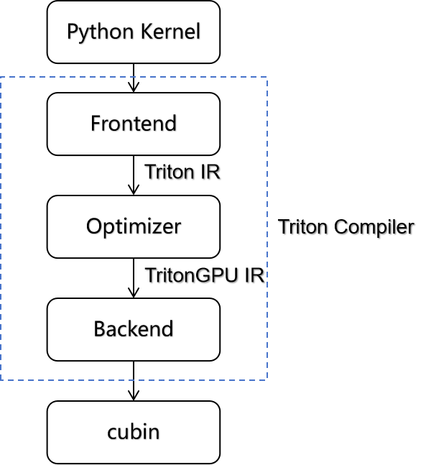

Slide 17
LLVM IR
Identification
顶层ONNX模型
Compile
计算图
Compile
图层优化
Compile
MLIR
Acclerated Part
Compile
Binary Executable
Translate
LLVM IR + Primitive
CIM Runtime Environment
CPU
NPU

Slide 18
