Slide 1

CSC380: Principles of Data Science
Probability 6
Xinchen Yu

Slide 2
Announcements
No in-person lecture on Feb 8 (Tues) and Feb 13 (Thurs).
Recordings will be uploaded to D2L.

Slide 3
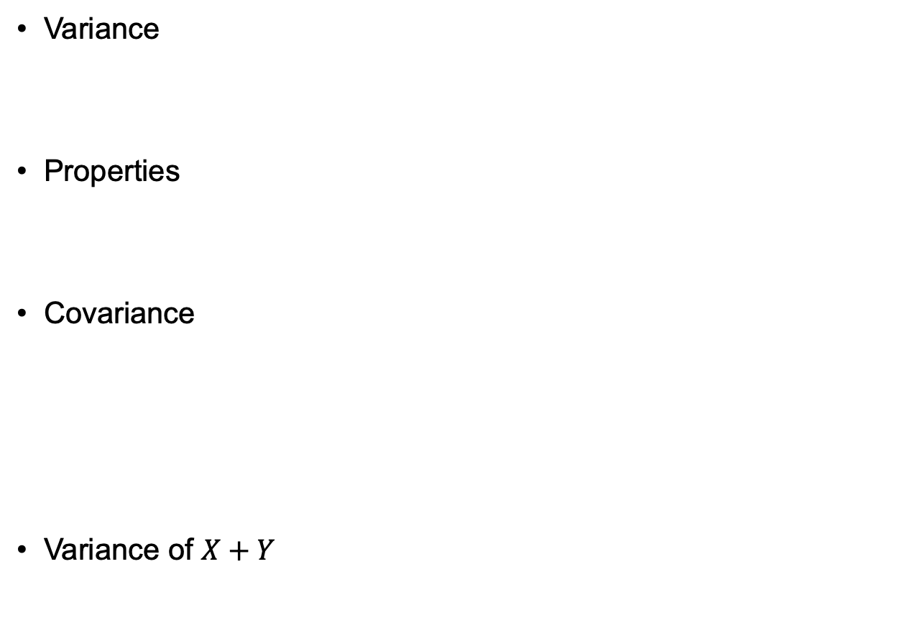
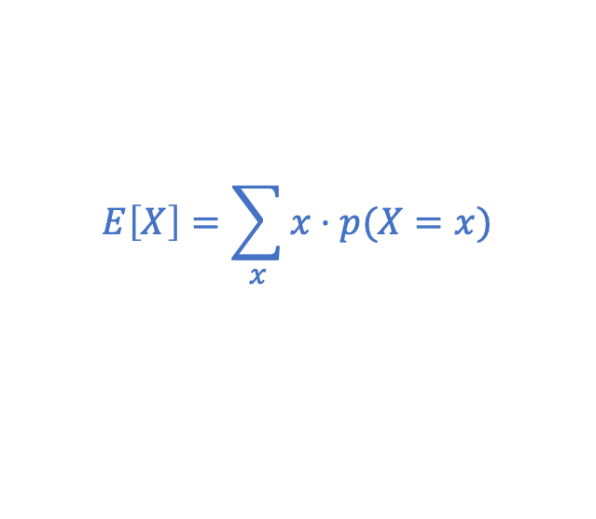
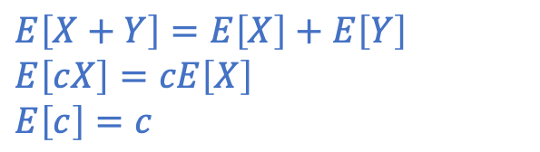


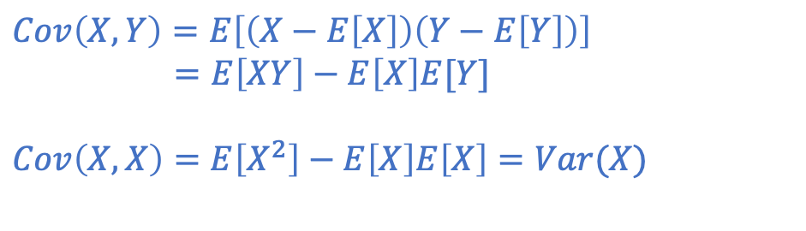
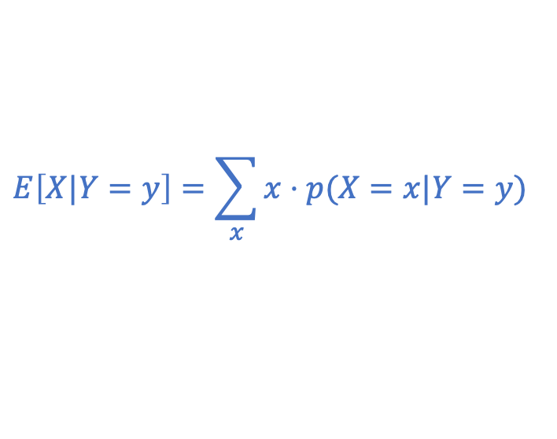
Review
Expectation
Properties
Conditional expected value

Slide 4
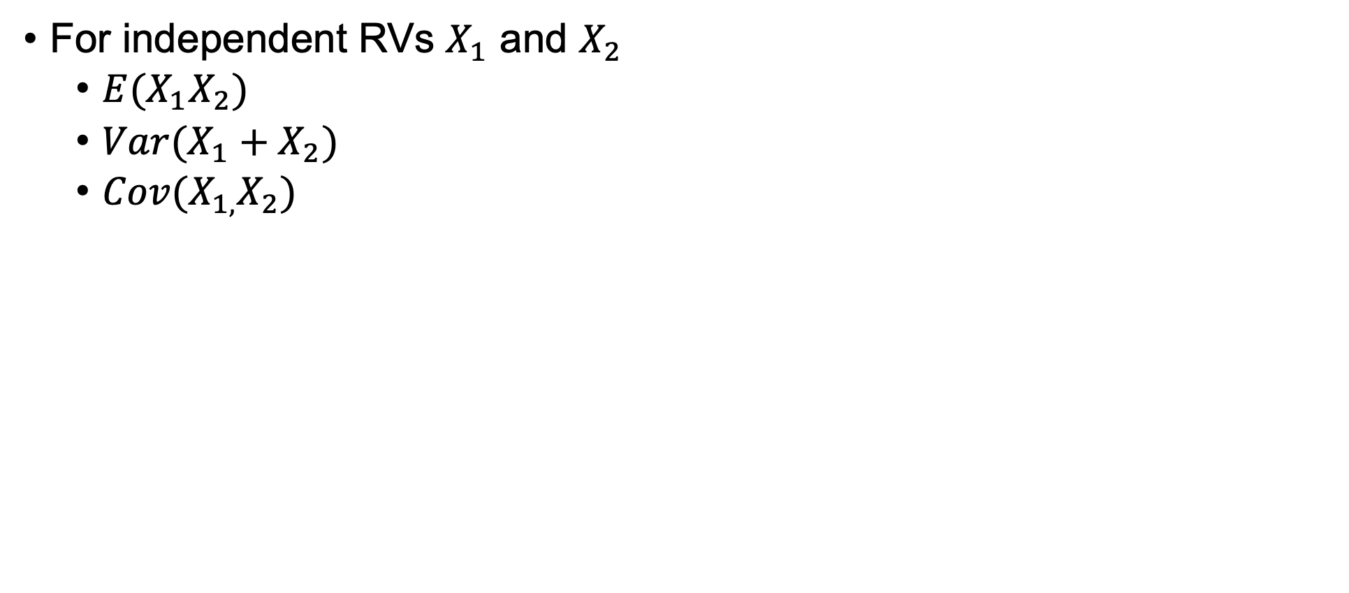
Outline

Slide 5


Independence and Moments
Theorem: If then .

Slide 6
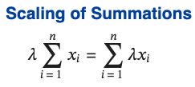
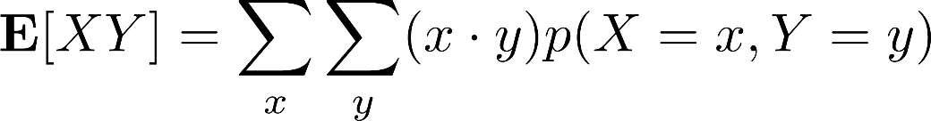
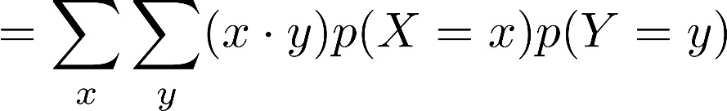
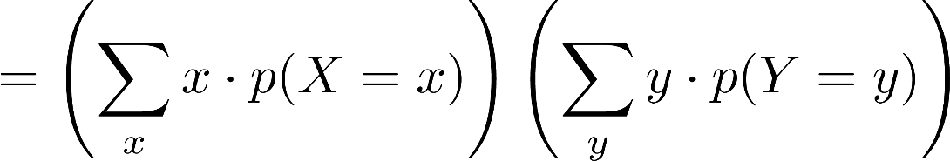


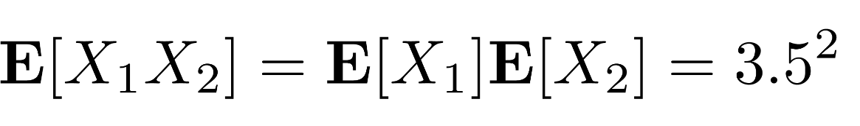
Independence and Moments
Theorem: If then .
Proof:
( Independence )
( Linearity of Sum )
Example Let be RVs representing the result of rolling two fair standard dice. What is the mean of their product?
=12.25

Slide 7


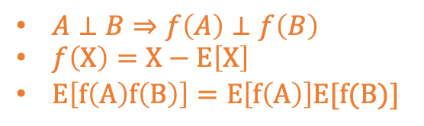
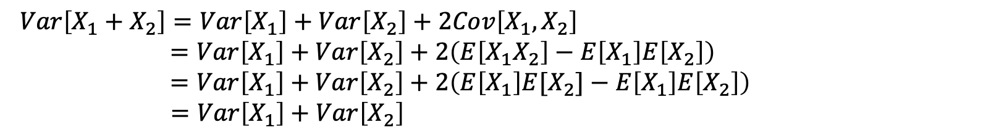
Independence and Moments
Question: What is the variance of their sum (recall independence)?
Proof 1:
Proof 2:

Slide 8


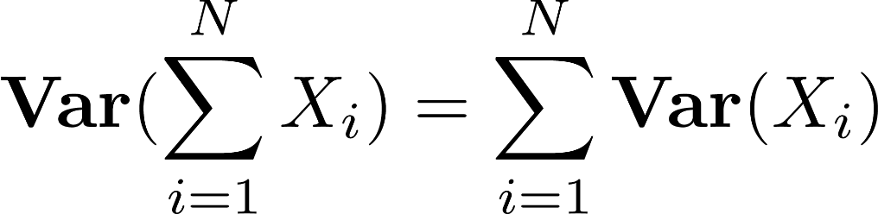
Independence and Moments
Recall that for any two RVs X and Y variance is not a linear function,
If X and Y are independent then they have zero covariance,
Thus,
And, for a collection of independent RVs we have,
Q: Is variance a linear operator under independence?

Slide 9
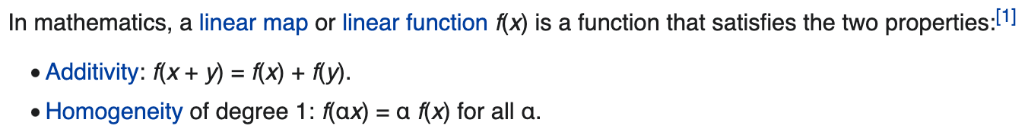
Linearity
Homogeneous must pass: f(zx, zy) = z^{n} f(x, y)
Homogeneous?
f(x, y) = 4x² + y²
⇒ homogeneous with degree 2: f(zx, zy) = z² f(x, y)
⇒ not linear
So, expectation is a linear function/operator, but variance is not !
We will just say ”linearity of expectation”
Notes:
if all its arguments are multiplied by a scalar, then its value is multiplied by some power of this scalar,

Slide 10
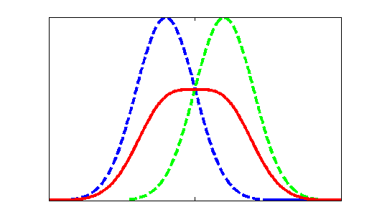

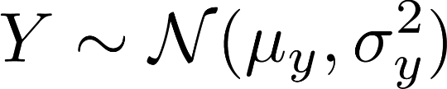



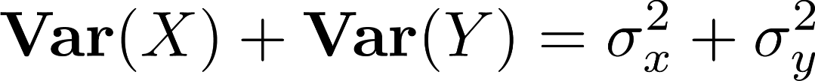





Example: Independent Gaussian RVs
Let X and Y be independent Gaussian RV with,
What is the variance of their sum?
What is the mean of their product?
Suppose X and Y are dependent, what is the mean of their sum?
Notes:
The parameter mu is the mean or expectation of the distribution (and also its median and mode), while the parameter sigma is its standard deviation.

Slide 11


The amazing Gaussian
Let X and Y be independent Gaussian RVs with,
For normal distributions
Closed under additivity:
Closed under affine transformation (a and b constant):
, 𝑋⊥𝑌

Slide 12
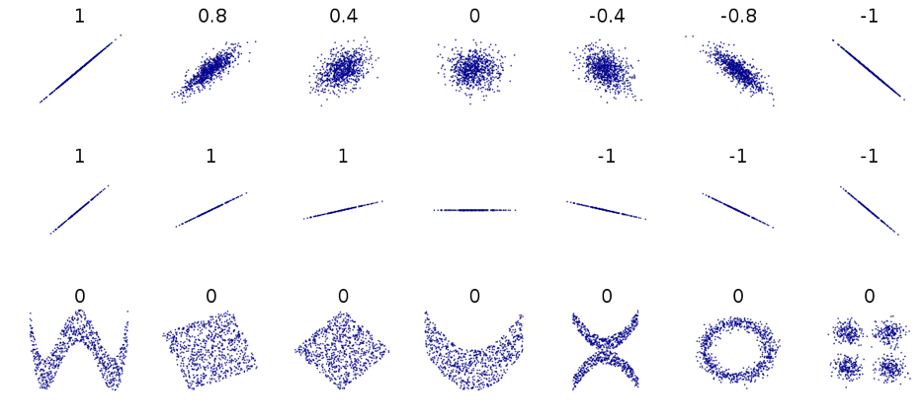
Independence and Moments
On slide page 6, If X and Y are independent RVs, then:
The reverse is not true!

Slide 13
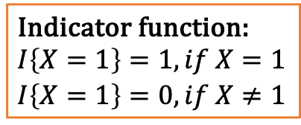
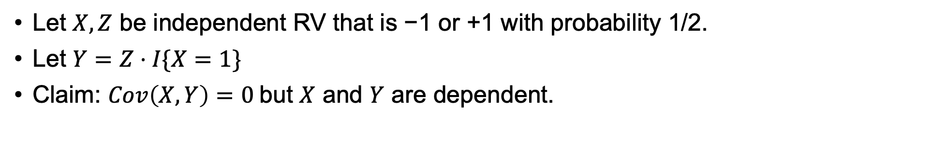



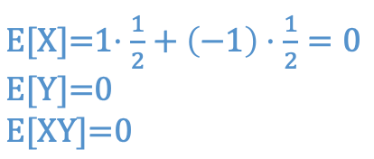
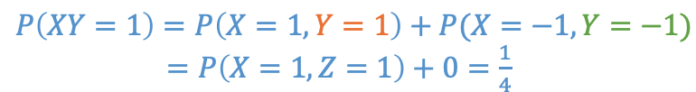

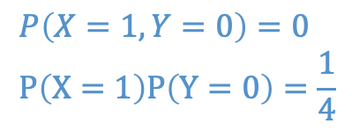
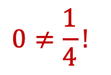

Counter Example
 | X | Z | Y | XY
1 | ½ | ½
-1 | ½ | ½
0 | N/A | N/A
¼
¼
¼
¼
½
½

Slide 14
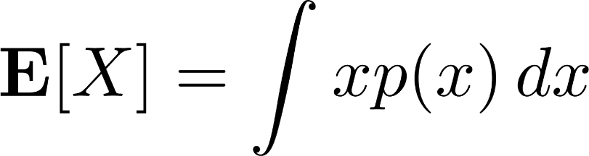
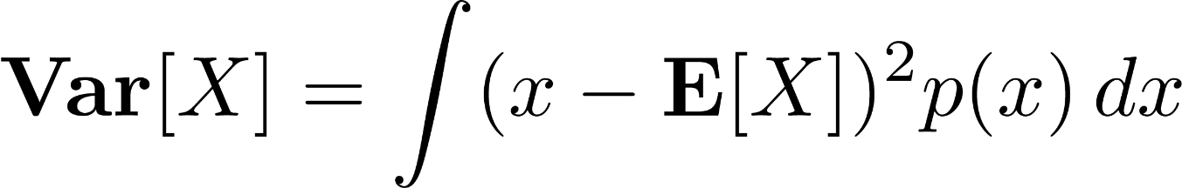
Moments of Continuous RVs
Replace all sums with integrals,
All properties push through, as you would expect (e.g. law of total expectation, conditional expectation, etc.)
(and use PDF p(x) instead of PMF P(X=x))

Slide 15
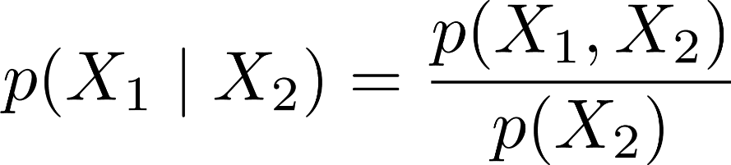
Exercise
Question: Roll two dice and let their outcomes be for die 1 and die 2, respectively. Recall the definition of conditional probability,
Which of the following are true?
a)
b)
Outcome of die 2 doesn’t affect die 1
c)

Slide 16





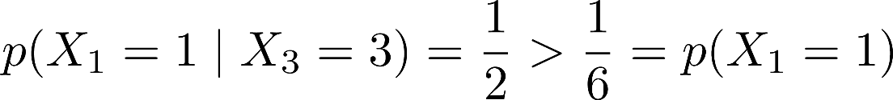
Exercise
Question: Let be outcome of die 1, as before. Now let be the sum of both dice. Which of the following are true?
Only 2 ways to get , each with equal probability:
a)
or
b)
so
c)

Slide 17
Review
We have covered a lot of ground on probability in short time…
Discrete Random Processes
Definition of sample space / random events
Axioms of probability
Uniform probability of random event
Random Variables
Fundamental rules of probability (chain rule, conditional, law of total probability)
Moments / Independence
Expected Value
Linearity
Variance, Covariance, Corr.
Dependent / Independent RVs
Probability Distributions
Useful discrete probability mass functions
Introduction to continuous probability
Useful probability density functions

Slide 18
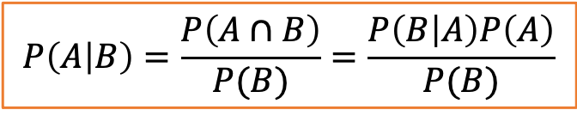
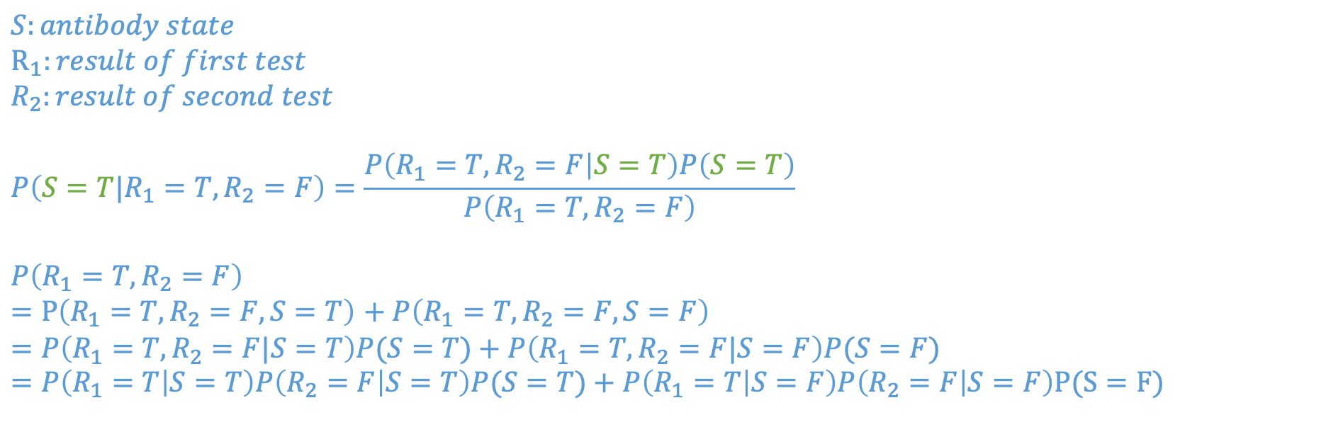
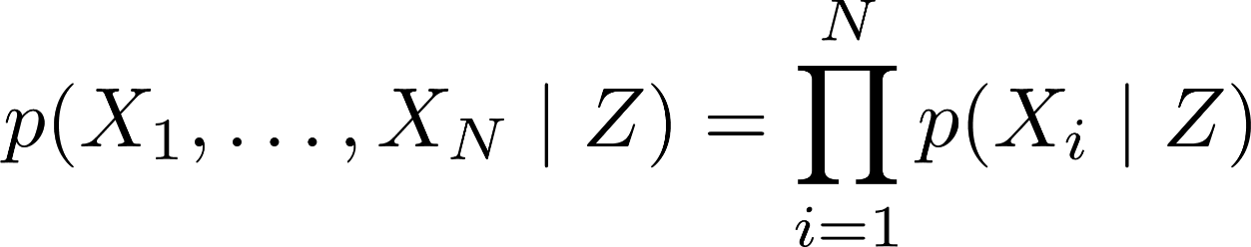
Homework 2
d) Assume I take the test twice, and receive a positive result in the first test and a negative result in the second test. Assume that the two test results are conditionally independent given the existence of the antibody. What is the probability that I have COVID-19 antibodies according to Bayes’ rule?
Law of total probability

