Slide 1
Breast Cancer Detection
Group member: Yin Yifan, Ding Xiangyun

Slide 2
Problem Description
• Molecular subtyping of breast cancer has become common practice to understand prognosis of disease, and to design a treatment plan. The subtype indicates the severity of the cancer and influences the treatment plan.
• This task is to develop an automated method to classify the molecular subtype of breast cancer based on ultrasound images and clinical diagnostic data.

Slide 3
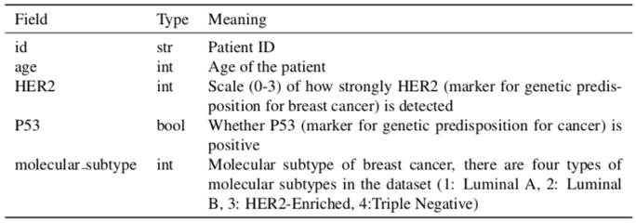
Dataset
• Given hundreds of medical records of breast cancer patients. Each medical record is associated with several ultrasound images and some clinical diagnostic data. The clinical diagnostic data contains the following fields:

Slide 4
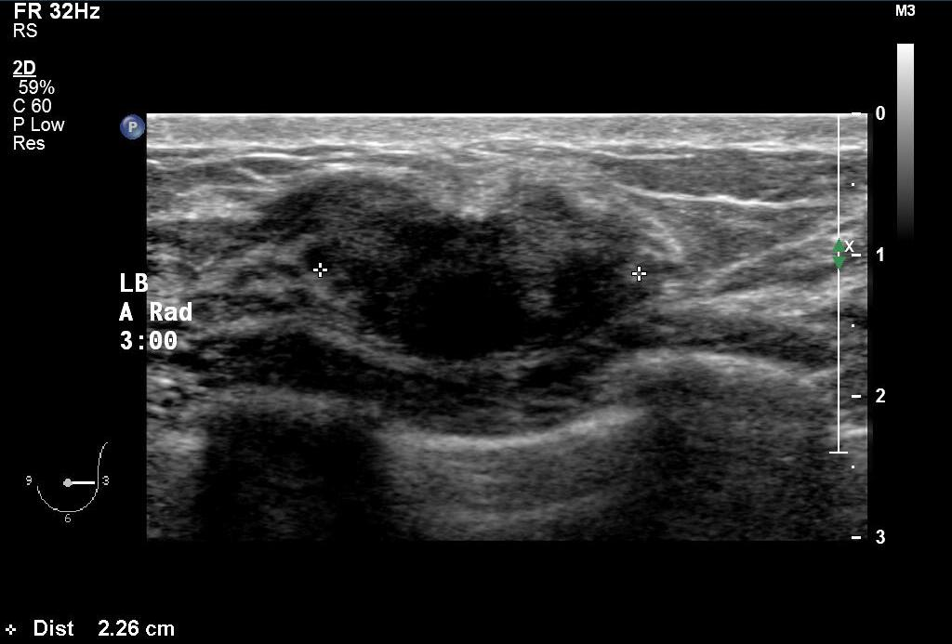
Ultrasound images

Slide 5
Expected output
Algorithm for automatic analysis of ultrasound images and clinical data.
A framework to automatically classify the molecular subtype of breast cancer.
An online website for medical staff.

Slide 6
Project plan
Learn how to read ultrasound image and basic breast cancer knowledge.
Read related papers about ultrasound image procession and breast cancer detection.
Detection algorithm design and implementation. Evaluate the model.
Build and deploy the website.
Presentation.

Slide 7
Data pre-process
Resize the images to have the same distance scale.
Remove artifacts from the ultrasound images.
Data augmentation to increase the size of training set, for example, picture rotation, flipping, et al.
Split the dataset to training set and validation set.

Slide 8
Cancer detection
Try different models, including traditional machine learning methods and deep learning methods, for prediction.
Experiments on different neural networks.
Try to mark the cancer area on each picture.

Slide 9
Schedule
Week | Main task
9-10 | Learn related medical knowledge and coding skills. Read papers and research related methods. Determine the approximate code framework.
11-12 | Implement the algorithm. Make a simple demo.
13-14 | Optimize our algorithm. Try different models and methods.
15-16 | Visualize the results on the website. Prepare presentation.

Slide 10
Thank you.

