Slide 1
Core Methods in Educational Data Mining
EDUC6191 Fall 2023

Slide 2
Welcome!

Slide 3
Your instructor
Ryan Baker

Slide 4
Your teaching assistants
Tanvi Gupta
Xiner “Rachel” Liu
Rachel Liu: xiner@upenn.edu / Tanvi Gupta: guptanvi@seas.upenn.edu

Slide 5
Course Goals
This course covers methods from the emerging area of educational data mining.
You will learn how to execute these methods in standard software packages
And the limitations of existing implementations of these methods.
Equally importantly, you will learn when and why to use these methods.

Slide 6
Course Goals
Discussion of how EDM differs from more traditional statistical and psychometric approaches will be a key part of this course
In particular, we will study how many of the same statistical and mathematical approaches are used in different ways in these research communities.

Slide 7
Background in Statistics
This is not a statistics class
But I will compare EDM methods to statistics throughout the class
For those interested, I will offer a special session “An Inappropriately Brief Introduction to Frequentist Statistics”
I will post a poll to schedule this on the discussion forum

Slide 8
How this class is going to work
Watch the videos in the video textbook
Read the readings
Participate in the discussion forums
Attend class and discuss the topics
You are also welcome at my office hours
Do the assignments, and post to the forum when you have questions or comments

Slide 9
Two sections
You can attend either section, it’s up to you
Tuesdays 6pm-8pm fully virtual
Thursdays 945am-1145am in-person
With hybrid simulcast
Will be virtual a couple times during semester, will be announced well in advance
Same link

Slide 10
Two office hours
You can attend either office hours, it’s up to you
Mondays 6am-7am fully virtual
Thursdays noon-2pm in-person
No hybrid simulcast sorry
Will be virtual a couple times during semester, will be announced well in advance
Same link

Slide 11
Administrative Stuff
Is everyone signed up for class?
If not, and you want to receive credit, please send me an email
If you ARE signed up for this class, and have NOT gotten email from me yet, also please send me an email

Slide 12
Course website
https://www.upenn.edu/learninganalytics/ryanbaker/EDM2023/index.html

Slide 13
Class Schedule

Slide 14
Class Schedule
Updated versions will be available on the course webpage
Readings are available from the class schedule

Slide 15
Class Schedule
If any schedule changes happen due to unforeseen circumstances
Online schedule will be kept up-to-date

Slide 16
Course Discussion Forum (Shared by both sections)
http://educ6191-f23.jeepytee.net/
This semester, we will be joined by a new LLM-powered TA, Jeepytee
Not just basic GPT-4; we’ve done some pre-training
Jeepytee will answer some of your questions when we aren’t available, and will answer them faster than we can
My colleagues will be conducting a study on Jeepytee, which they will invite you to join

Slide 17
Course Discussion Forum
Key communication tool for this class
Hand in some assignments there
Comment on other students’ assignments there
Discuss the readings and videos there
Please look at the folder names and post in the right place, it makes things easier for everyone

Slide 18
Required Text
Baker, R.S. (2023) Big Data and Education. 7th edition.
http://www.upenn.edu/learninganalytics/MOOT/bigdataeducation.html
The course schedule tells you what videos to watch each week

Slide 19
Other Readings
Available off the course schedule webpage

Slide 20
Assignments
There will be 8 basic homeworks
You choose 6 of them to complete
3 from the first 4 (e.g. BHW 1-4)
3 from the second 4 (e.g. BHW 5-8)

Slide 21
Assignments
Basic homeworks are through the ASSISTments platform
You can either use Google Classroom or use ASSISTments directly
Information will be available on the course webpage
You will conduct data mining with instant feedback and on-demand context-sensitive hints
Regardless of what the system says, there are no penalties for making errors or requesting hints
Unless you game the system – so don’t do that

Slide 22
Assignments
There will be 4 creative homeworks
You choose 3 of them to complete

Slide 23
Creative homeworks
The creative homeworks will not require flawless, perfect execution
They will require personal discovery and learning from text and video resources

Slide 24
Posting requirement
After you turn in your own creative assignment, you will need to post meaningfully on four other students’ creative assignments
Either section is fine
This is not just for their benefit – it’s for yours as well, to see other ways to solve the same problem

Slide 25
Assignments
Please try to meet all homework due dates
Given the state of the world these days, I intend to be more flexible than usual on extensions – but please do email me to tell me why your assignment will be late

Slide 26
You can not do extra assignments
If you do extra assignments
I will grade the first 3 of each 4 basic assignments
I will grade creative assignments 1,2, and 4
I will give you feedback but no extra credit
You cannot get extra credit by doing more assignments
You cannot pick which assignments I grade after the fact
Are there any questions about this?

Slide 27

Stressed out about not having done data mining before?

Slide 28
If you’re worried
Come talk to us during our office hours (or email one of us to set up a meeting)
I try to find a way to accommodate every student

Slide 29
Homework
All assignments for this class are individual assignments
You must turn in your own work
It cannot be identical to another student’s work (except where the Basic Assignments make all assignments identical)
The goal of the Creative Assignments is to get diverse solutions we can discuss in class
However, you are welcome to discuss the readings or technical details of the assignments with each other
Including on the class discussion forum

Slide 30
Examples
Buford can’t figure out the UI for the software tool. Alpharetta helps him with the UI.
OK!
Deanna is struggling to understand the item parameter in PFA to set up the mathematical model. Carlito explains it to her.
OK!

Slide 31
Examples
Fernando and Evie do the assignment together from beginning to end, but write it up separately.
Not OK
Giorgio and Hannah do the assignment separately, but discuss their (fairly different) approaches over virtual lunch
OK!

Slide 32
Examples
Iphigenia posts her assignment early on Piazza. Joelmo reads Iphigenia’s assignment post, and gets an idea for his own assignment, which he tries out
Not recommended but will not be treated as an ethical violation.
Iphigenia posts her assignment early on Piazza. Kreacher copies Iphigenia’s code or modified data file and turns it in as his own
Not OK!

Slide 33
Plagiarism and Cheating: Boilerplate Slide
Don’t do it
If you have any questions about what it is, talk to me before you turn in an assignment that involves either of these
University regulations will be followed to the letter

Slide 34
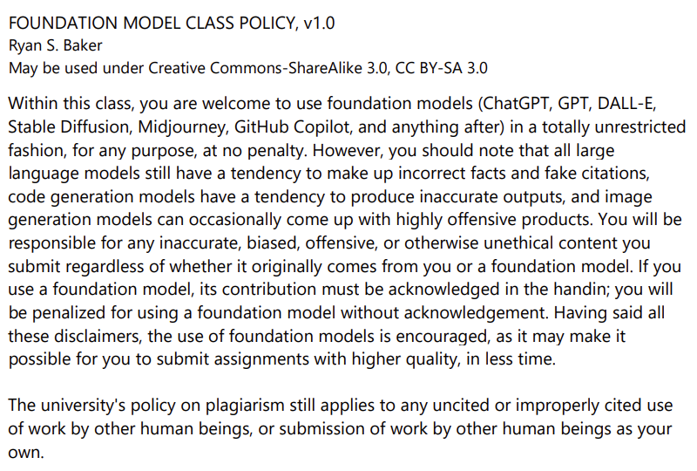

Slide 35
Grading
6 of 8 Basic Assignments 6% each (up to a maximum of 36%)
3 of 4 Creative Assignments 13% each (up to a maximum of 39%)
Asynchronous participation 8% each (up to a maximum of 24%)
Aka posting on classmates’ creative assignments
1 bonus point
PLUS: For every creative homework, there will be a special bonus of 20% for the best hand‐in. “Best” will be defined in each assignment.

Slide 36
Accommodations for Students with Disabilities
Please email me to set up a meeting so we can best accommodate you

Slide 37
Ways to get in touch with me
Post to the forum
Strongly preferred for all questions that could be of interest to other students; fastest response by me and Rachel and Tanvi and Jeepytee
Come to office hours
Set up a virtual meeting penn.learninganalytics@gmail.com for Ryan
Questions on grades or late handins rybaker@upenn.edu
Use the right approach, get a much faster response

Slide 38
Discussion Forums
Before emailing me, if you have a technical question or a question of general interest for the class
Post to the forum!
I will check there before I check my email
And maybe one of your classmates or Jeepytee will have the answer!

Slide 39
Questions
Any questions on the syllabus, schedule, or administrative topics?

Slide 40
Who are you
And why are you here?
What kind of methods do you use in your research/work?
What kind of methods do you see yourself wanting to use in the future?

Slide 41
Basic HW 1
Due in two weeks
Note that this assignment requires the use of Python

Slide 42
Any other questions?

Slide 43
The End

