Slide 1
自动化框架 之Selenium
R: 0
G: 108
B: 184
R: 240
G: 131
B: 0

Slide 2
Definition
Selenium是一种跨平台、跨浏览器端到端Web自动化解决方案。Selenium主要包括：Selenium IDE、WebDriver、 Selenium Grid。
网站UI自动化测试的主要工具。

Slide 3
Components
1、WebDriver
2、selenium IDE
firefox plugin
Katalon Studio
3、selenium grid

Slide 4
How to begin?

Slide 5
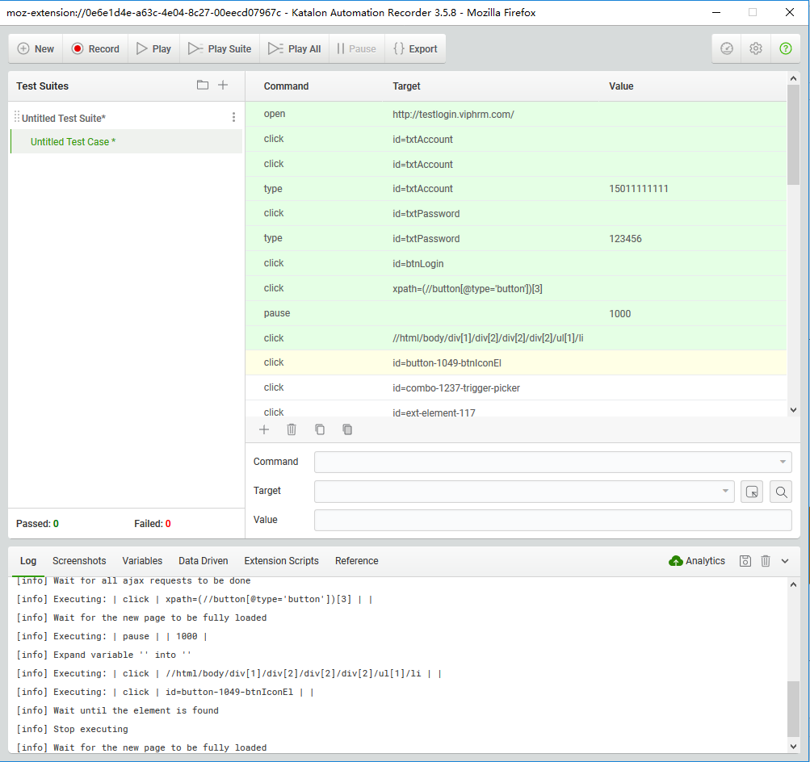
Selenium IDE

Slide 6
Webdriver
WebDriver是用于自动化测试的接口。核心是通过findElement方法返回DOM对象(WebElement) 。

Slide 7
Which browsers are support?
geckodriver.exe（Firefox）
chromedriver.exe（Chrome）
MicrosoftWebDriver.exe（Edge）
IEDriverServer.exe（IE）
operadriver.exe（Opera）

Slide 8
geckodriver.exe（Firefox）
private RemoteDriver createGeckodriver() {
System.setProperty("webdriver.gecko.driver",
System.getProperty("user.dir") + "/lib/geckodriver.exe");
return new FirefoxDriver();
}

Slide 9
chromedriver.exe（Chrome）
private RemoteDriver createChromeDriver(){
ChromeOptions options = new ChromeOptions();
Map<String, Object> prefs = new HashMap<String, Object>();
prefs.put("download.prompt_for_download", true);
options.setExperimentalOption("prefs", prefs);
System.setProperty("webdriver.chrome.driver",
System.getProperty("user.dir") + "/lib/chromedriver.exe");
return new ChromeDriver(options);
}

Slide 10
IEDriverServer.exe（IE）
private RemoteDriver createIEDriver(){
System.setProperty("webdriver.ie.driver",
System.getProperty("user.dir")+"/lib/IEDriverServer.exe"); //32 bit
DesiredCapabilities ieCapabilities = DesiredCapabilities.internetExplorer();
ieCapabilities.setCapability(InternetExplorerDriver.
INTRODUCE_FLAKINESS_BY_IGNORING_SECURITY_DOMAINS, true);
return new InternetExplorerDriver
(InternetExplorerDriverService.createDefaultService(), ieCapabilities);
}

Slide 11
Hanlder
Iframe
Element
Alert

Slide 12
Handler
public void switchToWindowByHandle(String handleOrName) throws FrameworkException {
try {
driver.switchTo().window(handleOrName);
} catch(Exception e) {
ReportUtil reportUtil = new ReportUtil();
reportUtil.logAndScreenshot(this, "switch to new window failed");
throw new FrameworkException("Can't switch to window:");
}
}
public String switchToNewWindowFromDefault(String defaultHandler) throws FrameworkException {
try {
for (String winHandle : driver.getWindowHandles()) {
if (!winHandle.equals(defaultHandler)) {
driver.switchTo().window(winHandle);
return winHandle;
}
}
} catch(Exception e) {
ReportUtil reportUtil = new ReportUtil();
reportUtil.logAndScreenshot(this, "switch to new window failed");
throw new FrameworkException("Can't switch to window:");
}
return null;
}

Slide 13
Iframe
public void switchToFrame(String nameOrId) {
driver.switchTo().frame(nameOrId);
}
public void switchToFrame(int index) {
driver.switchTo().frame(index);
}

Slide 14
Element
1、button
2、input（textbox）
3、label
4、a（link）
5、document
6、select
7、li（list）
8、textarea
9、td（table）

Slide 15
How to get ?
By.linkText ()
By.cssSelector ()
By.Id ()
By.tagName ()
By.className ()
By.name()
By.partialLinkText()
By.Xpath ()

Slide 16
Explicit and Implicit Waits
public boolean eleDisplayChk(By locator) throws Throwable {
try
{
WebDriverWait webWait = new WebDriverWait(this.handler.getMetaDriver(), MAX_TIME);
webWait.until(ExpectedConditions.visibilityOfElementLocated(locator));
return true;
}
catch(TimeoutException ex)
{
logUtil.error("element:\\" + locator + " \\is not visible");
return false;
}
}

Slide 17
Alert
public boolean alertIsPresent() throws Throwable {
try{
this.handler.swithToAlert();
return true;
}
catch(Exception ex)
{
//log.error("no alert is appeared");
return false;
}
}

