Slide 1
Parancoe
Easy going Web applications
Lucio Benfante, Paolo Foletto and Enrico Giurin
JUG Padova
1720

Slide 2
AGENDA
  What is parancoe?
  A simple but useful application for a JUG community
  Functionalities are
    Managing Events,
    participant registration,
    list of user registered
  Web application layer
  Persistence, web interface, authorisation
  Easy going web application
Notes:
<numero>

Slide 3
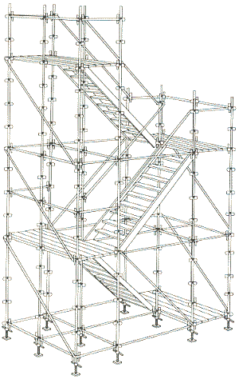
What is Parancoe?
  A framework
  A tool
  A framework aggregation
  Objectives
    A very simple way to build a web application
    Simple reuse of best tools available
  Guide lines
    Convention over configuration
    Dry
  Spring, Hibernate, Spring MVC, Maven 2
  parancoe.dev.java.net
simple and useful help to build
Notes:
<numero>

Slide 4
Starting with the management of the events
  Scaffolding the web application using the Parancoe web archetype
  mvn archetype:create -DarchetypeGroupId=org.parancoe \
  -DarchetypeArtifactId=parancoe-webarchetype \
  -DarchetypeVersion=1.0-SNAPSHOT \
  -DgroupId=it.jugpadova -DartifactId=jugevents
  Starts NetBeans!
  (why netbeans 6.0?)
Notes:
<numero>

Slide 5
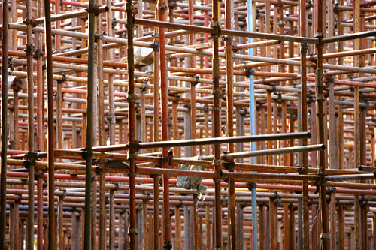
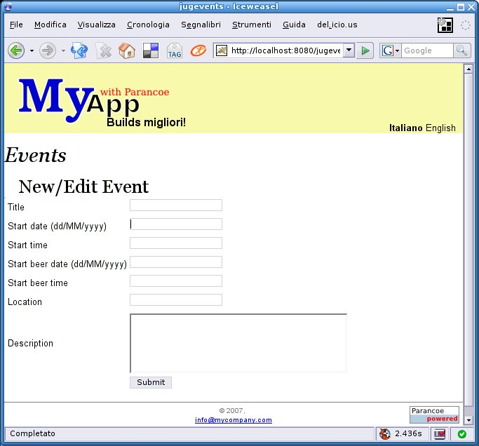
Live Demo!
Notes:
<numero>

Slide 6
Lucio Benfante www.benfante.com
JUG Padova lucio.benfante@jugpadova.it
Paolo Foletto
JUG Padova paolo.foletto@jugpadova.it
Enrico Giurin
JUG Padova enrico.giurin@jugpadova.it
www.jugpadova.it
info@jugpadova.it

