Slide 1
AI, Communication, and Social Transformation · XJTLU · 4–5 September 2026
From Lived Experience to Playable Systems
AI-Assisted Game Design as a Pedagogical Method
AI as implementation and reflection partner — a teaching experiment in two summer programs
Xingchen Ian Zhang
Interactive Media Arts · New York University Shanghai
Panel 11 — Human-Guided AI Pedagogy · Room C (IA121) · Saturday, 5 September 2026, 09:00
Notes:
Good morning.

Slide 2
Outline
Setting the scene
01
The one-prompt trend, its empirical failure, and why this matters in an NYU Shanghai classroom.
The method
02
Game Design from Life in six steps; guided interview instead of prompt; development logs as accountability.
What we learned
03
Thirty student games, one case in depth, three findings, and where the field is going.
Xingchen Zhang · NYU Shanghai · XJTLU 2026 · Panel 11
02 / 16
Notes:
Three chapters. The first frames the problem with recent industry and academic numbers. The second is the method: Game Design from Life in six steps, then the move from prompt to guided interview, and the development log as accountability. The third is what we saw, and where it points.

Slide 3
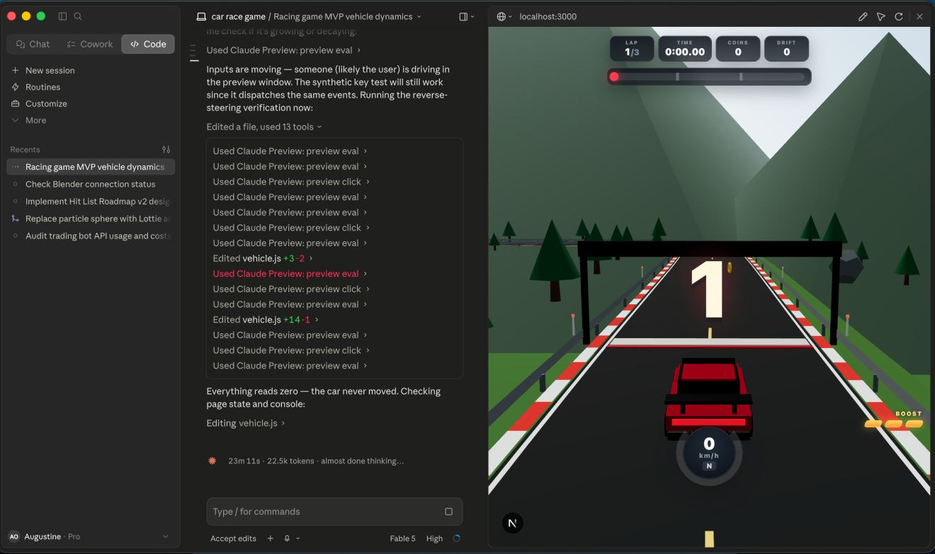
PART ONE
01
Setting the scene
”The ‘I build this with one prompt’ Trend: Myth or Method?
”August G. Osei
A short trend that became a benchmark, the empirical evidence that follows, and why it matters in a classroom where students come to express something, not to learn an engine.
"A game in one sentence" as a 2025–26 industry signal
What 10,400 single-pass generations, an end-to-end benchmark, and a playtest loop tell us
NYU Shanghai IMA: who shows up, and what they are trying to do
Xingchen Zhang · NYU Shanghai · XJTLU 2026 · Panel 11
03 / 16
Notes:
Chapter one. I want to set the scene in three beats: a short industry trend, a short empirical counterpoint, and the specific classroom that I am in. Each of those will get its own slide.

Slide 4
Why this matters in an NYU Shanghai classroom
OUR SETTING
STUDENTS
Interdisciplinary cohort, mixed coding background
Two courses in one summer
with
One Situation &
Two Missions
Many have never written a line of code. All have something they want to express — a frustration, a memory, a practice. The course exists to give that impulse a system.
COURSE MISSION
Not "game developer" — "systematic expression of experience"
We treat the game as a structured translation of lived experience. The evaluation question is not "is it fun?" but "did the translation succeed?"
The IMA program draws students from across the liberal-arts curriculum. Game Design is not a vocational track — students enroll to learn how to use a system to express an experience.
TWO CONSEQUENCES
AI is welcome — but only within a boundary
Because coding is not the learning goal, AI assistance is legitimate. Because intent and emotional structure are the learning goal, those cannot be outsourced. The question becomes how to draw the line.
Xingchen Zhang · NYU Shanghai · XJTLU 2026 · Panel 11
06 / 16
Notes:
So why teach game design at a research university in 2026? Our IMA students are not training to be game developers. They come from across the liberal-arts curriculum, with mixed coding experience, and they enroll because they have something they want to express — a frustration, a memory, a practice. Our mission is to teach them to use a system to express an experience. The success question is not is it fun, but did the translation succeed. Because coding is not the learning goal, AI assistance is legitimate. Because intent and emotional structure are the learning goal, those cannot be outsourced. The course lives exactly in that boundary, and that is the boundary I want to talk about.

Slide 5
PART TWO
02
The method
Game Design from Life, in six steps. The decisive move: replace the prompt with a guided interview, and let the development log carry the accountability that a chat history cannot.
1
Six steps in one picture
2
From prompt to guided interview
3
Accountability in a development log
Xingchen Zhang · NYU Shanghai · XJTLU 2026 · Panel 11
07 / 16
Notes:
Chapter two. The method has three pieces. A six-step structure that takes a lived experience to a playable system. The decisive move from prompt to guided interview. And the development log as accountability. I will spend a slide on each.

Slide 6
Game Design from Life, in six steps
STEP 1
STEP 2
STEP 3
STEP 3.5
STEP 4
STEP 5+6
Lived experience
Emotional structure / domain knowledge
Datalization
System graph
Minimum playable
AI partner + world
Map the structure to adjustable variables
Show the variables, rules, and feedback as a diagram
AI for implementation and reflection; expand the world
An experience from real life
Trigger, tension, turn, peak, aftertaste
Prototype in Unity / on Web page
WHAT EACH STEP PRODUCES
1 Lived experience
a specific life experience, not a topic
2 Emotional structure / domain knowledge
a sequence the player should feel
3 Datalization
named, bounded, tunable variables
3.5 System graph
an inspectable blueprint (who proposes, who decides)
4 Minimum playable
a runnable build that someone can actually play
5 + 6 AI partner + world
an expanded system with documented decision provenance
Xingchen Zhang · NYU Shanghai · XJTLU 2026 · Panel 11
08 / 16
Notes:
Six steps. Step one is a specific moment, not a topic. Step two is its emotional structure — trigger, tension, turn, peak, aftertaste. Step three datalizes the structure into named, bounded, tunable variables. Step three-point-five turns the variables into an inspectable system graph, with proposal and decision provenance. Step four is a minimum playable prototype — in our case, on the Tuanjie Engine, which is what NYU Shanghai students use. Steps five and six are where AI enters, and where the world is expanded around the core mechanic. The thing I want to underline is that AI enters at step five, not at step one.

Slide 7
From one prompt to a guided interview
THE DECISIVE MOVE
ONE PROMPT
GUIDED INTERVIEW
"Make me a game about feeling overwhelmed in a Shanghai subway at rush hour."
→
"What was happening just before the overwhelm? What time were you trying to be somewhere? What were you watching for — an empty seat, a face, the door closing?"
Intent
compressed into a few words
Iteration
one shot
Intent
expanded through a question list, until inspectable
Iteration
multi-turn, with reflection pauses
Output
whatever the model proposes
Output
a system description, not a finished game
Accountability
none beyond the chat log
Accountability
a development log records who proposed what, and who accepted
SYSTEM DESCRIPTION, NOT PROMPT
Intent is not compressed in five words. It is unfolded by a question list until a verifiable system description emerges — and that description is what the AI works from.
Xingchen Zhang · NYU Shanghai · XJTLU 2026 · Panel 11
09 / 16
Notes:
This is the slide I care about most. On the left, a one-prompt user compresses an entire emotional target into a few words, gets one shot, and has no trace. On the right, a guided interview unfolds the same target across many turns, with reflection pauses, and produces not a finished game but a system description — intent, mechanics, variables, feedback — that a human can read and that an AI can implement. Intent is not compressed in five words. It is unfolded by a question list until it is verifiable. This is the move from prompt to system description, and it is the heart of the pedagogy.

Slide 8
PART THREE
03
What we learned
Thirty playable games, one case in depth, three findings, and where the field is going next.
12 / 30 student works on screen in 36 seconds
One case in depth: The Darkroom by Boyan
Three findings, and one honest limitation
Where the next generation of tools should point
Xingchen Zhang · NYU Shanghai · XJTLU 2026 · Panel 11
11 / 16
Notes:
Chapter three. I will play a thirty-six-second reel of twelve student works. Then I will show one case in depth, name three findings, and close with where I think the field should go next.

Slide 9
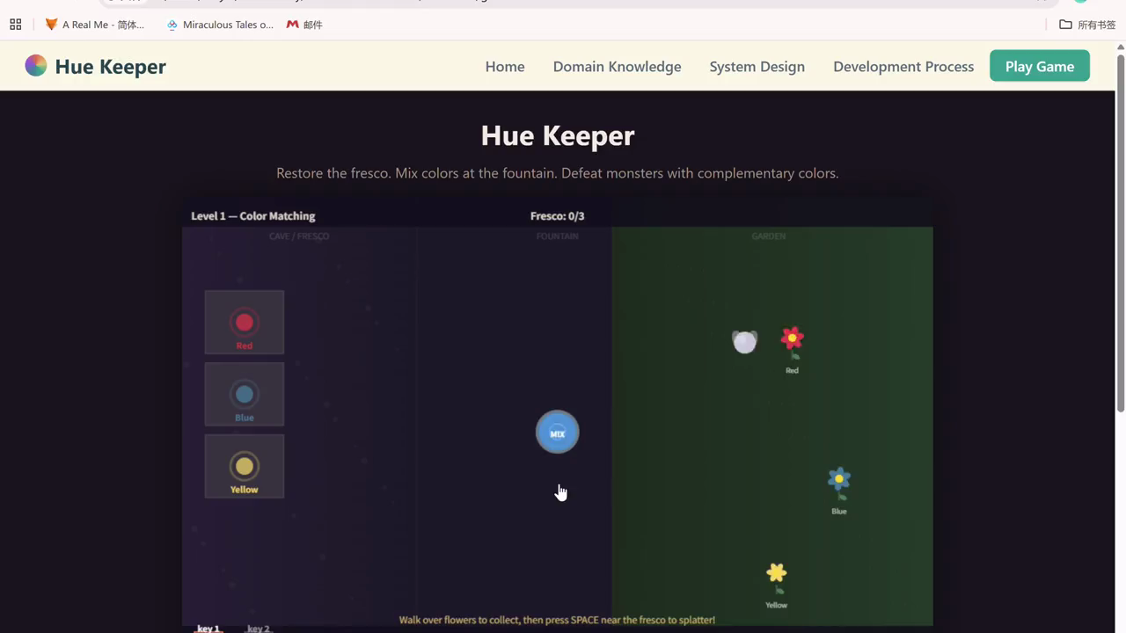
30 playable games, in two weeks, by zero-coding high-schoolers
▶ PLAYING IN SLIDE SHOW
12 works in 36 seconds
Skating · Rock climbing · Curling · Golf · Skiing · Cycling · Archery
Cello resonance · Granny square · First diagnosis · Virtual kitchen · Paper folding
Xingchen Zhang · NYU Shanghai · XJTLU 2026 · Panel 11
12 / 16
Notes:
This is the moment to stop talking. Thirty-six seconds, twelve works, drawn from this summer's high-school camp in Shanghai. Zero of these students had written a line of code before. Each picked a domain they actually knew — skating, climbing, curling, golf, archery, cello, crochet, first diagnosis, virtual kitchen, paper folding — and translated it into a playable system. Please watch, and remember what each game is trying to feel like.

Slide 10
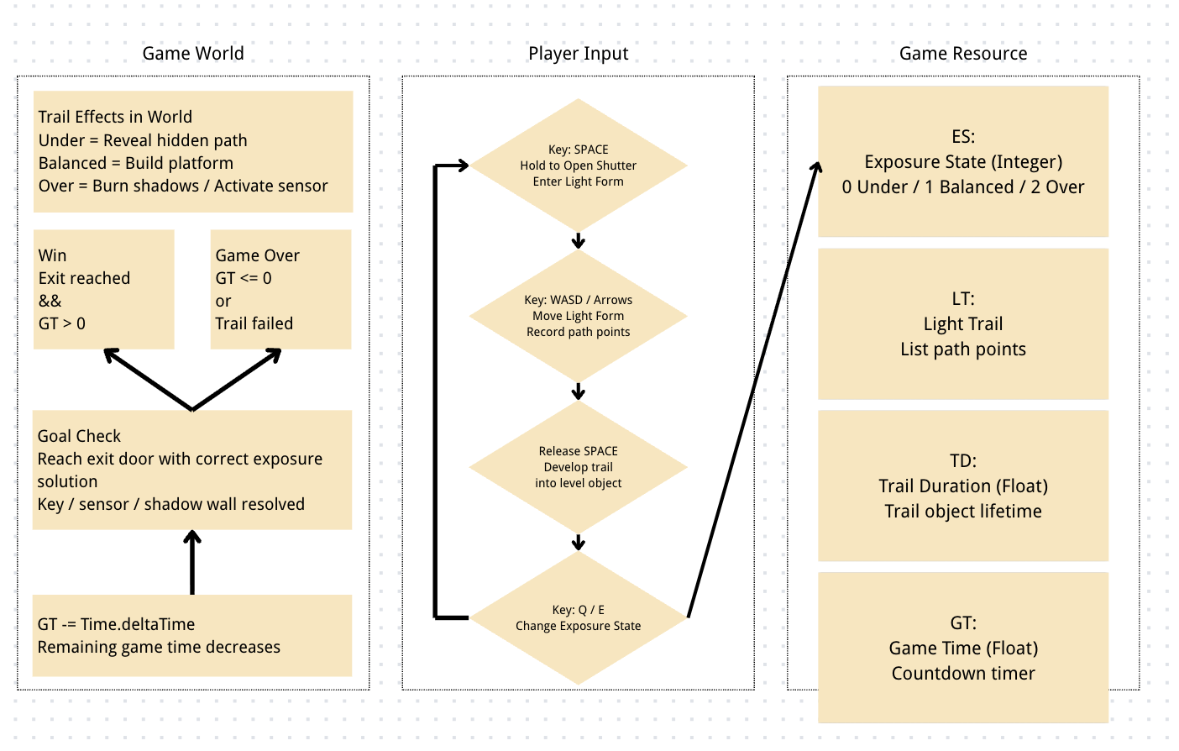
One student’s system description: The Darkroom
CASE
Boyan · NYU Summer 2026
LIVED EXPERIENCE
The frustration of a long-exposure photograph that comes back too dark, too bright, or too washed out to read.
DATA
ES (Exposure State) · LT (Light Trail) · TD (Trail Duration) · GT (Game Time)
BUILD + LOG
51 Unity scripts · 72 logged interactions
STUDENT DECISION
“The trail becomes a platform; overexposure makes the trail too unstable to use safely, but you can burn shadows to activate photo sensors.” — Boyan
Xingchen Zhang · NYU Shanghai · XJTLU 2026 · Panel 11
13 / 16
Notes:
The Darkroom, by Boyan. The lived experience is the frustration of a long-exposure photograph that comes back wrong. The data are four variables — Exposure State, Light Trail, Trail Duration, Game Time. The build has fifty-one Unity scripts, and the log records seventy-two interactions. The system graph on the left is the artifact I want to point to: it shows intent, data, and player input in one place, in language a human can read. That is the system description our pedagogy produces. The student quote at the bottom right is the kind of decision a chat history alone would never let us see.

Slide 11
Three things we saw
FINDINGS
It is feasible
F1
Zero-coding students can produce a playable demo in a few days that still expresses the original emotional target. The democratization of the demo is real — at least at the level of "a build that someone can play".
Verification is asymmetric
F2
AI can tell you whether the system runs. It cannot tell you whether the prototype still carries the feeling. That judgment lives with the student and with the log — and it is where a playtest loop and a human reader are indispensable.
F2 echoes CHI 2026 Best Paper (Väkevä et al.): resonance with lived experience is the strongest anchor of meaningful gameplay. Tools must serve that anchor, not bypass it.
Xingchen Zhang · NYU Shanghai · XJTLU 2026 · Panel 11
14 / 16
Notes:
Three findings. Feasible — zero-coding students can produce a playable demo in days. Asymmetric verification — AI can tell you the system runs, it cannot tell you the prototype still carries the feeling. That is the part where a playtest loop and a human reader are indispensable, and it echoes Väkevä and colleagues' CHI 2026 Best Paper argument that resonance with lived experience is the strongest anchor of meaningful gameplay. And learning happens in the experiment — at the cost of too many questions and not enough real-time feedback.

Slide 12
Where this is going
WHAT THE NEXT GENERATION OF TOOLS SHOULD ANSWER
TREND 1
Lower floor
Three trends are already underway. A fourth, more speculative one, may matter more for pedagogy than any of them.
Generation tools lower the bar to a playable demo. More people will try, and more will produce something.
A SHIFT WE SHOULD NAME
TREND 2
From "AI-assisted game making" to systematic expression as a literacy for the AI era.
A growing case library
Classrooms and indie teams leave a trail of system descriptions and process logs. The field gets a corpus to study.
When making a game is easy, the scarce skill is asking a precise question of an experience. Game design is a natural training ground — and a teachable, accountable one, if the workflow is structured for it.
TREND 3
Specialized, one-stop tools
Generic IDEs hit a ceiling on complete games.
Purpose-built engines — blueprint as source of truth, embedded playtest — are the natural next step.
Xingchen Zhang · NYU Shanghai · XJTLU 2026 · Panel 11
15 / 16
Notes:
Three trends. Lower floor to a playable demo. A growing case library of system descriptions and process logs. And a clear demand for specialized, one-stop tools — generic IDEs hit a ceiling on complete games. But the fourth shift is the one I would like to leave you with. From AI-assisted game making to systematic expression as a literacy for the AI era. When making a game is easy, the scarce skill is asking a precise question of an experience. Game design is a natural training ground, and a teachable, accountable one, if the workflow is structured for it.

Slide 13
TO CLOSE
When making a game becomes easy,
the hard part is knowing what you want players to feel.
AI can’t do that for you — but it can help you ask it clearly.
Xingchen Zhang · Interactive Media Arts · NYU Shanghai
xingchen.zhang@nyu.edu · xingchen-ian on GitHub
Thanks to the NYU Shanghai IMA students, the summer-camp teams, and the XJTLU organizers.
XJTLU 2026 · Panel 11 — Human-Guided AI Pedagogy
16 / 16
Notes:
When making a game becomes easy, the hard part is knowing what you want players to feel. AI cannot do that for you — but it can help you ask it clearly. Thank you. I am happy to take questions on the method, the data, the cases, or the next step.

Slide 14
"A game in one sentence" became a benchmark
In 2025–26, generating a playable game from a one-sentence prompt became a standard way to demonstrate model capability.
SINGLE-PASS GENERATION
0
Rosebud, Summer Engine, and chat-driven IDEs ship browser or desktop games from a short natural-language brief. Unity 7 will bundle a coding agent; UE 5.8 has experimental MCP. Industry surveys report broad adoption.
of 10,400 single-pass generations compiled
At a research university this is not just a product story. It is a teaching question: if a sentence can yield a running game, what are we asking our students to do?
without a fix loop, on a professional engine task
Source: arXiv:2607.10187 (2026)
Democratization of the demo is real. The next question is what survives the demo.
Xingchen Zhang · NYU Shanghai · XJTLU 2026 · Panel 11
04 / 16
Notes:
From late 2024 onward, generating a playable game from a one-sentence prompt has become a standard way to demonstrate model capability. Rosebud, Summer Engine, chat-driven IDEs, and the engine vendors themselves all lean in. GDC 2026 puts adoption over fifty percent. But the number on the right is a warning: zero of ten thousand four hundred single-pass generations compiled without a fix loop. Democratization of the demo is real — the question is what survives the demo.

Slide 15
It compiles. It runs. It is structurally vacuous.
THE EMPIRICAL DIAGNOSIS
F1 ≈ 0.12
80.4 → 5.7%
41.46%
+37.1 pt
mechanism fidelity of direct NL→C#
best coding agent, end-to-end benchmark
rubric gain with a GUI-agent playtester
runtime pass-rate cliff at project scale
Mage · arXiv:2605.07342
JAMER · arXiv:2606.19830
GameCraft-Bench · arXiv:2606.17861
Play2Code · arXiv:2605.28258
DATA → JUDGMENT
Compile rate and functional correctness are anti-correlated.
Failure lives in structure and architecture, not in syntax. The largest single proven gain comes not from better prompts but from putting a playtester in the loop.
Xingchen Zhang · NYU Shanghai · XJTLU 2026 · Panel 11
05 / 16
Notes:
Four numbers from four independent 2026 papers. The mechanism fidelity F1 of direct natural-language to C# is statistically indistinguishable from doing nothing — about 0.12. The runtime pass rate collapses from eighty percent on small projects to under six percent on real ones. The best coding agent on an end-to-end benchmark reaches forty-one percent. The single largest proven gain is not a better prompt — it is putting a GUI-agent playtester in the loop, plus thirty-seven points on the rubric. Failure lives in structure and architecture, not in syntax. This is the gap our pedagogy has to address.

Slide 16
What AI did, what was kept, what was rejected
ACCOUNTABILITY IN A DEVELOPMENT LOG
STUDENT REQUEST
AGENT RESPONSE
STUDENT DECISION
"Can you scaffold an obstacle spawner for the cart so the track is more dramatic?"
"Here is a Unity script that places obstacles at intervals along the path. The cart has a forward velocity and respawns after collision."
"I replaced the spawner with a prebuilt track. The cart moves forward; the player only reacts. This feels more like being carried by the coaster than driving it."
→
→
Student writes the request as a clear instruction, not a one-line prompt.
The student copies a short summary of what the agent produced — enough to recall later, no more.
This is where the emotional target meets the design choice. Without it, the AI’s output is just code.
WHAT THE LOG MAKES POSSIBLE
The log is not documentation. It is the trace that lets us answer the question the chat history cannot: when the prototype diverged from the original emotional target, whose decision was it?
In The Darkroom, this trail runs 72 times. In Coaster Carnage, it runs 4 sessions plus a reflection. The trail is the artifact we study, not the build alone.
Xingchen Zhang · NYU Shanghai · XJTLU 2026 · Panel 11
10 / 16
Notes:
Once AI is in the loop, the question becomes: who decided what? The development log records each interaction as a three-line trace: what the student asked for, a short summary of what the agent produced, and the student's decision — accepted, rejected, rewritten, and why. In The Darkroom, this trace runs seventy-two times. In Coaster Carnage, the student replaced the AI's obstacle spawner with a prebuilt track; the cart moves forward and the player only reacts. The student's reflection says explicitly that the new architecture felt more like being carried by the coaster than driving it. Without the log, that decision is invisible. With it, it is the artifact we study.

