Slide 1
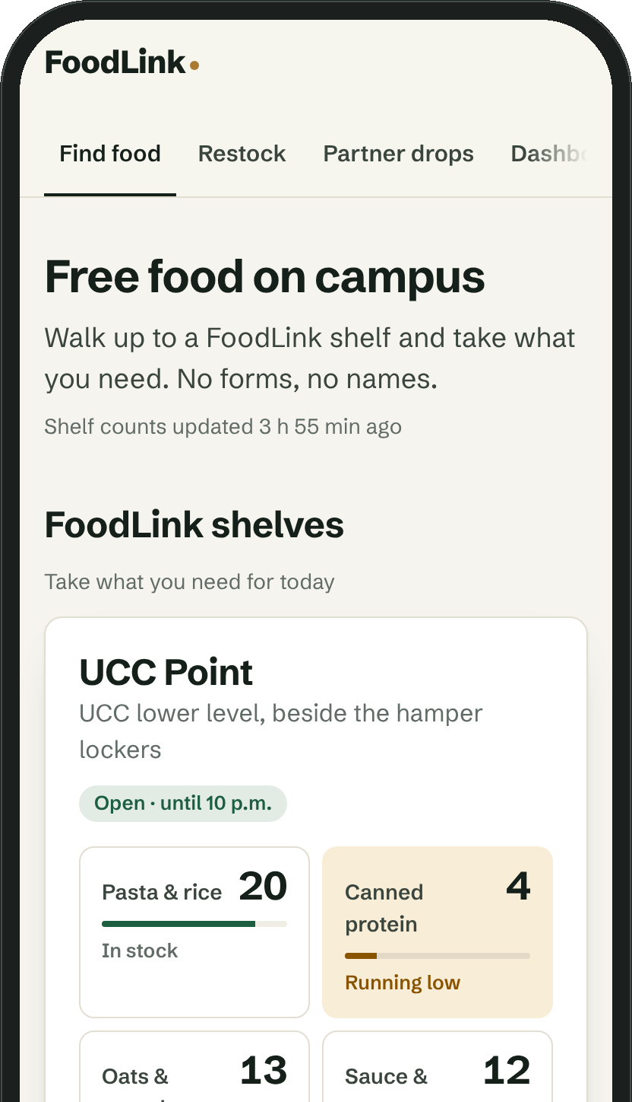
Prepared for Azaad Gill, VP Student Engagement, and the USC Executive Team
PBSN ASPIRE:
FoodLink
Bringing USC Food Support to where students already are.
Team
Xinge Xu (Zinger) · Nuo Zhang · Zohra Khawaja · Ahana Gehlot
Notes:
[0:00–0:10] Good afternoon. We’re Xinge, Nuo, Zohra and Ahana. We chose USC Food Support, and our plan is called FoodLink.

Slide 2
We recommend FoodLink to bring USC
Food Support to where students are
Initiative
Food Support Services. Need is broad, use is narrow, and the USC’s 2025–26 Roadmap already calls for raising awareness of it.
Root causes
Students don’t hear of it when they need it, can reach it 24 hours a week in one basement room, and see it as a last resort.
Plan
A FoodLink tab in USC Now, walk-up shelves co-run with faculty councils, and sealed surplus from The Spoke and The Wave.
Ask
An 11-week pilot, January to March 2027: $6,900, with $4,900 from the USC and the rest from councils and a sponsor.
Notes:
[0:10–0:30] Need for Food Support is broad but use is narrow, and the USC’s roadmap already calls for more awareness. FoodLink brings it to students: a USC Now tab, shelves co-run with faculty councils, and surplus from The Spoke and The Wave. We ask for an eleven-week, $6,900 pilot.

Slide 3
Food Support is under-engaged
relative to the need it serves
Hampers handed out by USC Food Support
40%
1,700+
of Canadian students skipped meals because of cost in 2024
1 in 5
750
TMU students used their food bank; 48.5% were food insecure
Priority
in the USC’s 2025–26 Roadmap: awareness of Food Support
2022–23
Sept 2023 – mid-March 2024
Full year
6.5 months
Sources: Global News, Mar 15, 2024; CASA, Walking the Tightrope, Mar 2025; The Eyeopener, Oct 27, 2026; Aspire 2026 case.
Notes:
[0:30–0:55] We chose Food Support because need is broad and use is narrow. Hamper demand more than doubled in 2023–24. Nationally, 40% of students skip meals because of cost; at TMU, half are food insecure but only one in five has used the food bank. And the USC’s roadmap already commits to raising awareness of Food Support.

Slide 4
Four root causes keep students
away from Food Support
Awareness
Access
First heard of at O-Week, amid overload
Its page says requests reopen Sept 2025
One basement room, 24 hours a week
Hampers take 48+ hours, via a locker
Relevance
Perception
Built for a week of groceries, not a lunch
Special requests often go unmet
TMU: 48.5% food insecure, 20% used it
A food bank feels like a last resort
Sources: Aspire 2026 case (Consideration 1); USC Food Support page, checked Oct 31, 2026; The Eyeopener, Oct 27, 2026.
Notes:
[0:55–1:25] We found four root causes. Awareness: students meet the USC at O-Week, when overload peaks, and the Food Support page still says requests reopen September 2025. Access: one basement room, 24 hours a week, and hampers take at least two days. Relevance: it’s built for a week of groceries, not a missed lunch. Perception: need goes unspoken.

Slide 5
The USC closed walk-ins in 2023
because they were hard to organize
“
FoodLink brings walk-up access back with the controls walk-ins lacked:
Walk-ins made it incredibly difficult to get food out in an organized way.
Counted restocks
Each check-in is logged.
Live stock
Seen before walking over.
One-tap reports
Empty shelf alerts a volunteer.
The USC, quoted in The Gazette, October 4, 2024
Safety checklist
Sealed, in date, no fridge.
Notes:
[1:25–1:40] One finding shaped our design: the USC closed walk-ins because they were hard to organize. So FoodLink brings walk-up access back with the controls walk-ins lacked: counted restocks, live stock, one-tap reports and a safety checklist.

Slide 6
FoodLink brings Food Support to
students in three ways
Find it
Bring it
Fuel it
A tab in USC Now with live stock, live drops and every food option.
Walk-up shelves in faculty and affiliate buildings, run with their councils.
Surplus from The Spoke, The Wave and catering, plus sponsored stock.
USC dashboard
Items taken, waste, restock time, surplus rescued, partners and volunteers. Published weekly.
Notes:
[1:40–2:05] FoodLink works in three ways. Find it: a tab in USC Now shows live stock, live drops and every option, so there is no new app. Bring it: walk-up shelves in faculty and affiliate buildings, co-run with their councils. Fuel it: sealed surplus from The Spoke, The Wave and catering. It all feeds one weekly dashboard.

Slide 7
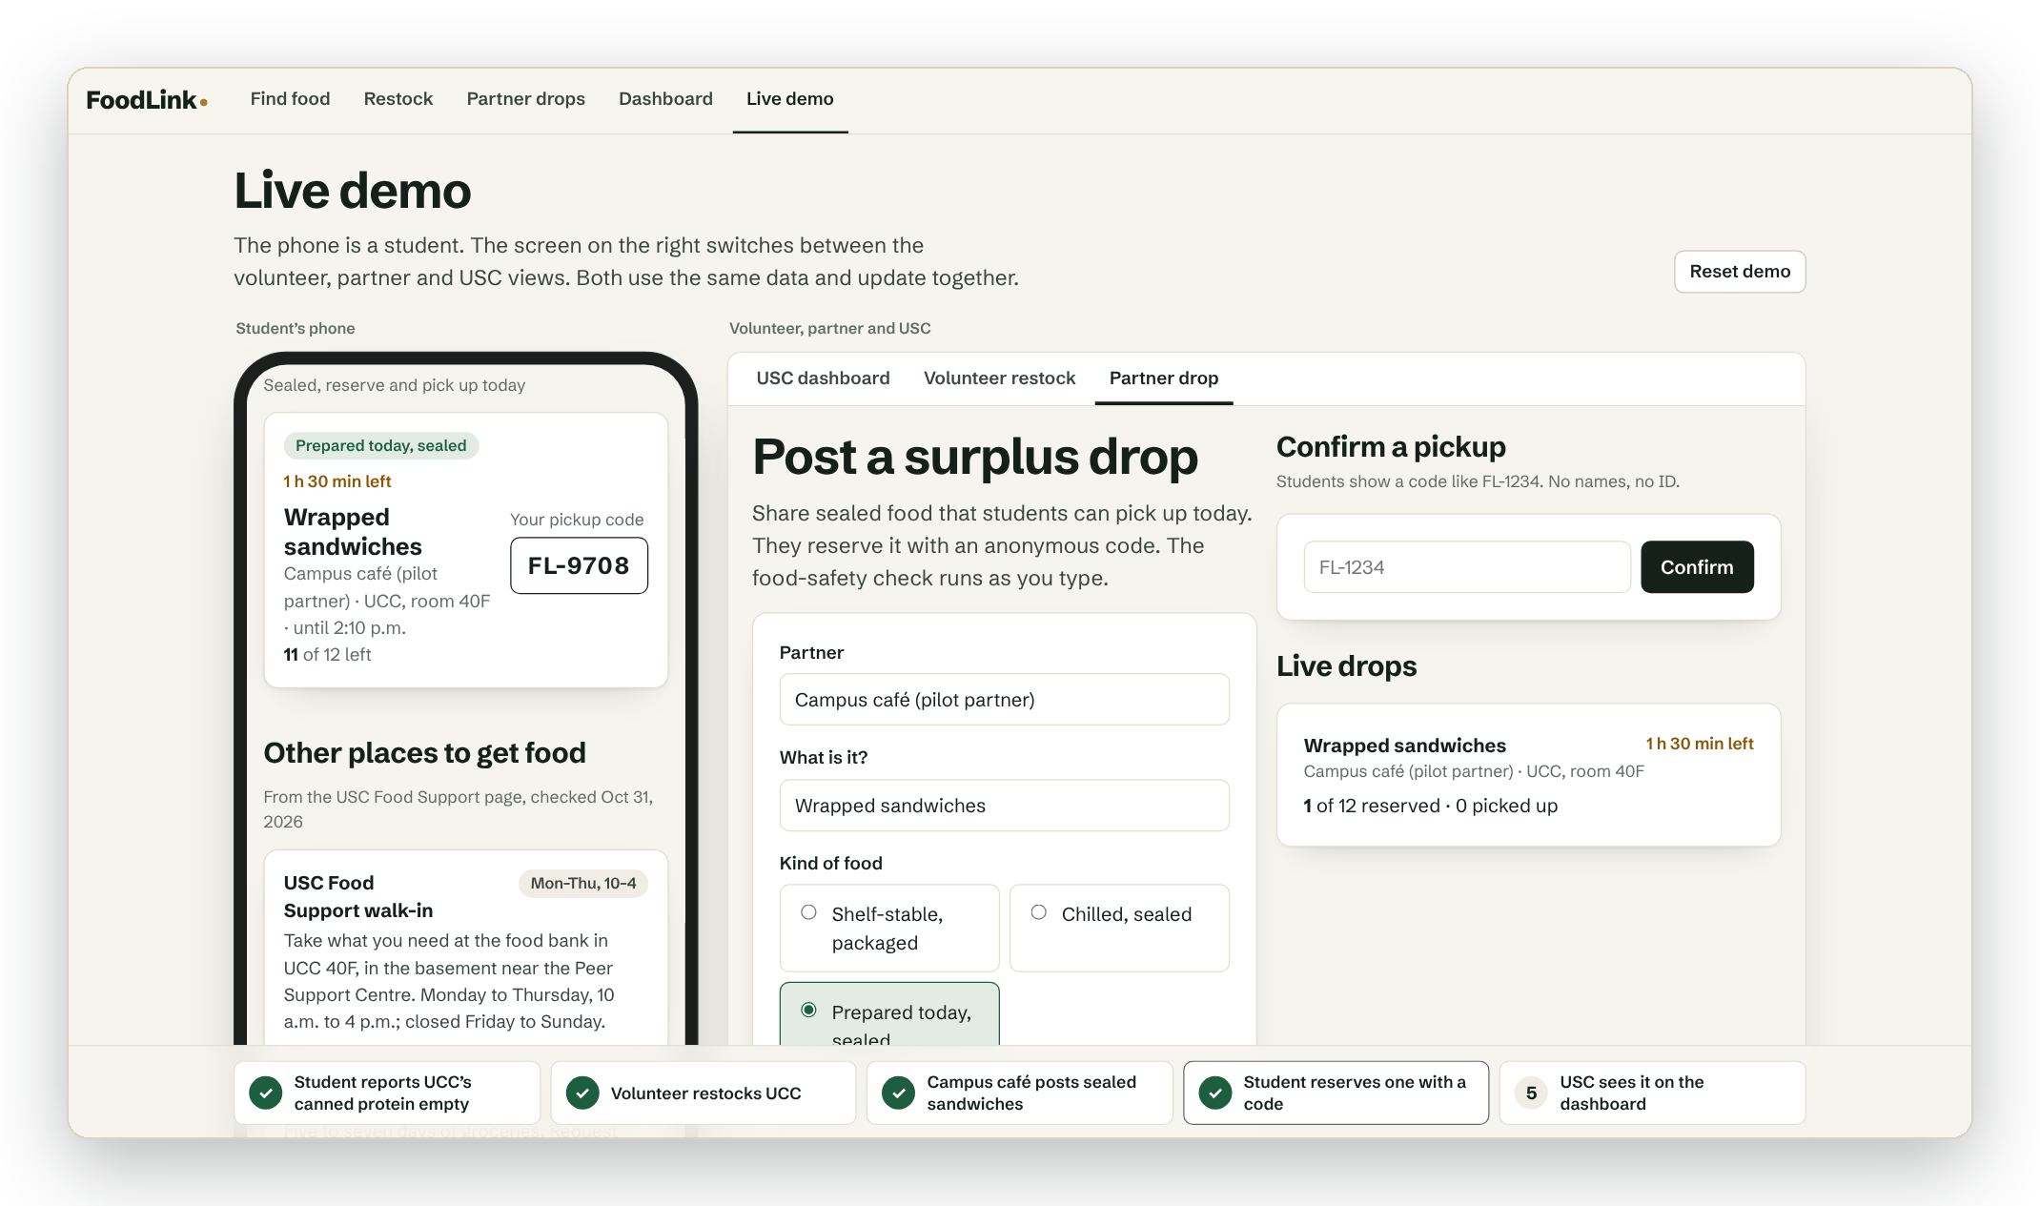
Live demo: a report, a restock and
a surplus drop, in real time
1
Student reports an empty shelf
2
Volunteer restocks it
3
Café posts sealed surplus
4
Student reserves with a code
5
USC dashboard updates
The app’s live demo page after step 4. Dashboard history is simulated.
Notes:
[2:05–3:20] LIVE DEMO, 75 seconds. Open the app’s Live demo page and press Reset demo first. The phone is what the FoodLink tab in USC Now would show. Step 1: a student reports the UCC canned protein empty, with no login. Step 2: a volunteer logs a restock; the phone updates and the dashboard records what was taken. Step 3: a café posts twelve sealed sandwiches; imagine The Wave’s catering leftovers. The app checks the food-safety rules first. Step 4: the student reserves one with an anonymous code. Step 5: switch to USC dashboard; every number we just created is there, on top of simulated history. If the network fails, narrate the steps from this screenshot.

Slide 8
Where campus food is walk-up,
students use it
5,263
Hours
200
door openings in one school year at anonymous, unstaffed pantries at Virginia Commonwealth University. Vandalism was rare.
for a week’s stock to run out at the University of Alberta’s walk-up pantry. Its food bank had a six-week waitlist.
students a week, at peak, came to Laurier’s free weekly food distribution in 2023–24.
Jones et al., JAFSCD, 2024 (corrected 2025)
The Gateway, May 3, 2024
LSPIRG, Year in Review 2023–2024
What we take from it: put shelves where students already go, line up supply before launch, and measure Western’s own use from day one. We have no Western usage data yet; the pilot produces it.
Notes:
[3:20–3:40] Will students use it? We have no Western data yet, so here is the closest evidence. Anonymous pantries at VCU were opened over five thousand times in a year with little misuse. Alberta’s walk-up pantry emptied in hours. Laurier’s free weekly distribution drew up to 200 students a week.

Slide 9
Students find FoodLink through people
and places they already trust
Community | Messenger | What they do
Faculty and affiliate councils | Council reps | Host a shelf in their building and keep it stocked
Residences | Sophs and dons | Show FoodLink at floor meetings; QR codes on floor boards
Clubs (240+, reaching 17,000) | Club executives | Post event leftovers as drops; adopt a shelf
Online | USC Now, Hype Team | Push live drops during exam weeks and late nights
First-years | Sophs at O-Week 2027 | One FoodLink minute in every soph group
Moments that matter: exam weeks, late nights and weekends, when the UCC room is closed. That is when FoodLink speaks up.
Notes:
[3:40–4:05] For awareness we use messengers students already trust, as the case suggests. Council reps host shelves in their buildings. Sophs and dons show FoodLink on residence floors. Club executives post event leftovers as drops. And USC Now pushes live drops at the moments that matter: exam weeks, late nights and weekends.

Slide 10
USC businesses already reach students
every day; FoodLink puts them to work
USC unit | What it contributes | Cost to the USC
The Spoke ($4.3M revenue) | Sealed surplus as drops; QR on tables; the largest student employer spreads the word | Packaging only
The Wave and catering ($1.9M) | Event and catering leftovers posted as drops | None
UCC tenants: grocery, pharmacy | Sponsor shelf stock and hygiene items | Adds sponsor revenue
Purple Store | A FoodLink tote, so carrying food looks like shopping | Sponsor-funded
O-Week, PurpleFest, Productions | Launch moments that reach every first-year | Existing budgets
Free the Dot | Period products on every FoodLink shelf | Existing program
Revenue: USC 2026–27 budget (Aspire 2026 case, Exhibit 4). Each contribution is a proposal to agree with that unit.
Notes:
[4:05–4:30] The USC’s businesses are its most frequent contact with students, so we put them to work. The Spoke and The Wave post sealed surplus as drops instead of wasting it. UCC tenants sponsor stock. A Purple Store tote makes carrying food look like shopping. O-Week and PurpleFest give launch moments, and Free the Dot stocks period products.

Slide 11
FoodLink adds engagement instead of
moving it between USC services
Complements hampers
Shelves cover today; hampers cover the week. The app links to both, and we track hamper requests so they don’t fall.
One front door
A tab in USC Now, not another app. It lists USC, Western and city options so students pick the right one.
Lifts other services
Every shelf and the app point to the Peer Support Centre and Free the Dot.
Builds participation
Volunteers come from clubs and councils. With 16 of 51 Council seats vacant, they are the USC’s next candidates.
Council data: Aspire 2026 case (16 of 51 faculty and affiliate seats vacant in October 2026; 24.6% election turnout in February 2026).
Notes:
[4:30–4:55] The case warns about a crowded campus, so FoodLink adds engagement instead of moving it. Shelves cover today and hampers cover the week, and we track hamper requests. It’s one front door inside USC Now. Every shelf points to Peer Support and Free the Dot. And with 16 Council seats vacant, our volunteers are the USC’s next candidates.

Slide 12
The 11-week pilot costs $6,900: under
20 cents per undergraduate
Pilot costs
Coordinator (part-time)
$3,000
Who pays for it
Shelving and signs
$1,100
Student Life budget: $4,900
Food stock
$1,050
The Student Life fee funds all USC programs.
Contingency
$600
Host councils: $1,000
Promotion
$500
$500 each, from their council grant.
Hygiene items
$400
UCC tenant sponsor: $1,000
Volunteer training
$200
Shelf stock and hygiene items, to be agreed.
Hosting
$50
In kind
Total
$6,900
Surplus food from The Spoke and The Wave.
Case Exhibits 1–2. Coordinator: about a third of the $9,000 role the USC funds for Public Arts and for EnviroUSC. Other amounts are our estimates.
Notes:
[4:55–5:20] The pilot costs $6,900 for eleven weeks, under 20 cents per undergraduate. The biggest line is a part-time coordinator, priced at a third of the USC’s own $9,000 coordinator roles. The Student Life budget covers $4,900; host councils and a UCC tenant sponsor cover the rest, and the food from The Spoke and The Wave is surplus.

Slide 13
We will measure engagement, not just
food handed out
Goal | Metric | Pilot target
Awareness | Know how to get food support (USC Now poll) | +15 points over January
Reach | Items taken from shelves; surplus portions rescued | 1,000 items; 150 portions
Embedding | Councils, clubs and USC units taking part | 2 councils, 10 clubs, 3 units
Participation | Volunteers recruited; feedback sent through USC Now | 30 volunteers; 100 responses
No shifting | Hamper requests compared with last winter | Not lower
Safety | Waste; time to restock; incidents | Under 5%; under 2 h; zero
Decision rule: at week 11, expand if five of the six goals are met. Safety must be one of the five.
Notes:
[5:20–5:45] We will measure engagement, not just food. Awareness from a USC Now poll, aiming fifteen points above January. A thousand items and 150 surplus portions. Two councils, ten clubs, three USC units. Thirty volunteers. Hamper requests must not fall, and safety incidents stay at zero. At week eleven we expand if five of six goals are met.

Slide 14
Approve in November, pilot in winter,
launch at scale in O-Week 2027
Nov
Dec
Jan
Feb
Mar
Apr
Sep 2027
Set up
Approval, partners, USC Now tab
Quick win
Exam-season drops; baseline poll
Pilot
Two shelves and weekly dashboard
Decide
Review, report, handover
Scale
Every first-year at O-Week
Next 30 days: name an owner · confirm two host councils · agree surplus rules with The Spoke and The Wave · add the FoodLink tab to USC Now
Notes:
[5:45–6:10] In November we get approval, sign partners and add the USC Now tab. In December’s exams, surplus drops are a quick win, and we take a baseline poll. The pilot runs January to March. In April we report to Council and hand over to next year’s team, and if it works, every first-year meets FoodLink at O-Week 2027.

Slide 15
Each of the main risks has a control
built into the plan
Risk | Control
Turnover every year | Councils own their shelves, the coordinator role carries over, and the app keeps every count and the playbook.
Shifting, not growing | Shelves link to hampers; hamper requests are tracked weekly and must not fall.
Food safety | Sealed, shelf-stable items on shelves; perishables only as drops, picked up within two hours.
Stigma | No names or accounts; shelves sit in busy, neutral spots; the tote looks like shopping.
No host building | Start at the UCC; Weldon needs Western Libraries’ approval.
One person empties a shelf | A posted guide, two restocks a day, and live counts that show rushes.
Notes:
[6:10–6:30] The biggest risk is turnover, so councils own their shelves, the coordinator role carries over, and the app keeps the records and the playbook. If FoodLink only shifted students from hampers, the weekly numbers would show it. Food safety, stigma and site approval each have a control too.

Slide 16
Our ask: approve the FoodLink pilot
$4,900
2
11
from the USC Student Life budget
host councils for the first shelves
weeks, January to March 2027
FoodLink keeps everything Food Support does today and brings it to where students already are. The app is already built.
Thank you. We’re happy to take questions.
Xinge Xu (Zinger) · Nuo Zhang · Zohra Khawaja · Ahana Gehlot
Notes:
[6:30–7:00] Our ask: approve an eleven-week pilot with $4,900 from the Student Life budget, two host councils, and introductions to The Spoke, The Wave and a UCC tenant. FoodLink keeps everything Food Support does today and brings it to where students already are, and the app is already built. Thank you; we’re happy to take questions.

Slide 17
A1. SWOT analysis
Strengths
Weaknesses
Built and working today
Anonymous, walk-up access
Runs on USC assets already paid for
Measures itself at every check-in
Shelf-stable food only on shelves
Depends on volunteers
No per-person limit
No Western usage data yet
Opportunities
Threats
USC Now overhaul already planned
O-Week 2027 reaches every first-year
Surplus from USC hospitality
Same model for CoatCycle or Peer Support
A food-safety incident
Turnover every year
Stigma if shelves are badly placed
A host building says no
Notes:
Appendix. SWOT, if a judge asks for it.

Slide 18
A2. How access to Food Support
changed, 2023 to 2026
Sept 2023
Walk-ins closed after demand rose 600%.
Oct 2024
Hamper-only. 40 volunteers were replaced by six part-time staff.
Feb 2025
The proposed USC budget dropped the Food Support Coordinator.
Oct 2026
The USC page lists walk-in hours in UCC 40F, Mon–Thu, 10 to 4, and still says requests reopen Sept 8, 2025.
Today
Otherwise: an online form, at least 48 hours, and a locker.
Sources: The Gazette, Oct 4, 2024 and Feb 2025; USC Food Support page, checked Oct 31, 2026.
Notes:
Appendix. How access narrowed, if asked.

Slide 19
A3. Sources
Aspire 2026 case and exhibits
Jones et al., JAFSCD 2024; corrected 2025
USC fees, 2026–27 budget, FY2024 statements, Roadmap, election data.
Anonymous pantries at VCU: 5,263 door openings in 2022–23.
Global News, Mar 15, 2024
The Gateway, May 3, 2024
1,700+ hampers since Sept 2023; about 750 in all of 2022–23.
U of Alberta: walk-up pantry empty in hours; six-week waitlist.
The Gazette, Oct 4, 2024
LSPIRG, Year in Review 2023–2024
Walk-ins closed Sept 2023 after a 600% rise; “incredibly difficult.”
Laurier’s free weekly food distribution: up to 200 students a week.
The Gazette, Feb 2025
Western News, Oct 25, 2024
Proposed 2025–26 budget drops the Food Support Coordinator role.
Campus dining gave 7,500+ surplus meals to 19 off-campus agencies.
USC Food Support page, Oct 31, 2026
Donation of Food Act, 1994 (Ontario)
Mon–Thu 10–4, UCC 40F; hampers “as soon as 48 hours”; donations only.
Donors are liable only for unfit food given with intent or recklessness.
CASA, Walking the Tightrope, Mar 2025
Western Libraries, Weldon Displays Policy
Abacus Data, 1,500 students, May 2024: 40% skipped meals for cost.
Displays in Weldon are selected and authorized by Western Libraries.
The Eyeopener, Oct 27, 2026
TMU: 48.5% food insecure; 20% had visited the food bank.
Notes:
Appendix. Use only if a judge asks where a number came from.

Slide 20
A4. Budget assumptions
Line | Amount | Basis
Coordinator (part-time) | $3,000 | About a third of the $9,000 coordinator role the USC funds for Public Arts.
Shelving and signs | $1,100 | Two lockable shelving units (about $400 each), bins, signs and QR codes.
Food stock | $1,050 | About 420 shelf-stable items at $2.50, bought after approval.
Contingency | $600 | About 10% of the other lines.
Promotion | $500 | Table tents, posters, QR stickers and messenger kits.
Hygiene items | $400 | Soap and toothpaste; period products come from Free the Dot.
Volunteer training | $200 | Online food-handler certification for six volunteers.
Hosting | $50 | Free hosting tier and a domain; the app sits inside USC Now.
Full year, six shelves | ~$25,000 | Full coordinator; four more shelves; stock and hygiene at pilot rates for 26 weeks; plus 10%. Under 70 cents a student.
Council ($500 each) and sponsor ($1,000) amounts are targets to confirm. Surplus food from USC hospitality is in kind.
Notes:
Appendix. Bases for each budget line.

Slide 21
A5. Options we ruled out
Option | What it offers | Why not on its own
Bigger O-Week push for hampers | Reaches every first-year | Lands when information overload peaks; nothing at the moment of need.
Longer hours at UCC 40F | Familiar, staffed | Still one basement room, and every extra hour needs paid staff.
A standalone FoodLink app | Full control | One more app to download. FoodLink lives inside USC Now instead.
Community fridge | Fresh food | Needs temperature logs and public-health rules. A phase-two option.
Too Good To Go | Cheap surplus bags | Costs students money and is mostly off campus.
Notes:
Appendix. Why not something simpler.

Slide 22
A6. Questions we expect
Why Food Support and not Peer Support?
Isn’t this just walk-ins again?
The USC’s roadmap names it, its need is measurable, and the fix is visible. FoodLink also points students to Peer Support.
Walk-up access with counted restocks and live stock: the controls the USC said walk-ins lacked.
Won’t shelves pull students from hampers?
Who runs it when this year’s team leaves?
Shelves cover today and hampers cover the week; the app links to both. Hamper requests are tracked and must not fall.
Host councils own their shelves, the coordinator role carries over, and the app keeps the counts and the playbook.
Why not a separate app?
What stops one person emptying a shelf?
Students won’t download another app. FoodLink is a tab in USC Now, which the roadmap already plans to overhaul.
A posted guide, two restocks a day, and live counts that show rushes so stock can move.
Is giving out surplus food safe and legal?
What happens after week 11?
Sealed, labelled, in-date food only, checked in the app. Ontario’s Donation of Food Act protects good-faith donors.
If five of six goals are met, add shelves and launch at O-Week 2027. If not, stop and publish what we learned.
Notes:
Appendix. Short answers for Q&A.

