Slide 1

Hadoop与数据分析
淘宝数据平台及产品部基础研发组 周敏
日期：2010-05-26

Slide 2
Outline
Hadoop基本概念
Hadoop的应用范围
Hadoop底层实现原理
Hive与数据分析
Hadoop集群管理
典型的Hadoop离线分析系统架构
常见问题及解决方案

Slide 3

关于打扑克的哲学

Slide 4
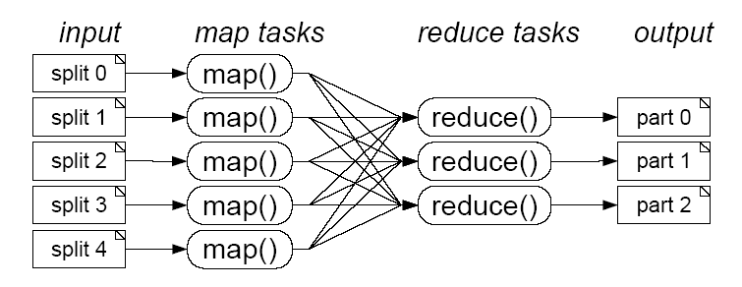
打扑克与MapReduce
分牌
各自齐牌
再次理牌
搞定
交换
Input split
shuffle
output

Slide 5
统计单词数
the 1
weather 1
is 1
good 1
a 1
The weather
is good
good 1
good 1
good 1
good 1
good 1
a 1
good 5
today 1
is 1
good 1
Today
is good
guy 1
guy 1
is 1
is 1
is 1
is 1
is 4
this 1
guy 1
is 1
a 1
good 1
man 1
man 2
This guy
is a good man
the 1
man 1
man 1
this 1
the 1
today 1
good 1
man 1
is 1
good 1
this 1
Good man
is good
weather 1
today 1
weather 1

Slide 6
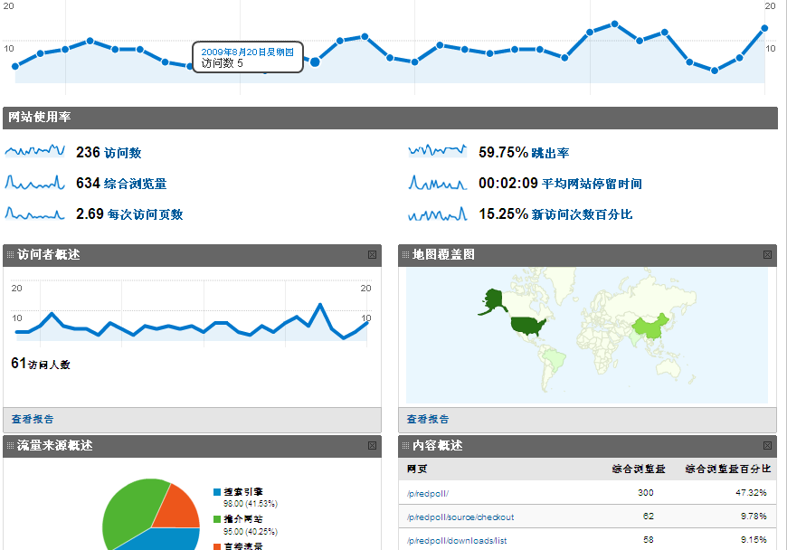
流量计算

Slide 7

趋势分析
http://www.trendingtopics.org/截图

Slide 8

用户推荐

Slide 9
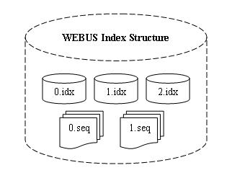
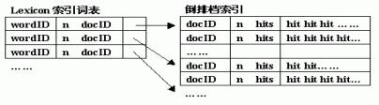
分布式索引

Slide 10



Hadoop生态系统
Hadoop 核心
  Hadoop Common
  分布式文件系统HDFS
  MapReduce框架
并行数据分析语言Pig
列存储NoSQL数据库 Hbase
分布式协调器Zookeeper
数据仓库Hive(使用SQL)
Hadoop日志分析工具Chukwa

Slide 11
Hadoop实现
Hadoop Cluster
Data
Data data data data data
Data data data data data
Data data data data data
Data data data data data
Data data data data data
Data data data data data
Data data data data data
Data data data data data
Data data data data data
Data data data data data
Data data data data data
Data data data data data
DFS Block 1
DFS Block 1
DFS Block 1
Results
Data data data data
Data data data data
Data data data data
Data data data data
Data data data data
Data data data data
Data data data data
Data data data data
Data data data data
MAP
DFS Block 2
DFS Block 2
MAP
Reduce
DFS Block 2
MAP
DFS Block 3
DFS Block 3
DFS Block 3

Slide 12
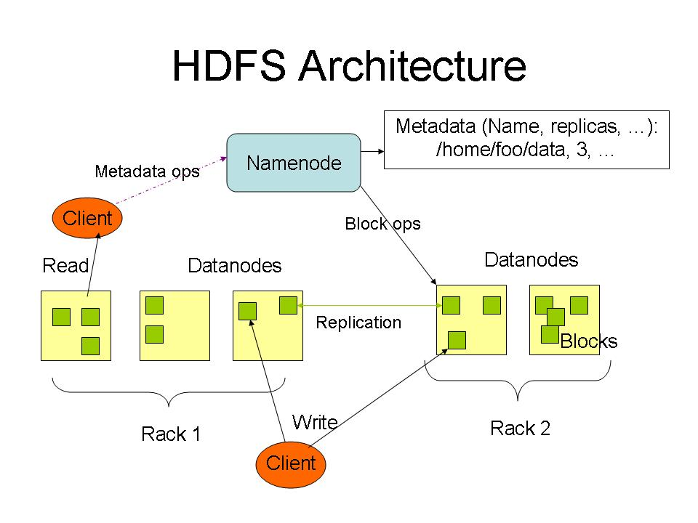

Slide 13
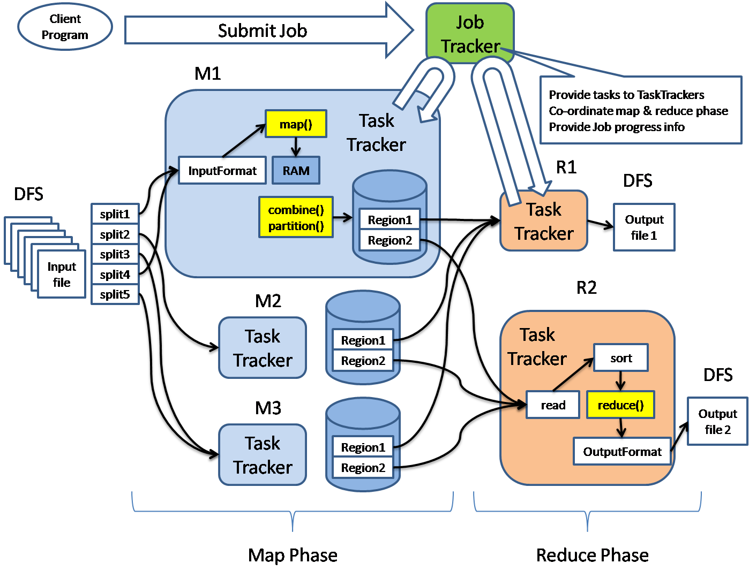
作业执行流程

Slide 14
Hadoop案例(1)
// MapClass1中的map方法
public void map(LongWritable Key, Text value, OutputCollector<Text, Text> output, Reporter reporter) throws IOException {
String strLine = value.toString();
String[] strList = strLine.split("\"");
String mid = strList[3];
String sid = strList[4];
String timestr = strList[0];
try{
timestr = timestr.substring(0,10);
}catch(Exception e){return;}
timestr += "0000";
// 省略数十行
output.collect(new Text(mid + “\”” + “sid\”” + timestr , ...);
}

Slide 15
Hadoop案例(2)
public static class Reducer1 extends MapReduceBase implements Reducer<Text, Text, Text, Text> {
private Text word = new Text();
private Text str = new Text();
public void reduce(Text key, Iterator<Text> values,
OutputCollector<Text, Text> output,
Reporter reporter) throws IOException {
String[] t = key.toString().split("\"");
word.set(t[0]);//
str.set(t[1]);
output.collect(word,str);//uid kind
}//reduce
}//Reduce0b

Slide 16
Hadoop案例(3)
public static class MapClass2 extends MapReduceBase implements Mapper<LongWritable, Text, Text, Text> {
private Text word = new Text();
private Text str = new Text();
public void map(LongWritable Key, Text value, OutputCollector<Text, Text> output, Reporter reporter) throws IOException
{
String strLine = value.toString();
String[] strList = strLine.split("\\s+");
word.set(strList[0]);
str.set(strList[1]);
output.collect(word,str);
}
}

Slide 17
Hadoop案例(4)
public static class Reducer2 extends MapReduceBase implements Reducer<Text, Text, Text, Text> {
private Text word = new Text();
private Text str = new Text();
public void reduce(Text key, Iterator<Text> values,
OutputCollector<Text, Text> output,
Reporter reporter) throws IOException {
while(values.hasNext()) {
String t = values.next().toString();
// 省略数十行代码
}
// 省略数十行代码
output.collect(new Text(mid + “\”” + sid + “\””) + ...., ...)
}

Slide 18
Thinking in MapReduce(1)
A
A
B
C
Filter
Co-group
A
B
D
Group
Filter
B
C
D
Function
C
Aggregate

Slide 19
Thinking in MapReduce(2)

Slide 20
Hive的魔力
Magics of Hive:
SELECT COUNT(DISTINCT mid) FROM log_table

Slide 21
为什么淘宝采用Hadoop?
webalizer awstat 般若
Atpanel时代
  日志最高达250GB/天
  最高达约50道作业
  每天运行20小时以上
Hadoop时代
  当前日志470GB/天
  当前366道作业
  平均6~7小时完成

Slide 22
还有谁在用Hadoop?
雅虎北京全球软件研发中心
中国移动研究院
英特尔研究院
金山软件
百度
腾讯
新浪
搜狐
IBM
Facebook
Amazon
Yahoo!

Slide 23



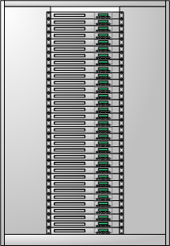


Web站点的典型Hadoop架构
Web Servers
Log Collection Servers
Filers
Data Warehousing on
a Cluster
Oracle RAC
Federated MySQL

Slide 24
淘宝Hadoop与Hive的使用
Scheduler
Thrift
Server
Rich Client
Client
Program
Hadoop
CLI/GUI
Web
Server
MetaStore
Server
Web
Mysql
JobClient

Slide 25
调试
标准输出,标准出错
Web显示(50030, 50060, 50070)
NameNode,JobTracker, DataNode, TaskTracker日志
本地重现: Local Runner
DistributedCache中放入调试代码

Slide 26
Profiling
目的：查性能瓶颈，内存泄漏，线程死锁等
工具： jmap, jstat, hprof,jconsole, jprofiler mat,jstack
对JobTracker的Profile
对各slave节点TaskTracker的Profile
对各slave节点某Child进程的Profile(可能存在单点执行速度过慢)

Slide 27
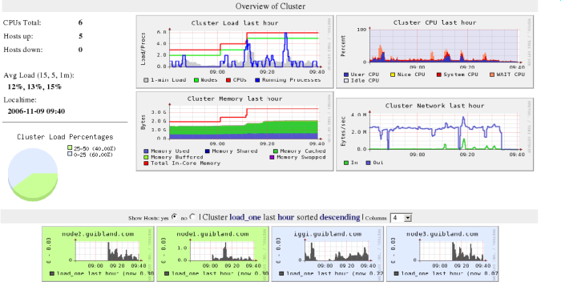
监控
目的：监控集群或单个节点I/O, 内存及CPU
工具： Ganglia

Slide 28

如何减少数据搬动?

Slide 29

数据倾斜

Slide 30


