Slide 1

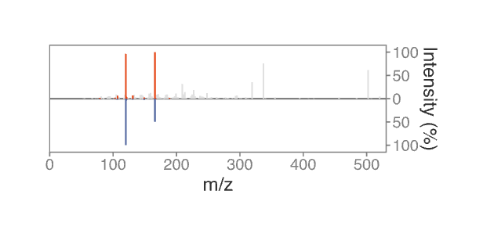

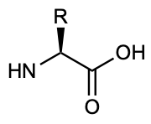
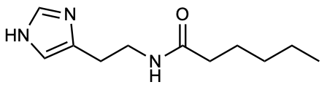
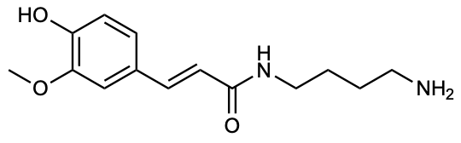
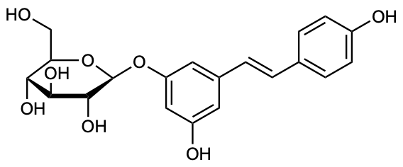
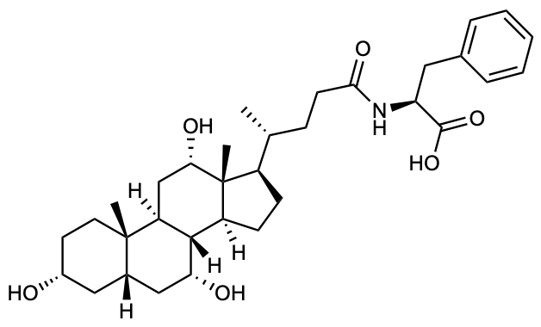
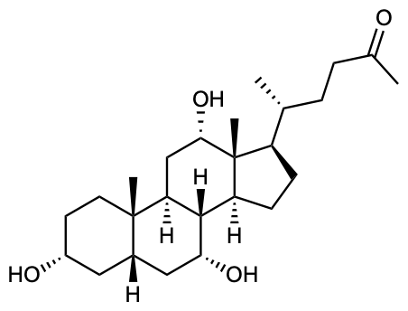

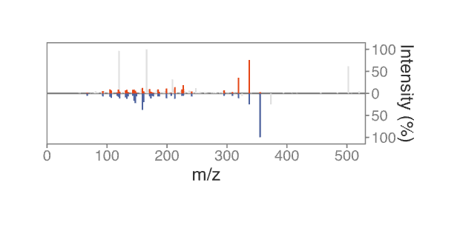
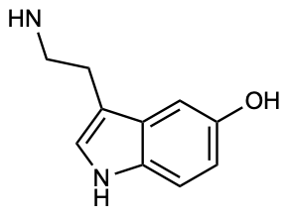
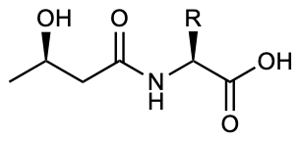

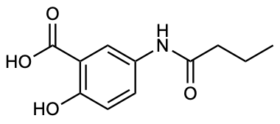

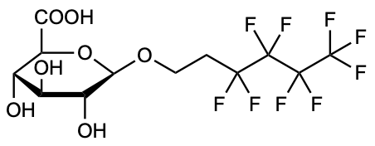


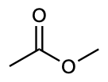



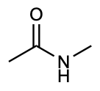

a
N-acyl lipids
Feruloyl-putrescine
Polydatin
b
Bile acid conjugates
Phenylalanine
Rev. cos 0.93
BHB-amino acids
N-butyryl-5-ASA
4:2 FTOH glucuronide
Cholyl-phenylalanine
Cholic acid
Rev. cos 0.81
c
1.32 billion public MS/MS spectra
MS/MS quality control
539,204,333 curated high-resolution MS/MS
MS/MS clustering
149,945,326
MS/MS clusters
Conjugate search
24,227,439
annotated MS/MS
3,340 LC-MS/MS metabolomics datasets
…
This is an example main figure. All texts should be in Arial.
Fig. 1 | XXXX. a, XXXXXXX. b, XXXXXXX. c, XXXXXXX.

Slide 2
Fig. 2 | XXXX. a, XXXXXXX. b, XXXXXXX. c, XXXXXXX.

Slide 3
Supplementary Figures
Supplementary Fig. 1 | XXXXxx.

Slide 4
Supplementary Fig. 2 | XXXXxx.

