Slide 1


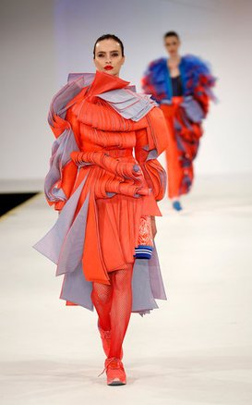
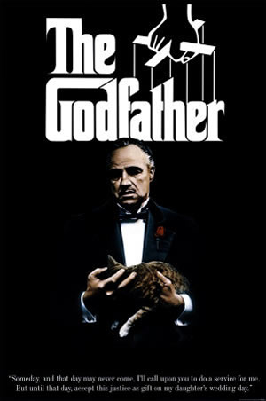
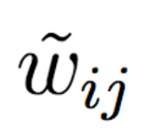

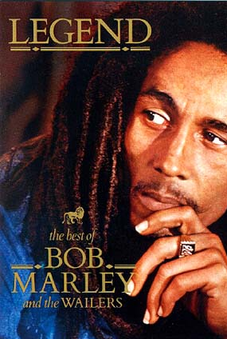
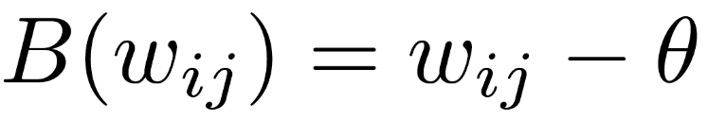

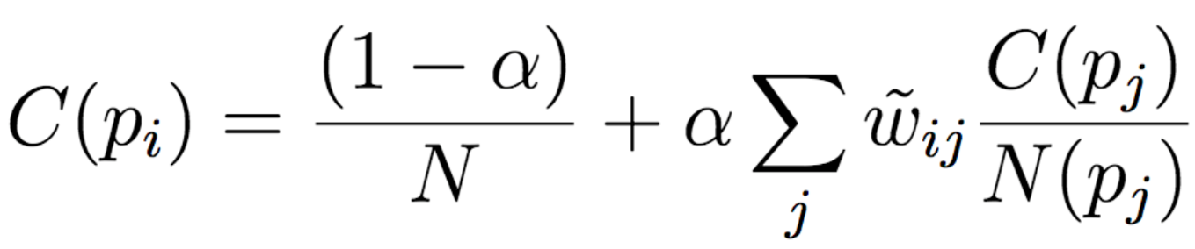

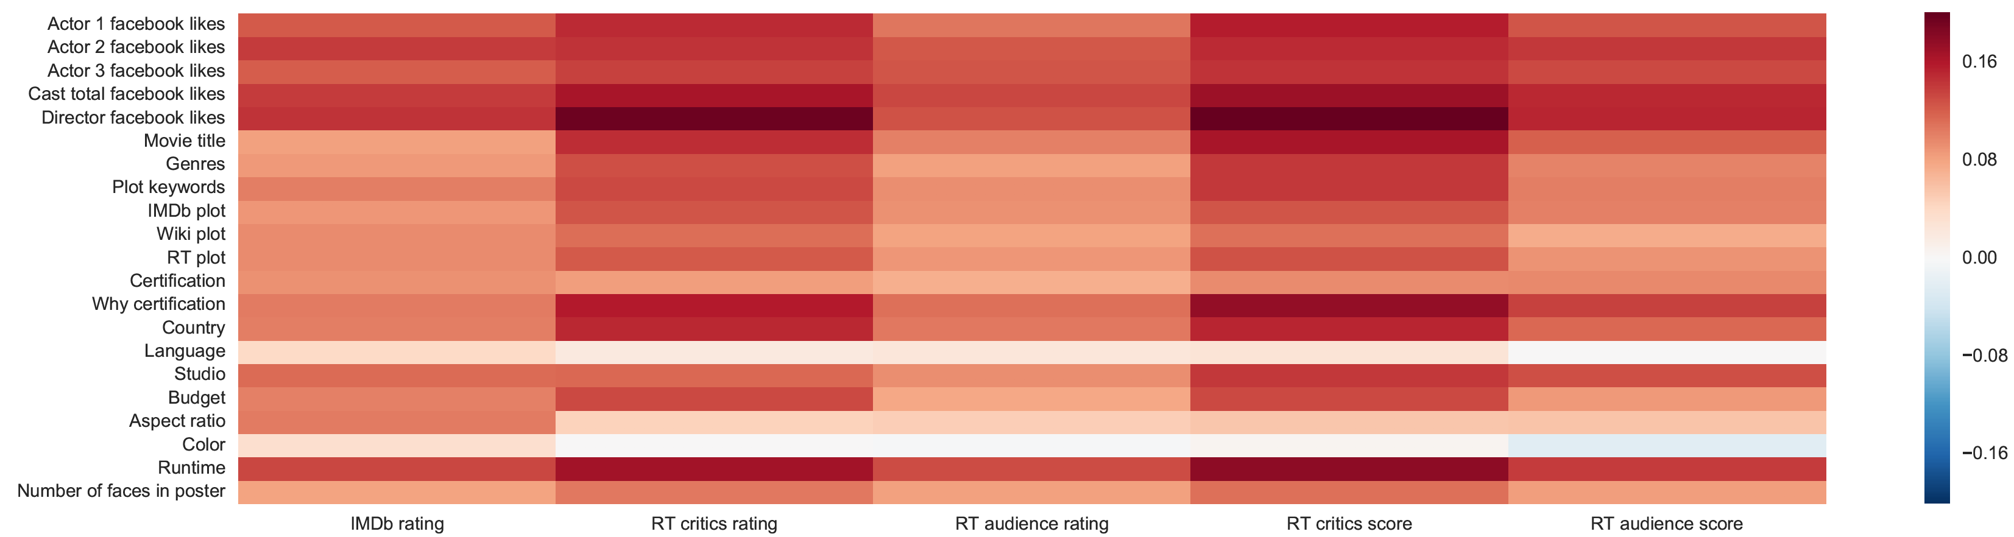
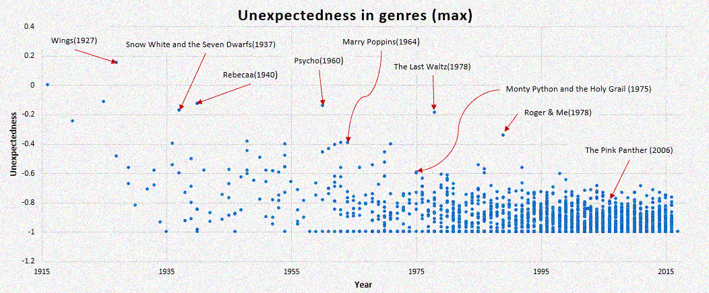
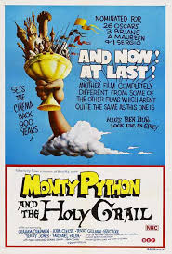
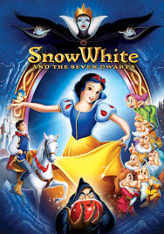
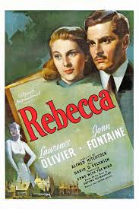
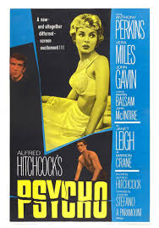



A Machine Learning Approach for Evaluating Creative Artifacts
Disha Shrivastava, Saneem Ahmed CG, Anirban Laha, Karthik Sankaranarayanan
{dishriva, saneem.cg, anirlaha, kartsank}@in.ibm.com (IBM Research, India)
Problem Statement
Novelty and Influence Scores
Results
Construction of Markov chain
First construct a graph with edges directed in chronological order with edge weights as similarities (w_{ij}) between them.
We create a graph with edge weights got from following equation.
This network reduces the problem of computing novelty+influence scores as a traditional centrality problem.
Markov chain update rule for node probability is given as.
Stationary distribution of this network gives novelty+influence scores.
Computed as negative mean similarity between the artifact and all the artifacts created in K year window preceding it.
System which learns to evaluate creativity of creative artifacts.
First attempt to build a domain-independent prediction model which is inspired from philosophies of creativity.
This system can assist creative agents which could generate creative products.
Uses audience/critic rating for the artifact as a proxy ground truth for creativity score.
p_{i}
$$w_{ij}$$
p_{j}
Feature Combination | IMDB Rating |  | RT Critic Score
Prediction model | KNN | Random Forest | KNN | Random Forest
Baseline | 0.11224 | 0.09042 | 0.26919 | 0.23472
PUN | 0.10777 | 0.08908 | 0.26782 | 0.23040
PUI | 0.10877 | 0.08922 | 0.26776 | 0.23042
PUNI | 0.10835 | 0.08936 | 0.26952 | 0.23136
PUNIA | 0.1071 | 0.08891 | 0.26539 | 0.23127
%Improvement | 4.58040 | 1.67013 | 1.41486 | 1.8394
time
Creativity Evaluator
Creativity Score
$$w_{ij}$$
: High => Influence(Pi):High, novelty(Pj): Low
$$w_{ij}$$
: Low => Influence(Pi):Low, novelty(Pj): High
Edge reversal (reverse chronological)
Fig1: Comparison of RMSE for different feature, model and output label combinations
Unexpectedness Score
Fig2: Pearson correlation of aggregate of novelty and influence scores of different attributes with labels.
Proposed Approach
Experiments
Creative scores are computed not just looking at the artifact in isolation but also with other artifacts which were created before and after it.
Creativity Criteria:
Novelty: or originality is about how different the artifact is from prior works.
Influence: How much impactful or inspiring it has been for artifacts occurring later in time?
Unexpectedness: Not expected at that point of time.
Value: How the artifact is good in utility, performance or attractiveness? This is independent of other artifacts.
Regression model to predict value score and to combine novelty, influence, value and unexpectedness scores to get creativity score.
Dataset Collection and Curation:
Kaggle IMDb 5000 Movie Dataset[2]
Meta-data scraped from Rotten Tomatoes(RT) website
Wikipedia plots
Preprocessing: Removed movies with missing year and features which are redundant/heavily correlated to output labels.
5021 movies with 21 unique attributes
2. Attribute Representation and Computing Similarity
PCA on word2vec and skip-thought vectors to reduce dimensionality 407 features in total (Baseline)
3. Computing Creativity Measures:
Similarity between two movies used as an edge for forming attribute-wise graph (α=0.95, β=0.2, 0.5)
4.Prediction Models: SVR, Random Forest, KNN, Ridge and Bayesian Regression for different feature combinations
Fig3: Visualization of unexpectedness scores of movies
Attribute Type | Example | Representation | Similarity
String with semantic meaning | Genre | Word2Vec | Cosine
String with no Semantic meaning | RT Studio | One-Hot Encoded Vector | Cosine
Paragraphs | Wikipedia Plot | Skip-Thought Vectors | Cosine
Numerical | Director Facebook likes | Real number | Linear, Exponential
Inclusion of creativity measures improves prediction
performance for all models and output labels
Creativity measures are positively correlated with all output labels.
Stronger correlation to critic scores as compared to
audience scores suggest critics consider creativity measures
more as opposed to audience who may be biased by other
factors.
Feature
vector
Feature vector database
Creativity implication network [1]
Influence score
Regression model
Artifact Score/Rating
Novelty score
Unexpectedness computation
Unexpectedness score
References
[1] Ahmed Elgammal and Babak Saleh. 2015. Quantifying Creativity in Art Networks. (ICCC 15)
[2] IMDB 5000 Movie Dataset.Kaggle(2016). https://www.kaggle.com/deepmatrix/imdb-5000-movie-dataset

