Slide 1
Generating Natural Language Descriptions from Structured Data
Preksha Nema*, Shreyas Shetty*, Parag Jain**,
Anirban Laha**, Karthik Sankaranarayanan**, Mitesh Khapra*
**IBM Research
*Indian Institute of Technology Madras, India.

Slide 2
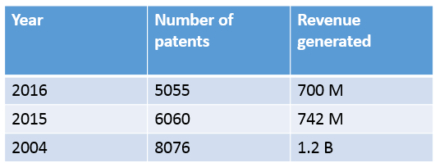
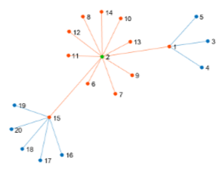

Structured Data
Unstructured Text
Table
Graph
The child and his mother:
A curious child asked his mother: “Mommy, why are some of your hairs turning grey?”
The mother tried to use this occasion to teach her child: “It is because of you, dear. Every bad action of yours will turn one of my hairs grey!”
The child replied innocently: “Now I know why grandmother has only grey hairs on her head.”
{
"answer":
{
"premium": {"$":502.83},
"initial_payment": {"$":100},
"monthly_payment": {"$":85.57}
}
}
JSON
HTML

Slide 3
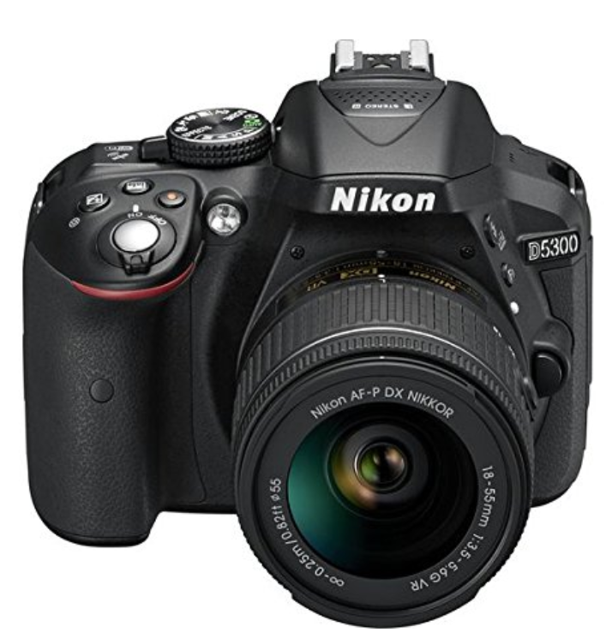
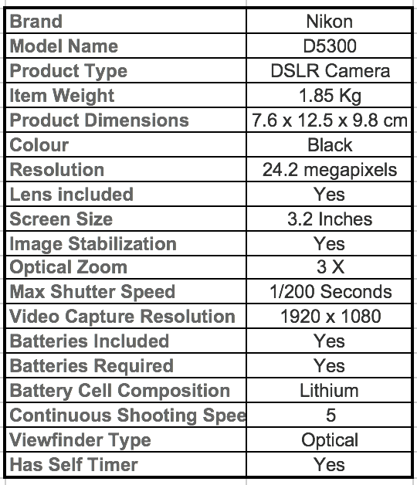
Structured Data → Natural Language Description
Product Information
Product Description
The Nikon D5300 DSLR Camera, which comes in black color features 24.2 megapixels and 3X optical zoom. It also has image stabilization and self-timer capabilities. The package includes lens and Lithium cell batteries.

Slide 4
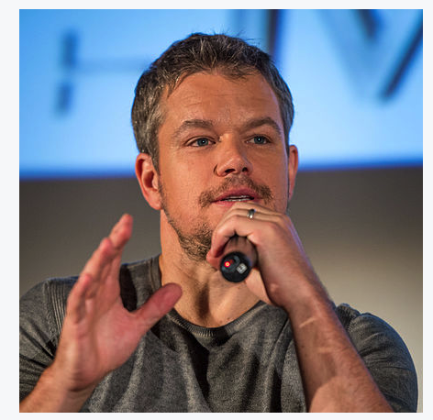

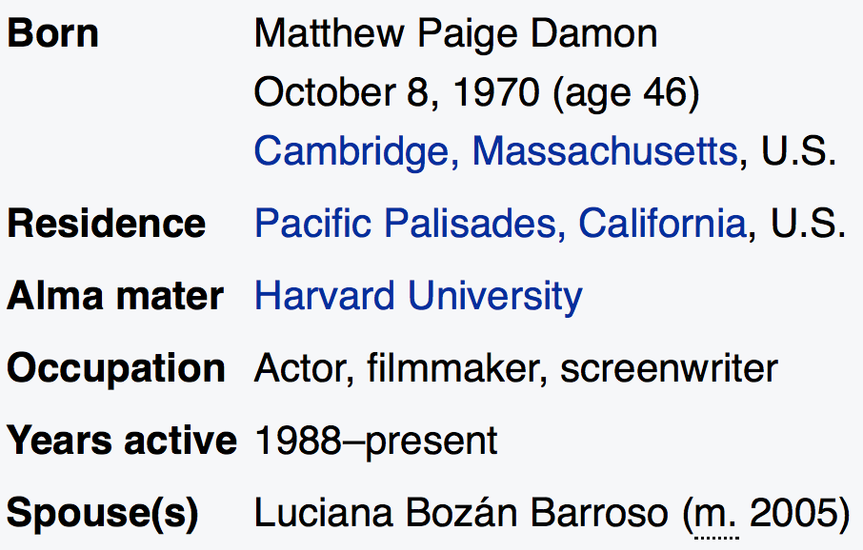

Natural Language Generation
Input
Output
Born Matthew Paige Damon October 8, 1970 Residence U.S. Occupation Actor filmmaker screenwriter
Matthew Paige Damon who was born in October 8, 1970 is an American actor, film producer, and screenwriter.

Slide 5
ENCODE
ATTEND
DECODE
Popular Deep Learning Paradigm
Used in a wide range of NLP and Vision Problems
For Text, also known as Seq2Seq Approach

Slide 6
Neural Encode-Attend-Decode Framework
Hindi: Aaj Aapka din kaisa tha
ENCODER
Encoder States
Word Embedding
English: How was your day today ?
[Bahdanau et. al. 2015]

Slide 7
Neural Encode-Attend-Decode Framework
Attention Mechanism
Aaj
ENCODER
Encoder States
Word Embedding
En: How was your day today ?
[Bahdanau et. al. 2015]

Slide 8
Neural Encode-Attend-Decode Framework
Attention Mechanism
Aaj aapka
ENCODER
Encoder States
Word Embedding
En: How was your day today ?
[Bahdanau et. al. 2015]

Slide 9
Neural Encode-Attend-Decode Framework
Attention Mechanism
Aaj aapka din kaisa tha
Output
ENCODER
Encoder States
Decoder States
Word Embedding
En: How was your day today ?
[Bahdanau et. al. 2015]

Slide 10
Various NLP Applications
TARGET
Attention Mechanism
Federer wins Aus Open again
Output
ENCODER
Encoder States
Decoder States
Word Embedding
Summarization
SOURCE: Roger Federer wins a record equaling sixth men’s singles title at Aus Open on Sunday

Slide 11


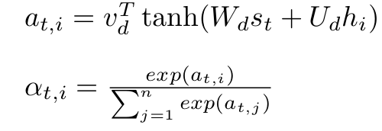
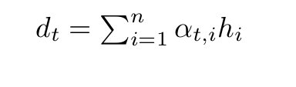

Some Basic Notation
Decoder state at time step t:
Encoder state corresponding to word j:
Attention Weights:
Context Vector :
Attention Mechanism
Decoder
(Probabilities)
Encoder

Slide 12
Case Study: Wikipedia Biographies

Slide 13
Matthew Paige Damon (born October 8, 1970) is an American actor, film producer, and screenwriter.
ENCODE-ATTEND-DECODE
[Born] Matthew Paige Damon October 8 1970 age 46 Cambridge Massachusetts U.S. [Residence] Pacific Palisades California U.S. [Alma mater] Harvard University [Occupation] Actor filmmaker screenwriter …..

Slide 14
Matt
Matt Damon born on Oct 8
is an American actor…
Basic Encode-Attend-Decode Model
Too generic!
Unable to exploit structure
Damon
Oct
8
1970
Encoder
U.S.
Decoder
Attention
…
actor
Attention
filmmaker
screen
writer

Slide 15
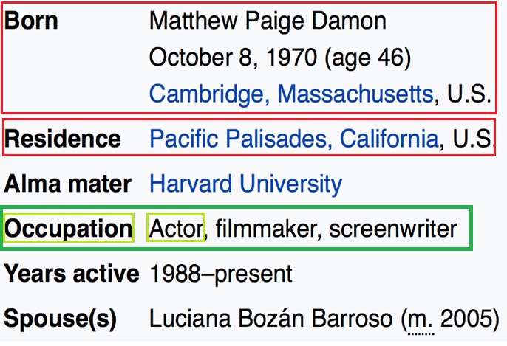
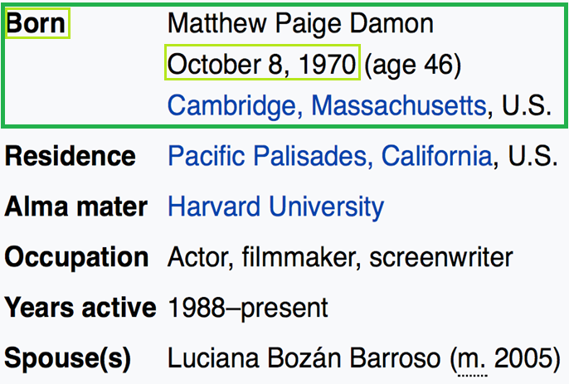
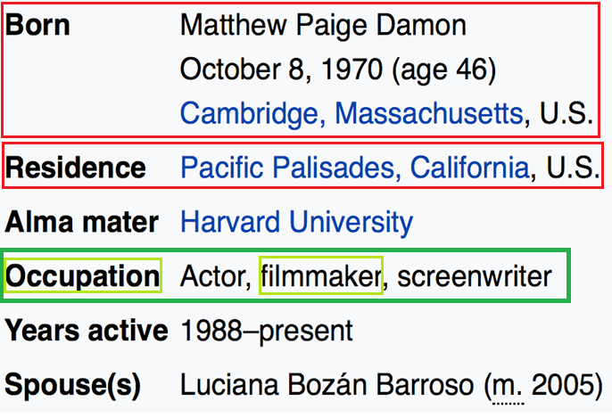
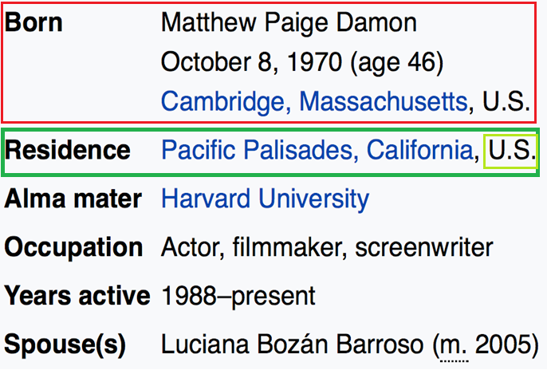
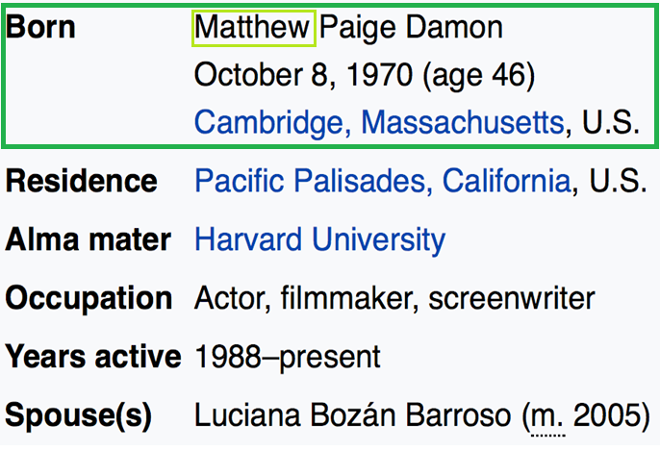
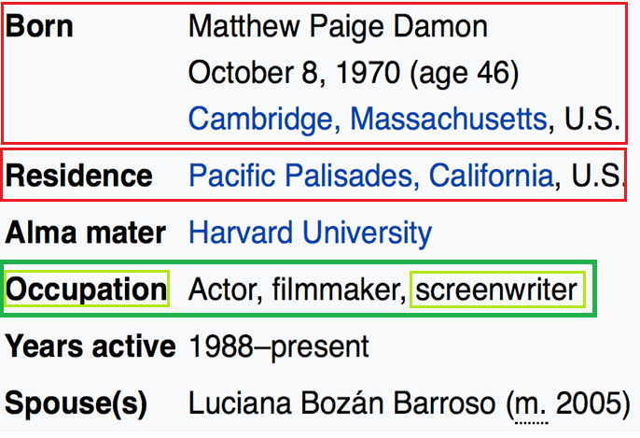

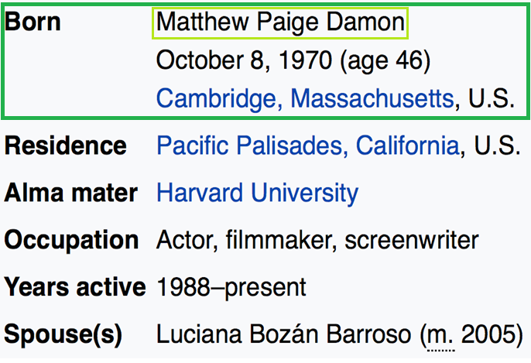

Matthew Paige Damon (born October 8, 1970) is an American actor,
Matthew Paige Damon (born October 8, 1970)
Matthew Paige Damon (born October 8, 1970) is an American actor, film producer,
Matthew Paige Damon (born October 8, 1970) is an American
Matthew
Matthew Paige Damon (born October 8, 1970) is an American actor, film producer, and screenwriter.
Matthew Paige
Matthew Paige Damon
Matthew Paige Damon (born October 8,
Input has a natural hierarchy
Table → Fields → Tokens
Once you visit a field you tend to stay on it for a while
One you exit a field you never look back
Matthew Paige Damon (born October 8, 1970) is an American actor, film producer, and screenwriter.

Slide 16
Matt
Matt Damon born on Oct 8
is an American actor…
Basic Encode-Attend-Decode Model
Key aspects of our model
Hierarchical Model
Modify attention to never look back at the same field
Modify attention to stay on one field for a few consecutive time-steps
Damon
name
Oct
8
born
actor
Encoder
writer
occupation
Field Attention
Decoder
…
…
US
Attention
citizen
nationality
Luciana
Bozan
spouse

Slide 17
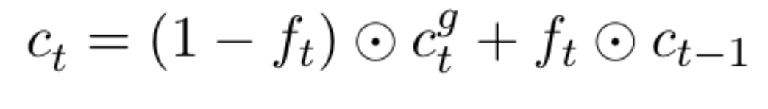


Modeling Stay-On Behaviour
FORGET GATE: decides till when to stay on a field
Context vector seen at last time-step
Encodes information about previous seen field.
New context vector:

Slide 18
Matt
Matt Damon born on Oct 8
is an American actor…
Basic Encode-Attend-Decode Model
Key aspects of our model
Hierarchical Model
Forget gate to STAY ON or FORGET previous field.
Modify attention to stay on one field for a few consecutive time-steps
Damon
name
Oct
8
born
actor
Encoder
writer
occupation
Forget Gate
Decoder
Field Attention
Modified
…
…
US
Attend
citizen
nationality
Luciana
Bozan
spouse

Slide 19
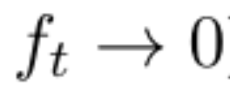
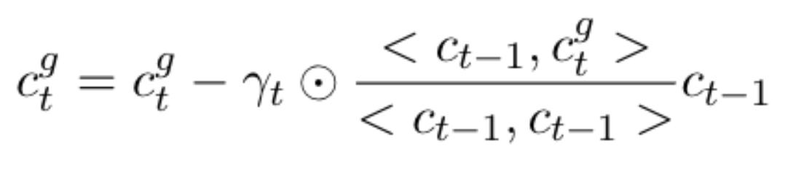
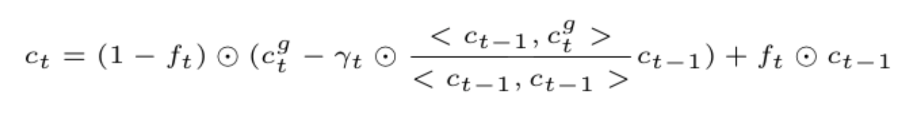
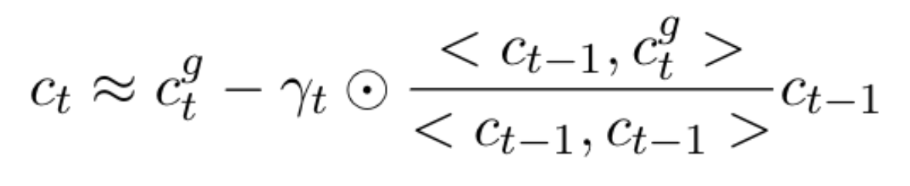
Modeling Never-Look-Back
FORGET GATE: decides till when to stay on a field
Orthogonalize the context vector once it is time to forget
Gamma: Soft orthogonalization
Modified

Slide 20
Matt
Matt Damon born on Oct 8
is an American actor…
Basic Encode-Attend-Decode Model
Key aspects of our model
Hierarchical Model
Forget gate to STAY ON or FORGET previous field.
Modify context vector to NEVER LOOK BACK at the same field once FORGET is activated.
Damon
name
Oct
8
born
actor
Encoder
Stay On + Never Look Back
writer
occupation
Field Attention
Decoder
Modified
…
…
US
Attend
Refine
citizen
nationality
Luciana
Bozan
spouse

Slide 21
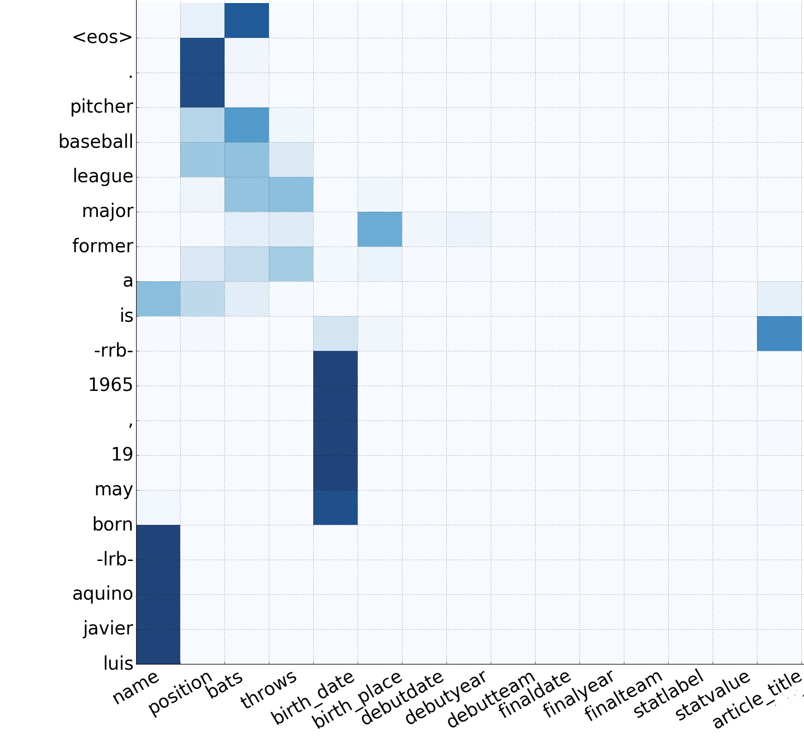
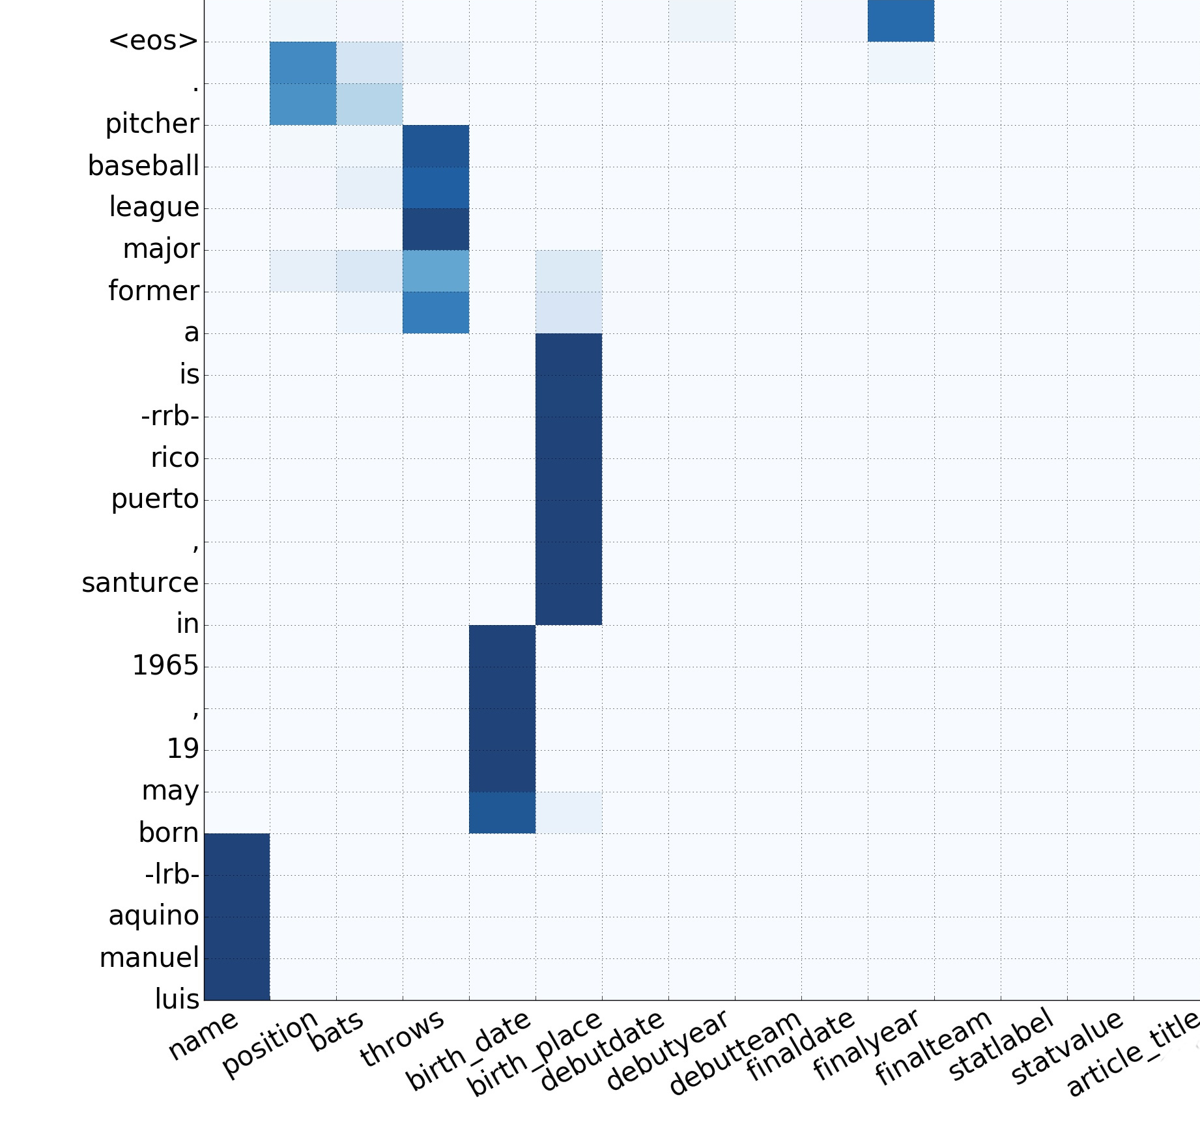
Visualizing Attention Weights
Hierarchical Model
Hierarchical + SO-NLB Model

Slide 22
Experimental Results
Model | BLEU-4 | NIST-4 | ROUGE-4
Baseline[ Lebret et al., 2016] | 34.7 | 7.98 | 25.8
Encode-Attend-Decode | 38.2 | 8.47 | 34.28
Hierarchical Encoder | 41.2 | 8.96 | 38.7
Hierarchical + SO-NLB | 42.0 | 9.17 | 39.1
WikiBio dataset [Lebret et. al 2016]
728,321 instances extracted from English Wikipedia 2015.
We generated dataset for French and German – Similar results seen.
French (170K) and German (50K).
Too be released soon.

Slide 23
Summary
ENCODE
ATTEND
REFINE
DECODE
Refine context vectors to model task specific behavior – accommodate structure.

Slide 24
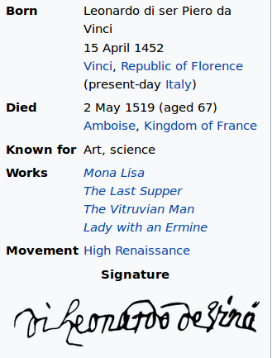
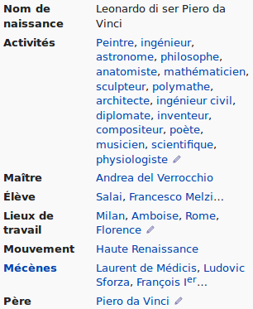
Future: Multilingual natural language generation
Leonardo di ser Piero da Vinci (15 April 1452 – 2 May 1519), more commonly Leonardo da Vinci or simply Leonardo, was an Italian Renaissance polymath whose areas of interest included invention, painting, sculpting, architecture, science, music, mathematics, engineering, literature, anatomy, geology, astronomy, botany, writing, history, and cartography.
English
French

Slide 25
Manuscripts
Preksha Nema, Shreyas Shetty M, Parag Jain, Anirban Laha, Karthik Sankaranarayanan and Mitesh M. Khapra. Generating Descriptions from Structured Data Using a Bifocal Attention Mechanism and Gated Orthogonalization. [To appear in NAACL-HLT 2018]
Parag Jain, Anirban Laha, Karthik Sankaranarayanan, Preksha Nema, Mitesh M. Khapra and Shreyas Shetty M. A Mixed Hierarchical Attention based Encoder-Decoder Approach for Standard Table Summarization. [To appear in NAACL-HLT 2018]

Slide 26
Thank You!

