Slide 1

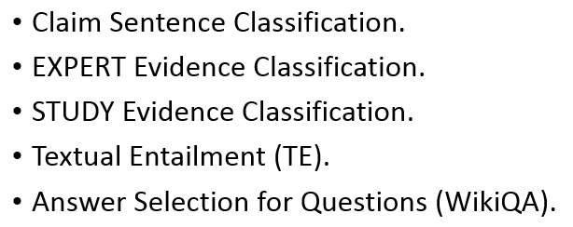
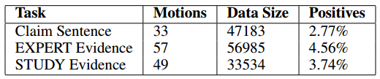
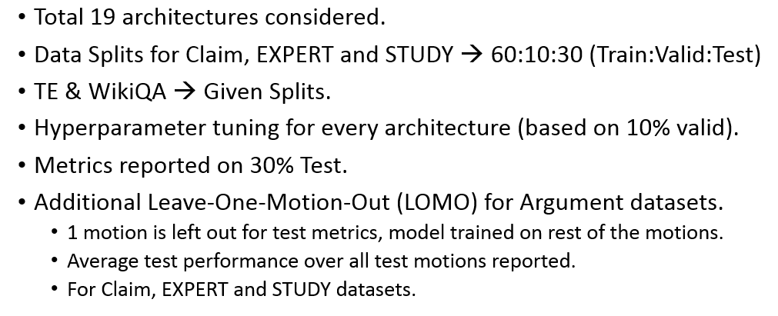
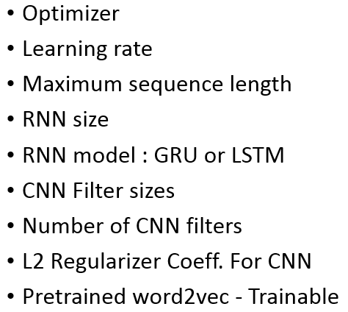
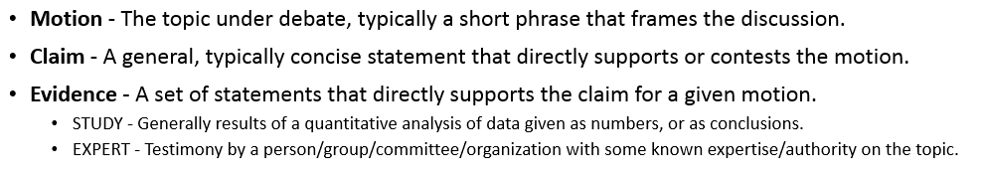

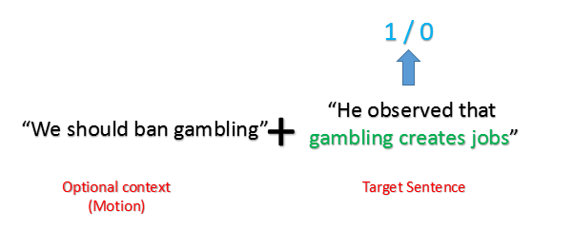
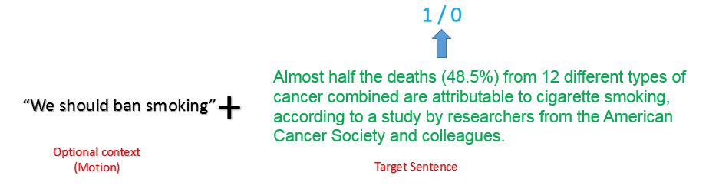
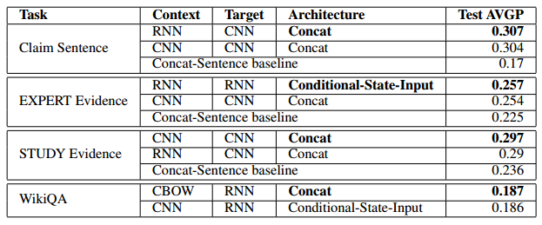
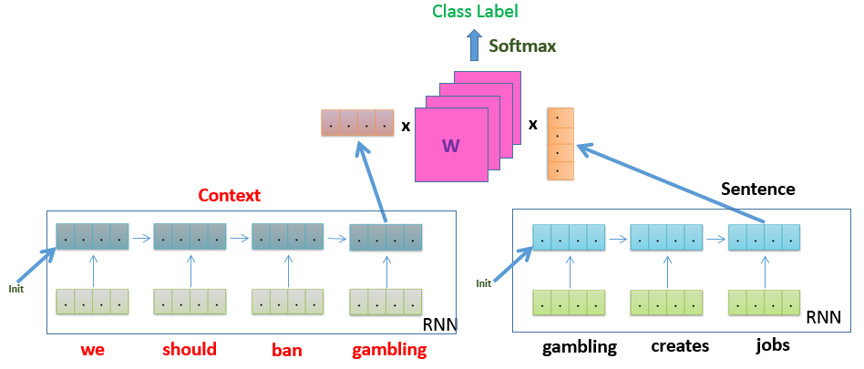
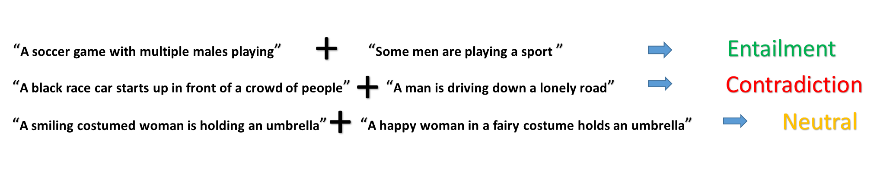
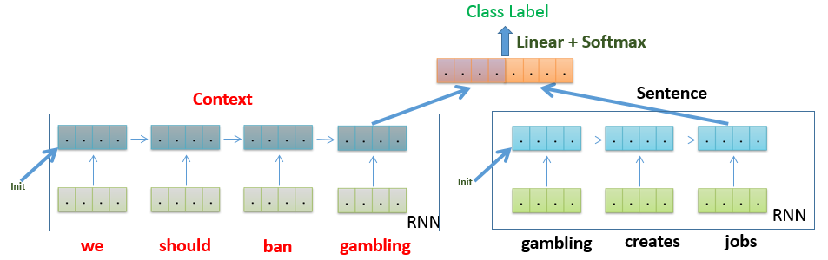
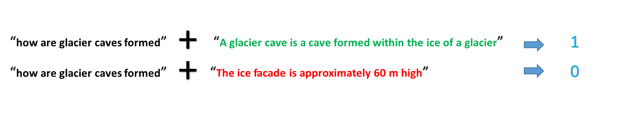
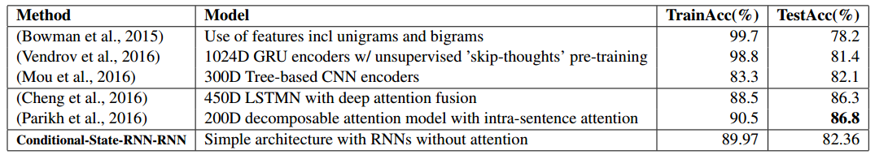
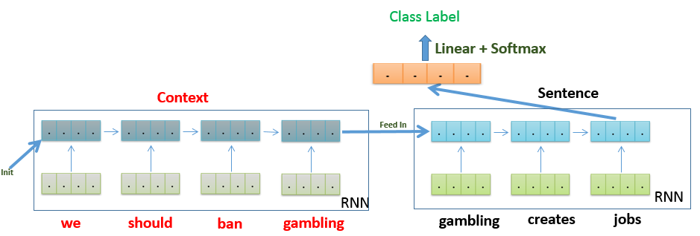
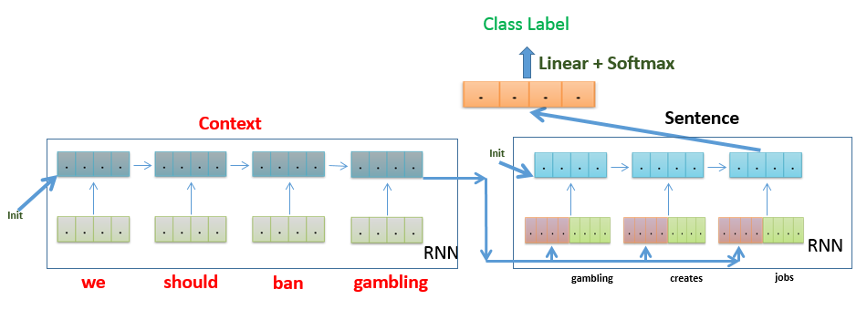
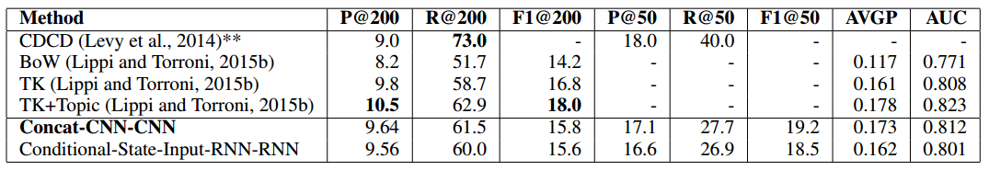
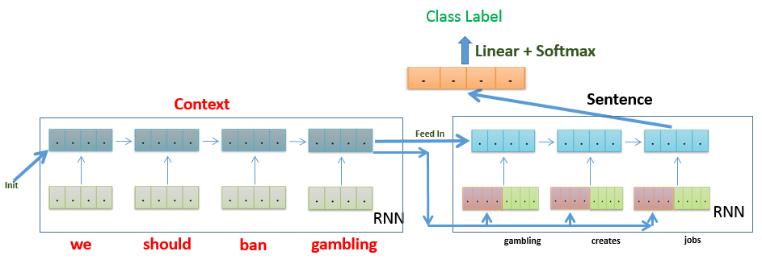
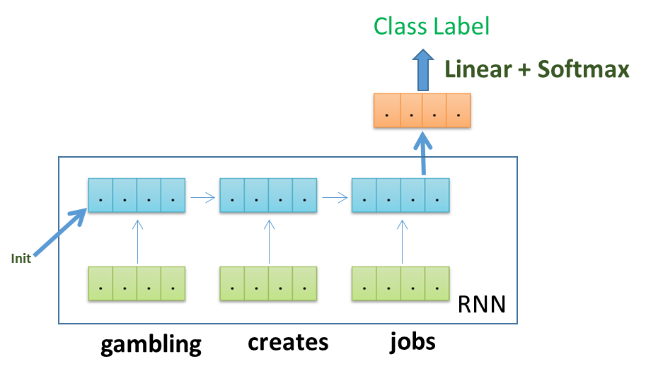
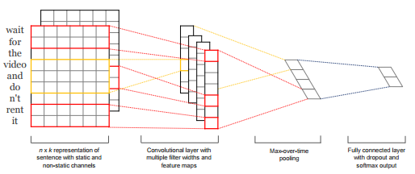
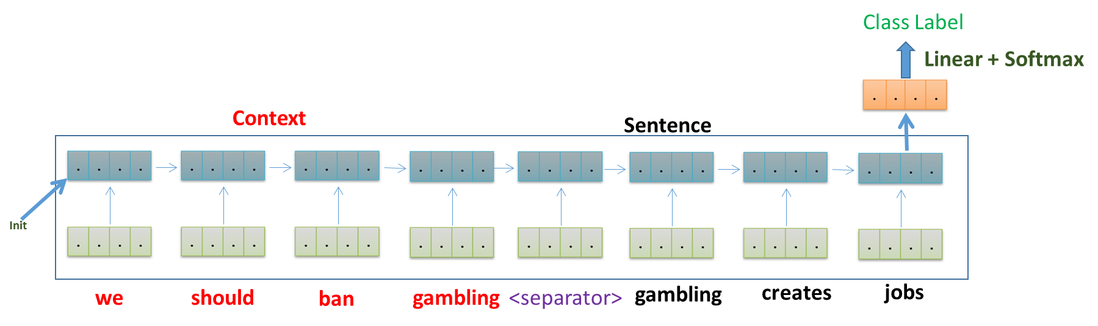
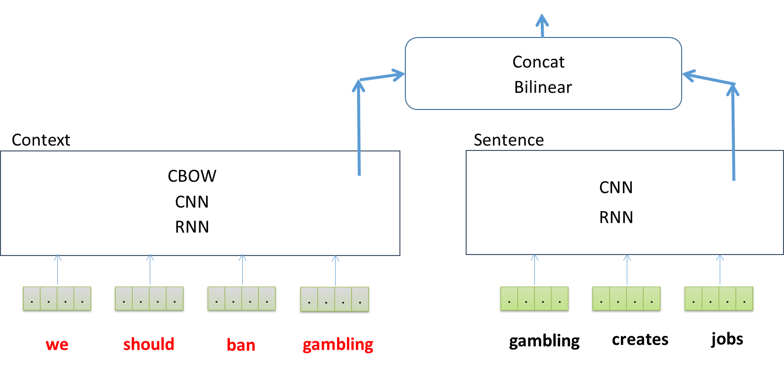
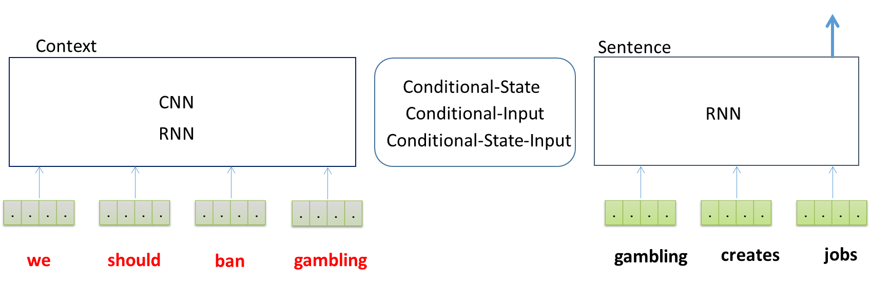
An Empirical Evaluation of various Deep Learning Architectures for Bi-Sequence Classification Tasks
Anirban Laha and Vikas C. Raykar, IBM Research – India.
anirlaha@in.ibm.com, viraykar@in.ibm.com
Bi-Sequence Classification
Tasks being Considered
Experiments
Argumentation Mining
Details
Hyperparameters
CLAIM Sentence
Key idea:
Extend from Single Sequence (or Context-free)
to Bi-Sequence (or Context-based) Classification
Experimental Results
STUDY Evidence
Deep-Learning based Architectures
Textual Entailment
Empirical evaluation based on Average Precision on asymmetric datasets
Answer Selection
concat
bilinear
Our Goal:
Deep Learning based solution for modelling context for the purpose of classifying a target sentence.
Comparison with the state-of-the-art in Textual Entailment dataset
conditional-state
conditional-input
Single Sequence Classification
Results in Leave-One-Motion-Out mode for Claim Sentence Task
RNN
CNN (Kim, EMNLP 2014)
conditional-state-input
Numbers in Leave-One-Motion-Out mode for all three debating tasks using our approach
More variations
Contribution/Takeaways:
Exhaustive empirical evaluation of various ways of handling context for bi-sequence classification tasks.
Insights and recommendations based on different kinds of datasets used – symmetric vs asymmetric, binary vs multiclass, etc.
First deep-learning baselines (zero feature-engineered) for argumentation mining datasets.
Simple baseline
Notes:
The area under the ROC curve (AUC) is a widely used performance measure in machine learning. Increasingly, however, in several applications, performance is measured not in terms of the full area under the ROC curve, but instead, in terms of the partial area under the ROC curve between two specified false positive rates. In this paper, we develop a structural SVM framework for directly optimizing the partial AUC between any two false positive rates. Our approach makes use of a cutting plane solver along the lines of the structural SVM based approach for optimizing the full AUC developed by Joachims (2005). Unlike the full AUC, where the combinatorial optimization problem needed to find the most violated constraint in the cutting plane solver can be decomposed easily to yield an efficient algorithm, the corresponding optimization problem in the case of partial AUC is harder to decompose. One of our key technical contributions is an efficient algorithm for solving this combinatorial optimization problem that has the same computational complexity as Joachims’ algorithm for optimizing the AUC. We demonstrate the effectiveness of our approach on several real-world tasks.

