Slide 1

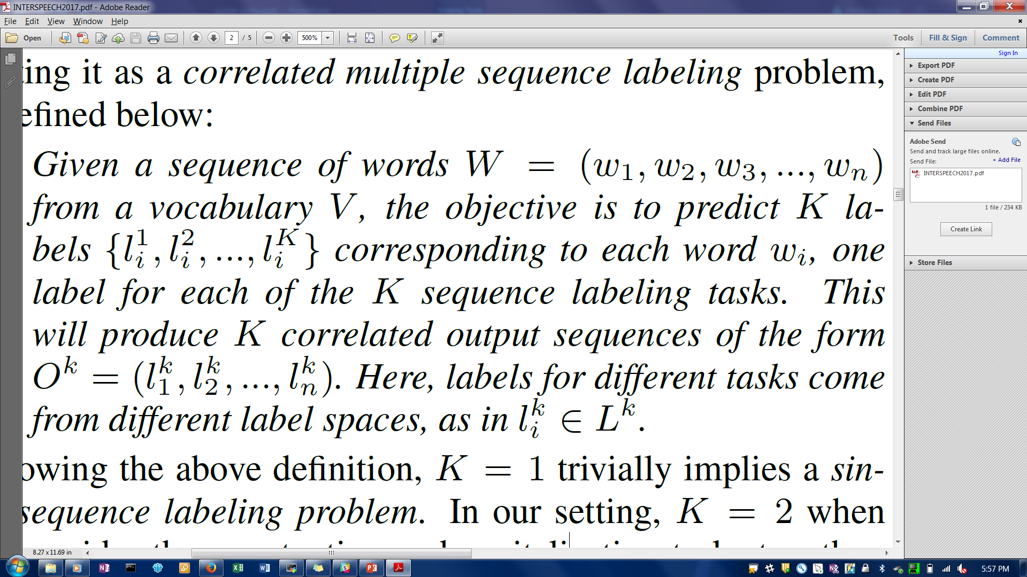
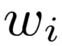
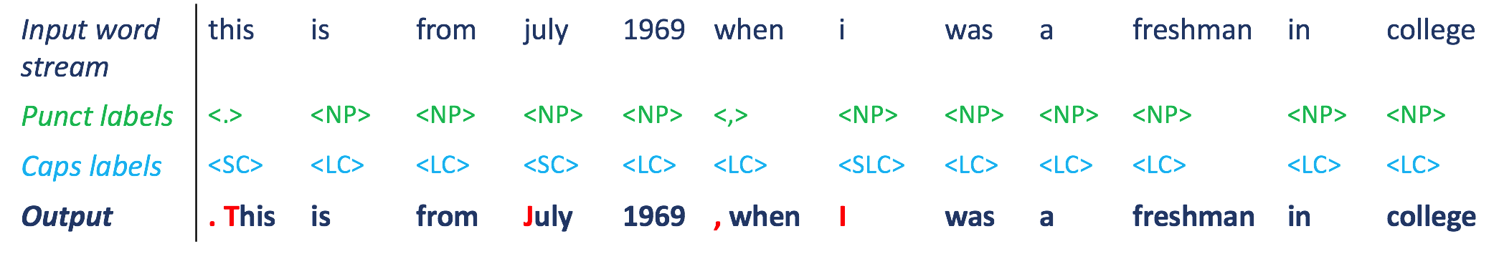
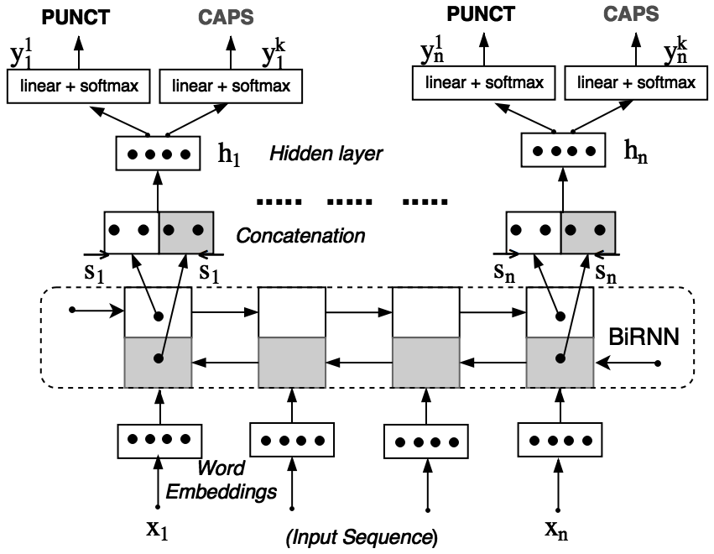
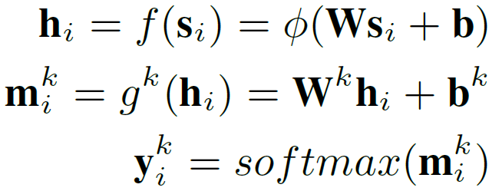
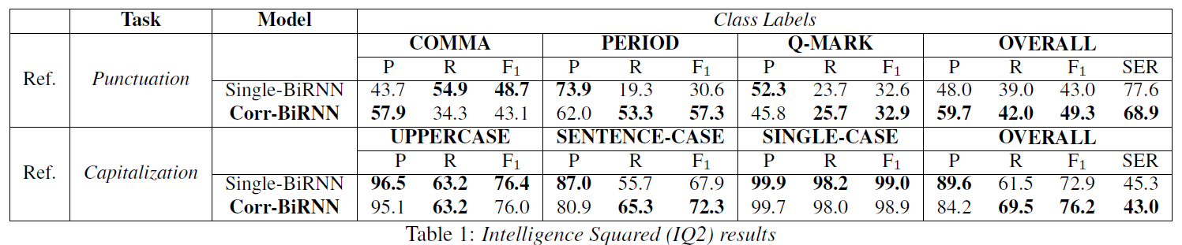
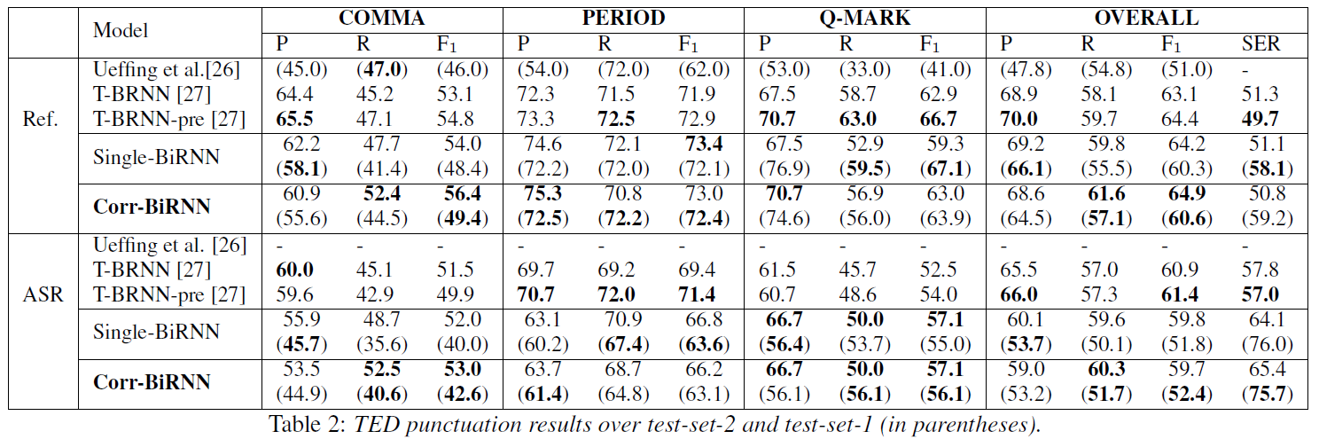
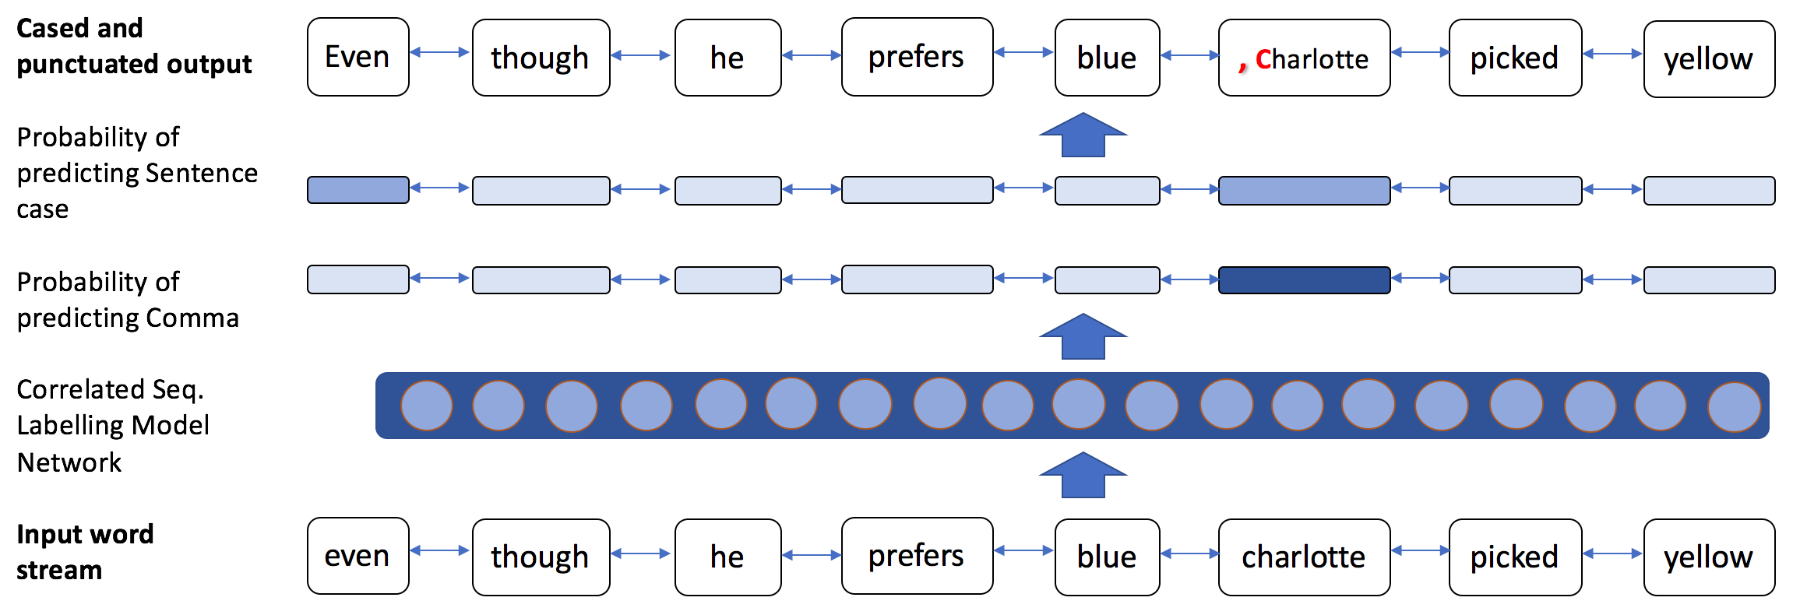
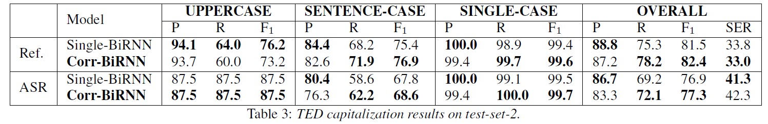
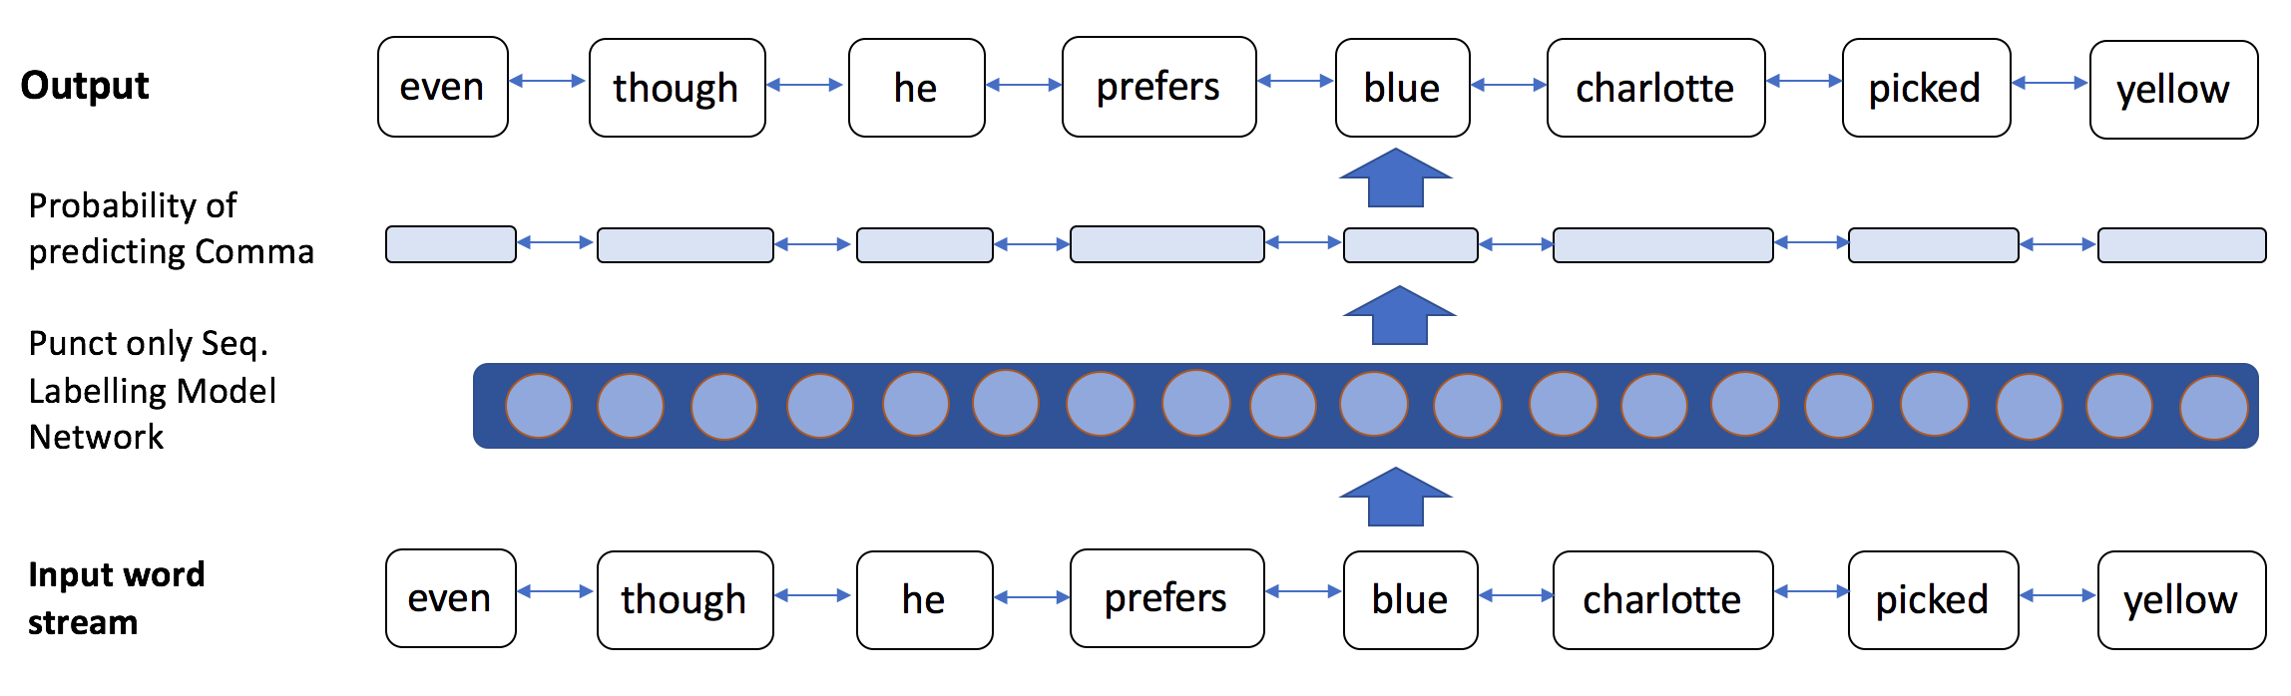
Joint Learning of Correlated Sequence Labeling Tasks
Using Bidirectional Recurrent Neural Networks
Vardaan Pahuja, Anirban Laha, Shachar Mirkin, Vikas Raykar, Lili Kotlerman, Guy Lev
vapahuja@in.ibm.com, anirlaha@in.ibm.com, shacharm@il.ibm.com, viraykar@in.ibm.com, lili.kotlerman@il.ibm.com, guylev@il.ibm.com
Correlated Multiple Sequence Labeling
Tasks labels
Given a sequence of words from a vocabulary V , the objective is to predict K labels corresponding to each word , one label for each of the K sequence labeling tasks.
This will produce K output sequences of the form
Here, labels for different tasks come from different label spaces, as in
K output sequences correlated
Punctuation Labels | Capitalization Labels
Comma (,) | All-lowercase (hello)/LC
Period (.) | All-uppercase (NASA)/UC
Q-Mark (?) | Sentence case (Lincoln)/SC
No Punct (NP) | Single-letter-word-case (I)/SLC
Input: unpunctuated stream of words devoid of casing
TASK 1
TASK 2
Experiments
Output : (punctuated and cased stream of words)
Data pre-processing
Training sequences
Consists of a random number of tokens (40 to 70)
Each sequence must begin with a new sentence.
Validation and test dataset
A single consolidated sequence comprising all the sentences, to simulate a real ASR stream
Reference transcripts and ASR transcripts evaluated.
Correlated Multiple Sequence Labeling
Key idea:
Punctuation and Capitalization are two correlated tasks that could benefit from each other
ASR Evaluation
Use Levenshtein alignment to map of punctuations and casing from the reference transcripts to the ASR transcripts.
Evaluation restricted to those punctuations for which the left and right context words were recognized correctly by the ASR.
For casing, evaluation restricted to those words which were correctly recognized by the ASR.
Deep-Learning based Architectures
Experimental Results
Sample performance of Single vs Corr. models
 | Punctuation | Capitalization
Gold | I ended up hiking up Mount Kilimanjaro , the highest mountain in Africa . | I wish you luck . May none of your non cancer cells become endangered species .
Single-BiRNN | i ended up hiking up mount kilimanjaro . the highest mountain in africa . | I wish you luck may none of your non cancer cells become endangered species
Corr-BiRNN | I ended up hiking up Mount Kilimanjaro , the highest mountain in Africa . | I wish you luck . May none of your non cancer cells become endangered species .
Datasets
Intelligence Squared:
Contains 45 debate transcripts from the Intelligence Squared (IQ2) debating television show
IWSLT TED Talks:
Training data: English transcripts of the English-to-French machine translation task in IWSLT 2012.
Test sets: Development data and Test-dataset-2 of the IWSLT 2011 ASR and SLT tasks
Contribution/Takeaways:
An RNN (BiRNN)-based joint learning framework for multiple correlated sequence labeling tasks, with no feature engineering, applicable for any correlated multiple sequence labeling tasks.
Improvement in punctuation prediction on speech transcripts by jointly training it with capitalization, without using any prosodic features.
A similar improvement is also observed in capitalization.
Our Goal:
To jointly model multiple correlated tasks such as punctuation and capitalization using bidirectional recurrent neural networks, which leads to improved performance for each of these tasks.
Notes:
The area under the ROC curve (AUC) is a widely used performance measure in machine learning. Increasingly, however, in several applications, performance is measured not in terms of the full area under the ROC curve, but instead, in terms of the partial area under the ROC curve between two specified false positive rates. In this paper, we develop a structural SVM framework for directly optimizing the partial AUC between any two false positive rates. Our approach makes use of a cutting plane solver along the lines of the structural SVM based approach for optimizing the full AUC developed by Joachims (2005). Unlike the full AUC, where the combinatorial optimization problem needed to find the most violated constraint in the cutting plane solver can be decomposed easily to yield an efficient algorithm, the corresponding optimization problem in the case of partial AUC is harder to decompose. One of our key technical contributions is an efficient algorithm for solving this combinatorial optimization problem that has the same computational complexity as Joachims’ algorithm for optimizing the AUC. We demonstrate the effectiveness of our approach on several real-world tasks.

