Slide 1
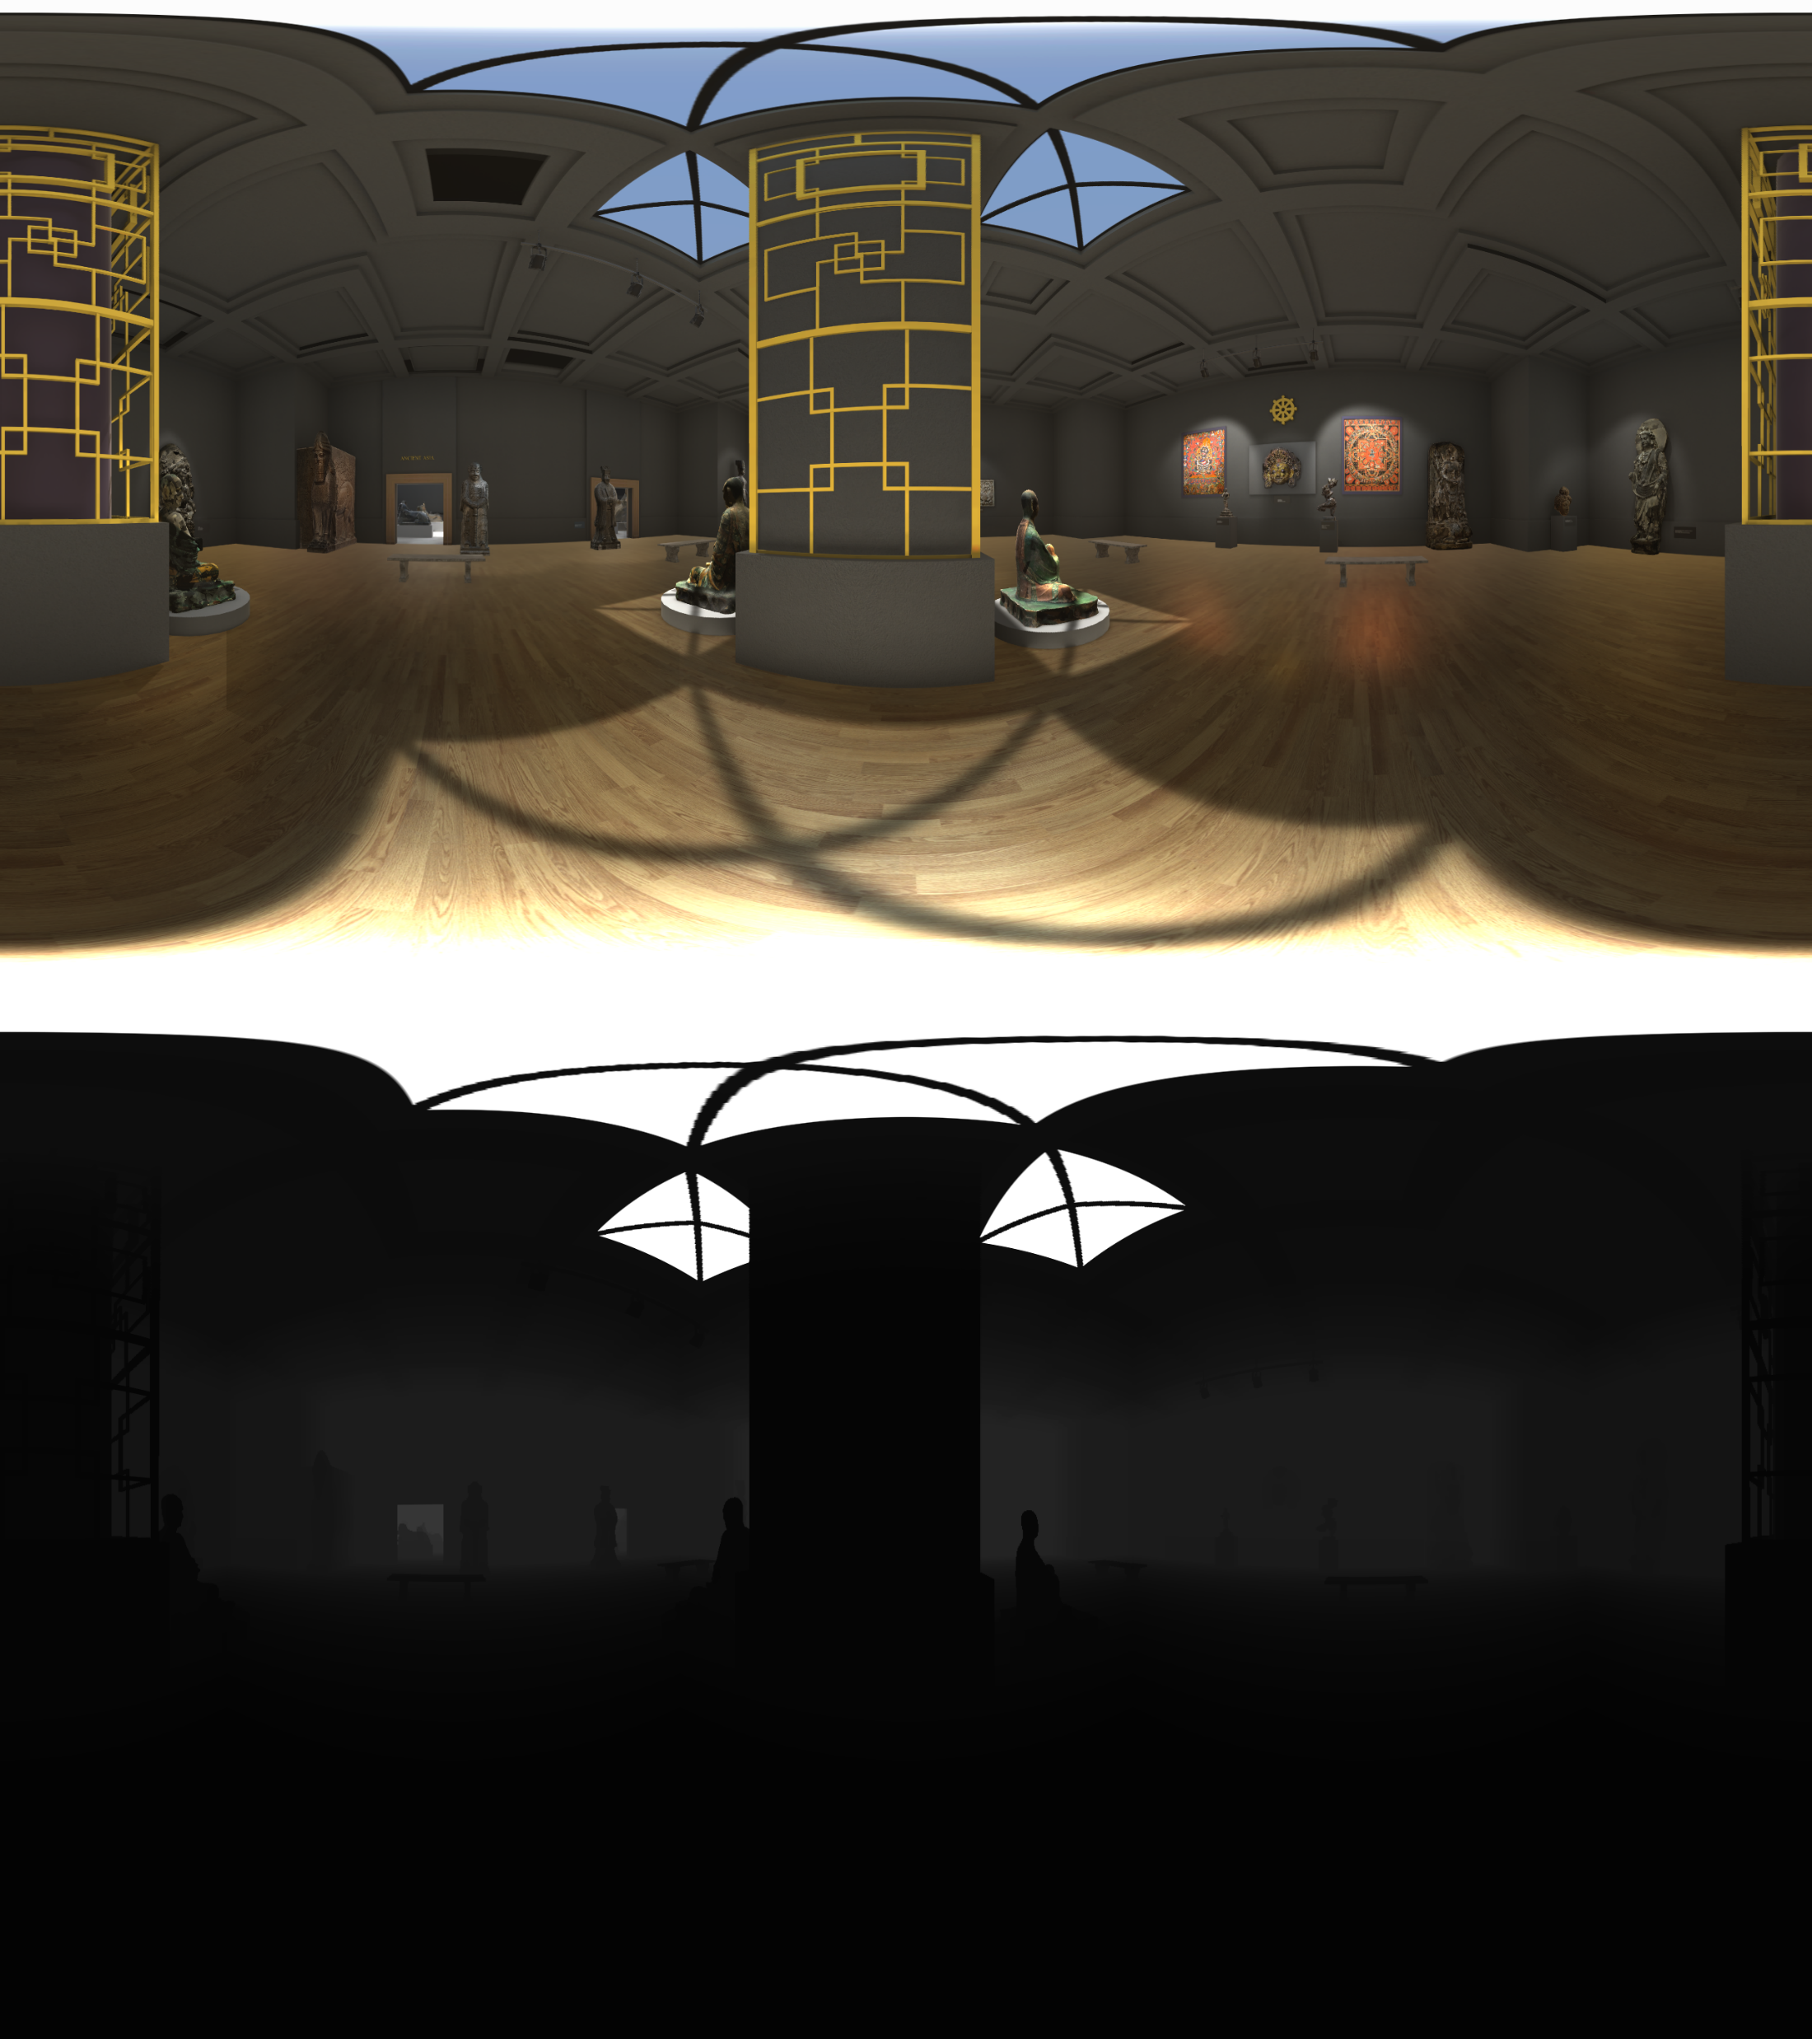
Color
Mega Tile 1
Mega Tile 3
Mega Tile 2
Mega Tile 4
Depth

