Slide 1

Journal Club
Zihan Li 25th Jul 2025
https://doi.org/10.48550/arXiv.2501.01576

Slide 2
Content
Background for Research
2. Results and Discussion
3. Conclusion

Slide 3
Background for Research

Slide 4
Section 1. Background for Research
Machine Learning
drug discovery, molecular simulations, chemical reaction prediction, synthesis planning, etc.
Black box model
Eg. deep neural networks
highly accurate ✅
lack of interpretability ❌
limits the ability to extract scientific knowledge

Slide 5
Section 1. Background for Research
Solution
explainable artificial intelligence (XAI)
Applied on QSAR
elucidating what ML algorithms have learned
Quantitative Structure–Activity Relationship
fostering scientific knowledge
Predict Lewis acidity
inspiring new concepts and ideas
current job: Greb group’s GNN model
Angew Chem Int Ed 2024, e202401084.

Slide 6
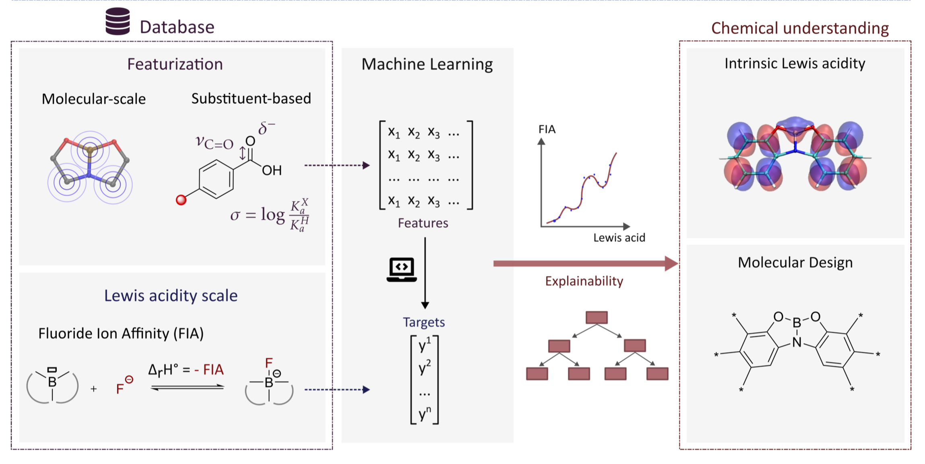
Section 1. Background for Research
This Work
Notes:
Therefore, predicting the Lewis acidity of compounds is highly valuable and has recently been explored by the Greb group. 36 An advanced graph neural network (GNN) model was trained on a substantial database of nearly 49k Lewis acids with diverse central atoms and ligands to predict the Lewis acidity of any compound. Complementarily, we aim at expanding the exploration of Lewis acidity using XAI, focusing on restricted chemical spaces, employing “white-box” self-explanatory models or XAI post-hoc techniques. Interpreting ML models can enhance chemical understanding by acting as a “computational microscope”, 24,25 to explore the qualitative concept of Lewis acidity and as a “source of inspiration” 24,25 for designing novel boron compounds with targeted Lewis acidity. Strategies to boost the Lewis acidity of borane derivatives include introducing electron-withdrawing groups onto ligands 37–40 or using constrained geometry ligands. 41–43 While functional group decoration is common in QSAR organic chemistry studies, applying ML techniques allows for the exploration of a much broader chemical space, providing novel insights for molecule design.
In this study, we employed ML techniques to create and analyze arrays of Lewis acids, annotated with their corresponding Lewis acidity, measured via the fluoride ion affinity (FIA) ( Figure 1). To improve explainability, we restricted the explored chemical space to four boron derivative scaffolds possessing aromatic rings substituted by electron-donating or -withdrawing substituents. Combining several molecular descriptors and ML algorithms, we built regression models to predict FIA and interpreted them to decipher the intrinsic Lewis acidity of these compounds and identify actionable levers for molecular design.

Slide 7
2. Results and Discussion

Slide 8
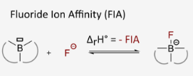
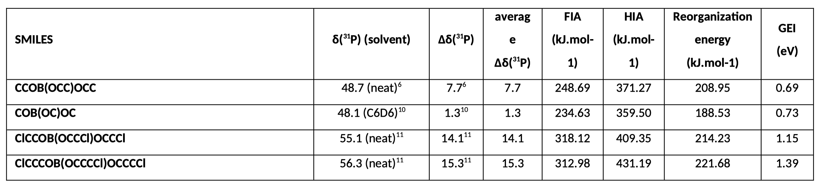
Section 2. Results and Discussion
Lewis acidity scale
relevant, consistent and accessible quantity
use DFT at the M062X/6-31G(d) level of theory in isodesmic calculations as a compromise between efficiency and precision to provide reliable FIA data.

Slide 9
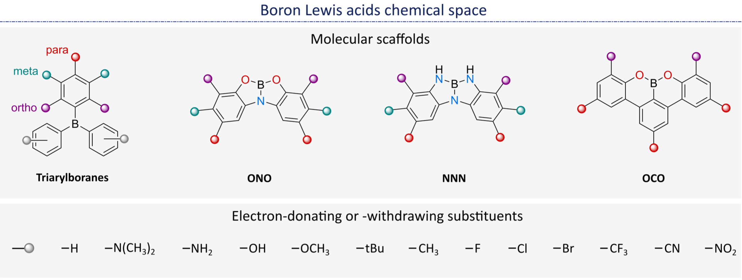
Section 2. Results and Discussion
Chemical space
Use k-means + Morgan fingerprint to enhance diversity and chemical space
Get more samples

Slide 10
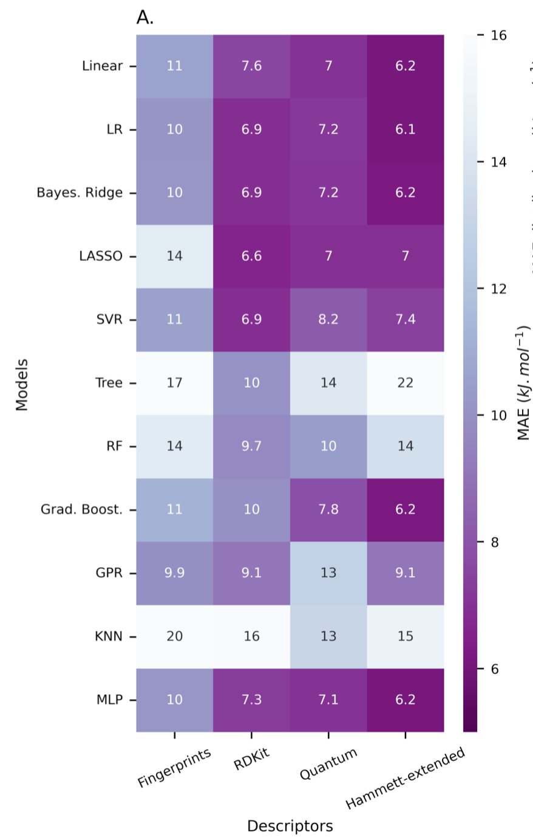

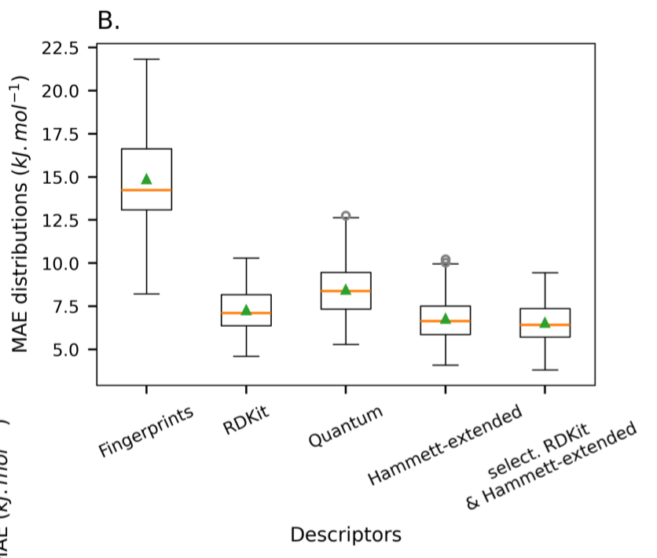
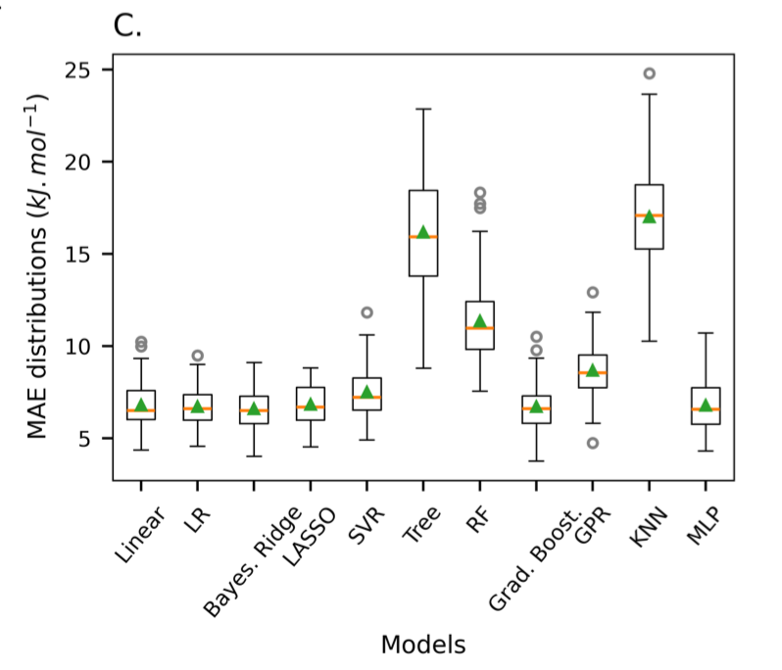
Section 2. Results and Discussion
Constructing models for ONO
RDKit
Hammett-extended
Mean Absolute Error
+ F-statistic

Slide 11
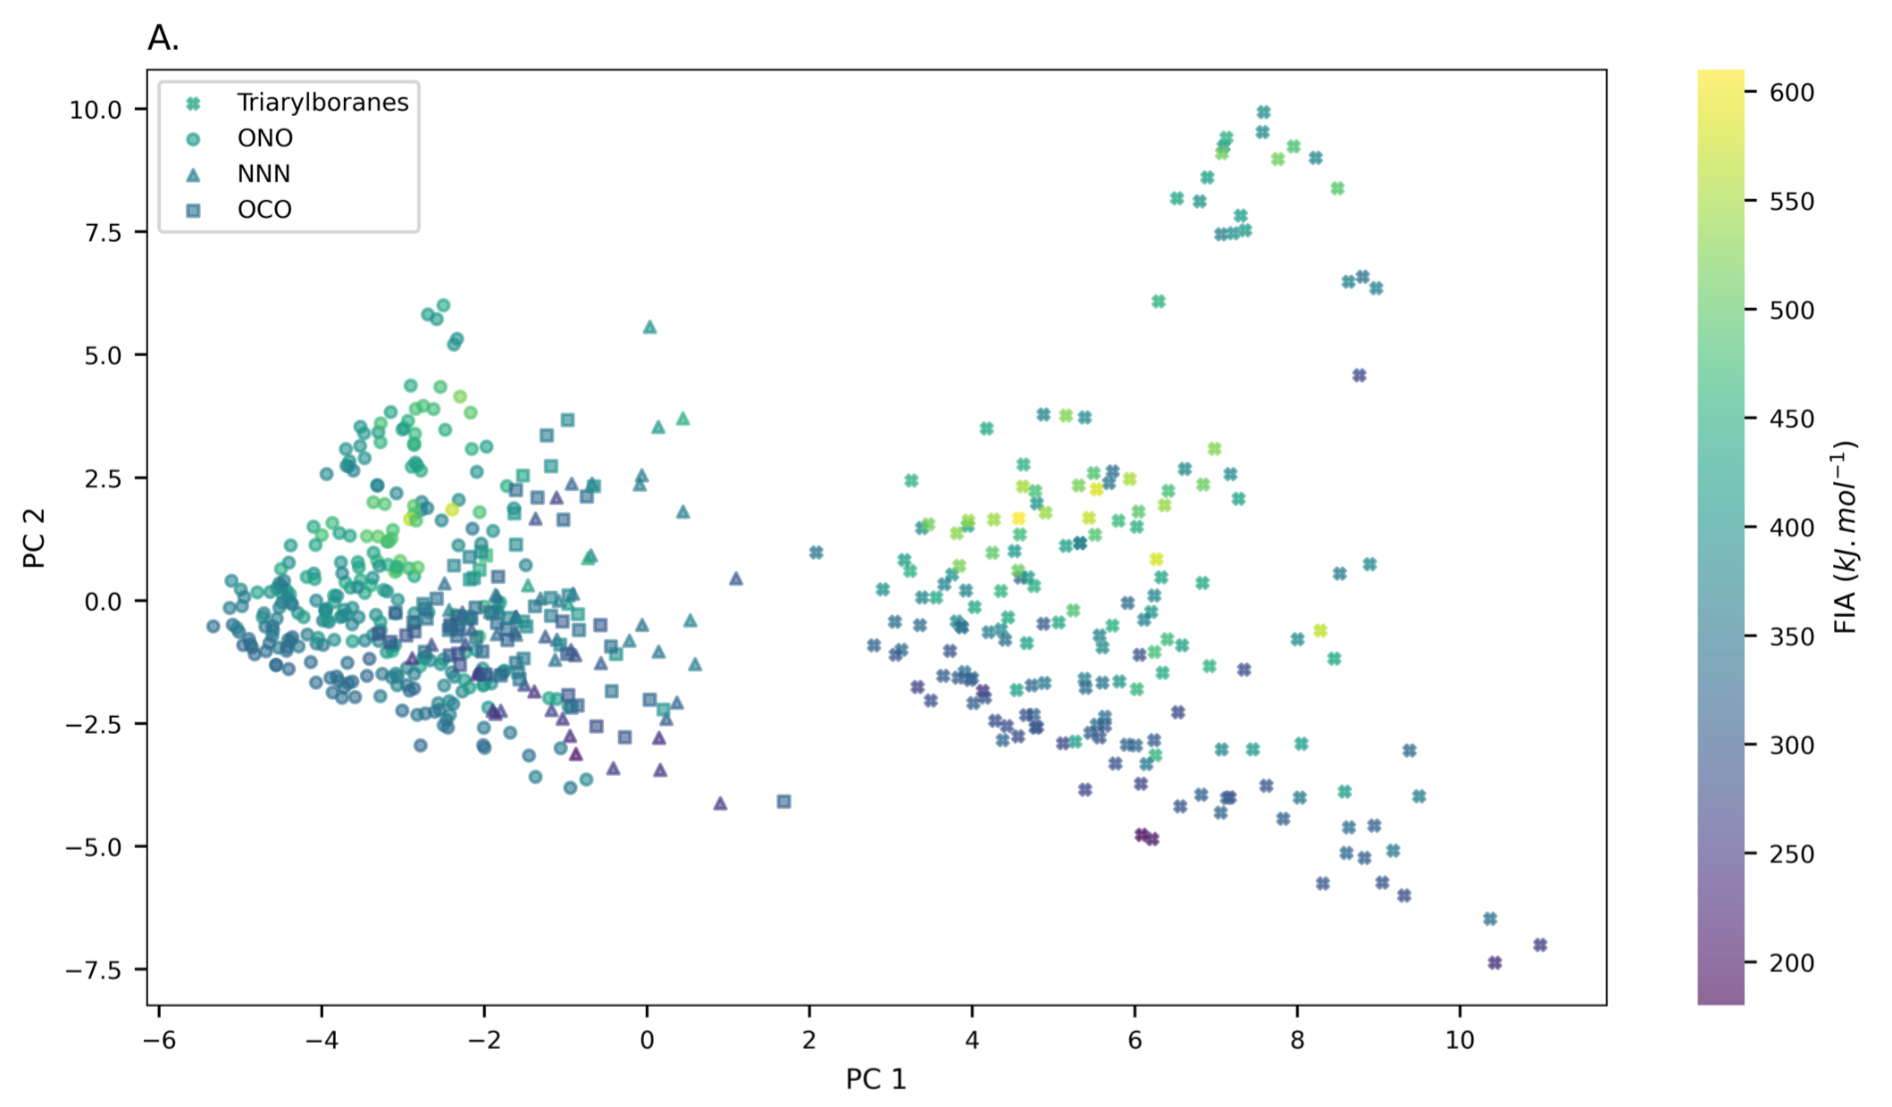
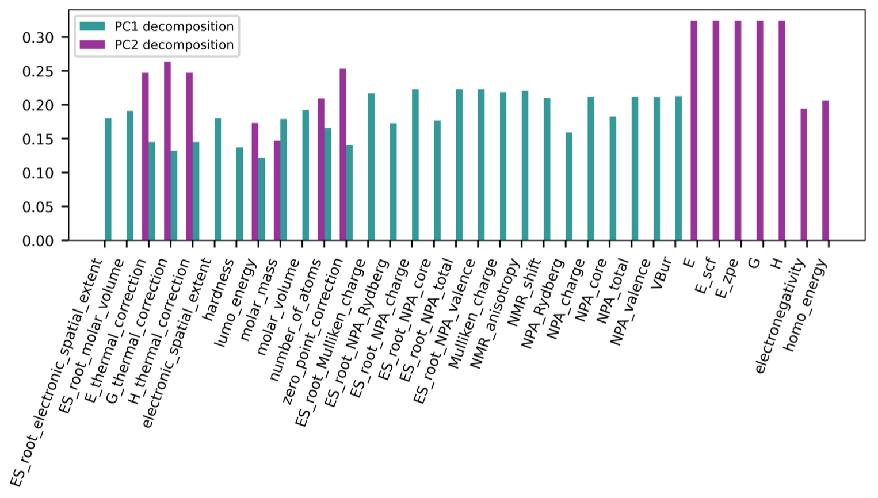
Section 2. Results and Discussion
Interpretability
Insights in the Lewis acidity
Principal Component Analysis (PCA) reduces high-dimensional correlated data into a few uncorrelated components, capturing the main variance for easier visualization and analysis.

Slide 12
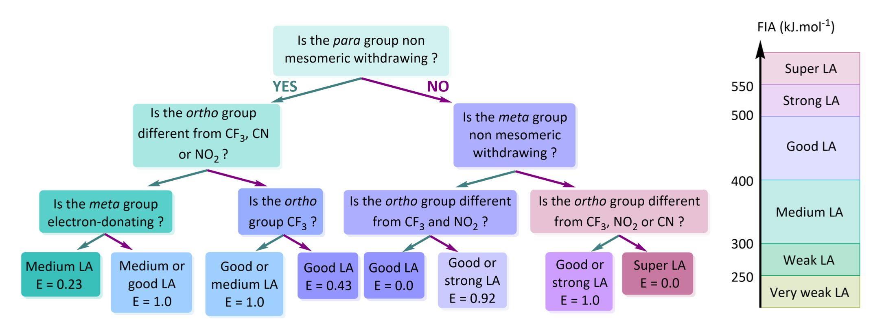
Section 2. Results and Discussion
Interpretability
ONO Molecular design
para-σ
meta-σ
ortho-σ

Slide 13
3. Conclusion

Slide 14
Section 3. Conclusion
Conclusion
The authors combined RDKit descriptors with Hammett-extended descriptors and built a high-performance predictive model, oracle, using linear regression. FIA was used as the index to predict the Lewis acidity of boron compounds, achieving a mean absolute error (MAE) of less than 6 kJ·mol⁻¹.
· Clear Process
· Interpretability (PCA)

Slide 15
Thank You

