Slide 1
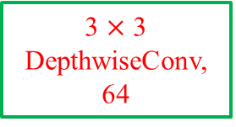

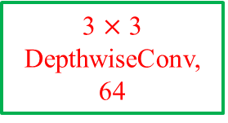

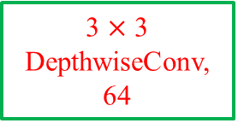




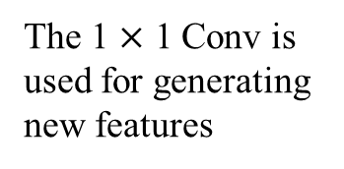



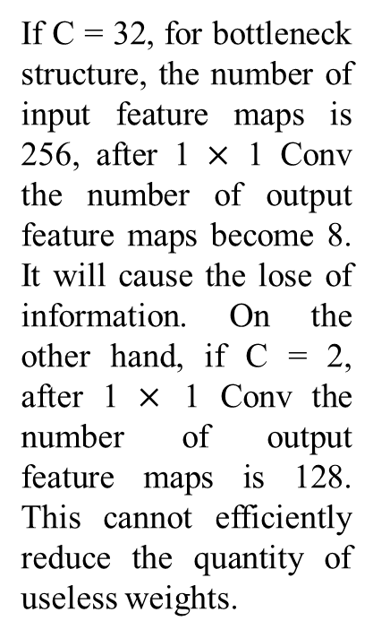
256 Feature Maps
Why C = 4 is better?
Bottleneck
Structure
1 $×$ 1 Conv, 64
1 $×$ 1 Conv, 64
1 $×$ 1 Conv, 64
1 $×$ 1 Conv, 64
If C = 32, for bottleneck structure, the number of input feature maps is 256, after 1 $×$ 1 Conv the number of output feature maps become 8. It will cause the lose of information. On the other hand, if C = 2, after 1 $×$ 1 Conv the number of output feature maps is 128. This cannot efficiently reduce the quantity of useless weights.
Batch Norm
Batch Norm
Batch Norm
Batch Norm
ReLU
ReLU
ReLU
ReLU
3 $×$ 3 DepthwiseConv, 64
3 $×$ 3 DepthwiseConv, 64
3 $×$ 3 DepthwiseConv, 64
3 $×$ 3 DepthwiseConv, 64
Grouped Convolution
The 1 $×$ 1 Conv is used for generating new features
1 $×$ 1 Conv, 64
1 $×$ 1 Conv, 64
1 $×$ 1 Conv, 64
1 $×$ 1 Conv, 64
Batch Norm
Batch Norm
Batch Norm
Batch Norm
ReLU
ReLU
ReLU
ReLU
ReLU
Concatenate, 256

Slide 2
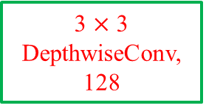

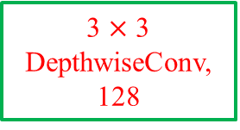
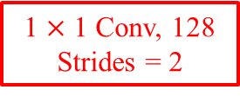
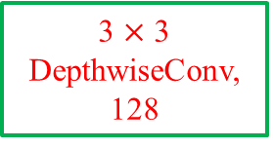

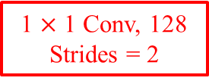

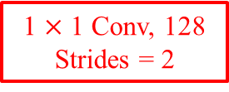
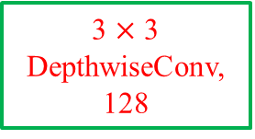



256 Feature Maps
Bottleneck
Structure
1 $×$ 1 Conv, 128
Strides = 2
1 $×$ 1 Conv, 128
Strides = 2
1 $×$ 1 Conv, 128
Strides = 2
1 $×$ 1 Conv, 128
Strides = 2
Batch Norm
Batch Norm
Batch Norm
Batch Norm
ReLU
ReLU
ReLU
ReLU
1 $×$ 1 Conv, 512
Strides = 2
3 $×$ 3 DepthwiseConv, 128
3 $×$ 3 DepthwiseConv, 128
3 $×$ 3 DepthwiseConv, 128
3 $×$ 3 DepthwiseConv, 128
1 $×$ 1 Conv, 128
1 $×$ 1 Conv, 128
1 $×$ 1 Conv, 128
1 $×$ 1 Conv, 128
Batch Norm
Batch Norm
Batch Norm
Batch Norm
ReLU
ReLU
ReLU
ReLU
Concatenate, 512
ReLU

Slide 3





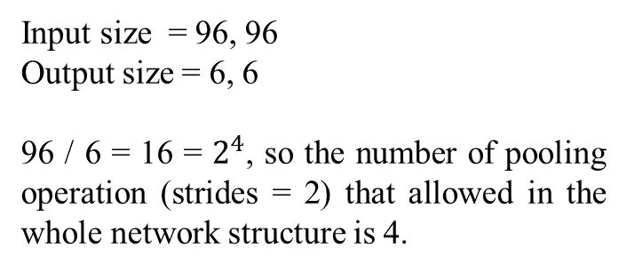
1 $×$ 1 Conv, 64
Input size = 96, 96
Output size = 6, 6
96 / 6 = 16 = $2^{4}$, so the number of pooling operation (strides = 2) that allowed in the whole network structure is 4.
If the size of feature map become the half of original, the number of feature maps should be doubled.
1 $×$ 1 Conv, 128
Strides = 2
1024 Feature Maps
We also find that, the dimension of traffic information that will be merged is also quarter of original.
H, W H/2, W/2
Channels Channels / 2
FC_1
3 $×$ 3 DeformableConv, 1024
1 $×$ 1 Conv, 1024
Why deformable？
The first reason is Data augmentation will bring unknown affine transformation.
The second reason is dataset which contain different zoom scales of the same feature.
GlobalAveragePooling
FC_2
1 $×$ 1 Conv, num_classes

Slide 4
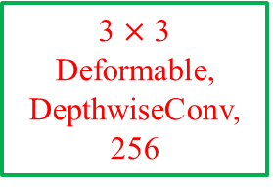

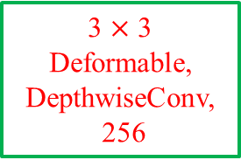

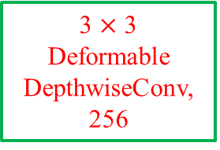




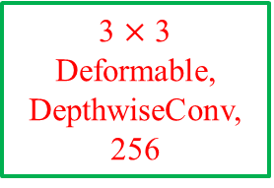


1024 Feature Maps
1 $×$ 1 Conv, 256
1 $×$ 1 Conv, 256
1 $×$ 1 Conv, 256
1 $×$ 1 Conv, 256
Batch Norm
Batch Norm
Batch Norm
Batch Norm
ReLU
ReLU
ReLU
ReLU
3 $×$ 3
Deformable,
DepthwiseConv,
256
3 $×$ 3
Deformable,
DepthwiseConv,
256
3 $×$ 3
Deformable,
DepthwiseConv, 256
3 $×$ 3
Deformable
DepthwiseConv,
256
Dilated rate = 1
Without residual
connections
1 $×$ 1 Conv, 256
1 $×$ 1 Conv, 256
1 $×$ 1 Conv, 256
1 $×$ 1 Conv, 256
Batch Norm
Batch Norm
Batch Norm
Batch Norm
ReLU
ReLU
ReLU
ReLU
Concatenate, 1024

Slide 5
Dilated Convolution
1 → 2 → 1 (without residual connections)

