Slide 1
DeepRacer Car

Slide 2
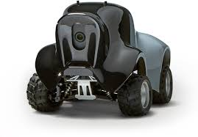
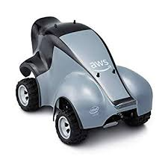
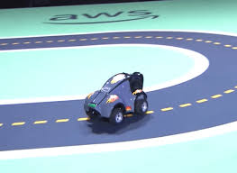
Agent: RC car with camera
Action: Go forward, turn left, turn right

Slide 3
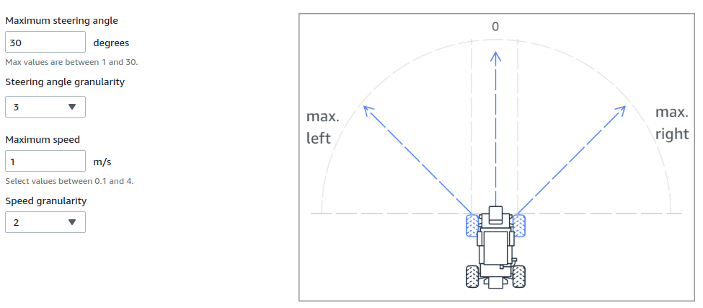
Action Space

Slide 4
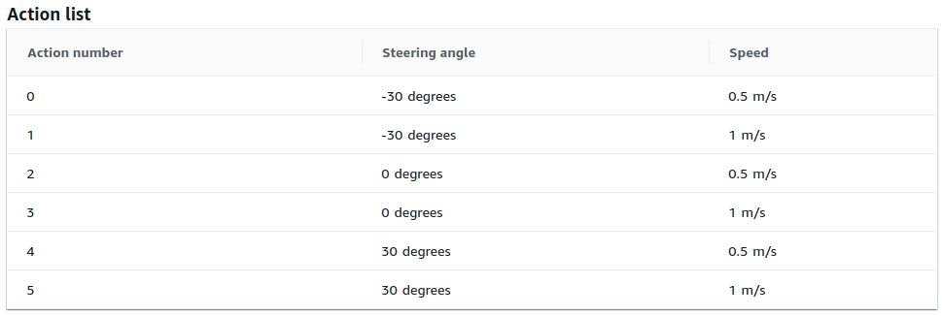

Slide 5
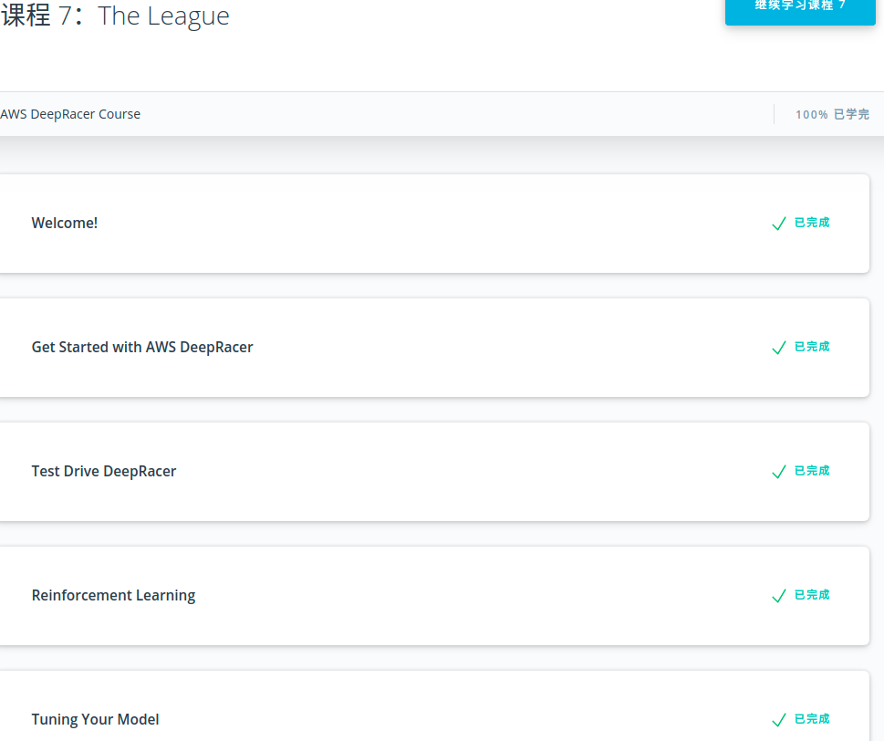
The course from Udacity provides good instructions for the deepracer car. It gives basic knowledges about RL.
It also described the main contents of the training steps and details about the hyperparameters and reward function.

Slide 6
Envrionment

Slide 7
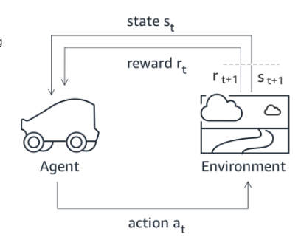
In reinforcement learning for AWS DeepRacer, an agent (vehicle) learns from an environment (a track) by interacting with it and receiving rewards for performing specific actions.

Slide 8
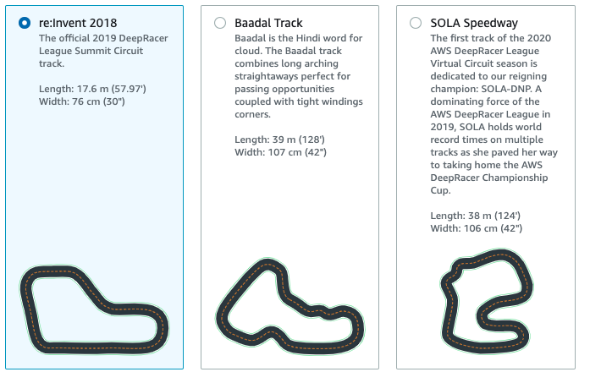
We can choose different tracks as the environment.
The state is the position that the car on the track, and the image from
There is a center lane on the track to help locate the car.
There are two conditions can be considered as finish. One is complete the track and the other one is drive out of the track.

Slide 9
First Try before Checkpoint

Slide 10
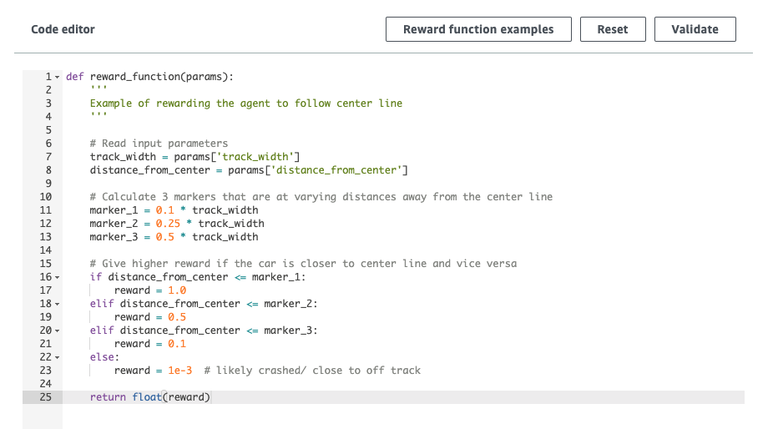
This is the default reward function that helps agent to learn.
We can modify it to gain better performance.

Slide 11
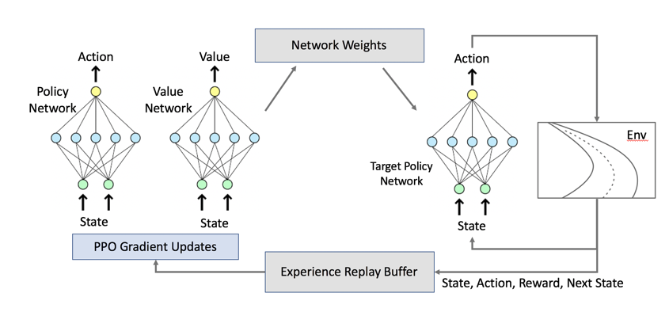
The default algorithm in DeepRacer is Proximal Policy Optimization algorithm.
PPO uses two neural networks during training: a policy network and a value network. The policy network (also called actor network) decides which action to take given an image as input. The value network (also called critic network) estimates the cumulative reward we are likely to get given the image as input. Only the policy network interacts with the simulator and gets deployed to the real agent, namely an AWS DeepRacer vehicle.

Slide 12
Hyperparameters of PPO
Gradient descent batch size: The number recent vehicle experiences sampled at random from an experience buffer and used for updating the underlying deep-learning neural network weights.
Number of epochs: The number of passes through the training data to update the neural network weights during gradient descent.
Learning rate: During each update, a portion of the new weight can be from the gradient-descent (or ascent) contribution and the rest from the existing weight value.
Entropy:A degree of uncertainty used to determine when to add randomness to the policy distribution.
Discount factor: A factor specifies how much of the future rewards contribute to the expected reward.
Loss type: Type of the objective function used to update the network weights.
Number of experience episodes between each policy-updating iteration: The size of the experience buffer used to draw training data from for learning policy network weights.

Slide 13
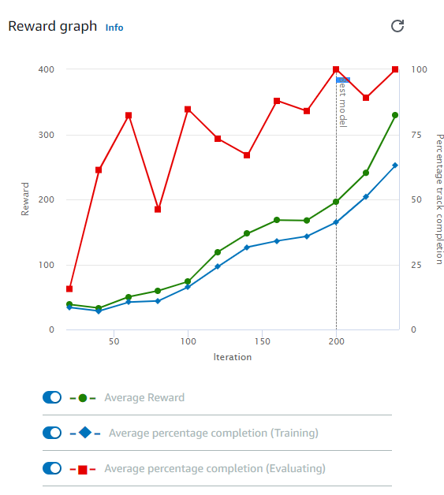
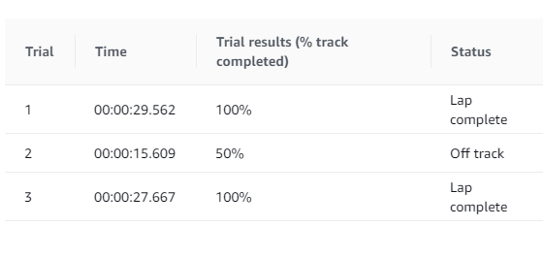
Here is the result from the training using default rewards function and PPO algorithm. The result is pretty good and I even did not finish the training with some issues on the AWS. I setted training time to 1 hour and the training just ran for around half an hour, then it stopped and return error. The guide said I can still evaluate my result. So I got the above evaluation. Two run completed and one failed, not bad.

Slide 14
Install on Local

Slide 15
Repository From ARCC
The recommended OS is Ubuntu 18.04, but I use 16.04 and it works
Nvidia GPU needed
CUDA and CUDNN
Docker Docker compose and Nvidia-Docker
AWS-cli(used for interaction with AWS)
vncviewer(simulation visualization)
https://github.com/ARCC-RACE/deepracer-for-dummies.git
Git clone the repository from above link.
Then go into the folder and run the script init.sh for initialization.
Setup aws-cli(https://www.youtube.com/watch?v=FOK5BPy30HQ)

Slide 16
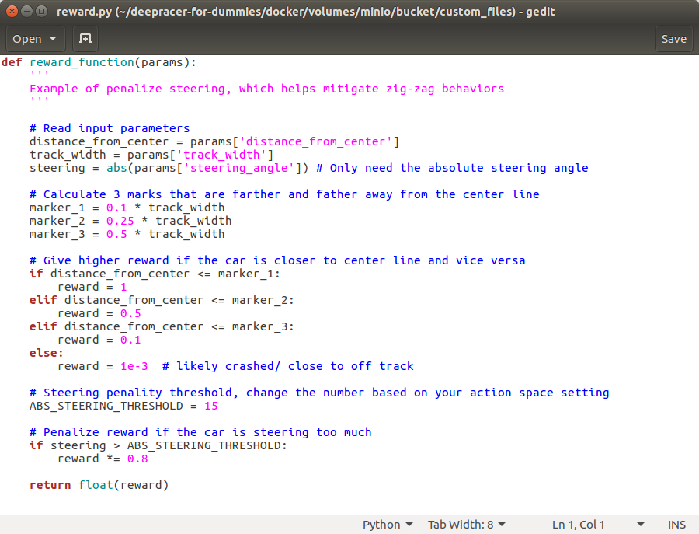
Edit the reward function in the deepracer-for-dummies/docker/volumes/minio/bucket/custom_files/reward.py file.

Slide 17
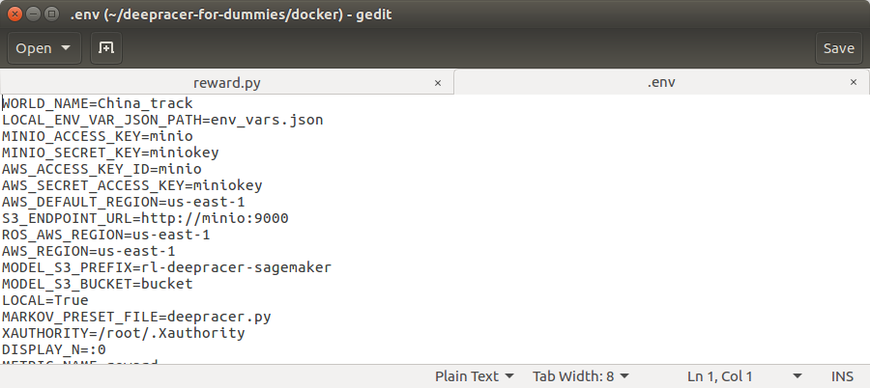
Change the track in `deepracer-for-dummies/docker/.env`.

Slide 18
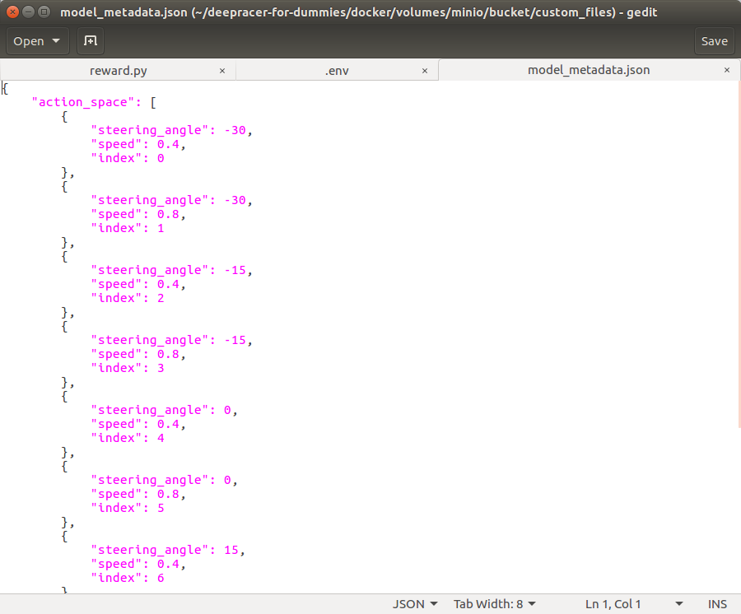
Adjust the hyperparameters list in the deepracer-for-dummies/docker/volumes/minio/bucket/custom_files/model_metadata.json file.
Make sure to update the action indices as you add more actions.

Slide 19
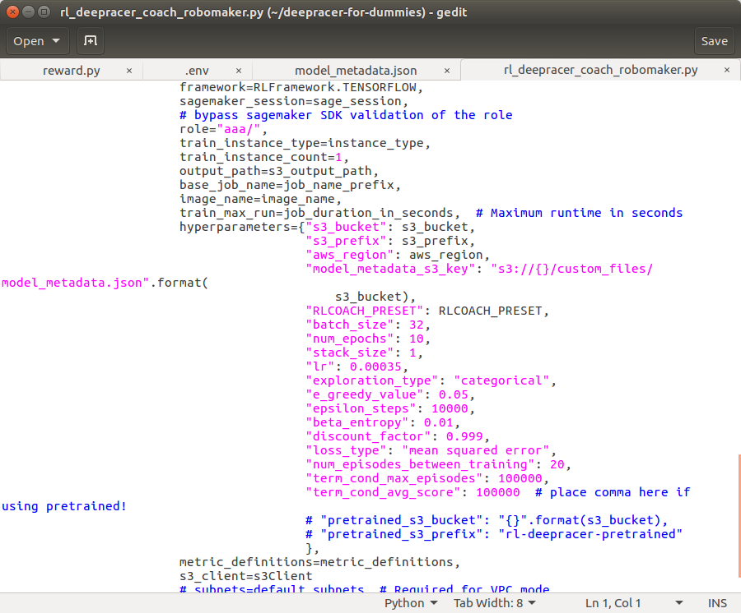
Adjust the hyperparameters in the deepracer-for-dummies/rl_deepracer_coach_robomaker.py file.

Slide 20
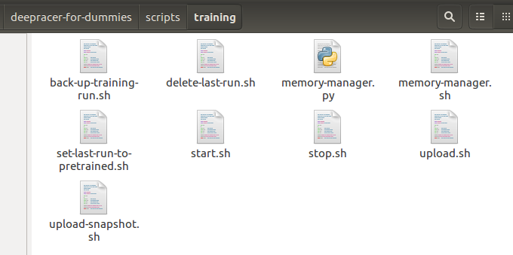
After edit the previously files, we can start training by run the script start.sh. Run stop.sh to stop the training and delete-last-run.sh to clean the space before next run.

Slide 21
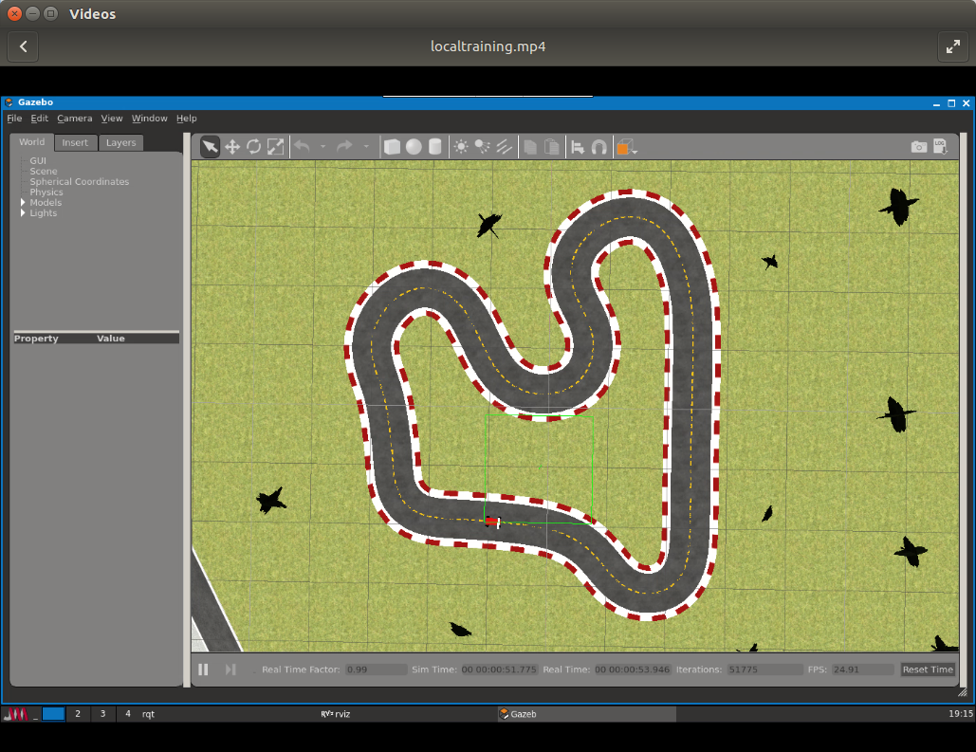
Local training using vncviewer for visualization
The track in the image is China_track map

Slide 22
Change reward function

Slide 23
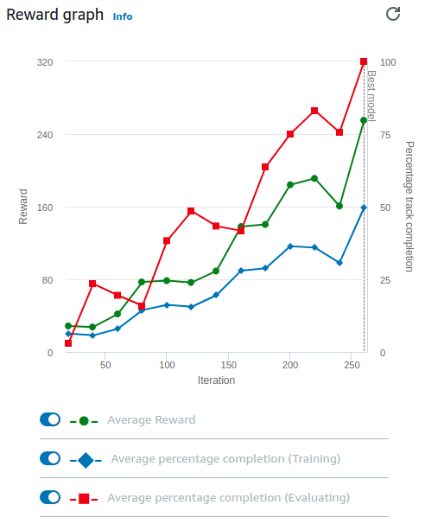
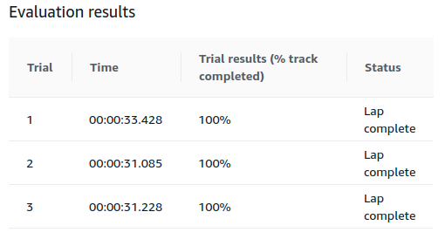
Default reward function which is focus on follow the center line to get more rewards.

Slide 24
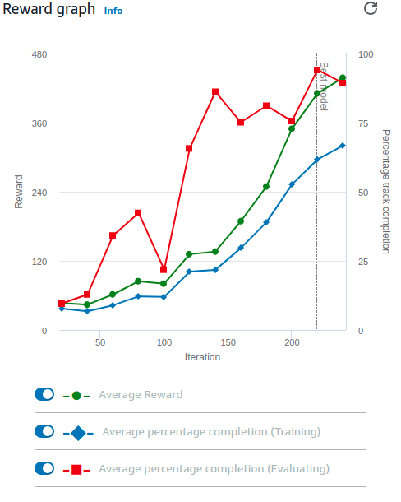
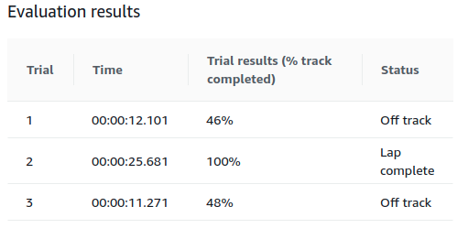
Give reward if there is no wheels go off the track.

Slide 25
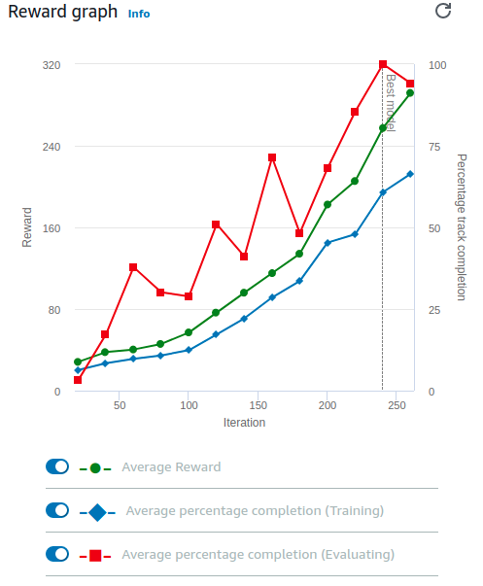
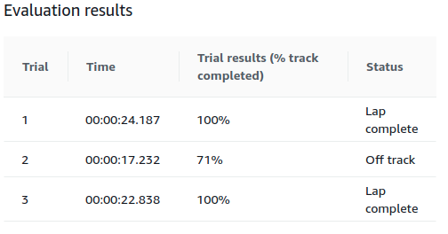
This is based on the follow the center line function, and it add formula to penalize reward if the agent is steering too much.

Slide 26
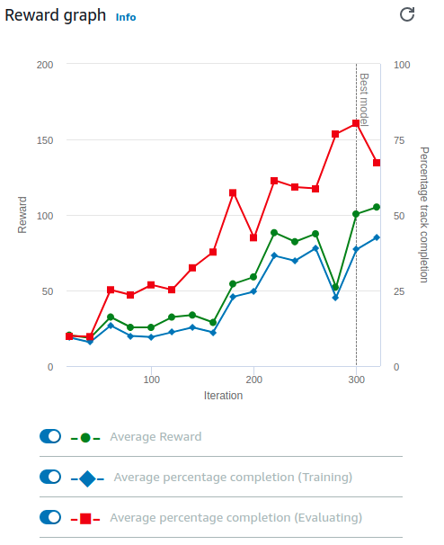
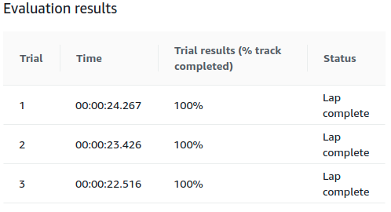
This is based on the follow the center line function, and it add formula to give more reward if the agent using high speed to drive.

Slide 27
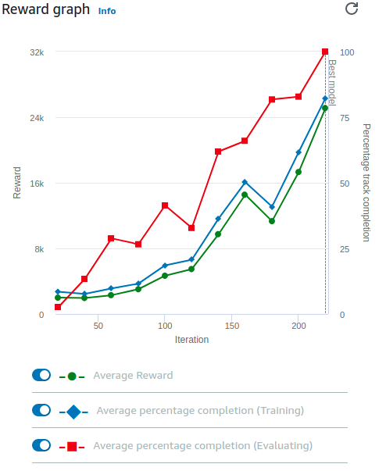
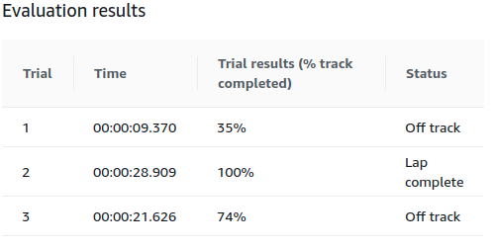
This reward function is different from the previously reward functions. I use the waypoints as the reference to give rewards.

Slide 28
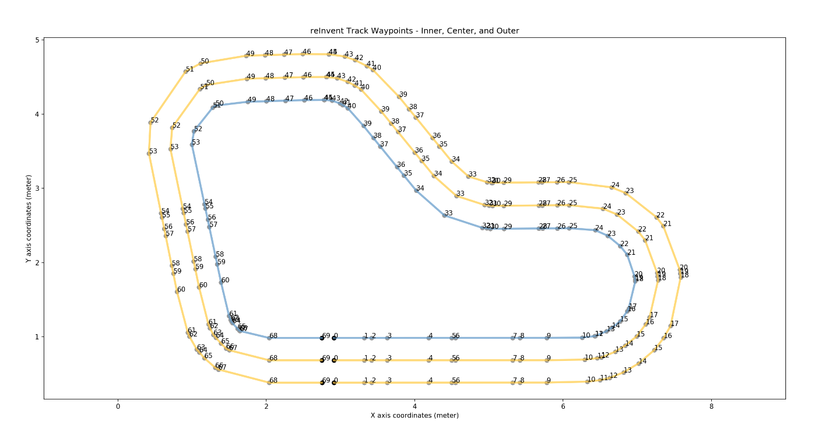

Slide 29
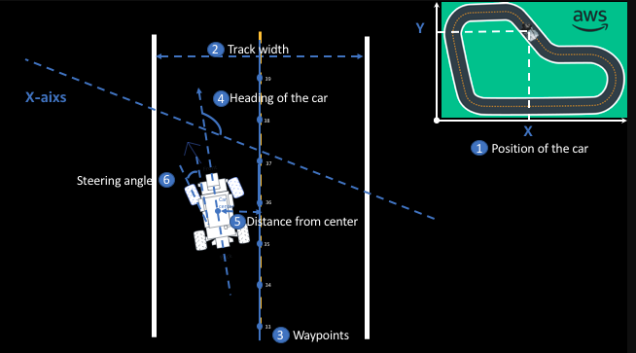
Variable Name | Type
all_wheels_on_track | Boolean
distance_from_center | Float
is_left_of_center | Boolean
speed | Float
steering_angle | Float
track_width | Float
closest_waypoints | Integer
progress | Float

Slide 30
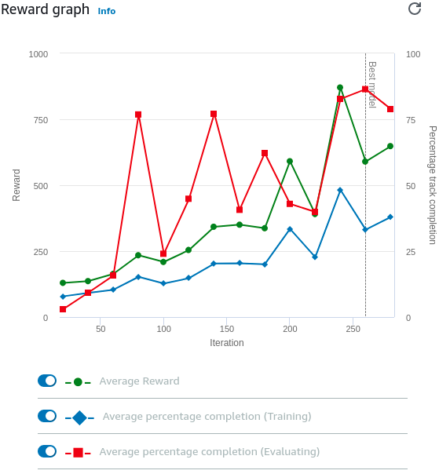
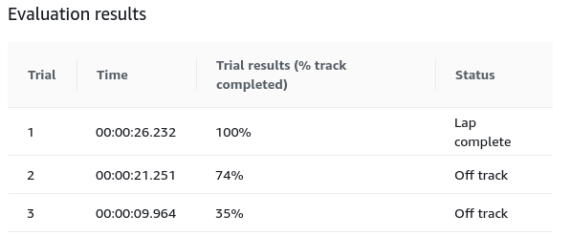
This is based on the waypoints following function. I add formula to give higher reward if the speed is fast and using less steps to finish the lap.

Slide 31
Thank you

